Slide 1
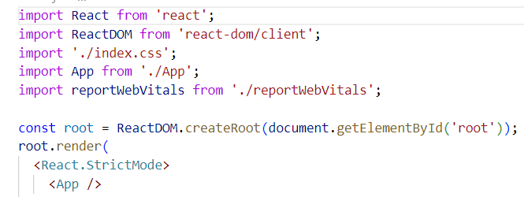
Setting up dev environment
If we want to use the components JSX
we will need to add import statement - import React
create-react-app ->set ups local react dev app
npx create-react-app appName
Posle cd appName
Npm start -> starts the dev server
Npm run build -> bundles the app into static files for prod
Npm test -> starts the test runner
//do not do that!!!! Better check the manual way guide
Npm run eject ->this command creates local config and scripts
Folders with files
And we can edit them ->this is permanent command
Step by step guide for creating dev environment -> the manual way
https://jscomplete.com/learn/1rd-reactful - follow the guide
Then configure the installed tools to run together: p. 3,4 and 5 in the guide
Example structure: Make new dir
Dis -> distribution
Src ->source ->we put all react app files there including the server files there. Webpack will take our source files and will write them in dis folder
Src/components
Src/server
Localhost:4242
If we have server side rendered react app and the user disabled js on his browser the app will still be rendered as it is server side ☺
https://jscomplete.com/learn/1rd-reactful -> no extra features only the bearbon needed to run react server side with a little but extra config then the prev guide
The always-recent guide to creating a development environment for Node and React (with Babel and Webpack
Notes:
Star match game
https://github.com/jscomplete/rgs-star-match

Slide 2

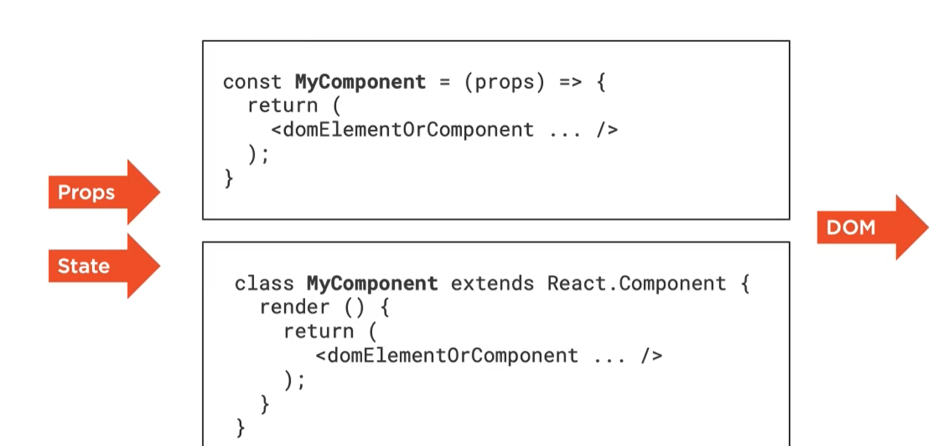
2 type components
Function component
class component
Compoents can only change their state but can’t change their props
Notes:
Course Pluralsight:
Creating Asynchronous TypeScript Code – Lector: John Papa
https://app.pluralsight.com/library/courses/typescript-asynchronous-code/table-of-contents

Slide 3
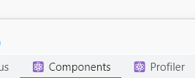

React dev tool extension for chrome
->in chrome install react dev tool extension.
Kogato go imame i natisnem f12 veche imame Components i Profiler
React simple dev site for playground
https://jscomplete.com/playground
Our 1st react component
//create function component
function Hello(){
return <div> Hello React! </div>;
}
//render it – react older version
ReactDOM.render(
<Hello/>,
//this comes from the playground to display the element.
//In real react app we don’t need it
document.getElementById('mountNode'),
)
// *** The React 18 way:
root.render(
<Hello />,
);
Component name always starts with upper case
JSX language

Slide 4
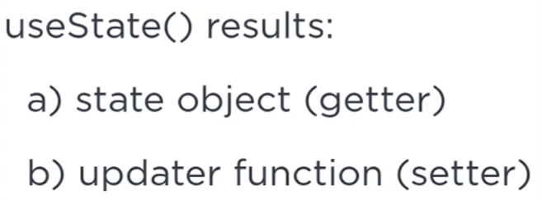
State object using React hooks
function Button() {
//state object -> counter, update function -> setCounter
//we need to use array destructuring as useState returns array with 2 elements
const [counter, setCounter] = useState(0) //we set our counter with init value 0
//onClick in react always receives func reference, but we do not invoke it () we only pass the reference to the function
return <button onClick={logRandom}>{counter}</button>;
//example with arrow function
//return <button onClick={() => setCounter(counter+1)}>{counter}</button>;
}
function logRandom(){
console.log(Math.random());
}
UseState function is called React Hooks
2 ways to render more then 1 component in react:
-using array
root.render(
[<Button />, <Display />]
);
As child éléments to another element like div ili s <React.Fragment>
// *** The React 18 way: - tuj ne mi proraboti
root.render(
<div>
<Button />
<Display />
</div>
);
//React.Fragment can be replaced even with empty tag <>

Slide 5
Btn func improvements & 1 way flow data
/*The state of the comp can be accessed only by the component. In order to be
Accessible for other components we will need to lift it up from its comp and put it
In a parent comp. */
function Button(props) {
// we use return () as we return function call
const handleClick = () => props.onHandleClick(props.increment);
return (
//here in order to work we need reference to a func not invokation of a func
//thats why we can use arrow func to pass args or create const func
<button onClick={handleClick}>
+{props.increment}
</button>
);
}
//Display component without state as we dont need state here
function Display(props) {
return (
<div> {props.message} </div>
)
}
//App component - iznasiame si vsichki component det she displayvame v otdelen komponent
function App(){
//we move it here in the parent comp in order to be accessible for all the children
const [counter, setCounter] = useState(0)
const incrementCounter = (incrementValue) => setCounter(counter+incrementValue);
return (
[ <Button onHandleClick= {incrementCounter} increment = {2}/>,
<Button onHandleClick= {incrementCounter} increment = {10}/>,
//To pass data in component we use props
<Display message = {counter}/>]
)
}
// displayvame samo edin component -> taka e po chisto
root.render(
<App/>
);
//moj primer
function Button(props){
const handleClick = () => props.onHandleClick(props.increment);
const resetCounter = () => props.onResetClick(props);
return (
<div>
<button onClick={handleClick}>+{props.increment}</button>
<button onClick={resetCounter}>Reset</button>
</div>
);
}
function Display(props){
return(
<div>{props.message}</div>
);
}
function App(){
const [counter, setCounter] = useState(0);
const incrementCounter = (incrementVal) => setCounter(counter+incrementVal);
const resetCounter = () => setCounter(0);
return (
[
<Button onHandleClick={incrementCounter} onResetClick={resetCounter} increment= {2}/>,
<Display message={counter}/>
]
)
}
root.render(
<App/>
);

Slide 6
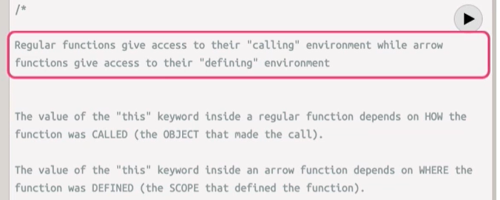
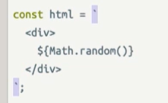
Modern js ecma crash course
This means they are perfect for delayed execution cases – for events and listeners
Template strings -> with ` ->in them we can include dynamic vals

Slide 7
Class components
class Card extends React.Component {
render() {
return (
<div className="github-profile">
<img src="" />
<div className="info">
<div className="name"> Name here... </div>
<div className="company"> Company here... </div>
</div>
</div>
);
}
}
class App extends React.Component {
//all class comp have render method which return the virtual dom description for the component
render(){
//v klasovete tuj kato rabotim s instances dynamic data minava prez props this.props.title
//demek vmesto samo title kakto e vuv funcs tuk go pishe sus this.props.title
return (
//kato displayvame povehe ot 1 component triabva da gi nestvame v div
<div>
<div className="header">{this.props.title}</div>
<Card/>
</div>
);
}
}
// *** The React 18 way:
root.render(
<App title="The GitHub Cards App" />
);
Css moje da se pishe i v style object

Slide 8
Working with data
//{...profile} -> taka destrukturirae props na obekta
const CardList = (props) => (
<div>
{testData.map(profile => <Card {...profile} />)}
</div>
);
class Card extends React.Component {
render() {
const profile = this.props;
return (
<div className="github-profile">
<img src={profile.avatar_url} />
<div className="info">
<div className="name"> {profile.name} </div>
<div className="company"> {profile.company} </div>
</div>
</div>
);
}
}
class App extends React.Component {
render(){
return (
<div>
<div className="header">{this.props.title}</div>
<CardList/>
</div>
);
}
}
const testData = [
{
"avatar_url": "https://avatars.githubusercontent.com/u/810438?v=4",
"name": "dan",
"company": "Facebook"
},
{
"avatar_url": "https://avatars.githubusercontent.com/u/18002288?v=4",
"name": "mirmeleon",
"company": "Facebook"
}
];
//tva e nakraia ->sled class App
// *** The React 18 way:
root.render(
<App title="The GitHub Cards App" />
);

Slide 9
Taking input from user
1ri approach ->ref ->ne sledi za vsiaka bukva det se changva
2ri approach ->state ->po-gotin
//every comp has its own responsability
class Form extends React.Component {
//ref is react special id to reference elements, in order to use it we need to init object with
//createRef
userNameInput = React.createRef();
//every react ev. function receives an event argument
handleSubmit = (event) => {
//in order to avoid page refresh
event.preventDefault();
console.log(this.userNameInput.current.value);
};
render(){
return (
<form onSubmit={this.handleSubmit}>
<input type="text" placeholder="Github username" ref={this.userNameInput} required />
<button>Add card</button>
</form>
)
}
}
class App extends React.Component {
//we need to use state as we will add elements to the list
//state is always an object in the ctor, it cant be number or string
state = {
profiles:testData,
};
render(){
return (
<div>
<div className="header">{this.props.title}</div>
<Form/>
<CardList profiles={this.state.profiles}/>
</div>
);
}
}
class Form extends React.Component {
//we use state obj to init the usr input as empty obj, then we use it as value element in the input
state = {userName: ''};
//every react ev. function recieves an event argument
handleSubmit = (event) => {
//in order to avoid page refresh
event.preventDefault();
console.log(this.state.userName);
};
//if we use value in the input (react is controlling the value) we will need to use //onChange event so the dom can tell react that something has changed
//event.target.value ->it takes the user entered value
render(){
return (
<form onSubmit={this.handleSubmit}>
<input type="text"
value={this.state.userName}
onChange={event => this.setState({userName: event.target.value})}
placeholder="Github username" required />
<button>Add card</button>
</form>
)
}
}
class App extends React.Component {
//we need to use state as we will add elements to the list
//state is always an object in the ctor, it cant be number or string
state = {
profiles:testData,
};
render(){
return (
<div>
<div className="header">{this.props.title}</div>
<Form/>
<CardList profiles={this.state.profiles}/>
</div>
);
}
}
//th other comps in this example are the same of the prev slides

Slide 10
Using axios for ajax calls
class App extends React.Component {
state = {
profiles: []
};
addNewProfile = (profileData) => {
console.log(profileData);
this.setState(prevState => ({
profiles: [...prevState.profiles, profileData]
}))
};
//in order to chane the state in a child comop (Form) we will need to use func ref
//this.addNewProfile. This way this func will be available in the child in props
render() {
return (
<div>
<div className="header">{this.props.title}</div>
<Form onSubmit={this.addNewProfile}/>
<CardList profiles={this.state.profiles} />
</div>
);
}
}
//key={profile.id} fix the console warning, key should be unique value
and it plays role in child elements ordering when we have dynamic list of children
const CardList = (props) => (
<div>
{props.profiles.map(profile => <Card key={profile.id} {...profile}/>)}
</div>
);
class Card extends React.Component {
render() {
const profile = this.props;
return (
<div className="github-profile">
<img src={profile.avatar_url} />
<div className="info">
<div className="name">{profile.name}</div>
<div className="company">{profile.company}</div>
</div>
</div>
);
}
}
class Form extends React.Component {
state = { userName: '' };
handleSubmit = async (event) => {
event.preventDefault();
const resp = await axios.get(`https://api.github.com/users/${this.state.userName}`)
//we call the parent func and pass the data
this.props.onSubmit(resp.data);
//reset the input field
this.setState({userName:''});
};
render() {
return (
<form onSubmit={this.handleSubmit}>
<input
type="text"
value={this.state.userName}
onChange={event => this.setState({ userName: event.target.value })}
placeholder="GitHub username"
required
/>
<button>Add card</button>
</form>
);
}
}
Notes:
React: Beyond the Basics - Samer Buma book

Slide 11
Star match game – using state
State ->when we have element that is changing value we should make him use state.
Identifing if we need to create component: 1. Every time that we have similar data or behaviour 2. Readability ->the component should be smaller and compact
Closures -> work in scope of the function: https://jscomplete.com/closures Stateful components in react dépend on closures, thats why we need to refresh the state of a closure
React Hooks:
UseState
UseEffect
//whenever we create sideEffect (useEffect) we will need to clean it when it is not needed
useEffect(() => {
//we see it every time when the component is done rendering
console.log('Rendered...');
//clean side effect
return () => console.log('this comp is changing');
});
Unmounting and mouting -> da go renderne nanovo componenta. Uj zavisi ot key-to ->ako za sushtia component mu slojim drugo key react si
misli che e drug component
const StarMatch = () => {
const [gameId, setGameId] = useState(1);
return <Game key={gameId} startNewGame={() => setGameId(gameId + 1)}/>;
}

