Slide 1
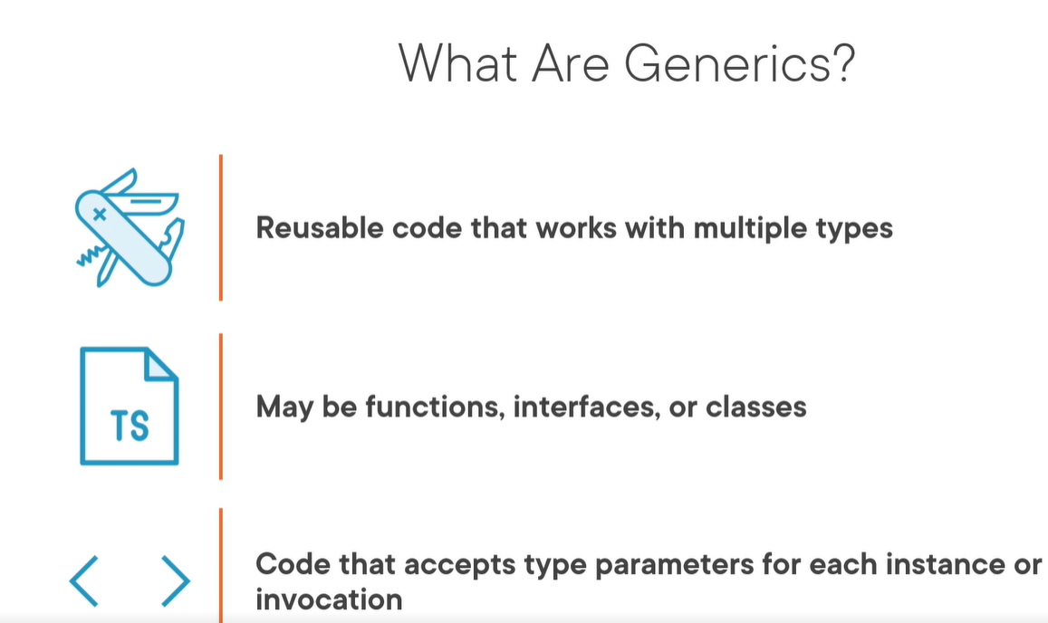
generics
Notes:
Course Pluralsight:
Creating Asynchronous TypeScript Code – Lector: John Papa
https://app.pluralsight.com/library/courses/typescript-asynchronous-code/table-of-contents

Slide 2
Generic type example
export class Shelf<T> {
_items: T[] = [];
addItemToCatalog(newItem:T) {
}
removeItemFromCatalog(oldItem:T){
}
}
Use of generic
let bookShelf: Shelf<Book> = new Shelf<Book>;
bookShelf.addItemToCatalog(new Book());
let magazineShelf: Shelf<Magazine> = new Shelf<Magazine>;
Simple tsconfig.json
{
"compilerOptions": {
"target":"ES5",
"module": "commonjs",
"esModuleInterop": true,
//tuj watch recompilira avtomatichno koda ni I nie
//ne triabva da go compilvame vseki put
"watch": true }
}
Generic arrays
let Junk: any[] = ['str',2];
let companies:Array<string> = ['ms', 'apple'];
let number: Array<number> = [1,2,3];
Functions
function checkOut<T>(item: T): T {
let availableItem: T = getItemFromDb(item);
if(availableItem){
//todo
}
return item;
}
let someBook: Book = new Book();
checkOut<Book>(someBook);
Function with 2 generics
function checkOut<T,V>(item: T, customer: V): T {
let availableItem: T = getItemFromDb(item);
let availableCustomer: V = getCustomerFromDb(customer);
if(availableItem && availableCustomer){
//todo
}

Slide 3
Applyng type constarints
export interface MeetingResource {
name: string;
capacity: number;
}
import {MeetingResource} from './meetingResource’;
//type constraints stavat s extends, taka mu kazvame che T triabva da mplementira interface-a meeting resource
function getBigRooms<T extends MeetingResource>(rooms: Array<T>, minSize:number):Array<T> {
let bigRooms: Array<T> = [];
rooms.forEach(r => {
if(r.capacity > minSize) {
bigRooms.push(r);
}
});
return bigRooms;
}

Slide 4
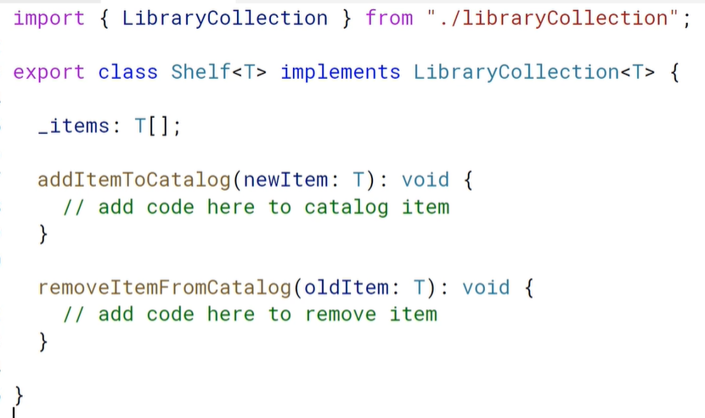
Generic interfaces & classes
export interface LibraryCollection<T> {
_item: T[];
addItemToCatalog(newItem: T): void;
removeItemFromCatalog(oldItem: T): void;
}
let titleCollection: LibraryCollection<string> = {
_item: ['Winnie the Pooh', 'Wierd sisters'],
addItemToCatalog: s => console.log(`Added item ${s}`),
removeItemFromCatalog: s => console.log(`Removed item ${s}`)
}
classes

