Slide 1




The Kirundi noun phrase An interface approach
Katya Morgunova & David Shanks
Department of Linguistics, McGill University
katya.morgunova@mail.mcgill.ca, david.shanks4@mail.mcgill.ca
June 13, 2023
ACAL 54, University of Connecticut

Slide 2
Overview
Through reference to the interaction of phonology and syntax, we propose an articulated structure for Kirundi nominals.
We examine asymmetries between regular nominals and demonstrative phrases, showing them to be distinct structural categories.
We also discuss the difference between two preposition-like elements – locatives and linkers – and show that they differ in the type of complement they select for.

Slide 3
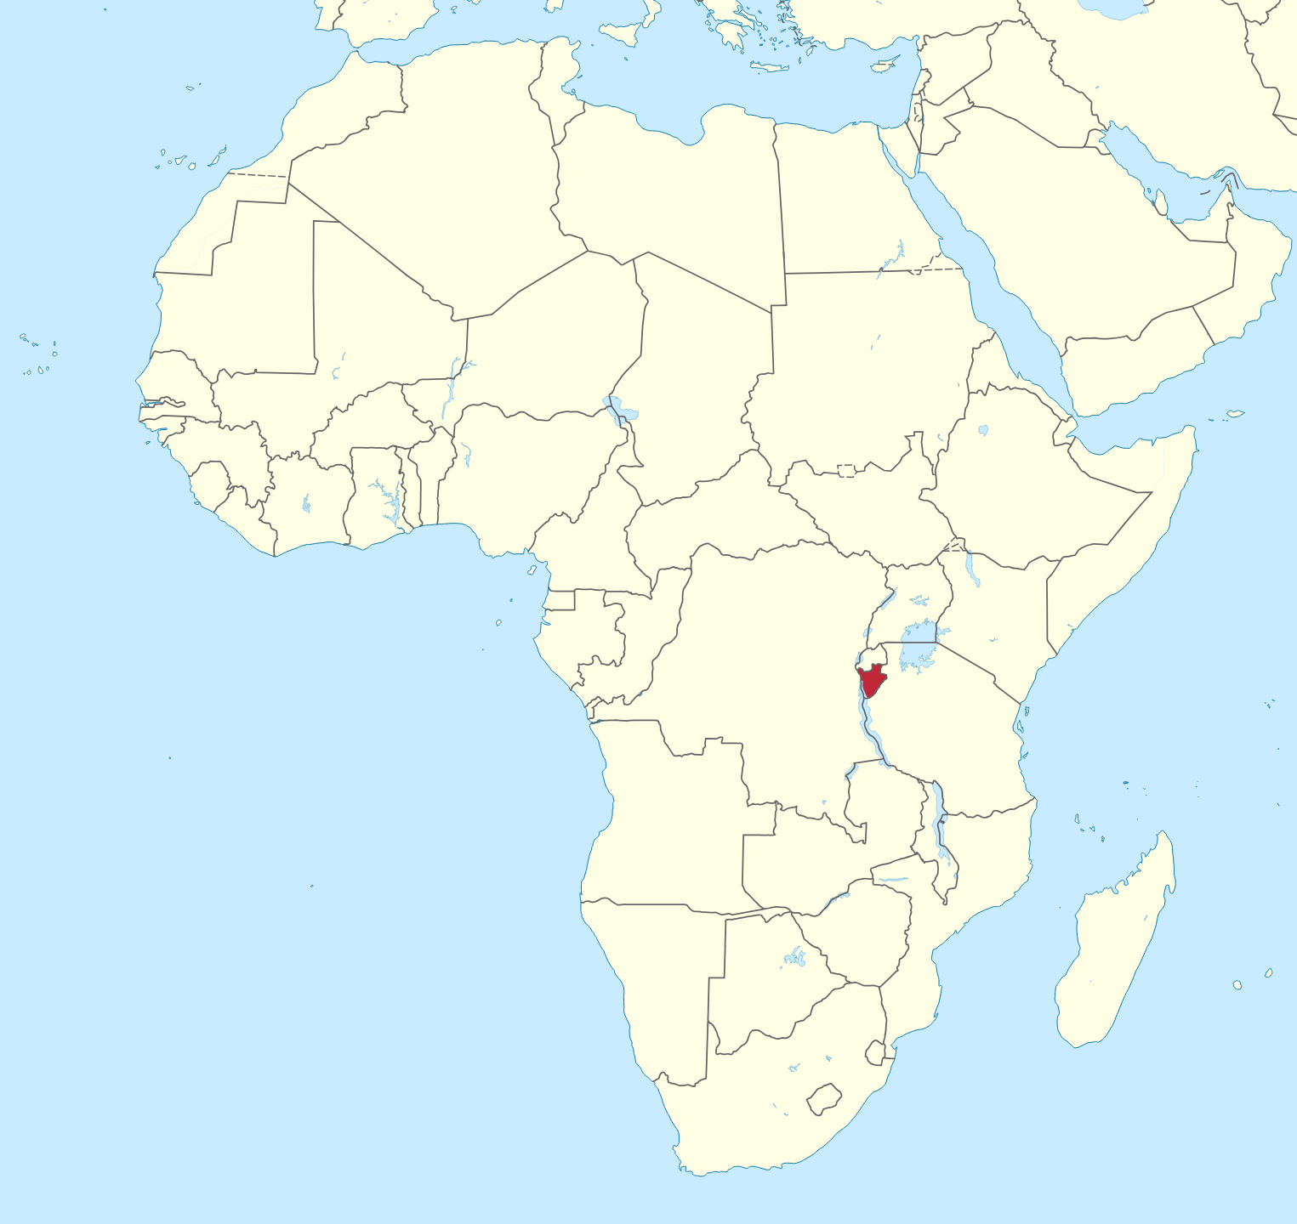
Kirundi
Great Lakes Bantu (J62/D62) (Bastin 2003).
11 million speakers primarily in Burundi.
Also in the DRC, Kenya, Rwanda, Tanzania and Uganda.
Part of the Rwanda-Rundi dialect continuum with Kinyarwanda and Ha.

Slide 4
Data

Slide 5
Nominals in Kirundi
Kirundi nouns in citation form consist of an augment (V-), a noun class prefix (CV-, N- or null) and a noun stem.
(1) a. umugoré b. igikére c. izúuba
u-mu-goré i-ki-kére i-Ø-zúuba
aug-1-woman aug-7-frog aug-5-sun
‘woman’ ‘frog’ ‘sun’

Slide 6
Kirundi noun classes
Number | Prefix | Example |  | Number | Prefix | Example
1 | mu- | u-mu-goré | ‘woman’ | 2 | ba- | a-ba-goré | ‘women’
3 | mu- | u-mu-twe | ‘head’ | 4 | mi- | i-mi-twe | ‘heads’
5 | ri-/Ø- | i-Ø-buye | ‘stone’ | 6 | ma- | a-ma-buye | ‘stones’
7 | ki- | i-gi-keré | ‘frog’ | 8 | bi- | i-bi-keré | ‘frogs’
9 | n-/Ø- | i-n-ká | ‘cow’ | 10 | n- | i-n-ká | ‘cows’
11 | ru- | u-ru-syo | ‘grinding stone’
12 | ka- | a-ka-buúnda | ‘puppy’ | 13 | tu- | u-tu-buúnda | ‘puppies’
14 | bu- | u-bu-menyi | ‘knowledge’
15 | ku- | u-ku-ri | ‘truth’
16 | ha- | a-ha-ntu | ‘location’

Slide 7
Demonstrative phrases
Kirundi has multiple series of deictic demonstratives, differentiated by degree of distance, as well as one series of anaphoric demonstratives.
(2) a. iyi nká b. yáa nká
iyi n-ká yáa n-ká
dem.prox.9 9-cow dem.anaph.9 9-cow
‘this cow’ ‘this (aforementioned) cow’

Slide 8
The augment in locative phrases
Kirundi also has three locative elements:
mu ‘in, into, within’
ku ‘on, upon, at, from’
i ‘in, to, at’
a. mu murima b. ku bavyéeyi c. i Bujumbura
mu mu-rima ku ba-vyéeyi i Bu-jumbura
in 3-field to 2-parent in 14-Bujumbura
‘in the field’ ‘to the parents’ ‘in Bujumbura’

Slide 9
The augment in locative phrases
Nouns of most classes lack the augment when they are preceded by a locative element, with the exception of null class nominals; the latter retain the initial i- in locative phrases.
(4) mw’iishuúre
mu i-Ø-shuúre
in aug-5-school
‘in the school’

Slide 10
muri and kuri
The locative elements mu and ku must be realized as muri and kuri when they take demonstrative phrases or proper names as their complements.
(5) a. kuri iyi nká b. *ku iyi nká
ku-ri iyi n-ká ku iyi n-ká
on-ri dem.9 9-cow on dem.9 9-cow
‘on this cow’ intended: on this cow

Slide 11
muri and kuri
This form, however, cannot be used with regular nouns.
(6) a. *muri murima b. mu murima
mu-ri mu-rima mu mu-rima
in-ri 3-field in 3-field
intended: in the field ‘in the field’

Slide 12
The augment in linker phrases
The linker element na has a variety of uses, like coordination and argument introduction, as shown below.
(7) Ingoma iravúzwa na Mizero.
i-n-goma i-ra-vúzwa na Mizero
aug-9-drum 9s-dj-is.played lk Mizero
‘The drum is played by Mizero today.’
Notes:
Na has a variety of uses: coordination, licensing like on this slide

Slide 13
The augment in linker phrases
When the noun is preceded by a linker, the augment is preserved with all classes.
(8) a. n’umugoré b. n’iitsítso
na u-mu-goré na i-Ø-tsítso
lk aug-1-woman lk aug-5-stem
‘with a woman’ ‘as a stem’

Slide 14
The augment in linker phrases
Unlike locative prefixes, linkers can merge with both augmented nominals and demonstrative phrases directly.
(9) a. n’umugoré b. n’uyu mugoré
na u-mu-goré na uyu mu-goré
lk aug-1-woman lk dem.1 1-woman
‘with a woman’ ‘with this woman’

Slide 15
Summary
Realization of the augment
Locative alternations
 | CV-class aug | Ø-class aug
argument | ✓ | ✓
locative phrase | × | ✓
linker phrase | ✓ | ✓
 | mu, ku | muri, kuri
noun | ✓ | ×
dem phrase | × | ✓

Slide 16
Background

Slide 17
The augment
The augment is an element (CV, V or tonal) found before noun class prefixes in many Bantu languages (de Blois 1970).
In languages like Bulu, it resembles a definite article, appearing only on definite nouns (Clem 2014).
This is not the case for Kirundi, since bare (augmentless) nouns are never permitted in argument positions (e.g., Ntahokaja 1994, Zorc & Nibagwire 2007). Moreover, augmented nouns are ambiguous between definite and indefinite interpretation.

Slide 18
Bantu locatives
Proto-Bantu is reconstructed with three locative noun classes: *pa- (16), *ku- (17) and *mu- (18) (Ziervogel 1971).
In many Bantu languages, locatives are noun class prefixes (either alone or iterating), triggering class agreement (16, 17 or 18) on verbs (e.g. Bresnan 1994 for Chichewa).
In Kirundi, only class 16 (ha-) is a noun class that triggers agreement. The other locative elements ku and mu do not trigger agreement, and the distribution of locative phrases differs from that of nominals (Morgunova & Shanks 2023, cf. Ngoboka 2017 for Kinyarwanda).
Notes:
can add that ha- attached to bare root like other classes but ku and mu can’t

Slide 19
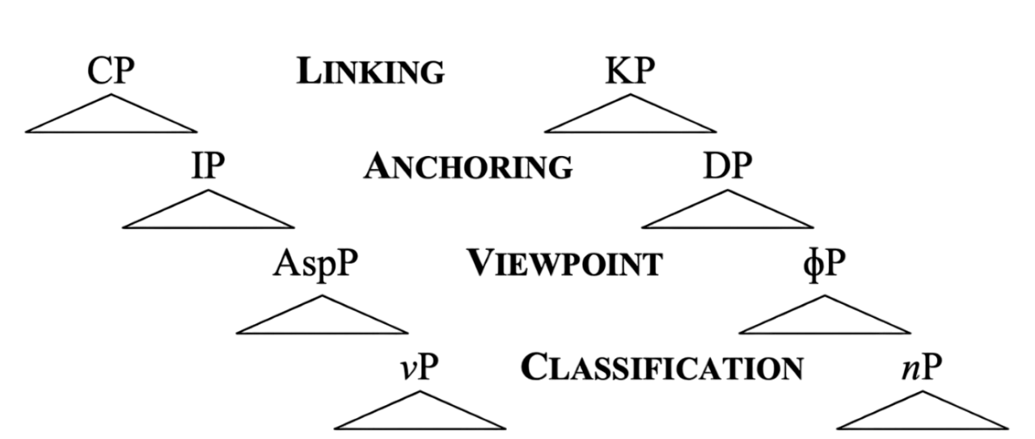
Universal syntactic spine
Universal Spine Hypothesis (Bliss 2013, Wiltschko 2014): a fixed order of the functional categories, parallel for the nominal and verbal domains.

Slide 20
The phonology-syntax interface
Syntax proceeds cyclically by phase (Chomsky 2000).
Words are built in the syntax (e.g. DM, Halle & Marantz 1994).
Phases correspond to phonological spellout domains (Newell 2008):
After each phase is constructed by the syntax, it is passed to the phonology for spellout.
Each phase is spelled out as a chunk:
nP and DP are phases (e.g. Chomsky 2001), so are spellout domains.
√ and 𝜑P are not phases, so are not.

Slide 21
The phonology of Kirundi nominals
The augment is an epenthetic vowel which copies the features of the adjacent class prefix (Shanks 2022, cf. Ndayiragije et al. 2012, Niyondagara 1993):
It is epenthesized to give phonological content to the features of the 𝜑-head.
The augment is weightless (mora-less), since it is epenthetic (e.g. Piggott 1995).
Its copying of vowel features from the class prefix can fail if the class prefix contains no vowels (e.g. null and N classes), giving default [i-].
(10) a. u_{x}mu_{x}goré b. i_{y}nká
V-mu-gore V-N-ká
aug-1-woman aug-9-cow
‘woman’ ‘cow’

Slide 22
The phonology of Kirundi nominals
Null and N class noun class prefixes have complex underlying forms which explain phonological asymmetries between them and CV classes (Shanks 2023, cf. Choti 2015 for Kinyarwanda, Ndayiragije et al. 2012).
Both non-CV class prefixes are underlyingly moraic, showing complex weight effects (beyond the scope of this talk).
N class prefixes are underlyingly /N_{μ}/, while “null” class prefixes are /Ø_{μ}/.

Slide 23
The phonology of locative phrases
Locative phrases with regular augmented nouns underlyingly contain the augment (Shanks 2022):
No augment surfaces in locatives with CV class nouns (11a).
But it does surface with null class nouns (11b).
(11) a. mu murima b. mw’iishuúre
mu V-mu-rima mu V-Ø-shuúre
in aug-3-field in aug-5-school
‘in a field’ ‘in a school’
Asymmetries in deletion are due to the underlying form of class prefixes rather than syntax (Shanks 2023).
Notes:
Because there is an underlying augment in all locative phrases, whatever the augment is in the syntax must be present in all locative phrases.

Slide 24
Proposal

Slide 25
Summary
Realization of the augment
Locative alternations
 | CV-class aug | Ø-class aug
argument | ✓ | ✓
locative phrase | × | ✓
linker phrase | ✓ | ✓
 | mu, ku | muri, kuri
noun | ✓ | ×
dem phrase | × | ✓

Slide 26
Two categories of nominals
Hypothesis 1: Both augmented nouns and demonstrative phrases can be arguments, so they have the same structural category.
However, they differ with regard to locative phrases:
Locatives surface as mu and ku with (underlyingly) augmented nouns (12a).
But, they surface as muri and kuri with demonstrative phrases (12b).
(12) a. ku nká b. kuri iyi nká
ku V-n-ká ku-ri iyi n-ká
on aug-9-cow on-ri dem.9 9-cow
‘on the cow’ ‘on that cow’
Notes:
so this aint it

Slide 27
Two categories of nominals
Hypothesis 2: The augment is in D (e.g. Ndayiragije et al. 2012), and augmented nouns are DPs. Demonstrative phrases have additional structure (e.g. KP/LinkP for Blackfoot, Bliss 2013).
This would account for the distributional asymmetry in locatives, with locatives selecting for a DP complement.
However, since DP is a phase, it would be spelled out by the phonology before merging with the locative.
This would incorrectly predict that the augment would never delete in locative phrases.
Therefore, augmented nouns must be smaller than DP.

Slide 28
Two categories of nominals
Hypothesis 3: Augmented nouns are 𝜑Ps, while demonstrative phrases are DPs (see, e.g., Chierchia 1998).
The augment occupies the 𝜑 head, which is the projection between DP and nP in the nominal spine.
Correspond to the Viewpoint role of 𝜑P (~AspP in the clausal spine).
Demonstrative phrases are DPs.
Demonstratives themselves are DPs rather than D, since they are multimorphemic and are spelled out by the phonology prior to merging with head nouns (e.g. Morgunova & Shanks 2023).
They are in Spec, DP, corresponding to the Anchoring role of DP (~TP).

Slide 29
Summary
Realization of the augment
Locative alternations
 | CV-class aug | Ø-class aug
argument | ✓ | ✓
locative phrase | × | ✓
linker phrase | ✓ | ✓
 | mu, ku | muri, kuri
noun | ✓ | ×
dem phrase | × | ✓

Slide 30
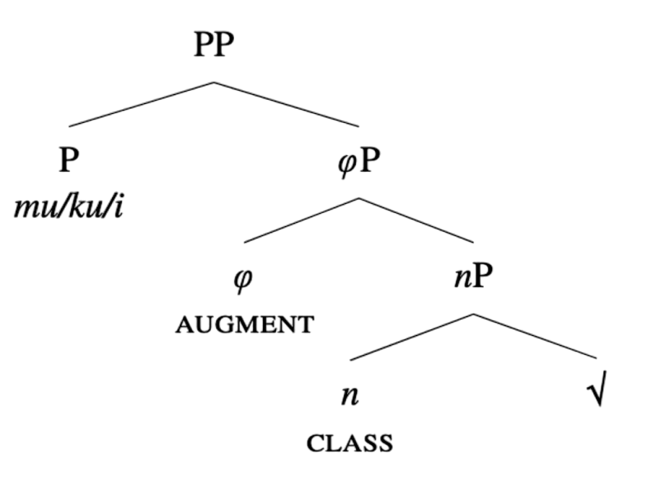
Locative phrases as PPs
We propose that locatives select 𝜑P as their complements.
Locative heads are not D elements as their distribution differs from that of DPs (cf. Ngoboka 2017 for Kinyarwanda).
For examples, locative phrases can be adjuncts, while DPs cannot.
Notes:
Mention type shifting; augment vulnerable to deletion, deleted since not spelled out by phonology before merging with locative

Slide 31
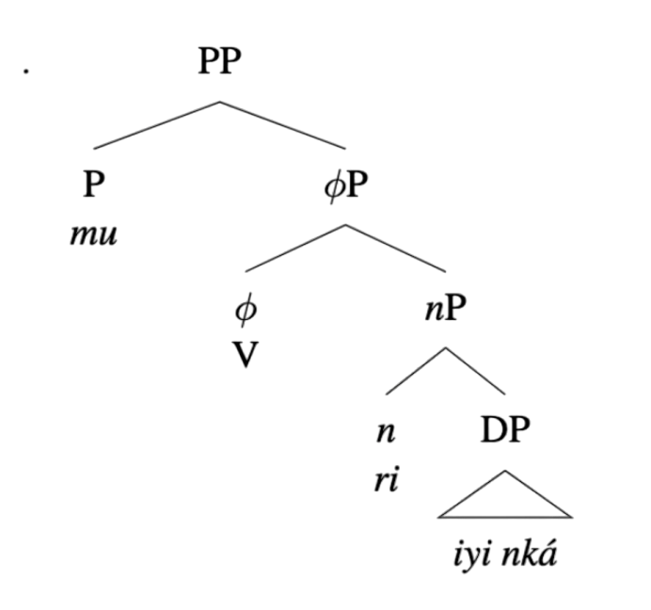
-ri as a repair mechanism
Locatives do not take DPs as their complements and therefore cannot merge with demonstrative phrases directly.
Instead, default (class 5) nominal structure is inserted to satisfy the selectional restrictions of the locative head.
(13) mu rigí
mu V-ri-gí
in V-5-egg
‘in the egg’
Notes:
emphasize default nature of class 5 (but also complex because lots of types of default)

Slide 32
The complements of linker phrases
Unlike locatives, the linker na can directly merge with both augmented nouns and demonstrative phrases.
An additional asymmetry is that the augment is never deleted in linker phrases.
(14) a. n’umugoré b. n’uyu mugoré
na u-mu-goré na uyu mu-goré
lk aug-1-woman lk dem.1 1-stem
‘with a woman’ ‘with this woman’

Slide 33
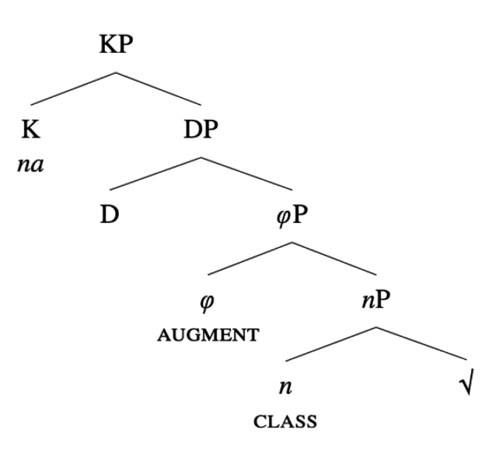
Linker phrases as KPs
We propose that the linker na selects for a DP; that allows it to merge with both augmented nouns (with a null D head) and demonstrative phrases directly.
The linker thus corresponds to a K head, associated with nominal licensing.
The augment on the complement noun is always realized as it is spelled out as a part of the DP phase.

Slide 34
Conclusion
In this talk, we look at different elements appearing in nominal phrases and argue that they correspond to different functional categories in the nominal domain:
The augment vowel is a 𝜑 head, making augmented nouns are 𝜑Ps. Demonstrative phrases are DPs; this explains the difference in the distribution of augmented nouns and demonstrative phrases.
Locatives are P that select for 𝜑Ps as their complements. This triggers the appearance of the nominal layer on the DP complements they take.
The linker na corresponds to the K head and acts as a nominal licensor. The augment is always realized in linker phrases as it is spelled out as a part of the DP phase.

Slide 35
Aknowledgements
We are very grateful to Benilde Mizero for sharing his language with us and always being an enthusiastic and refreshing voice. Urakóze caane!
Thanks to Jessica Coon, Terrance Gatchalian, Heather Goad, Martina Martinović, Willie Myers, Juvénal Ndayiragije, and Junko Shimoyama.
We are also grateful to the participants of the Winter 2022 Linguistic Field Research class at McGill University, the audience at Ba-TOM 1 and members of MULL-Lab at McGill University for their feedback.

Slide 36
References
Bastin, Y. 2003. The Interlacustrine zone (zone J). In The Bantu languages, ed. by D Nurse & G Philippson, 501–28. Routledge.
Bliss, H. The Blackfoot configurationality conspiracy: Parallels and differences in clausal and nominal structures. UBC dissertation.
de Blois, KF. 1970. The augment in Bantu languages. Africana Linguistica. 4.85–165.
Bresnan, J. 1994. Locative inversion and the architecture of Universal Grammar. Language. 70.72–131.
Carstens, V. 2008. DP in Bantu and Romance. In The Bantu-Romance connection, ed. by K Demuth & C de Cat, 131-166. Benjamins.
Chierchia, G. 1998. Reference to kinds across language. Natural Language Semantics. 6.339–405.
Chomsky, N. 2000. Minimalist inquiries. In Step by step: Essays on minimalist syntax in honor of Howard Lasnik, ed. by R Martin, D Michaels & J Uriagereka, 89–155. MIT Press.
Chomsky, N. 2001. Derivation by phase. In Ken Hale: A life in language, ed. by M Kenstowicz, 1–52. MIT Press.
Choti, J. 2015. Phonological (a)symmetries of nasal prefixes in Bantu. MSU dissertation.

Slide 37
References
Clem, E. 2014. The interaction of lexical and grammatical tone in the Bulu verb system. OSU dissertation.
Halle, M & A Marantz. 1994. Some key features of Distributed Morphology. MIT Working Papers in Linguistics. 21.275–288.
Morgunova, K & D Shanks. 2023. On the left periphery of the Kirundi noun phrase. TWPL, to appear.
Ndayiragije, J, E Nikiema & P Bhatt. 2012. The augment in Kirundi: When syntax meets phonology. In Selected proceedings of ACAL 42, ed. by MR Marlo, N Adams, CR Green, M Morrison & TM Purvis, 112–21. Cascadilla.
Newell, H. 2008. Aspects of the morphology and phonology of phases. McGill dissertation.
Niyondagara, A. 1993. Kirundi phonological representations and the formation of complex segments. Stony Brook dissertation.
Ngoboka, JP. 2017. Locative markers in Kinyarwanda as determiners. Nordic Journal of African Studies. 26.292–317.
Ntahokaja, J-B. 1994. Grammaire structurale du kirundi. L’université du Burundi.
Shanks, D. 2022. Copying your neighbour: The Kirundi augment as total vowel assimilation. Paper presented at Ba-TOM 1.

Slide 38
References
Shanks, D. 2023. Spelling out the Kirundi augment: Prosodic domains, epenthesis, and weight. TWPL, to appear.
Wiltschko, M. 2014. The universal structure of categories: Towards a formal typology. CUP.
Ziervogel, D. 1971. The Bantu locative. African Studies. 3/4.371–384.
Zorc, R & L Nibagwire. 2007. Kinyarwanda and Kirundi comparative grammar. Dunwoody.

Slide 39
Augmentless nouns
The augment is obligatorily present on most nouns in citation form and argument positions, with the exception of proper names, kinship terms and certain loanwords.
(15) a. Kagabo b. maawe c. paruwaasi
‘Kagabo’ ‘my mom’ ‘perish’

Slide 40
Augment asymmetries
While augments are realized with null class nouns in locative phrases, they are never realized with demonstratives. We have argued that this shows that the augment is not present underlyingly in demonstrative phrases (Morgunova & Shanks 2023, Shanks 2022, 2023).
(16) mw’iishuúre (17) iyo shuúre
mu i-Ø-shuúre iyo Ø-shuúre
in aug-9-school dem 9-school
‘in the school’ ‘that school’

Slide 41
No augment in DemPs
We propose that demonstratives are modifiers that merge to the nP
This explains why there is no augment on the nouns that act as complement to the demonstratives.
To explain why demonstrative phrases are always DPs, we propose that the demonstrative have a [u referential] feature that needs to be checked by the agreement with the D head.
This in turn triggers the movement of the nP to the Spec, DP.
As the complement of the 𝜑P is moved, the augment vowel cannot get realized.

Slide 42
Locative phrases as PPs
Locative phrases also differ from DPs in linker phrases
The linker surfaces as na with DPs
But, it surfaces as nó with locatives.
(18) a. na Montreal b. n’inká c. nó mu cuúmba
na Montreal na i-n-ká nó mu ki-uúmba
lk Montreal lk aug-9-cow lk in 7-room
‘by Montreal’ ‘by a cow’ ‘by the insides of the room’

