Slide 1
CDSS Hackathon Differential Privacy
Andrea, Lucy, Mori, & Sunny

Slide 2
Mission statements
Measure service Quality
User privacy
Visualization
Maintain accuracy
Present the data through bar chart
Avoid association between identity and tip amount through anonymization
Minimize the difference between real and private value with low epsilon value
Aggregate average of tip to fare ratio from each transaction reflects the service quality of each vendor

Slide 3
Problem vs solution
Problem
Solution
The Cab company wants to measure the service quality of the two vendors. We want to preserve customer privacy while extracting data.
Tip-to-fare ratio serves as a proxy to measure cab ride service quality. Generate synthetic data for tip and fare amount using differential privacy algorithm (2-margin).

Slide 4
Challenge
The trade off between accuracy and privacy
As we add more noise to the data, the accuracy decrease and privacy increase.
Epsilon value measures the privacy level as increase in epsilon decreases privacy.
We want to increase the privacy while making sure the synthetic data still reflect attributes of the population

Slide 5
Methodology
Use the PyDP library to measure statistics after introducing noise to our data, which creates synthetic data that preserves the descriptive statistics of the original data while obscuring individual’s information
Calculate the mean tip amount for each cab ride as a percent of the fare amount
Adding noise to the tip-to-fare ratio
Compare mean tip percent between vendors to compare quality of service using t-test
Compare t-test results before and after differential privacy to test accuracy

Slide 6
Methodology
Why PyDP?
Generates synthetic dataset without too much dependence on the underlying dataset (i.e., only end-results of aggregated information are produced)
It utilizes Laplace mechanism and has built-in functions on creating bounded means,

Slide 7
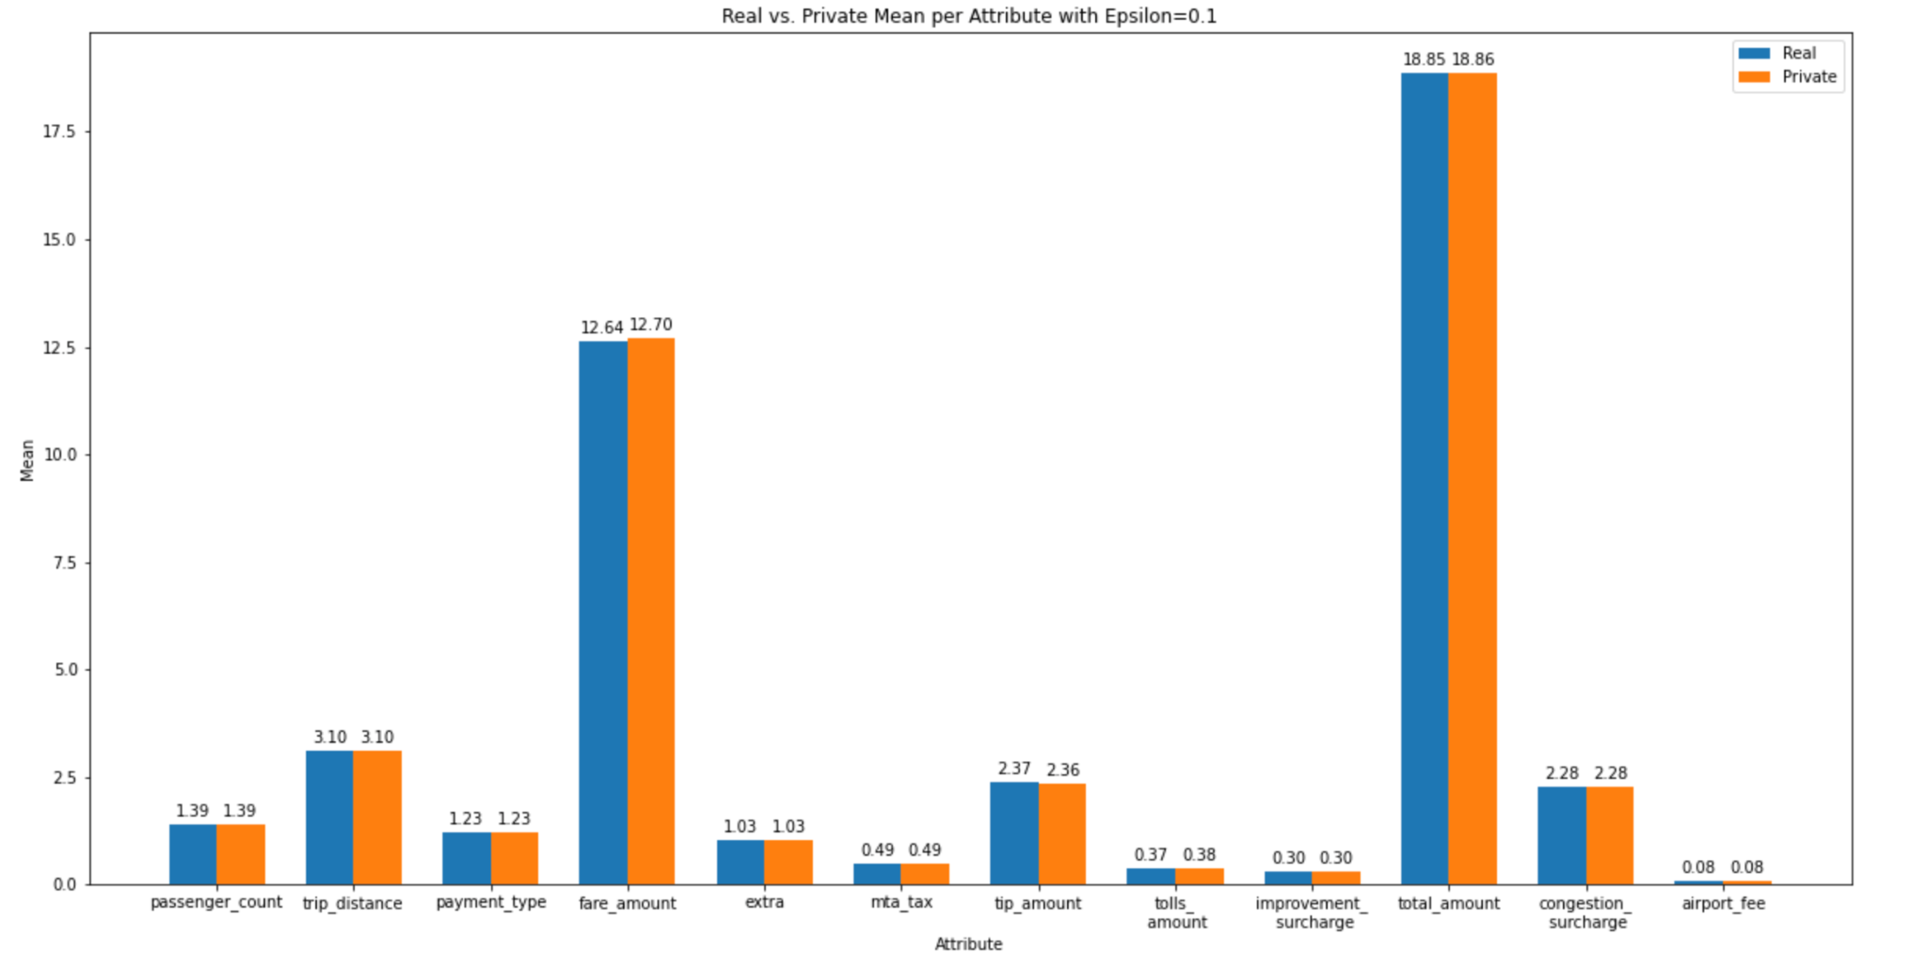
Real vs. Private Mean per Attribute (ε = 0.1)

Slide 8
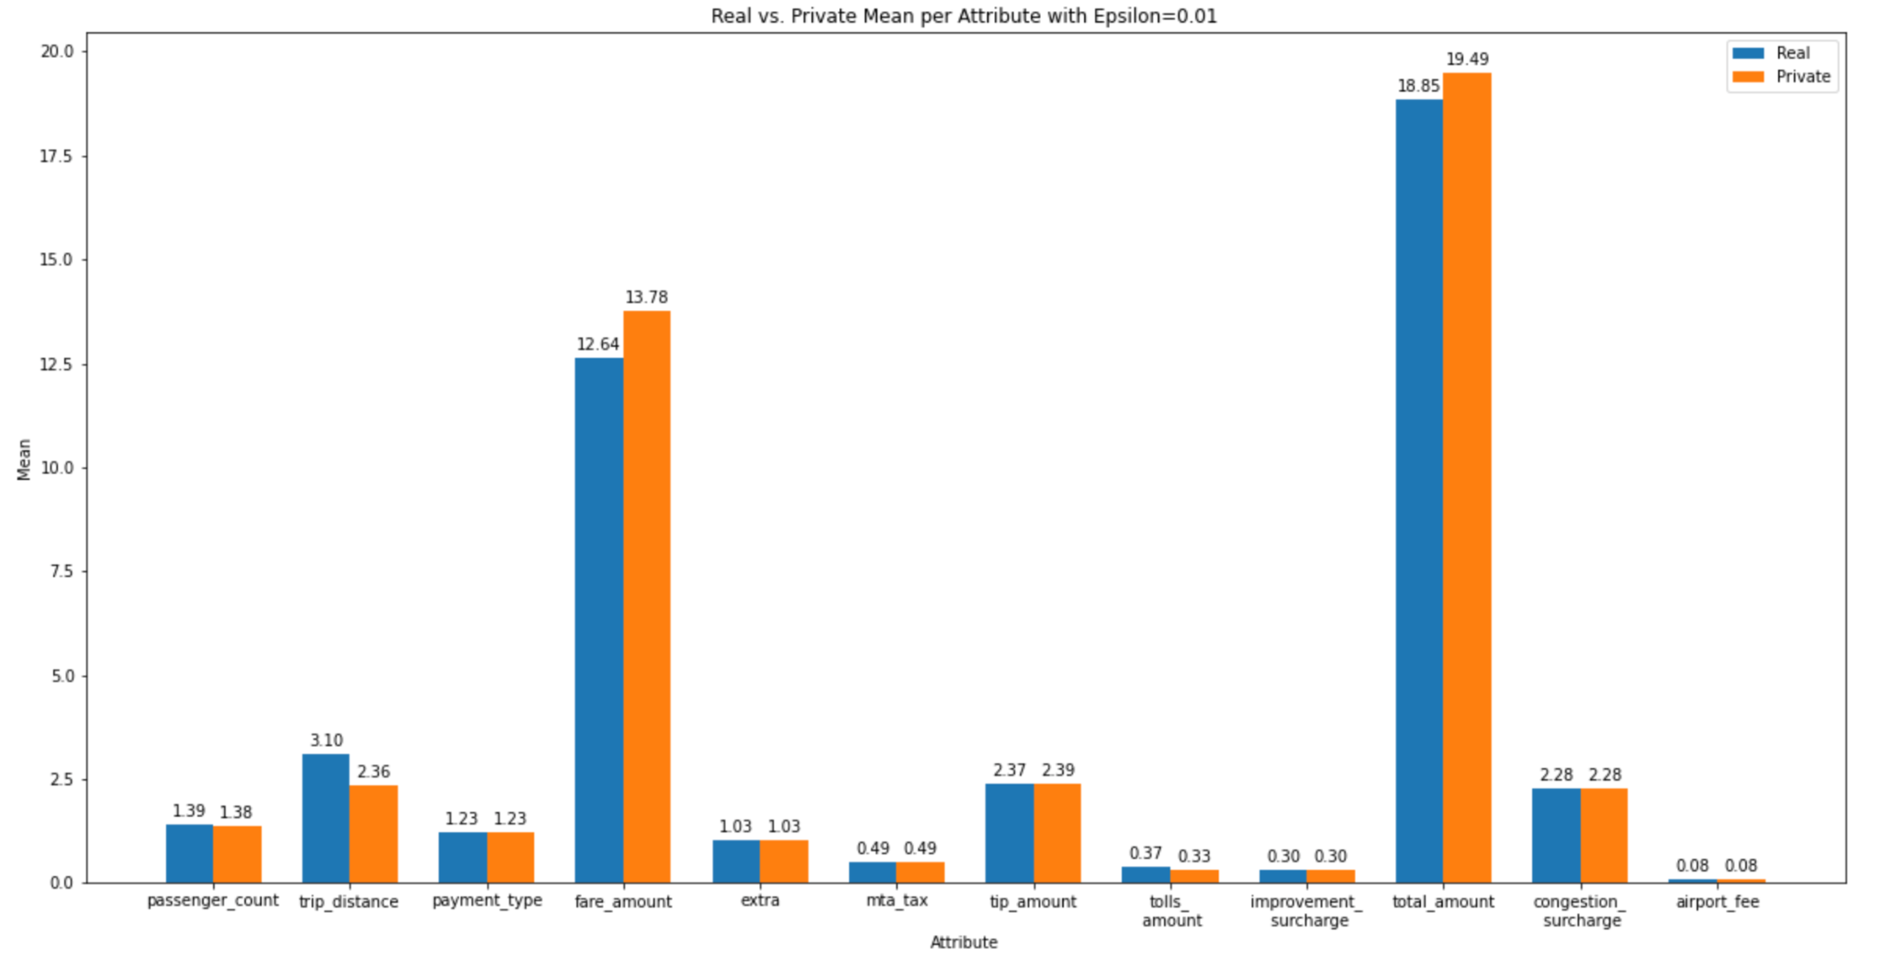
Real vs. Private Mean per Attribute (ε = 0.01)

Slide 9
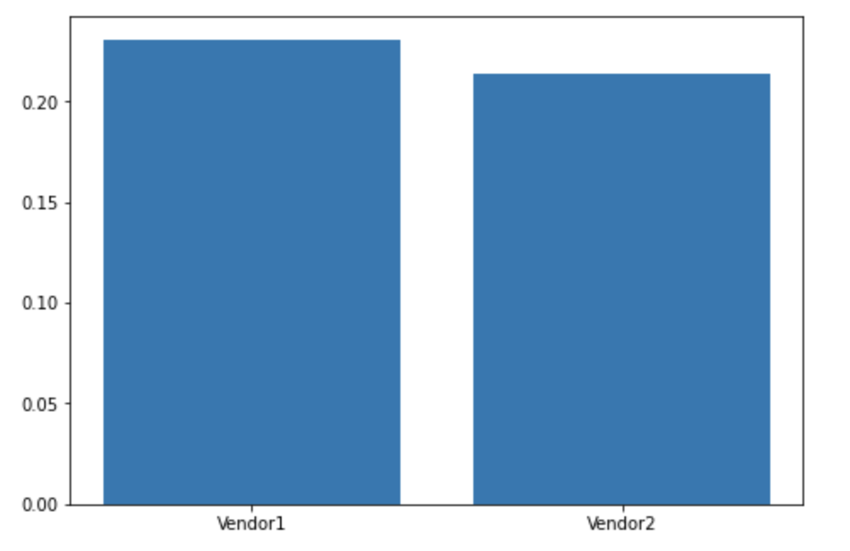
Average tip amounts
Vendor 1 vs Vendor 2 (ε = 0.9)
Average Tip-Fare Ratio
vendor
Notes:
0.23104107260860474 0.2136092200698254
Epsilon 0.9

Slide 10
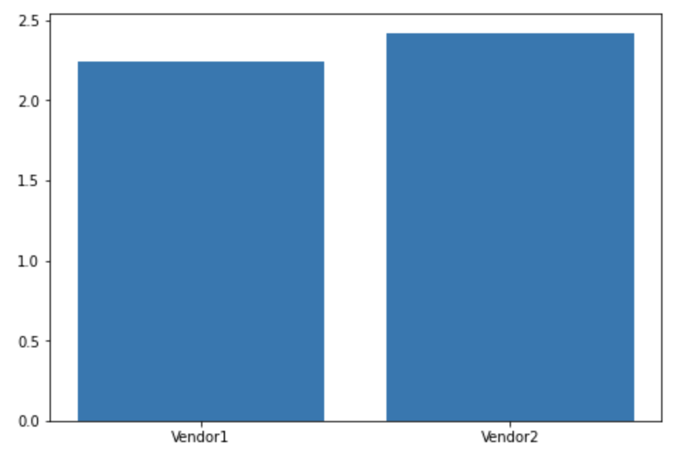
Average tip ($) amounts
Vendor 1 vs Vendor 2 (ε = 0.9)
Average Tip Amount ($)
vendor
Notes:
2.2441082506701804 2.4215158586407313
Epsilon 0.9

Slide 11
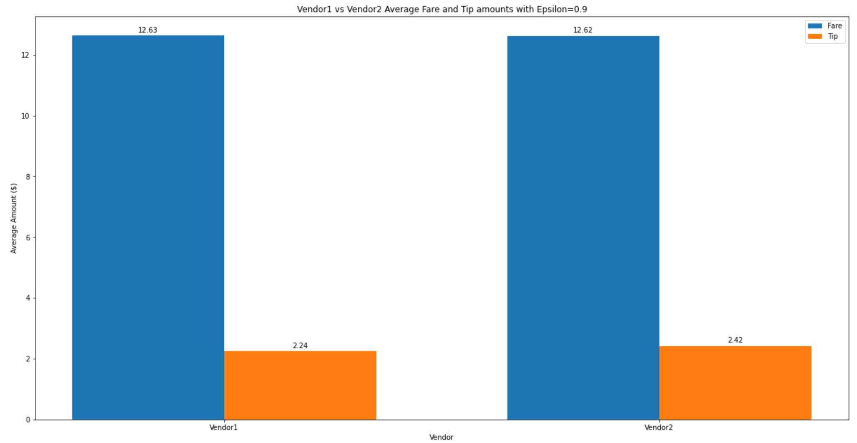

Slide 12
