Slide 1


Atliq Hardware Business Insights using SQL
SQL Business Case Study
Codebasics Resume Project
Prepared by: Anshul Chaudhary | Aspiring Data Analyst
Objective: Using SQL analysis to generate actionable business insights for management decision-making.
Notes:
1

Slide 2

Company Overview
Atliq Hardware is a leading computer hardware manufacturer operating across multiple international markets.
• Leading computer hardware manufacturer
• Global presence across multiple markets
• Large product portfolio including PCs, networking and peripherals
With growing operations, management requires data-driven insights to support strategic decision-making.
Notes:
2

Slide 3








Business Problem
Limited Analytical Reporting
Complex Data Analysis
Insufficient tools to extract meaningful insights from operational data
Difficulty analyzing complex datasets and identifying patterns
Slow Decision-Making
Limited Visibility
Delayed strategic decisions due to lack of timely insights
Inadequate visibility into sales performance and trends
This project aims to solve these challenges using SQL-based data analysis.
Notes:
3

Slide 4
Project Objective
The goal of this project is to analyze Atliq Hardware's database and generate insights for management.
01
02
Analyze Product Portfolio Growth
Identify High-Performing Segments
Track expansion and diversification of product offerings
Determine which product categories drive revenue
04
03
Identify Top-Performing Products
Evaluate Sales Channel Contribution
Pinpoint best-selling products for inventory optimization
Understand performance across different distribution channels
Notes:
4

Slide 5
Database Overview
The analysis uses six key tables from the company database:
dim_customer
dim_product
Customer and market information
Product details and segments
fact_sales_monthly
fact_gross_price
Monthly sales data
Product pricing information
fact_manufacturing_cost
fact_pre_invoice_deductions
Product manufacturing costs
Customer discount percentages
These tables allow analysis of sales trends, product strategy, and customer behavior.
Notes:
5

Slide 6
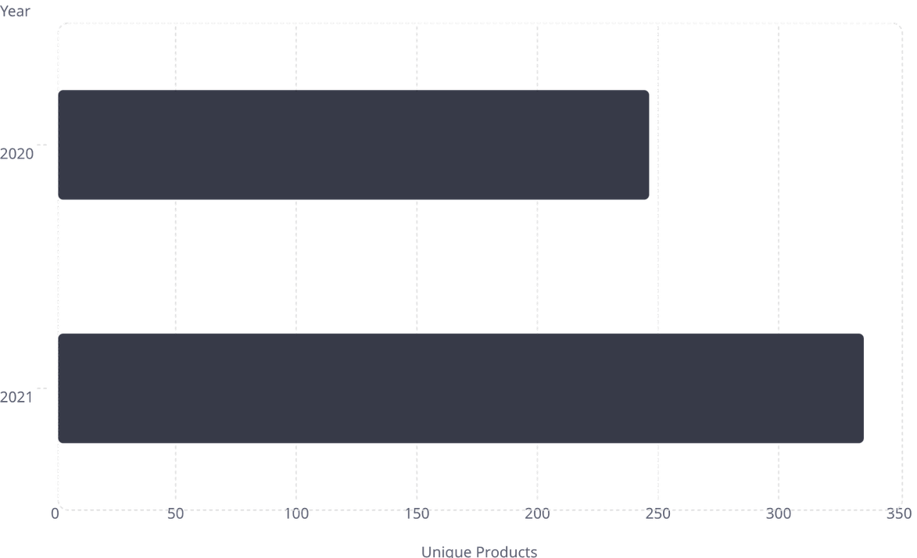
Product Portfolio Growth
245
334
36%
Unique Products 2020
Unique Products 2021
Product Growth
Baseline product count
Expanded product count
Year-over-year increase
Insight
The company expanded its product offerings significantly, indicating a strong focus on product innovation and market expansion.
Recommendation
Continue investing in product development to strengthen competitive positioning.
Notes:
6

Slide 7
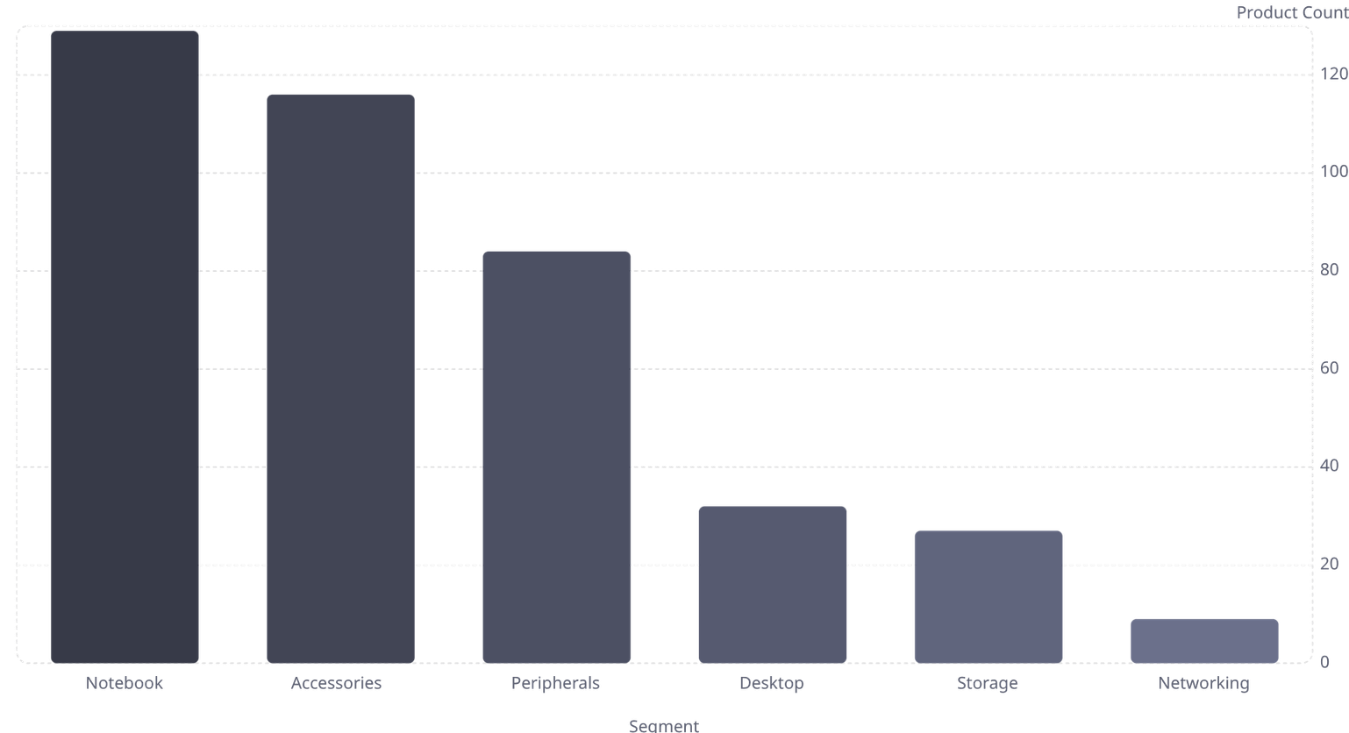
Product Segment Distribution
Insight
Notebook and accessory segments dominate the company's product portfolio.
Recommendation
Focus investment and marketing on high-demand segments.
Notes:
7

Slide 8

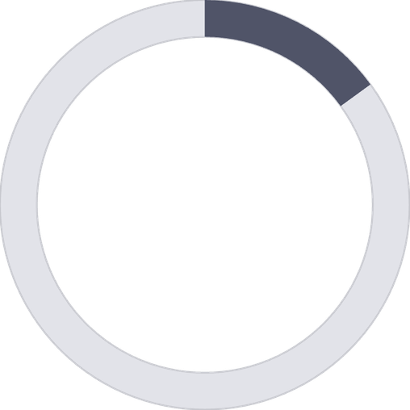
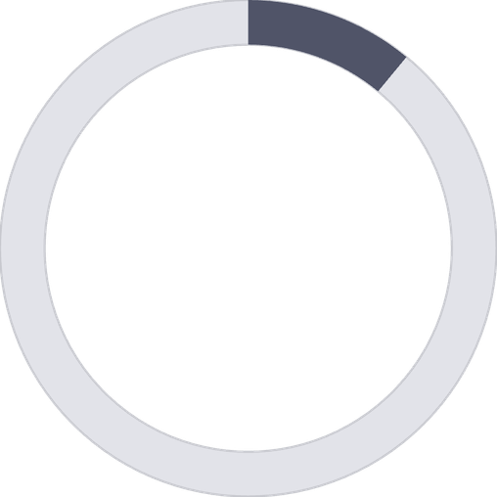
Sales Channel Contribution
73%
15%
11%
Retailer
Direct Sales
Distributor
Largest revenue contributor
Company-owned channels
Third-party partners
Insight: Retail partnerships represent the largest driver of revenue.
Recommendation: Strengthen retailer relationships and optimize retail distribution strategies.
Notes:
8

Slide 9
Customer Discount Analysis
Top customers receiving highest discounts in India:
Flipkart
Viveks
Ezone
30.83% discount level
30.38% discount level
30.28% discount level
Croma
Amazon
30.25% discount level
29.33% discount level
Insight
Recommendation
Large retail and e-commerce partners receive significant discounts due to high purchase volumes.
Regularly review discount strategies to maintain profitability.
Notes:
9

Slide 10
Key Insights & Recommendations
Key Insights from the Analysis
Product portfolio grew by 36% between 2020 and 2021
Notebook and accessory segments dominate the product portfolio
Retail channel contributes 73% of total sales revenue
Q4 shows the highest sales performance
Large retailers receive ~30% discount levels
Strategic Recommendations
Focus on High-Growth Segments
Optimize Discount Policies
Strengthen Retail Partnerships
Align Inventory Planning
Notes:
10

