Slide 1
Provide Insights to an Automotive company on Electric vehicles launch in India
Unguided Project - 3

Slide 2
Helpful Resources
1. Import csv to PostgreSQL - https://www.youtube.com/watch?v=UdMj8iKSCoc&list=LL&index=2&t=5s
2. Connect PostgreSQL to Power BI - https://www.youtube.com/watch?v=P71rGZHpozU&list=LL&index=1&t=472s

Slide 3
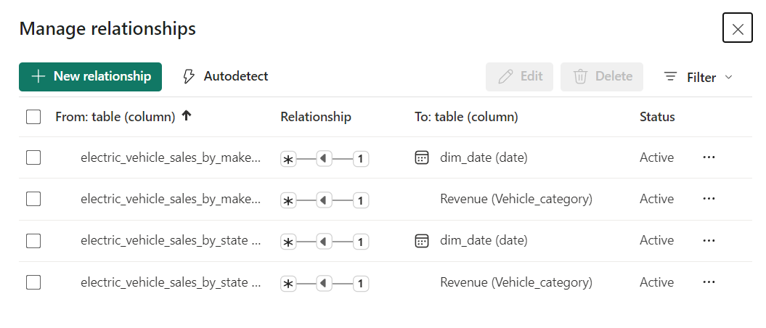
Data Modeling - Relationships

Slide 4
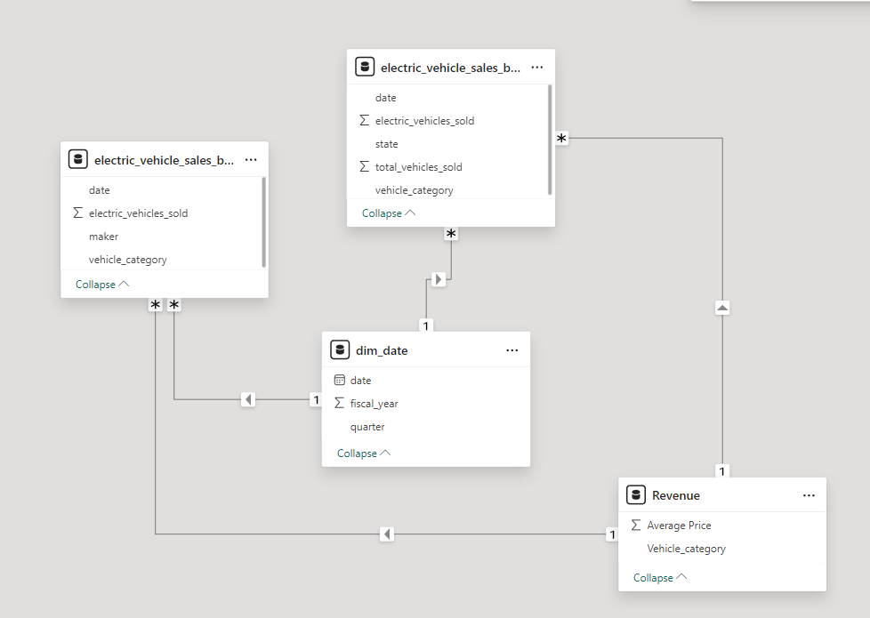
Data Modeling

Slide 5



Report
Live Report

