Slide 1
Provide Insights to the Product Strategy Team in the Banking Domain
Unguided Project – Migrate Tableau Dashboard to Power BI

Slide 2
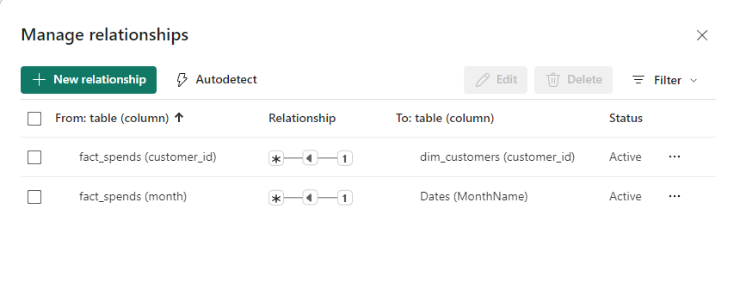
Data Modeling - Relationships

Slide 3
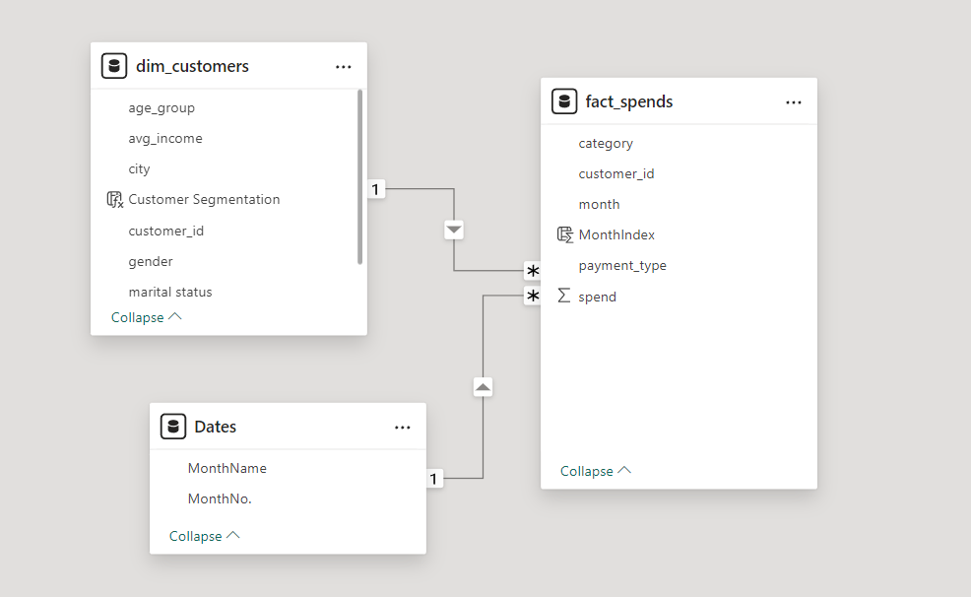
Data Modeling

Slide 4



Report
Live Report

