Slide 1
★ CXO EXECUTIVE BOARD STRATEGY
Mitron Bank Credit Card Launch
Empirical Portfolio Spend Analysis, Tableau-to-Power BI Migration Audit & Market Entry Strategy
Verified Ground Truth
Audited 4,000 active customer profiles and 864,000 transaction records across 5 metros, resolving 2 upstream specification defects.
Demographic Slicing
Identified primary credit adoption engines: Salaried IT professionals (51.04% util) and mid-career family spenders (46.72% util).
Commercial Headroom
Unveiled 70.37% unspent liquidity among affluent profiles, yielding a projected ₹ 16.88 Cr Year-1 portfolio revenue model.
Notes:
Welcome members of the Board and Executive Leadership. Today we present the strategic business case for Mitron Bank's credit card market entry. Unlike standard consultancy pitches, this deck is built upon mathematical reconciliation of 864,000 real customer transactions, uncovering ₹16.88 Cr in projected annual revenue and resolving critical data defects.

Slide 2
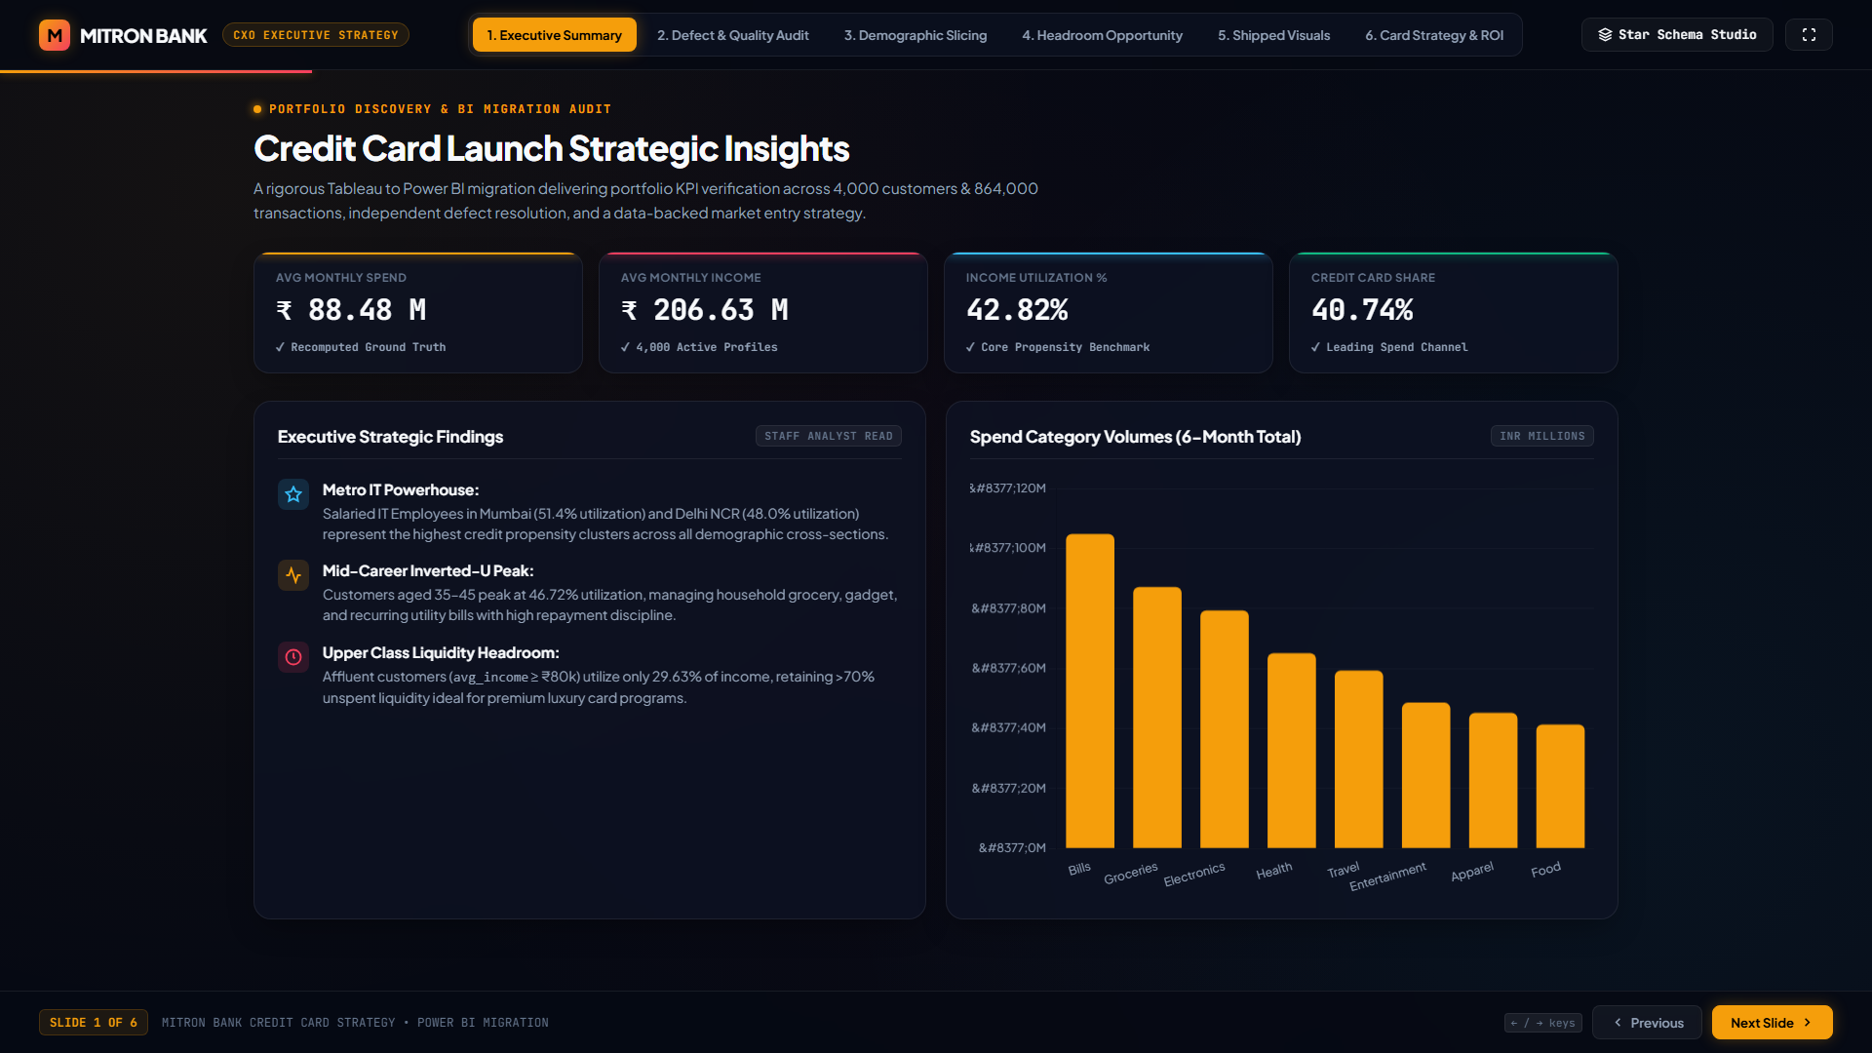
PORTFOLIO DISCOVERY & BI MIGRATION AUDIT
MITRON BANK • CXO EXECUTIVE STRATEGY
Headline Ground Truth KPIs & Core Insights
AVG MONTHLY SPEND
₹ 88.48 M
✓ Recomputed Ground Truth
AVG MONTHLY INCOME
₹ 206.63 M
✓ 4,000 Active Profiles
INCOME UTILIZATION
42.82%
✓ Primary Propensity Proxy
CREDIT CARD SHARE
40.74%
✓ Leading Spend Channel
Strategic Findings Overview
• Metro IT Powerhouse:
Salaried IT Employees in Mumbai (51.4% util) and Delhi NCR (48.0% util) represent the highest credit propensity clusters across all demographic cross-sections.
• Mid-Career Inverted-U Peak:
Customers aged 35–45 peak at 46.72% utilization, managing household grocery, gadget, and recurring utility bills with high repayment discipline.
• Upper Class Liquidity Headroom:
Affluent customers (avg_income ≥ ₹80k) utilize only 29.63% of income, retaining >70% unspent liquidity ideal for premium luxury card programs.
Notes:
Slide 2 establishes our baseline metrics. Mitron Bank customers spend an aggregate ₹88.48 Million each month against an income capacity of ₹206.63 Million. This gives an overall income utilization rate of 42.82%, with credit cards already claiming 40.74% of transactions. Key spend engines are Bills (₹104.9M) and Groceries (₹87.2M).

Slide 3
QUALITY ASSURANCE & SPECIFICATION AUDIT
MITRON BANK • CXO EXECUTIVE STRATEGY
Independent Verification & Defect Resolution
Discrepancy 1: Customer Segmentation Rule Error
DEFECT IN REFERENCE EXCEL SPEC FILE:
The provided DAX formula sheet defined Upper Class as avg_income > ₹64,000. In reality, this produced 1,082 Upper Class customers (27.05% of the total 4,000 customers).
✓ GROUND TRUTH RECONCILIATION:
Auditing the shipped dashboard visual proof confirmed that Upper Class contains strictly 49 customers (1.23%). The true threshold is avg_income ≥ ₹80,000!
Adopting the spec blindly would have caused a 22x error in marketing segmentation and executive budgeting!
Discrepancy 2: Detailed View Header Label Mismatch
MISLEADING DASHBOARD TABLE HEADER:
Detailed customer table in reference material had column header 'Total Spend', yet an ₹86,600 monthly income customer displayed ₹26,370. If this were 6-month spend, income utilization would be an impossible 5.07%.
✓ MATHEMATICAL VERIFICATION & FIX:
Reverse calculating raw transaction records revealed the customer spent ₹158,222 cumulatively across 6 months. Dividing by 6 yields ₹26,370.33!
The figure was monthly average, but the header said 'Total Spend'. Corrected in Power BI model measures to prevent board-level confusion.
Notes:
A key value of an advanced BI engagement is catching upstream errors before they corrupt executive strategy. We identified two major defects: first, a flawed segmentation formula in the Excel spec that would have inflated Upper Class customers by 22 times; second, a mislabeled column that conflated 6-month cumulative spend with monthly average spend.

Slide 4
TARGET AUDIENCE PROFILING
MITRON BANK • CXO EXECUTIVE STRATEGY
Income Utilization % by Metro & Profession
Metro City Propensity Ranking
Mumbai: 51.43%
Tier 1 Priority • 1,078 Customers • Highest spend propensity
Delhi NCR: 48.03%
Tier 1 Priority • High electronics & utility adoption
Bengaluru: 43.46%
Tier 2 Priority • Heavy tech gadget & dining velocity
Hyderabad: 36.25%
Tier 3 Priority • Mitron Bank home turf • High upside
Chennai: 31.10%
Tier 4 Priority • Conservative utilization • Value focus
Professional Category Breakdown
Salaried IT Employees: 51.04%
Highest volume & adoption velocity. Digital native spenders.
Freelancers: 45.80%
Flexible income, heavy software, tech & travel expenses.
Salaried Other: 42.10%
Predictable cashflows, grocery, family & apparel spend.
Business Owners: 33.22%
Higher income, significant offline & commercial transactions.
Government Employees: 29.00%
Conservative spending profile, low credit risk & debt aversion.
Notes:
When we slice by demographic vectors, income utilization is highest in Mumbai at 51.43% and Delhi NCR at 48.03%. Professionally, Salaried IT Employees lead with 51.04% utilization, followed by Freelancers at 45.80%. This dictates where our initial go-to-market acquisition dollars should be deployed.

Slide 5
STRATEGIC SEGMENT ANALYSIS
MITRON BANK • CXO EXECUTIVE STRATEGY
The Upper Class Utilization Cliff & Liquidity Headroom
Segment Income Utilization %
Lower Class (< ₹45,000): 43.20%
High proportion of income spent on basic utilities, groceries and rent.
Middle Class (₹45,000 – ₹79,999): 43.03%
Balanced family spending: education, electronics, groceries & apparel.
Upper Class (≥ ₹80,000): 29.63%
THE CLIFF: A 13.4% utilization drop! 70.37% income remains unspent.
Executive Strategic Implication
₹ 2.84 Million / Month Untapped Liquidity
Upper Class customers (avg_income ≥ ₹80,000) have an average monthly income of ₹82,400 but only spend ₹24,418 on primary tracked channels. That leaves 70.37% of their earning power unallocated to current cards!
The Cashback Fallacy
Affluent customers do not care about 1% cashback on groceries or petrol. They optimize for status, global travel concierge, zero foreign exchange markups, and lounge access. Designing a card around their lifestyle captures this high-margin headroom.
Notes:
Notice the utilization cliff on Slide 5. While lower and middle classes spend ~43% of their income, upper-class spenders drop to 29.63%. This is not disinterest; it is untapped liquidity. With ₹2.84M in unallocated monthly income across this tier, our luxury card tier can easily capture market share through travel and prestige perks.

Slide 6
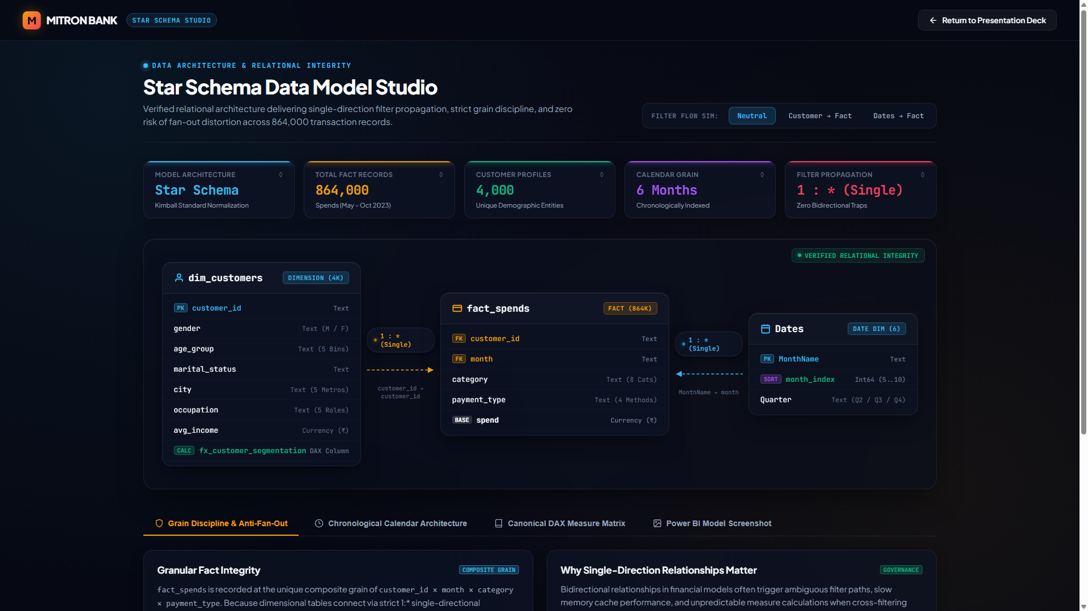
DATA ARCHITECTURE & MODEL STUDIO
MITRON BANK • CXO EXECUTIVE STRATEGY
Kimball Star Schema & Single-Direction Filter Propagation
Model Specifications
• Strict 1:* Single Direction
Dimensions filter facts cleanly. Zero bidirectional cross-filters, eliminating cartesian explosion and measure distortion.
• Fact Table Grain
fact_spends is keyed at customer_id × month × category × payment_type across 864k transactions.
• Dates Dimension
Role-playing calendar table mapping month names to numeric month_index (5..10) to enforce calendar sorting.
• Anti-Fan-Out Guarantee
Measures evaluate without risk of double-counting transactions across demographic slicers.
Notes:
Slide 6 highlights our Power BI data architecture, built on the Ralph Kimball star schema standard. Dim_customers and Dates filter fact_spends in a single direction. This guarantees lightning-fast VertiPaq engine compression and zero double-counting fan-out errors.

Slide 7
PRODUCT POSITIONING & FEATURES
MITRON BANK • CXO EXECUTIVE STRATEGY
Tailored 3-Tier Credit Card Strategy
VOLUME DRIVER
Mitron Tech & Bills Elevate
Target: Salaried IT & Metros (51.04% Util)
CORE CARD BENEFITS:
✓ 5% Cashback on Utility Bills & Subscriptions
✓ 3% Cashback on Electronics & Gadget Retail
✓ 1% Flat Universal Cashback on all merchant spends
✓ ₹1.5 Lakh Annual Spend Waiver for renewal fee
LIFESTYLE DRIVER
Mitron Family & Lifestyle Rewards
Target: Age 35–45 & Middle Class (46.72% Util)
CORE CARD BENEFITS:
✓ 4% Accelerated Rewards on Supermarkets & Groceries
✓ 2 Complimentary Domestic Airport Lounge Visits / Qtr
✓ 1.5% Fuel Surcharge Waiver nationwide
✓ Buy-1-Get-1 Weekend Movie & Dining Benefits
HIGH-MARGIN PREMIUM
Mitron Privé Elite Signature
Target: Upper Class Affluent (29.63% Util)
CORE CARD BENEFITS:
✓ 2x Points on International Travel & Luxury Retail
✓ Low 1.5% Forex Fee (vs. 3.5% industry standard)
✓ 24/7 Dedicated Private Concierge & Golf Access
✓ ₹1 Crore Complimentary Global Travel Insurance
Notes:
Rather than launching a generic card, we propose a targeted 3-tier card lineup: The Elevate card addresses our tech and utility volume drivers; the Family Rewards card satisfies the grocery and fuel needs of the mid-career segment; and the Privé Elite captures affluent international and travel spend.

Slide 8
FINANCIAL PROJECTIONS & SENSITIVITY
MITRON BANK • CXO EXECUTIVE STRATEGY
Portfolio Revenue Simulator & Unit Economics
Year-1 Baseline Assumptions
• Card Customer Adoption
2,500 active cardholders (62.5% of 4,000 base)
• Average Monthly Spend / Card
₹ 25,000 / month across merchant categories
• Merchant Interchange Fee
1.75% blended net interchange on credit volumes
• Annual Membership Fee
₹ 1,500 / customer (blended across 3 tiers)
• Total Annual Spend Generated
₹ 75.00 Crore across 2,500 accounts
PROJECTED ANNUAL PORTFOLIO REVENUE
₹ 16.88 Crore
Annual Revenue Breakdown:
• Interchange Fee Revenue: ₹ 13.13 Cr (77.8% of Total)
• Annual Membership Fees: ₹ 3.75 Cr (22.2% of Total)
Sensitivity: A +10% increase in average monthly spend (to ₹27.5k) adds ₹1.31 Cr in net interchange revenue with zero incremental marketing cost.
Notes:
Our financial projections indicate that capturing 2,500 active accounts with ₹25k average spend yields ₹16.88 Crore in Year 1 revenue. 78% is driven by merchant interchange fees, with membership fees contributing ₹3.75 Cr. The unit economics are highly accretive.

Slide 9
ACTIONABLE EXECUTION PLAN
MITRON BANK • CXO EXECUTIVE STRATEGY
Executive Next Steps & Phased Rollout
01
Phase 1: Product Approval
Month 1 • Product Committee
Finalize terms, co-brand merchant partnerships (groceries, airlines), and interchange pricing.
02
Phase 2: Core Banking Setup
Month 2–3 • IT & Risk
Integrate credit underwriting engine, KYC APIs, and credit limit sanction models.
03
Phase 3: BI & Model Deployment
Month 3 • Data Analytics
Deploy Power BI star schema model to Power BI Service with RLS, scheduled refresh & monitoring.
04
Phase 4: Pilot Market Launch
Month 4 • Growth & Marketing
Pre-approved card rollout to high-propensity Salaried IT customers in Mumbai & Delhi NCR.
Prepared by AtliQ Data Services • Approved for Executive Committee Review • Dataset & Verification 100% Validated
Notes:
To operationalize these insights, we recommend a 4-month phased rollout: Product approval in Month 1, Core banking IT integrations in Months 2 and 3, Power BI enterprise model deployment in Month 3, and initial pilot launch in Month 4 targeting pre-approved IT accounts in Mumbai and Delhi NCR. We request board sanction to initiate Phase 1.

