Slide 1
Shield Insurance Analytics

Slide 2

Shield Insurance Analytics
Report type
Business Performance
Document
Performance Report
Period
Nov 2022 - Apr 2023

Slide 3

Agenda
Shield Insurance Analytics
Business problem
Executive summary
Revenue trend
Sales channel analysis
Age group risk and reward
Risks and opportunities

Slide 4
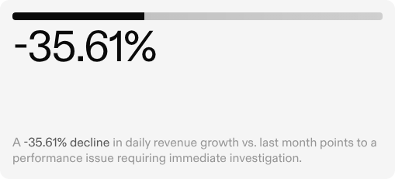
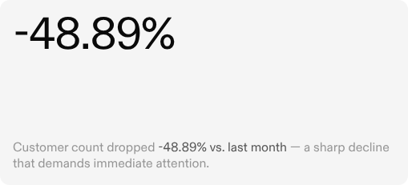
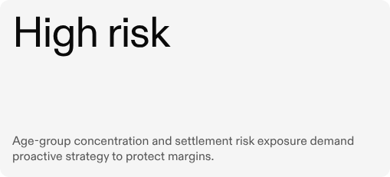
Business problem
Why this ​analysis matters

Slide 5
Executive summary
13.2M INR
+103.34% vs last month
Total revenue
26,841
-48.89% vs last month
Total customers
5.2M INR
-35.61% vs last month
Daily revenue growth
38.9K INR
+8.79% vs last month
Revenue per customer

Slide 6
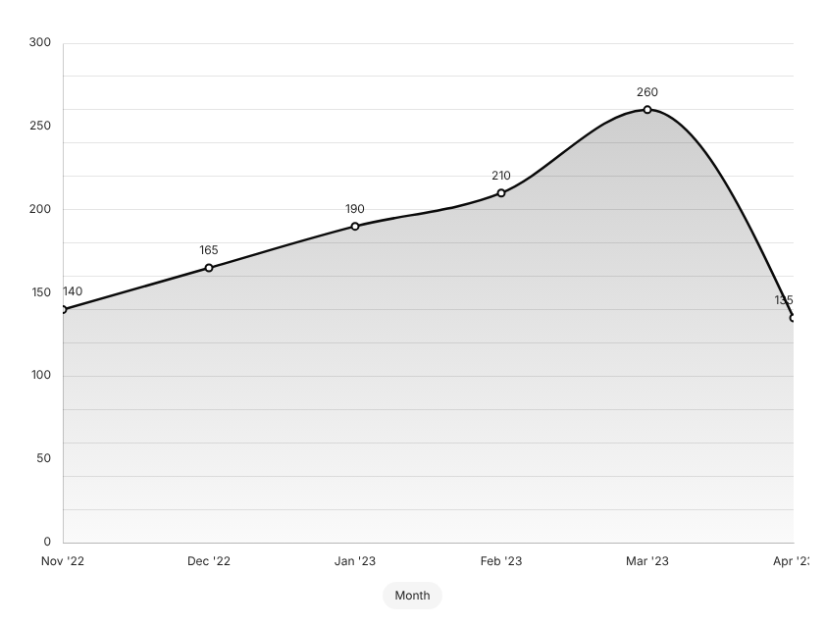
Revenue trend
Monthly revenue: Nov 2022 - Apr 2023
Revenue volatility: ​48% drop in Apr 2023
After peaking at ~260M INR in Mar 2023, revenue fell sharply to ~135M INR in Apr. Investigate policy renewals and acquisition pipeline immediately.

Slide 7
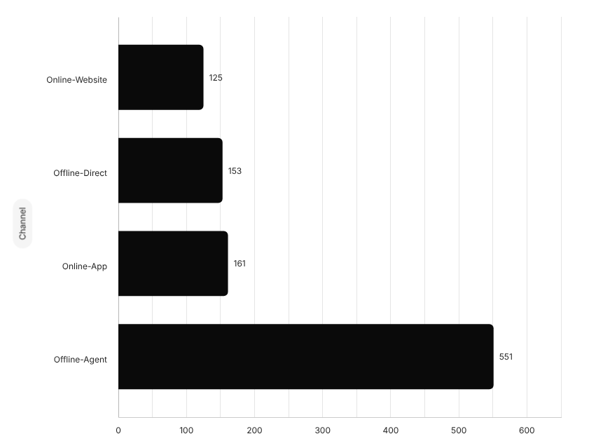
Key insight
Revenue by sales channel (INR millions)
One channel drives 56% of all revenue
Concentration risk: Offline-Agent at 55.67% means any disruption to the agent network directly impacts the majority of revenue.

Slide 8
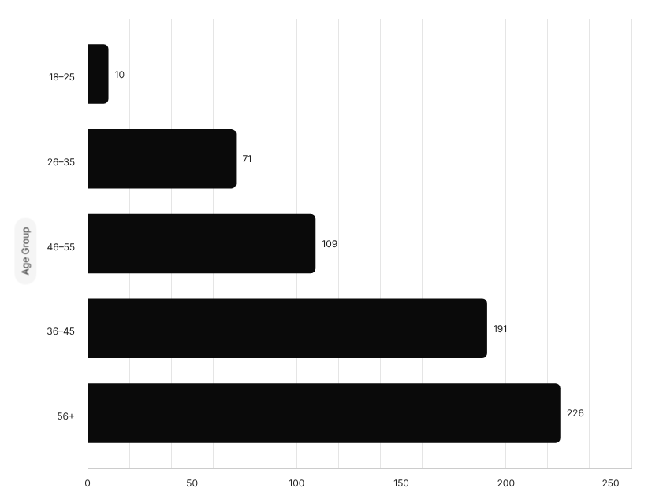
Age & risk
Expected settlement exposure by age group (INR M)
Older customers carry disproportionate settlement risk
The 18-25 segment (6.87% of customers, ~2K) carries the lowest settlement exposure at 10M INR — making it the lowest-risk age group by a significant margin. Source: Age group dashboard customer pie chart.

Slide 9
Channel Concentration
Offline-Agent at 55.67% of revenue creates high concentration risk if agent network is disrupted.
Customer Churn
April 2023 revenue drop of -48% MoM may signal early customer churn requiring immediate attention.
Risks and ​Opportunities
Settlement Exposure
56+ age group carries 226M INR in settlement exposure — the highest of any segment and a material financial risk.
Growth Potential
The 18-25 segment has the lowest settlement exposure (10M INR), and revenue per customer is up +8.79% MoM — both pointing to growth potential.
Key insights from our data analysis reveal critical risks and growth opportunities for Shield Insurance.

Slide 10

Next steps
Four actions to stabilize and grow
Investigate revenue drop
Diversify channel mix
Re-price 56+ policies
18–25 acquisition campaign
Identify churn triggers and lapsed renewals behind the Apr 2023 revenue drop. Owner: Revenue Analytics Team.
Deadline: 2 weeks
Grow App + Website to 40% of revenue by Q3 2023. Owner: Sales Strategy.
Deadline: End of Q2 2023
Review 226M INR settlement exposure and adjust underwriting criteria for 56+ age group. Owner: Actuarial Team.
Deadline: 30 days
Launch a digital-first campaign targeting the low-risk 18–25 segment. Owner: Marketing.
Deadline: Q3 2023

