Slide 1
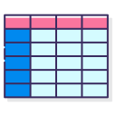



1. Scrape
2. Sentiment Analysis
3. Store Results
4. Display on Dashboard

