Slide 1

Comparative Study of ML Classifiers
for Anti-Money Laundering Detection
A systematic evaluation of 6 classifiers on the IBM AML synthetic dataset, examining the critical role of class imbalance handling in financial crime detection.
Machine Learning
AML
XGBoost
IBM Dataset

Slide 2



Research Background
The Challenge
Money laundering is a multi-billion dollar global problem. Illicit transactions are extremely rare — just 0.1% of all activity — making detection inherently difficult.
The Data
IBM's synthetic AML dataset (HI-Small) models an entire financial ecosystem: 5.07M transactions across 515,000 bank accounts over 18 days.
The Approach
Train and evaluate 6 ML classifiers under identical conditions. Demonstrate the critical impact of class imbalance handling on detection performance.

Slide 3
Dataset Overview
Total Transactions
5,078,336
Laundering Cases
5,177
0.10%
Bank Accounts
~515,000
Time Period
Sep 1–18, 2022 (18 days)
Currencies
15 types (USD, BTC, EUR...)
Payment Formats
7 types (ACH, Wire, Cash...)
Top Laundering Method
ACH transfers
86.6%

Slide 4

The Class Imbalance Problem
Legitimate
Laundering
99.90%
0.10%
5,073,159 transactions
5,177 transactions (1 in every 981)
Solution: Random Under-Sampling
Randomly reduce the majority class to match the minority. Without resampling, even XGBoost achieves only 0.06 Recall. After Under-Sampling, Recall jumps to 0.94 — a 1,473% improvement.

Slide 5
Methodology
1
Preprocessing
Remove 9 duplicates, convert timestamps to weekday, cast bank IDs to string
2
Random Under-Sampling
Balance classes to 1:1 ratio → 10,354 total samples
3
Train / Test Split
70% train (7,247) / 30% test (3,107), random_state=42
4
Feature Encoding
OneHotEncoder on 7 categorical columns (drop='first', handle_unknown='ignore')
5
Model Training & Evaluation
Identical sklearn Pipeline for all 6 classifiers
Models
Logistic Regression
Random Forest
Decision Tree
KNN (k=5)
SVM (Linear)
XGBoost

Slide 6
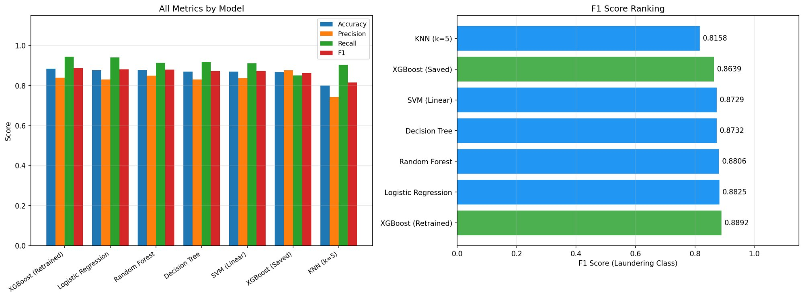
Model Comparison Results
Left: All metrics by model · Right: F1 Score ranking (Laundering class)

Slide 7

Detailed Results
Ranked by F1
# | Model | Accuracy | Precision | Recall | F1 | Time
1 | XGBoost (Retrained) | 0.8862 | 0.8443 | 0.9408 | 0.8892 | 1.53s
2 | Logistic Regression | 0.8801 | 0.8387 | 0.9336 | 0.8825 | 0.04s
3 | Random Forest | 0.8756 | 0.8340 | 0.9342 | 0.8806 | 4.33s
4 | Decision Tree | 0.8711 | 0.8480 | 0.9000 | 0.8732 | 0.20s
5 | SVM (Linear) | 0.8720 | 0.8380 | 0.9132 | 0.8729 | 0.04s
6 | XGBoost (Saved) | 0.8675 | 0.8766 | 0.8521 | 0.8639 | —
7 | KNN (k=5) | 0.7977 | 0.7436 | 0.9013 | 0.8158 | 0.02s
The top 5 models differ by only 1.63 F1 points — suggesting a performance ceiling from feature representation.

Slide 8


Key Findings
Class imbalance handling is critical
Without resampling, Recall is just 0.06. After Under-Sampling, it jumps to 0.94 — a 1,473% improvement. This single preprocessing step transforms an unusable model into an effective detector.
XGBoost achieves top performance
F1 = 0.8892 with Precision 0.84 and Recall 0.94. It provides the best balance between catching laundering and minimizing false alarms.
Simple models are surprisingly competitive
Logistic Regression reaches F1 = 0.8825 — only 0.67 points behind XGBoost while training 38× faster (0.04s vs 1.53s). The discriminative signal appears largely linear.
KNN is unsuitable for this task
F1 = 0.8158 (lowest). The curse of dimensionality in the high-dimensional OneHot-encoded space degrades distance-based methods.

Slide 9
Discussion & Limitations
Discussion
Limitations
Precision-Recall Trade-off
Most models favor high Recall (0.91–0.94) over Precision (0.83–0.85). In AML, missing laundering costs far more than false alarms — this trade-off is acceptable.
Evidence of Linearity
Logistic Regression nearly matches XGBoost, suggesting the discriminative signal in OneHot features is primarily linear. Non-linear models add only marginal value.
Numerical features excluded
Amount Received / Amount Paid were dropped. Amount-based anomaly detection is a cornerstone of traditional AML.
Missing receiver account
Account.1 (receiver ID) was not included, potentially losing important discriminative information.
Synthetic data constraints
IBM's simulated ecosystem cannot fully replicate the complexity and adversarial nature of real-world laundering schemes.

Slide 10
Conclusion & Future Work
With proper class imbalance handling, ML classifiers can effectively detect money laundering in synthetic financial data. XGBoost achieved the best F1 of 0.8892, while Logistic Regression proved competitive at 0.8825 — training 38× faster.
Future Directions
Incorporate numerical features (transaction amounts)
Feature engineering: frequency, amount ratios, time-of-day
Compare oversampling methods (SMOTE, ADASYN)
Leverage network structure via Graph Neural Networks

