Slide 1
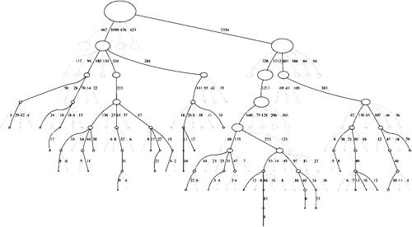

An Introduction to
Monte Carlo Tree Search
Manlio Morini, software developer
morini@eosdev.it
C++ Day – Parma 2019

Slide 2


The algorithm for General Game Playing (?)
2016
AlphaGo became the first computer program to beat the world champion in a game of Go.

Slide 3

The algorithm for General Game Playing (?)
2017 – 2018
Starting from random play and given no domain knowledge except the game rules, the AlphaZero program taught itself to play chess, shogi, and Go, defeating a world champion program in each game.

Slide 4
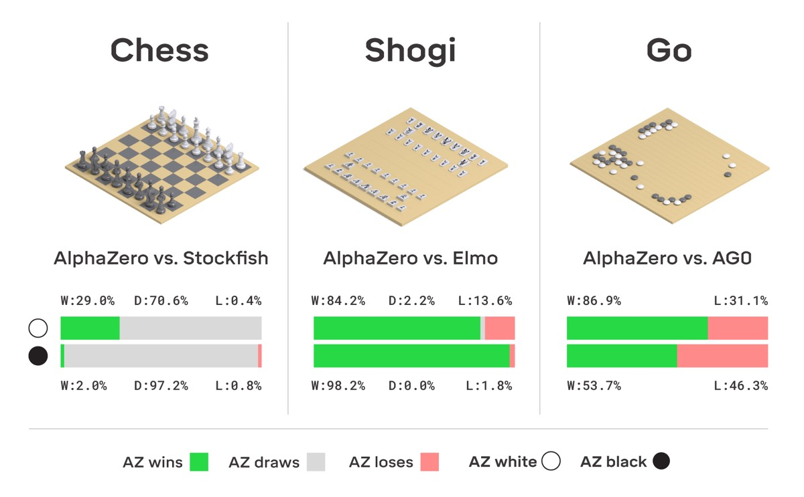
The algorithm for General Game Playing (?)

Slide 5
Foreward
MCTS is a heuristic search algorithm inspired from multi-armed bandits to efficiently explore a tree of possible action sequences.
Mostly employed in game play.
Likely birthday: 2006. Rémi Coulom describes the application of Monte Carlo methods to tree-search / Kocsis and Szepesvári develop the UCT (Upper Confidence bounds applied to Trees) algorithm.

Slide 6
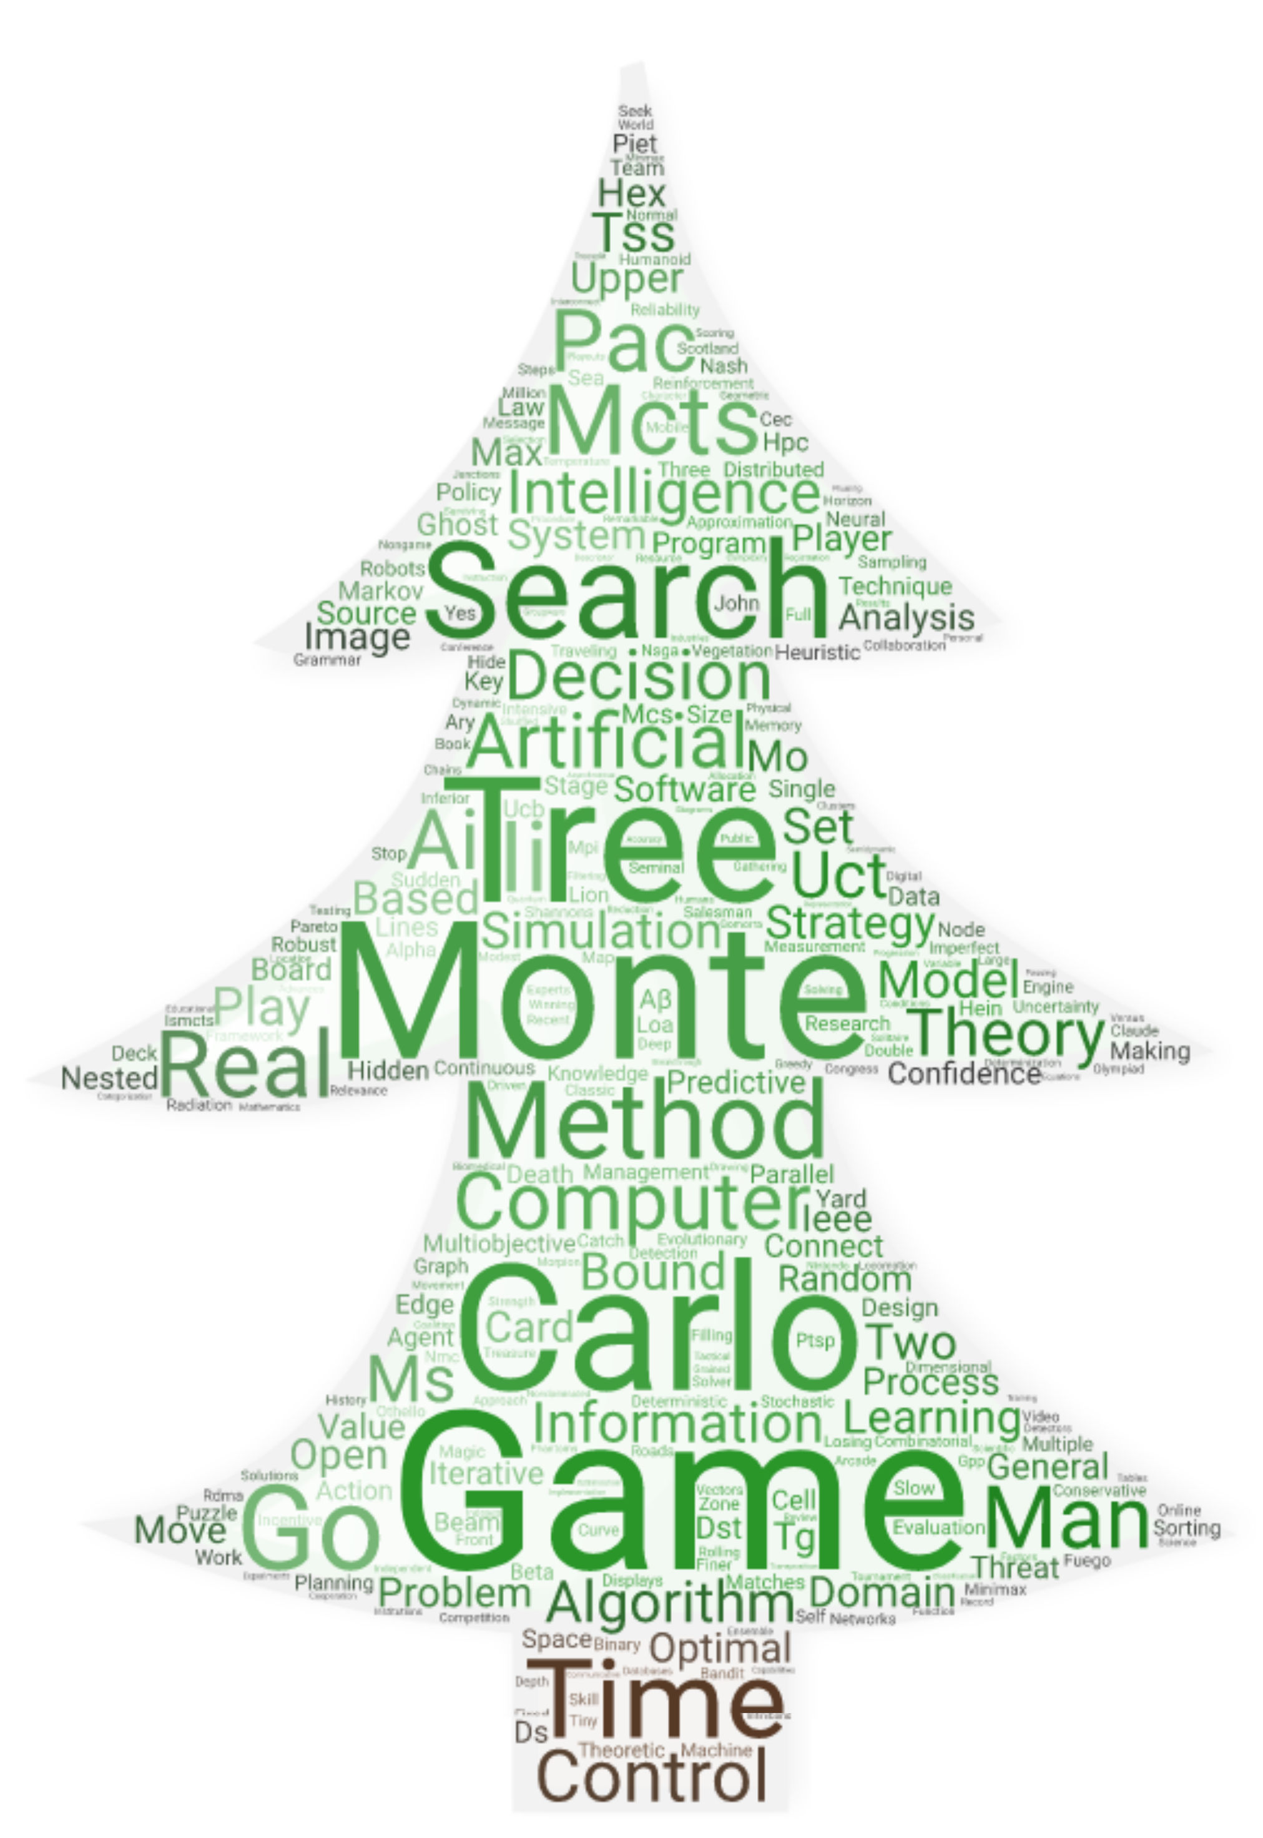
Scope
MCTS keywords tag cloud (first 100 most relevant papers about MCTS according to https://ieeexplore.ieee.org)
MCTS application extends beyond games, it can theoretically be applied to any domain that can be described in terms of {state, action} pairs and simulation used to forecast outcomes

Slide 7

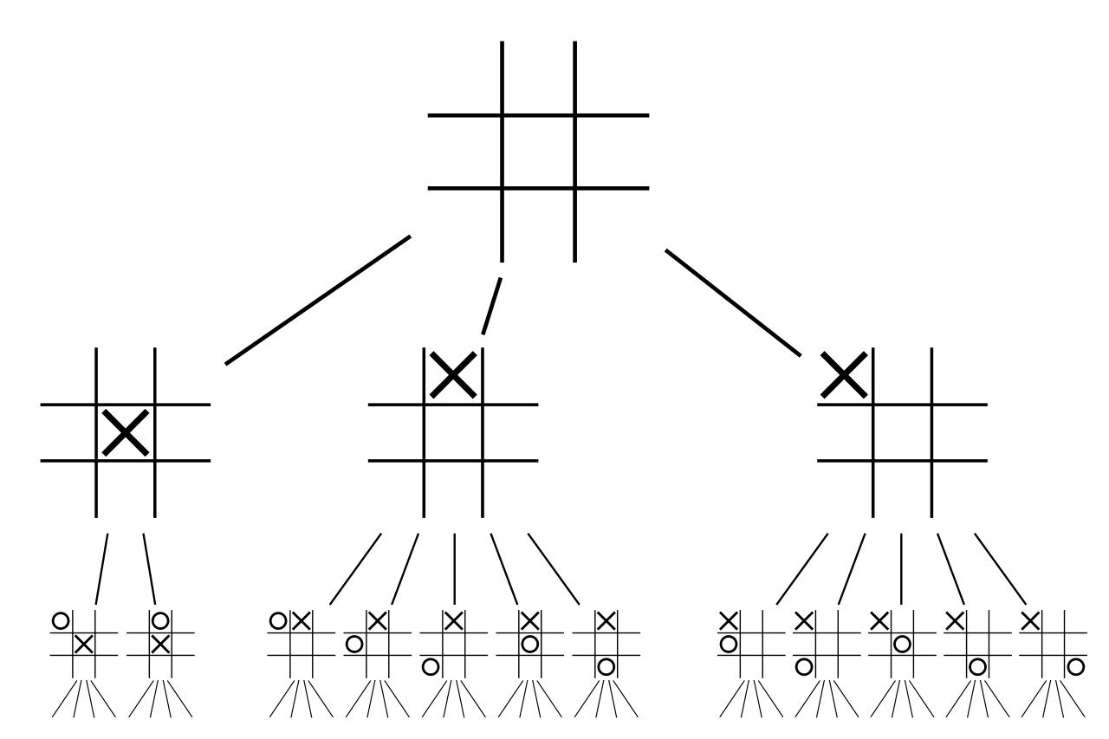
Game Tree
Partial game tree for the first two plies of tic-tac-toe
A node is associated to a state
and other information about the search

Slide 8
MCT(ree)S
MCTS builds a search/game tree (or graph) from scratch, by simulations, storing statistical information needed to choose good moves.

Slide 9
The `state`class - adapter pattern
class state
{
public:
using action = /* the representation of an action/move */;
std::vector<action> actions() const; // set of available actions in this
// state. MUST return an empty
// container for final states
void take_action(action); // performs the required action
// changing the current state
unsigned agent_id() const; // active agent
std::vector<double> eval() const; // how good is this state from each
// agent's POV
bool is_final() const; // returns `true` if the state is
// final
private:
// ...Hic sunt leones...
};
Legal actions only
Standard MCTS requires meaningful values
ONLY WHEN REACHING A FINAL STATE

Slide 10
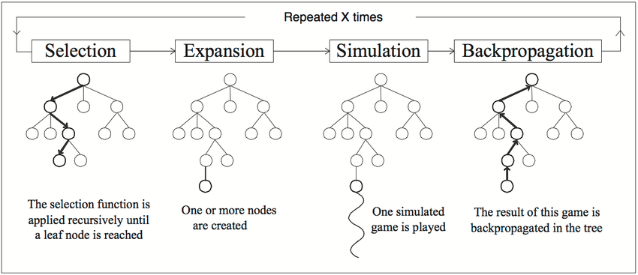
Basic algorithm
Figure from Chaslot (2006)

Slide 11
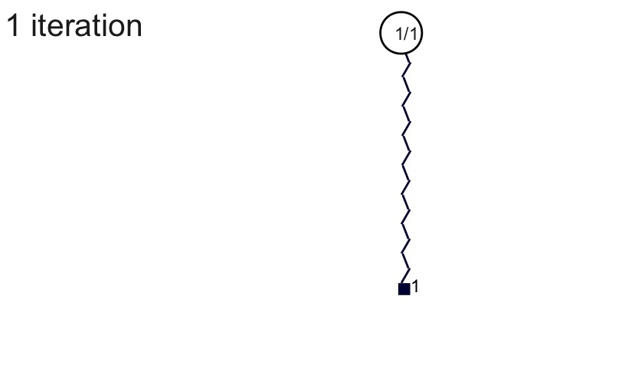
MCTS – Iterations

Slide 12
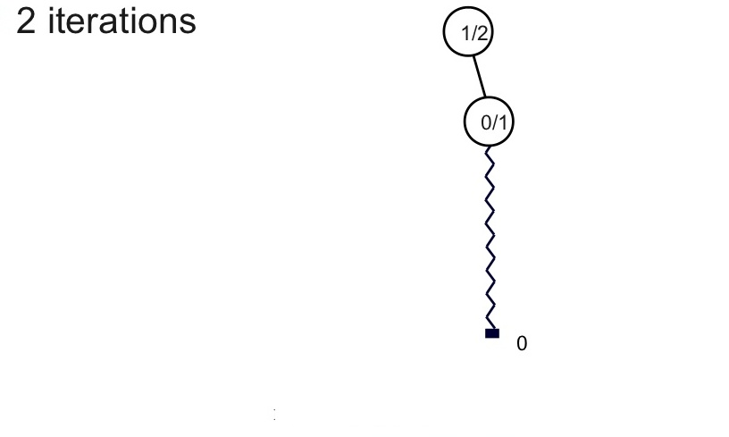
MCTS – Iterations

Slide 13
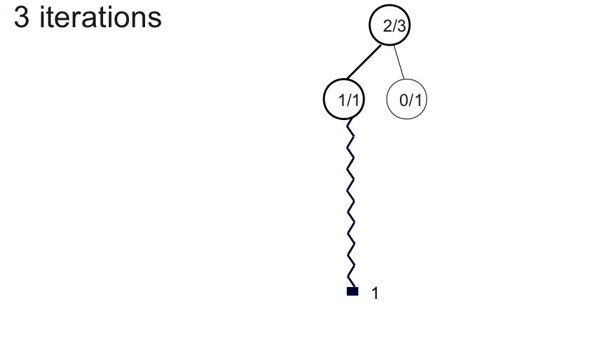
MCTS – Iterations

Slide 14
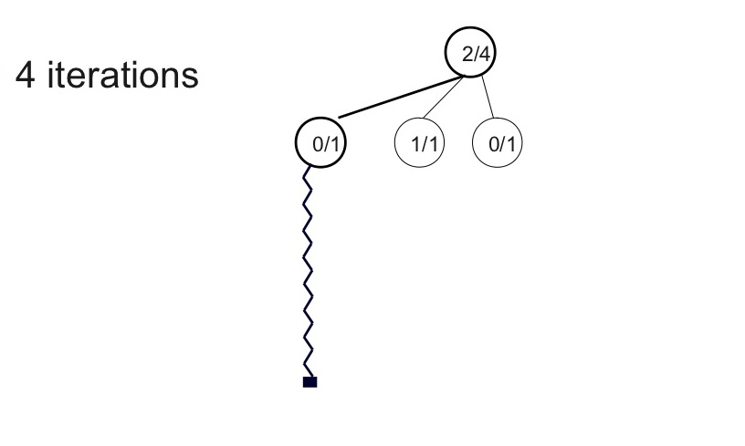
MCTS – Iterations

Slide 15
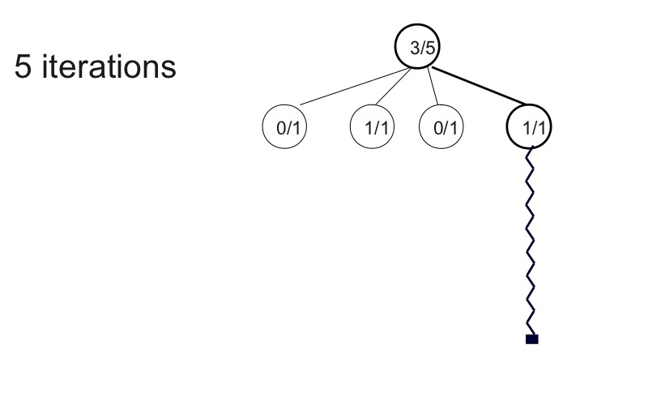
MCTS – Iterations
Fully expanded

Slide 16
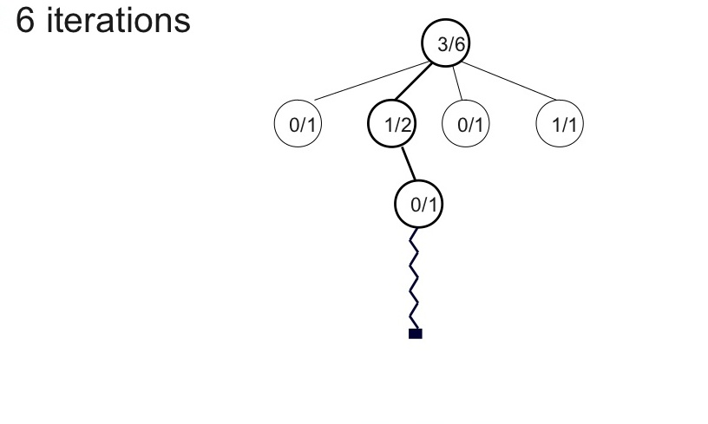
MCTS – Iterations
Fully expanded

Slide 17
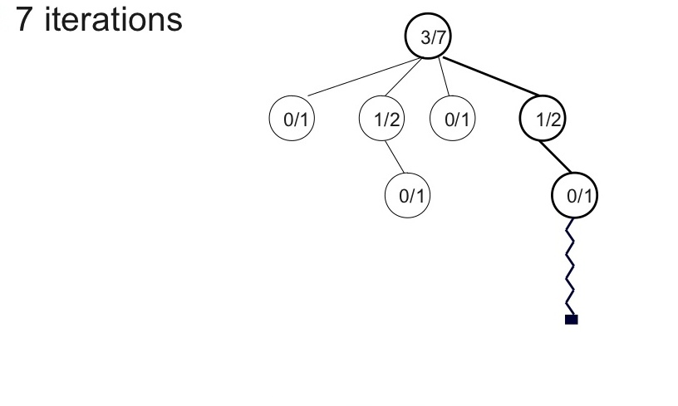
MCTS – Iterations

Slide 18
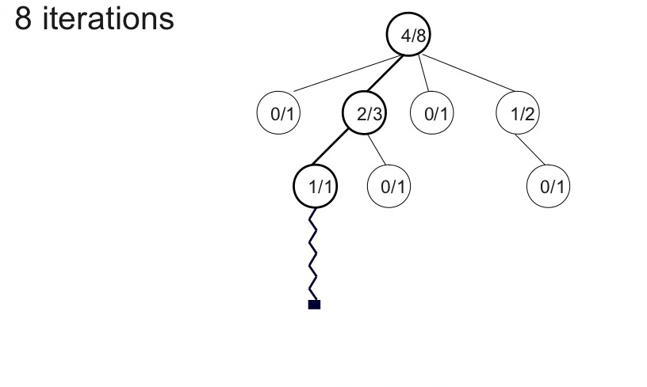
MCTS – Iterations

Slide 19
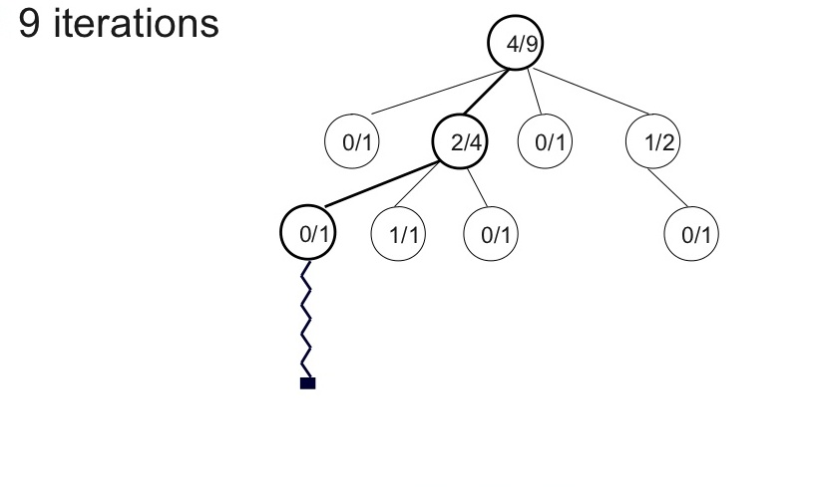
MCTS – Iterations

Slide 20
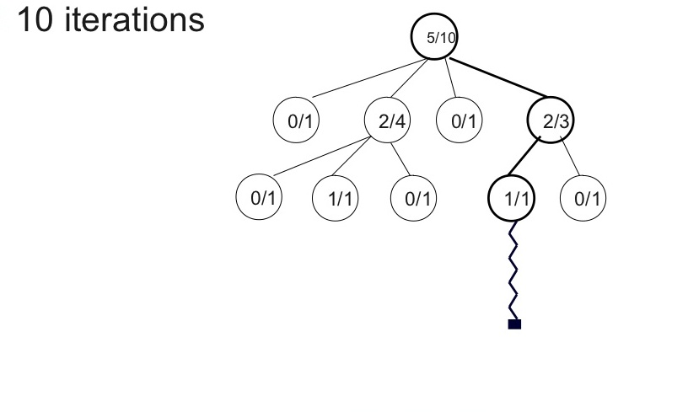
MCTS – Iterations

Slide 21
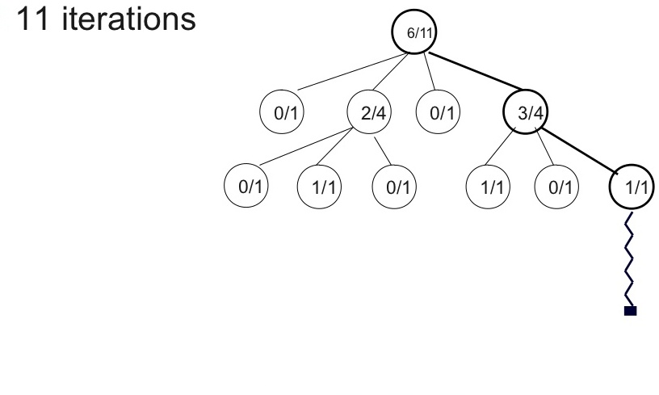
MCTS – Iterations

Slide 22
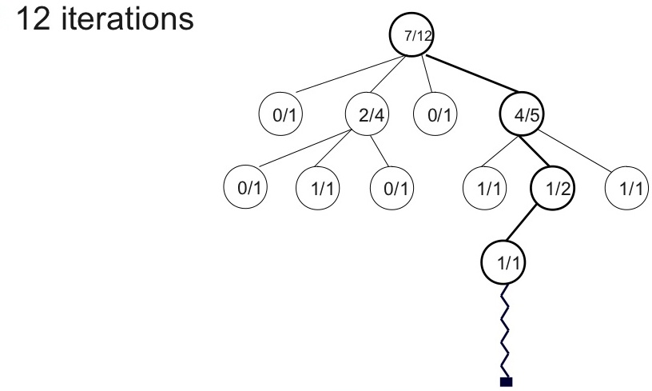
MCTS – Iterations

Slide 23
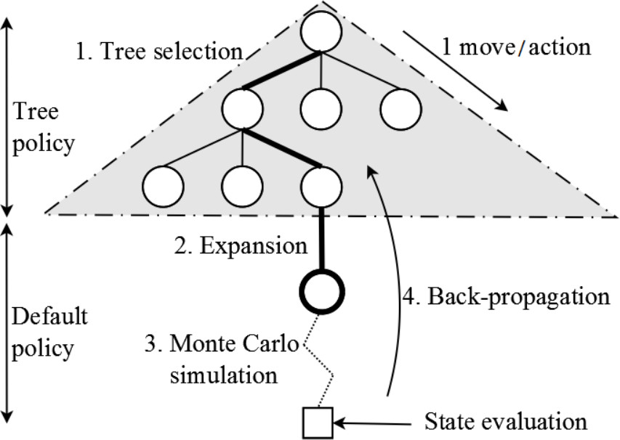
MCTS Tree
Figure from Chaslot (2006)

Slide 24
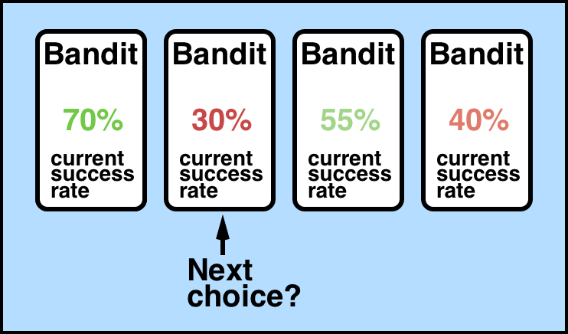
Selection – UCB and multiarmed bandit problem
Node selection during tree descent is achieved by choosing the node that maximizes some quantity.
An Upper Confidence Bounds (UCB) formula is typically used.
Analogous to the multiarmed bandit problem: a player must choose the slot machine (bandit) that maximizes the estimated reward each turn.

Slide 25
Selection – UCB (Upper Confidence Bounds)
vᵢ is the estimated (average) value of the node;
nᵢ is the number of times the node has been visited;
N is the number of times its parent has been visited;
C is a tunable bias parameter.

Slide 26
Selection - Exploitation vs Exploration
Exploration
UCB formula balances the exploitation of known rewards with the exploration of relatively unvisited nodes.
Reward estimates are based on random simulations, so nodes must be visited a number of times before these estimates become reliable.
MCTS estimates will typically be unreliable at the start of a search but converge to more reliable estimates given sufficient time and perfect estimates given infinite time.
Exploitation

Slide 27
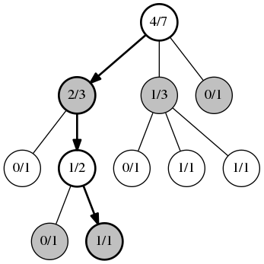
Selection – Example (two players game)
White player wins 1 time out of 3 from this position
Two alternating players. White moves at root.
Positions/moves selected by the UCB algorithm at each step are marked in bold.
Algorithm starts at root node, then moves down the tree by selecting optimal child node until a leaf node is reached.

Slide 28
`node` - Data members (partial list 1)
struct node
{
explicit node(const STATE &);
// ...
// *** DATA MEMBERS ***
// ...
const std::vector<action> actions;
std::vector<node> child_nodes;
// Score of the associated state from multiple POVs. It’s an estimated
// value based on simulation results.
std::vector<double> score;
std::intmax_t visits; // number of times this node has been visited
agent_id_t agent_id; // id of the active agent
};
E.g. {100, 20} means
first player has a good position
(5 times better than the second player)

Slide 29
`node` - Graphical representation
struct node
std::vector<double> score
std::intmax_t visits
3
5
0
…
9
/ 25
std::vector<node> child_nodes
…
…
std::vector<action> actions
actions[0]
actions[m]
actions[m+1]
actions[n-1]
child_nodes[0]
…
child_nodes[m]
…

Slide 30
`node` - Constructor (partial)
node::node(const STATE &state /* ... */)
: actions(state.actions()), child_nodes(),
score(), visits(0), agent_id(state.agent_id()) // ...
{
child_nodes.reserve(actions.size()); // to avoid reallocation
}

Slide 31
`node` - Selection
std::pair<action, node> *node::select_child()
{
const auto ucb = // UCB score of a child node
[this](const node &child)
{
if (!child.visits)
return std::numeric_limits<double>::max();
// Agent-just-moved point of view for the score.
return child.score[agent_id] / child.visits
+ uct_k * std::sqrt(std::log(visits) / child.visits);
};
const auto child(std::max_element(child_nodes.begin(), child_nodes.end(),
[ucb](const node &lhs, const node &rhs)
{
return ucb(lhs) < ucb(rhs);
}));
const auto pos(std::distance(child_nodes.begin(), child));
return {actions[pos], &*child};
}

Slide 32
MCTS – Skeleton of algorithm (1)
while (!stop_request)
{
node *n(&root_node);
STATE state(root_state_);
// Selection.
while (n->fully_expanded_branch())
{
const auto [best_action, best_child] = n->select_child();
n = best_child;
state.take_action(best_action);
}
// Expansion...
// Simulation (aka Playout / Rollout)...
// Backpropagation...
// Polling for stop conditions...
}

Slide 33
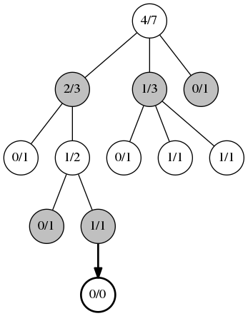
Expansion
Expansion, occurs when you can no longer apply UCB. An unvisited child position is randomly chosen and a new node is added to the tree.
The position marked 1/1 at the bottom of the tree has no further statistics records under it, so we choose a random move and add a new record for it (bold).

Slide 34
`node` - Data members (partial list 2)
struct node
{
explicit node(const STATE &, node * = nullptr);
std::pair<action, node *> select_child();
node *add_child(const STATE &);
// ...
// *** DATA MEMBERS ***
const std::vector<action> actions;
std::vector<node> child_nodes;
node *const parent_node; // used during backpropagation
// Score of the associated state from multiple POVs. It’s an estimated
// value based on simulation results.
std::vector<double> score;
std::intmax_t visits; // number of times this node has been visited
agent_id_t agent_id; // id of the active agent
};

Slide 35
`node` - Expansion
node *node::add_child(const STATE &s)
{
assert(untried_action()); // not fully expanded
assert(child_nodes.size() < child_nodes.capacity()); // no reallocation
child_nodes.emplace_back(s, this);
return &child_nodes.back();
}
node::node(const STATE &state, node *parent_n)
: actions(state.actions()), child_nodes(), parent_node(parent_n),
score(), visits(0), agent_id(state.agent_id())
{
child_nodes.reserve(actions.capacity()); // to avoid reallocation
}

Slide 36
MCTS – Skeleton of algorithm (Tree Policy)
while (!stop_request)
{
node *n(&root_node);
STATE state(root_state_);
// Selection.
while (n->fully_expanded_branch())
{
const auto [best_action, best_child] = n->select_child();
n = best_child;
state.take_action(best_action);
}
// Expansion.
if (n->untried_action()) // node can be expanded
{
state.take_action(*n->untried_action());
n = n->add_child(state);
}
// Simulation (aka Playout / Rollout)...
// Backpropagation...
// Polling for stop conditions...
}
TREE POLICY

Slide 37
`node` - Graphical representation
*parent_node
parent_node->actions[i]
struct node
std::vector<double> score
std::intmax_t visits
3
5
0
…
9
/ 25
std::vector<node> child_nodes
…
…
std::vector<action> actions
actions[0]
actions[m]
actions[n-1]
child_nodes[0]
…
child_nodes[m]
…

Slide 38
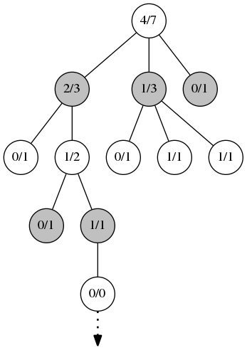
Simulation (Monte Carlo)
Run a simulated rollout from the new node until a terminal state is found. The terminal state contains a result that will be returned to upwards in the backpropagation phase.
Typical Monte Carlo simulation:
  either purely random
  with some simple weighting heuristics if a light playout is desired
  by using some computationally expensive heuristics and evaluations for a heavy playout.
With a lower branching factor, a light playout can give good results.

Slide 39
MCTS – Skeleton of algorithm (3)
while (!stop_request)
{
node *n(&root_node);
STATE state(root_state_);
while (n->fully_expanded_branch()) // Selection
{
const auto [best_action, best_child] = n->select_child();
n = best_child;
state.take_action(best_action);
}
if (n->untried_action()) // Expansion
{
state.take_action(*n->untried_action());
n = n->add_child(state);
}
// Simulation (aka Playout / Rollout).
for (auto actions=n->actions; !state.is_final(); actions=state.actions())
state.take_action(random_element(actions));
// ...
}

Slide 40
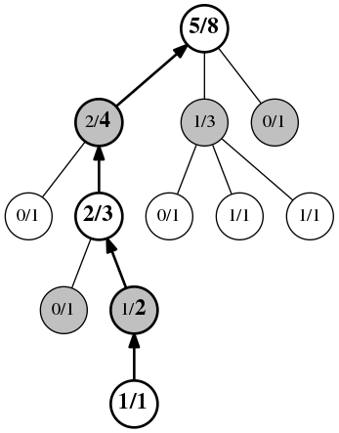
Backpropagation
Occurs when the simulation/playout reaches the end of the game.
All of the positions visited have their counter incremented and the score updated according to the result of the simulation.

Slide 41
`node` - Data members
struct node
{
explicit node(const STATE &, node * = nullptr);
std::pair<action, node *> select_child();
node *add_child(const STATE &);
void update(const std::vector<double> &);
bool fully_expanded_branch() const;
// *** DATA MEMBERS ***
const std::vector<action> actions;
std::vector<node> child_nodes;
node *const parent_node; // used during backpropagation
// Score of the associated state from multiple POVs. It’s an estimated
// value based on simulation results.
std::vector<double> score;
std::intmax_t visits; // number of times this node has been visited
agent_id_t agent_id; // id of the active agent
};

Slide 42
`node` - Backpropagation
void node::update(const std::vector<double> &sv)
{
++visits;
if (score.empty())
score = sv;
else
std::transform(score.begin(), score.end(), sv.begin(), score.begin(),
std::plus());
}

Slide 43
MCTS – Skeleton of algorithm (4)
while (!stop_request)
{
node *n(&root_node);
STATE state(root_state_);
while (n->fully_expanded_branch()) // Selection
{
const auto [best_action, best_child] = n->select_child();
n = best_child;
state.take_action(best_action);
}
if (n->untried_action()) // Expansion
{
state.take_action(*n->untried_action());
n = n->add_child(state);
}
// Simulation (aka Playout / Rollout).
for (auto actions=n->actions; !state.is_final(); actions=state.actions())
state.take_action(random_element(actions));
const auto scores(state.eval());
for (; n; n = n->parent_node) // Backpropagation
n->update(scores);
// Polling for stop conditions...
}

Slide 44
Benefits - Aheuristic
MCTS doesn’t require any knowledge about the given domain to make reasonable decisions.
The algorithm can function effectively with no knowledge of a game apart from its legal moves and end conditions; this makes MCTS a potential boon for general game playing.

Slide 45
Benefits - Asymmetric
MCTS performs asymmetric tree growth that adapts to the topology of the search space.
The algorithm visits more interesting nodes more often and focusses its search time in more relevant parts of the tree.

Slide 46
Benefits - Anytime
The algorithm can be halted at any time to return the current best estimate.
The search tree built thus far may be discarded or preserved for future reuse.

Slide 47
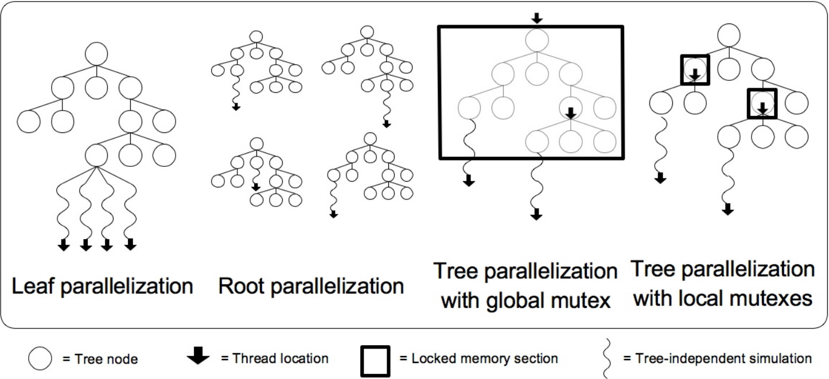
Benefits - Simple parallelization
From Parallel Monte-Carlo Tree Search
(Chaslot, Winands, van den Herik)

Slide 48
Drawbacks – Slow convergence
Can fail to find reasonable moves for even games of medium complexity within a reasonable amount of time.
This is mostly due to the sheer size of the combinatorial move space and the fact that key nodes may not be visited enough times to give reliable estimates.

Slide 49

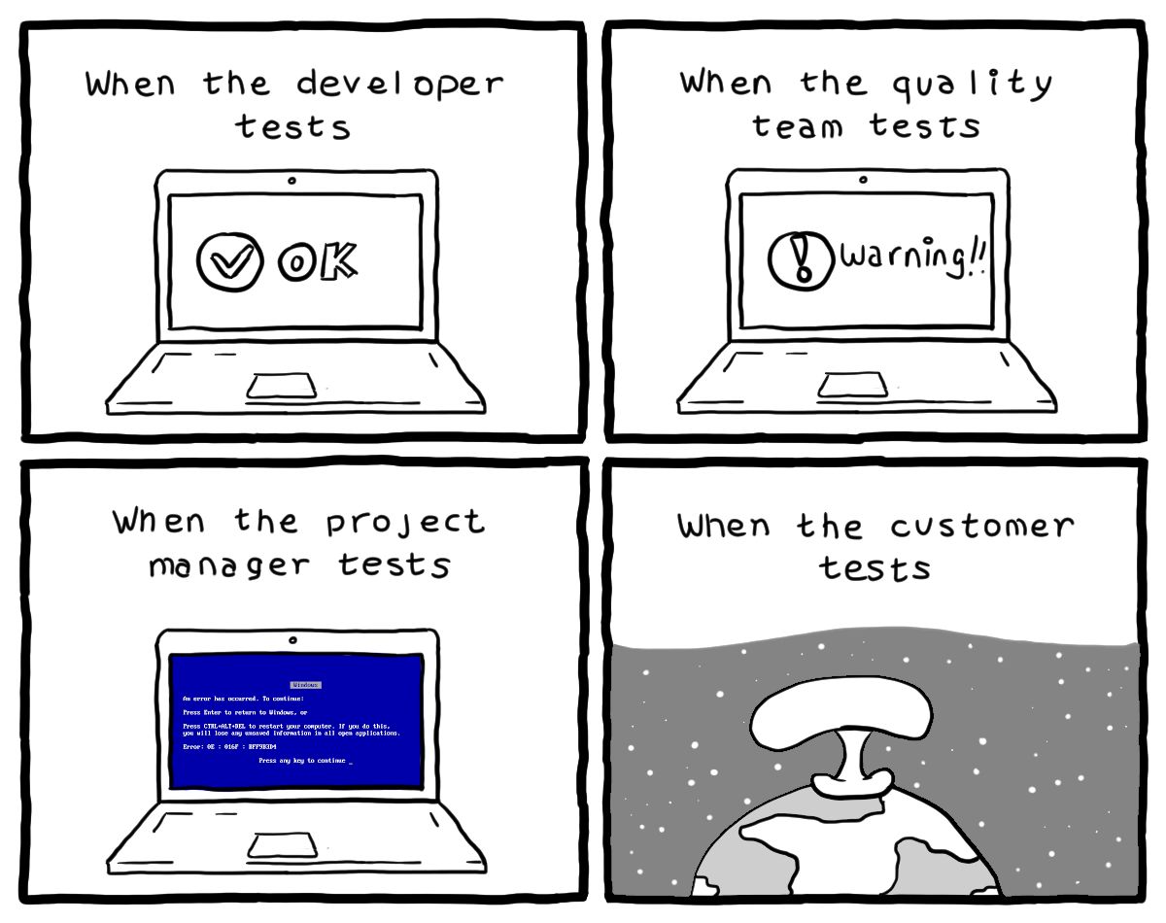
Simple implementation in C++17
https://github.com/morinim/pocket_mcts

Slide 50

QUESTIONS?

Slide 51
References - Algorithm
A Survey of Monte Carlo Tree Search Methods. IEEE Transactions on Computational Intelligence and AI in Games (volume 4, issue 1, march 2012). DOI: 10.1109/TCIAIG.2012.2186810
Bandit based Monte-Carlo Planning. Kocsis Levente, Szepesvári Csaba. Machine Learning: ECML 2006, 17th European Conference on Machine Learning. CiteSeerX 10.1.1.102.1296. doi:10.1007/11871842_29. ISBN 3-540-45375-X
Finite-time Analysis of the Multiarmed Bandit Problem. Peter Auer, Nicolò Cesa-Bianchi, Paul Fischer. Machine Learning (volume 47, pp 235-256, 2002)
Parallel Monte-Carlo Tree Search. Guillaume M. J-b. Chaslot , Mark H. M. Win , H. Jaap Van Den Herik (Computers and Games. CG 2008. Lecture Notes in Computer Science, vol 5131).

Slide 52
References – Videogames
Monte Mario: platforming with MCTS. Emil Juul Jacobsen, Rasmus Greve, Julian Togelius (GECCO '14 Proceedings of the 2014 Annual Conference on Genetic and Evolutionary Computation, pp 293-300). DOI: 10.1145/2576768.2598392. Also see https://youtu.be/Xj7-QA-aCus.
Curiosity-driven Exploration by Self-supervised Prediction. Deepak Pathak, Pulkit Agrawal, Alexei A. Efros, Trevor Darrell (Proceedings of the 34th International Conference on Machine Learning, PMLR 70:2778-2787, 2017).
Monte-Carlo Tree Search in TOTAL WAR: ROME II’s Campaign AI. Alex J. Champandard (2014).

Slide 53
References – Chess, Go, Shogi...
A General reinforcement learning algorithm that masters chess, shogi, and Go through self-play. Science 07 Dec 2018: Vol. 362, Issue 6419, pp. 1140-1144. DOI: 10.1126/science.aar6404
Mastering Chess and Shogi by Self-Play with a General Reinforcement Learning Algorithm. ArXiv:1712.01815v1 [cs.AI] 5 Dec 2017
https://www.chessprogramming.org/Monte-Carlo_Tree_Search.

