Slide 1


Lessons Learned Developing
Evolutionary Algorithms in C++
Manlio Morini, software developer
morini@eosdev.it
C++Day Pavia 2018

Slide 2
Contents
Understanding the big picture
(with code interludes)
Evolutionary frameworks

Slide 3
UNDERSTANDING THE BIG PICTURE

Slide 4
AI Mind Map (ACM – AI Norvig Russell)
Solving problem by searching
GENERAL
PROBLEM
SOLVING
Adversarial Search
Constraint Satisfaction Problems
COMMUNICATING,
PERCEIVING
AND ACTING
ARTIFICIAL
INTELLIGENCE
Beyond Classical Search
Genetic Algorithms
LEARNING
UNCERTAIN
KNOWLEDGE
AND REASONING
KNOWLEDGE,
REASONING,
PLANNING

Slide 5
AI Mind Map (ACM – AI Norvig Russell)
Solving problem by searching
GENERAL
PROBLEM
SOLVING
Adversarial Search
Constraint Satisfaction Problems
COMMUNICATING,
PERCEIVING
AND ACTING
ARTIFICIAL
INTELLIGENCE
Beyond Classical Search
Genetic Algorithms
LEARNING
UNCERTAIN
KNOWLEDGE
AND REASONING
KNOWLEDGE,
REASONING,
PLANNING
EVOLUTIONARY
ALGORITHMS

Slide 6
Distinctive features
A population-based meta-heuristic optimization algorithm. Candidate solutions to the optimization problem play the role of individuals in a population.
Mechanisms inspired by biological evolution (e.g. reproduction, mutation, recombination and selection).
A fitness function determines the quality of the solutions. Evolution of the population then takes place after the repeated application of the above operators.

Slide 7
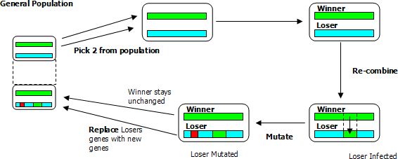
Simple EA cycle

Slide 8
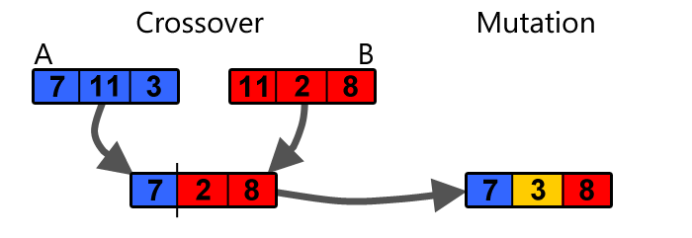
Crossover / mutation

Slide 9

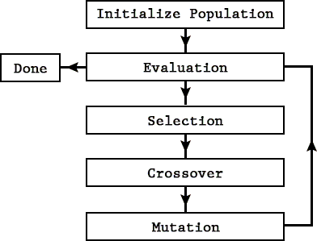
EA flowchart
Random
Random
Random
Random

Slide 10

1st Code Interlude
Scott Adams - https://dilbert.com/

Slide 11
Usual approach
#include <random>
int between(int min, int max)
{
thread_local std::mt19937 rng; // ← std::random_device{}()
std::uniform_int_distribution<int> d(min, max);
return d(rng);
}

Slide 12
XOSHIRO 256** - Source
static uint64_t s[4];
uint64_t next(void) {
const uint64_t result_starstar = rotl(s[1] * 5, 7) * 9;
const uint64_t t = s[1] << 17;
s[2] ^= s[0];
s[3] ^= s[1];
s[1] ^= s[2];
s[0] ^= s[3];
s[2] ^= t;
s[3] = rotl(s[3], 45);
return result_starstar;
}
// Written in 2018 by David Blackman and Sebastiano Vigna (vigna@acm.org)
// http://xoshiro.di.unimi.it/

Slide 13
XOSHIRO 256** - Features
All-purpose, rock-solid generator.
Excellent speed.
Internal state large enough (256 bits) for any parallel application.
Passes BigCrush suite of tests / tests for Hamming-weight dependencies

Slide 14
XOSHIRO256** vs Mersenne Twister
PRNG | Footprint (bits) | Period | BigCrush Failure | cycles/B
xoshiro256** | 256 |  | - | 0.41
MT19937-64 | 20032 |  | LinearComp | 1.26
++x has a period of 2^{k} for any k ≥ 0 provided that x is represented using k bits.
Heuristic rule of thumb:
  if you need to use t values, you need a generator with period at least t²;
  if you run n independent computations starting at random seeds, the sequences used by each computation should not overlap.

Slide 15
XOSHIRO256**
How to plug into a random number distribution
UniformRandomBitGenerator
https://en.cppreference.com/w/cpp/named_req/UniformRandomBitGenerator
A function object returning unsigned integer values such that each value in the range of possible results has (ideally) equal probability.
Not intended to be used as random number generators (just a source of random bits).
RandomNumberEngine
https://en.cppreference.com/w/cpp/named_req/RandomNumberEngine
Advances internal state as if by x consecutive calls to pRNG.

Slide 16
XOSHIRO256**
How to plug into a random number distribution
Expression | Return type | Requirements
G::result_type | T | T is an unsigned integer type
G::min() | T | Returns the smallest value that G's operator() may return. The value is strictly less than G::max()
G::max() | T | Returns the largest value that G's operator() may return. The value is strictly greater than G::min()
g() | T | Returns a value in the closed interval [G::min(), G::max()]. Has amortized constant complexity.

Slide 17
XOSHIRO256**
How to plug into a random number distribution
class xoshiro256ss
{
public:
using result_type = std::uint64_t;
explicit xoshiro256ss(result_type s = def_seed) noexcept;
constexpr static result_type min() noexcept { return 0; }
constexpr static result_type max() noexcept
{ return std::numeric_limits<result_type>::max(); }
result_type operator()() noexcept { /* next() */ }
private:
std::array<std::uint64_t, 4> state;
};

Slide 18

Recent studies showed that humans are using only 15% of C++ features... it is also estimated that dolphins are capable of using 20% of C++!
End of code interlude 1

Slide 19
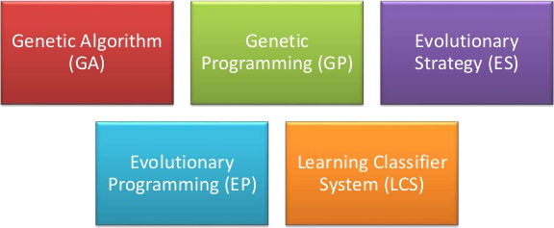
EAs Sub-Varieties

Slide 20
Sub-Varieties
Genetic algorithms. String of (traditionally binary) numbers. Used for optimization problems.
Genetic programming. Computer programs (tree / linear form). Fitness determined by the ability to solve a problem.
Differential evolution. Numerical optimization problem.
Neuroevolution. EA used to generate parameters / topology of artificial neural networks.
Evolutionary programming. Similar to genetic programming, but the structure of the program is fixed and its numerical parameters are allowed to evolve.
Evolution strategy. Vectors of real numbers as representations of solutions. Typically uses self-adaptive mutation rates.

Slide 21
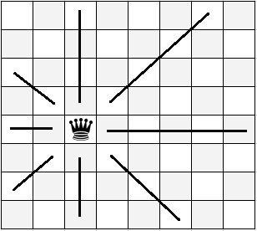
8-queens problem – Generalities
The goal is to place eight queens on a chessboard such that no queen attacks any other.
A queen attacks any piece in the same row, column or diagonal
Following example is taken from Artificial Intelligence (Norvig - Russell)

Slide 22
8-queens - State/Individual
Classical GAs: a string of 0s and 1s (24 bit required to specify the position of 8 queens, each in a column of 8 squares).
In the following example: each individual is represented as 8 digits (in the [1;8] range).
Performance: permutation encoding of 8 integers.
Encoding is important: different encodings behave differently.

Slide 23
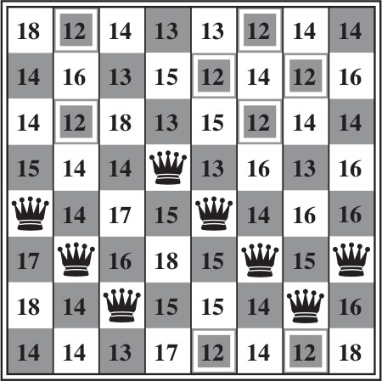
8-queens problem – Fitness function 1
Heuristic cost function h is the number of pairs of queens that are attacking each other, either directly or indirectly.
The global minimum is 0 (perfect solutions).
Figure shows a state with h==17 and the values of all its successors.

Slide 24
8-queens problem – Fitness function 2
Usually the fitness function should return higher values for better states.
In general minimizing a function f is equivalent to maximizing -f.
Some frameworks have problem working with negative values.
For the 8-queens problem we can use the number of non-conflicting pairs of queens (28 is a solution):
f = 28 – conflicts (== 28 - h)

Slide 25
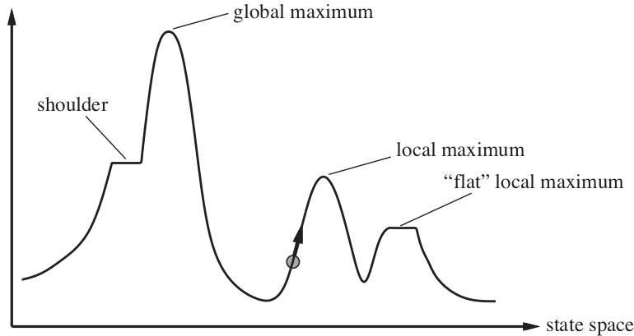

8-queens problem - Not straightforward
A one dimensional state space landscape in which elevation corresponds to the objective function.
A local minimum in the 8-queens state space (h==1, every successor has a higher cost).

Slide 26
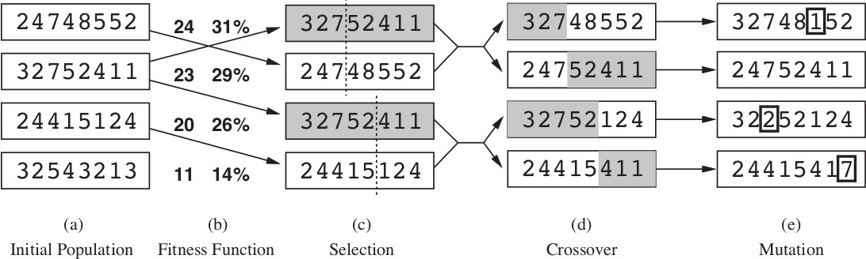

8-queens problem - Selection/Crossover/Mutation

Slide 27
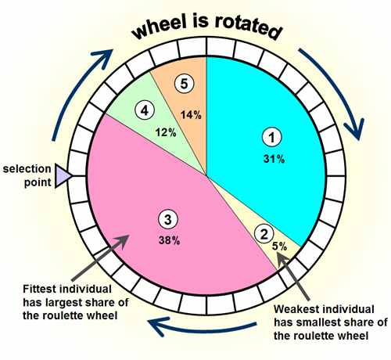
8-queens problem - Selection
Here the probability of being chosen for reproducing is directly proportional to the fitness score (percentage shown next to the the raw score)
One individual is selected twice and one not at all.

Slide 28
8 queens problem - Crossover
Crossover point is chosen randomly from the positions in the string.
The encoding matters. With a 24 bit encoding (instead of 8 digits) the crossover point has a 2/3 chance of being in the middle of a digit, which result in an essentially arbitrary mutation of that digit.
Initially crossover takes large steps in the state space and smaller steps later (when individuals are more similar).

Slide 29
8 queens problem - Mutation
Moves a queen to a random square in its column.
In the example one digit was mutated in the 1st, 3rd and 4th offspring.
Advantage comes from the ability of crossover to combine large blocks of data that have evolved independently to perform useful functions, thus raising the level of granularity at which the search operates (theory of schema).

Slide 30

2nd Code Interlude
Linus Torvalds

Slide 31
8-queens with Vita – individual
(aka chromosome / genome)
const int NQUEENS(8);
// Encodes the queen's placement (i.e. a gene in the chromosome).
struct row : vita::ga::integer
{
row() : vita::ga::integer({0, NQUEENS}) {} // open range
};
int main()
{
vita::problem prob;
prob.chromosome<row>(NQUEENS);
// …
}

Slide 32
8-queens with Vita – fitness function
auto f = [](const vita::i_ga &x) -> vita::fitness_t
{
double attacks(0);
for (int queen(0); queen < NQUEENS - 1; ++queen)
{
const int row(x[queen].as<int>());
for (int i(queen + 1); i < NQUEENS; ++i)
{
const int other_row(x[i].as<int>());
if (other_row == row // same row
|| std::abs(other_row - row) == i - queen) // or diagonal
++attacks;
}
}
return {-attacks};
};

Slide 33
8-queens with Vita – let’s go
vita::ga_search<decltype(f)> search(prob, f);
auto result = search.run();
// Prints result.
std::cout << "\nBest result: [";
for (auto gene : result.best.solution)
std::cout << " " << gene.as<int>();
std::cout << " ] (fitness "
<< result.best.score.fitness << ")\n";

Slide 34

Penguins are allergic to C++...
End of code interlude 2

Slide 35
Genetic Programming
GP “applies the genetic algorithm to a population of computer programs” (not just raw data).
Structural difference: programs do not have a fixed length.

Slide 36
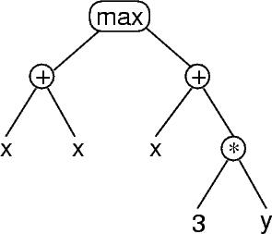
Genetic Programming – Representation
A tree representing max(x+x,x+3*y)
It’s common in the GP literature to represent programs with trees.
How one implements GP trees will obviously depend a great deal on the programming languages and libraries being used.
Symbols are classified in a terminal set / function set.

Slide 37
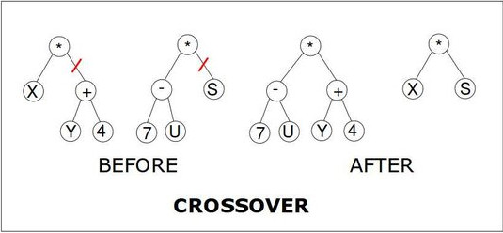
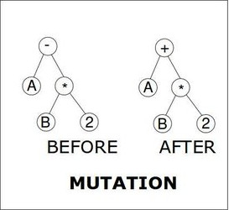
Genetic Programming - Recombination

Slide 38
Genetic Programming - Closure
For GP to work effectively, most function sets are required to have an important property known as closure, which can in turn be broken down into the properties of type consistency and evaluation safety.
Type consistency is required because sub-tree crossover can mix and join nodes arbitrarily.
Evaluation safety is required because many commonly used functions can fail at run time (e.g. division by 0).
Symbol set should have sufficiency: it should be possible to express a solution to the problem using the elements of the symbol set.

Slide 39
Symbolic regression with
Genetic Programming
X | Y
-10 | -9.456
-8 | -8.989
-6 | -5.721
-4 | -3.243
-2 | -2.909
0 | 0.000
2 | 2.909
4 | 3.243
6 | 5.721
8 | 8.989
Symbolic regression: you want to discover the analytic form of an unknown function that matches some given data.

Slide 40
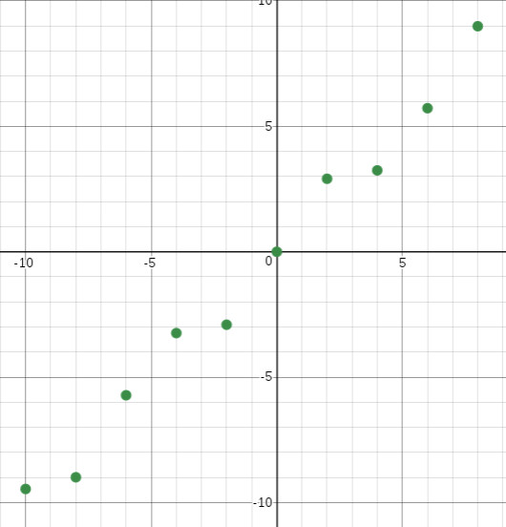
Symbolic regression with
Genetic Programming
Function set: sin, cos, +, -, /, *.
Terminal set: x.

Slide 41
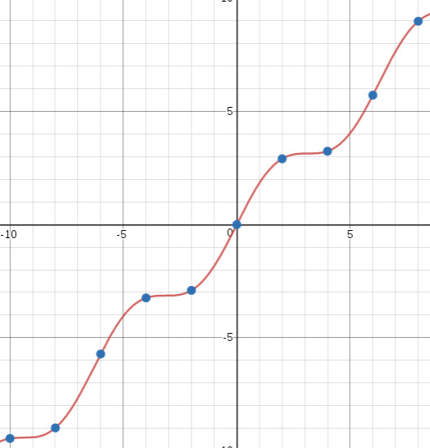
Symbolic regression with
Genetic Programming

Slide 42

3rd Code Interlude

Slide 43
Symbolic regression with Genetic Programming
Setup
int main()
{
vita::src_problem prob;
// DATA
prob.data().read_csv(training);
// SYMBOLS
prob.sset.insert<vita::real::sin>();
prob.sset.insert<vita::real::cos>();
prob.sset.insert<vita::real::add>();
prob.sset.insert<vita::real::sub>();
prob.sset.insert<vita::real::div>();
prob.sset.insert<vita::real::mul>();
prob.setup_terminals();
// …
}

Slide 44
Symbolic regression with Genetic Programming
Let’s go
vita::src_search<> s(prob);
const auto result(s.run());
std::cout << "\nCANDIDATE SOLUTION\n"
<< vita::out::print_format(vita::out::c_language_f)
<< result.best.solution
<< "\n\nFITNESS\n" << result.best.score.fitness
<< '\n';

Slide 45
Symbolic regression with Genetic Programming
Let’s go
Generation | Result | Fitness
100 | X+sin(X) | -0.0071387
5000 | ((((X/cos(X*X)+sin(X))*((X*X)*((X*X)*(X*X))))*((X*X)*((X*X)*(X*X))))/(cos(X*X)*cos(X*X)))*(cos(X*X)*cos(X*X)))+((X-((((X/cos(X*X))+sin(X))*((X*X)*((X*X)*(X*X))))*((X*X)*((X*X)*(X*X)))))+sin(X)) | -0.00540735
Overfitting, bloating
Regularization term, penalty function

Slide 46
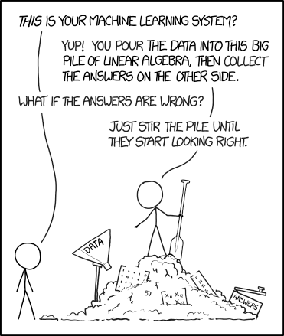
End of code interlude 3

Slide 47
How to identify when to use Evolutionary Algorithms
The key point in deciding whether or not to use genetic algorithms for a particular problem centers around the question:
what is the space to be searched?

Slide 48
How to identify when to use Evolutionary Algorithms
If that space is well-understood and contains structure that can be exploited by special-purpose search techniques, the use of genetic algorithms is generally computationally less efficient.
If the space to be searched is not so well understood and relatively unstructured, and if an effective GA representation of that space can be developed, then GAs provide a surprisingly powerful search heuristic for large, complex spaces.
(De Jong, Machine Learning, 1990 nr 5, pg. 351)

Slide 49
How to identify when to use Evolutionary Algorithms
In general EAs are more suited to find good solutions quickly than to finding the absolute best solution to a problem.

Slide 50

EVOLUTIONARY FRAMEWORKS

Slide 51
Evolutionary frameworks
Don't Reinvent The Wheel, Unless You Plan on Learning More About Wheels
https://blog.codinghorror.com/dont-reinvent-the-wheel-unless-you-plan-on-learning-more-about-wheels/

Slide 52
Evolutionary framework
Deeply educate yourself about all the existing solutions.
Do not undermine those who legitimately want to build something better or improve on what's already out there.
Consider the double nature of genetic algorithms: if there is a way to crash your code they will find it and, at the same time, they will bypass implementation errors as much as they can (at the expense of performance).

Slide 53
C++ Evolutionary frameworks for optimization
Framework | Remarks
Evolutionary Computation Framework (ECF) http://ecf.zemris.fer.hr/ | Straightforward configuration with few parameters Boost dependencies Support parallelism (MPI) MIT License
PaGMO / PaGMO 2 https://esa.github.io/pagmo2/ | C++14 / 17 Massively parallel optimization Multi Objective Optimization EAs sided with state of the art optimization algorithms Boost, Eigen… dependencies Also a Python version GPL3 License
JmetalCpp https://github.com/jMetal/jMetalCpp | Available for C++, Java, Python Multi Objective Optimization Last commit 3 years ago MIT License

Slide 54

Up to date references
https://accu.org/index.php/journals/2444

Slide 55

A C++ framework for Genetic Programming
Vita
https://github.com/morinim/vita
C++14
MPL2 License

Slide 56

4th Code Interlude
http://ithare.com/c-performance-common-wisdoms-and-common-wisdoms/

Slide 57
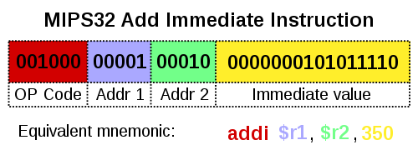
Small Vector
GP-Programming instructions in Vita include an opcode and zero or more operand specificer (just like a microprocessor instruction).
With high probability you can say that most of the time the number of elements in your containers do not exceed N. Maybe the number is even less.
We can “allocate memory” on the stack (which is just shifting the stack pointer). Only if we exceed this preallocated buffer we will fallback to the heap storage.

Slide 58
Small vector - Skeleton
template<class T, std::size_t N>
class SmallVector
{
public:
SmallVector();
~SmallVector();
void push_back(T value);
T &operator[](std::size_t index);
T &at(std::size_t index);
private:
std::array<T, N> small_buffer_;
std::size_t size_;
std::size_t capacity_;
T *heap_vector_;
};

Slide 59
Small vector – Constructor / access
template <class T, std::size_t N>
SmallVector<N>::SmallVector()
: size_(0), capacity_(N),
heap_vector_(small_buffer_.data())
{
for (auto &e : small_buffer_)
e = T();
}
template <std::size_t N>
T &SmallVector<N>::operator[](std::size_t index)
{
return heap_vector_[index];
}

Slide 60
Small vector – push_back
template <class T, std::size_t N>
void SmallVector<N>::push_back(T value)
{
if (size_ == capacity_)
{
T *new_storage(new T[capacity_ * 2]);
capacity_ *= 2;
std::memcpy(new_storage, heap_vector_,
size_ * sizeof(T));
if (heap_vector_ != small_buffer_.data())
delete [] heap_vector_;
heap_vector_ = new_storage;
}
heap_vector_[size_++] = value;
}

Slide 61
Small vector - Libraries
Boost (from v1.58) has the small_vector container
https://www.boost.org/doc/libs/1_68_0/doc/html/container/non_standard_containers.html
You can borrow the SmallVector implementation from LLVM
http://llvm.org/docs/ProgrammersManual.html#llvm-adt-smallvector-h

Slide 62


Slide 63
References
Artificial Intelligence. A Modern Approach – Peter Norvig, Stuart Russell (3rd edition)
Essentials of Metaheuristics – Sean Lukehttps://cs.gmu.edu/~sean/book/metaheuristics/
Genetic Algorithms in Search, Optimization & Machine Learning – David E. Goldberd
(Addison-Wesley Publishing Company, 1989!)
A Field Guide to Genetic Programming
http://www.gp-field-guide.org.uk/

Slide 64
References - Articles
Evolutionary Computing Frameworks for Optimisation
https://accu.org/index.php/journals/2444
What Makes a Problem Hard for a Genetic Algorithm? Some Anomalous Results and Their Explanation.
http://web.cecs.pdx.edu/~mm/Forrest-Mitchell-ML.pdf
Fitness distance correlation as a Measure of Problem Difficulty for Genetic Algorithms
https://www.cs.unm.edu/~forrest/publications/fdc-icga95.pdf
Xoshiro pRNG
http://xoshiro.di.unimi.it/
GAs string guessing
https://github.com/morinim/documents/blob/master/ga_string_guessing/article.md

Slide 65
References - Code
A simple `UniformRandomBitGenerator` wrapper for the xoshiro256*** and xoroshiro128+ PRNGs
https://github.com/morinim/xoshiro256ss
Symbolic regression with ECF
http://ecf.zemris.fer.hr/tutorial.html#tree

