Slide 1
MBB 243 - Lecture 7 (week 8)
Ryan Morin

Slide 2
Learning goals for the week
Understand the goals and core concepts of exploratory data analysis
Load data from tabular files (CSV, TSV) into R using the readr package
Manipulate data frames in R using the dplyr package and ombine multiple functions using pipes
Understand the basics of tidy data and appreciate how we can adopt a tidy format
Sort rows by one or more columns using arrange()
Create new columns from data using mutate()

Slide 3
Exploratory data analysis (EDA)
Numerical analysis and graphical presentations of data without a particular model or hypothesis with a goal of:
identifying underlying structure in the data and
Defining/manipulating variables according to data structure
Detecting outliers and other anomalies (remove if necessary)
Observe possible trends (e.g. correlations)
Important first step in any data analysis task
Over-arching goal is to generate hypotheses

Slide 4
Sanity checking
You will often (but not always) have a general idea of how your data should and should not look
Sanity checking can allow you to identify problems early in an analysis
Are you missing values for some variables?
Are some measurements very different from the rest?
Do you have mathematically impossible values based on what the data should represent?
Important: Don’t manipulate your data just because it gives you a better result. It must be justifiable!

Slide 5
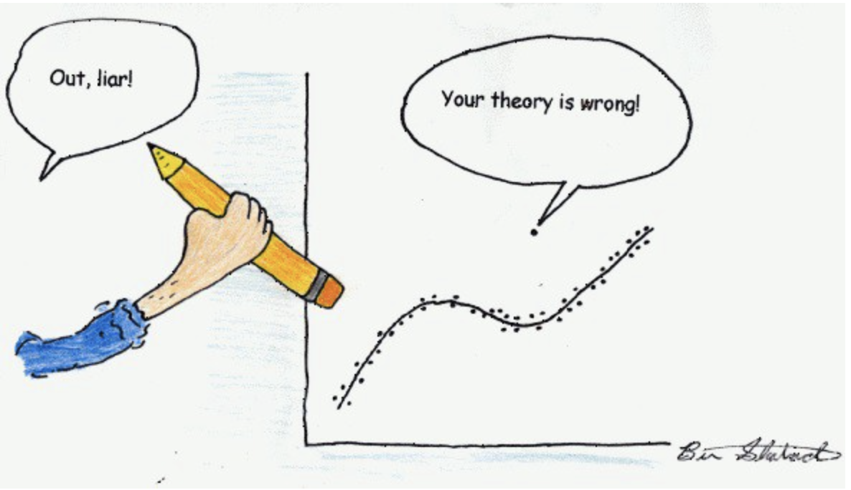
Sanity checking?

Slide 6
Basic EDA tasks
Manipulate/load data in a useable format
Did my data load the way I expected?
Note: auto-creation of column names leads to X1, X2 …
library(readr) expr = read_csv("data/GSE125966_GOYA_mini.csv")
## Warning: Missing column names filled in: 'X1' [1]
## ## ── Column specification ──────────────────────────────────────────────────────── ## cols( ## X1 = col_character(), ## sample1 = col_double(), ## sample2 = col_double() ## )

Slide 7
Basic EDA tasks
Manipulate/load data in a useable format
Did my data load the way I expected?
head(expr)
## # A tibble: 6 x 3 ## X1 sample1 sample2 ## <chr> <dbl> <dbl> ## 1 GeneID:1 0.412 1.33 ## 2 GeneID:10 -3.01 -4.12 ## 3 GeneID:100 7.75 7.21 ## 4 GeneID:1000 2.40 1.24 ## 5 GeneID:10000 4.16 4.44 ## 6 GeneID:100009613 -5.82 -5.70

Slide 8
Tibbles vs Data Frames
The readr package loads tabular data into a tibble
Guesses the data type of each column and assigns it for you
“Smart” recognition and handling of text data such as dates
More convenient default with print()
## # A tibble: 999 x 2 ## X1 sample1 ## <chr> <dbl> ## 1 GeneID:1 0.412 ## 2 GeneID:10 -3.01 ## 3 GeneID:100 7.75 ## 4 GeneID:1000 2.40 ## 5 GeneID:10000 4.16 ## 6 GeneID:100009613 -5.82 ## 7 GeneID:100009676 -1.91 ## 8 GeneID:10001 4.87 ## 9 GeneID:10002 -5.82 ## 10 GeneID:10003 -4.23 ## # … with 989 more rows

Slide 9
How to address readr parsing issues
ryan <- read_tsv("data/Morin_genotypes.txt" )
## ## ── Column specification ──────────────────────────────────────────────────────── ## cols( ## rsid = col_character(), ## chromosome = col_double(), ## position = col_double(), ## genotype = col_character() ## )
## Warning: 31844 parsing failures. ## row col expected actual file ## 931203 chromosome a double X 'data/Morin_genotypes.txt' ## 931204 chromosome a double X 'data/Morin_genotypes.txt' ## 931205 chromosome a double X 'data/Morin_genotypes.txt' ## 931206 chromosome a double X 'data/Morin_genotypes.txt' ## 931207 chromosome a double X 'data/Morin_genotypes.txt' ## ...... .......... ........ ...... .......................... ## See problems(...) for more details.
The code above will run with this warning:
31844 parsing failures. row col expected actual file 931203 chromosome a double X 'data/Morin_genotypes.txt' 931204 chromosome a double X 'data/Morin_genotypes.txt' 931205 chromosome a double X 'data/Morin_genotypes.txt
Don’t ignore warnings unless you know that they are benign

Slide 10
Diagnosing the issue
Sanity check: Do we have rows for all the expected chromosomes?
summary(ryan$chromosome)
## Min. 1st Qu. Median Mean 3rd Qu. Max. NA's ## 1.00 4.00 8.00 8.84 13.00 22.00 31844
table(ryan$chromosome)
## ## 1 2 3 4 5 6 7 8 9 10 11 12 13 ## 77016 77427 63330 55049 56048 63269 51032 49234 42982 50350 47988 47178 36110 ## 14 15 16 17 18 19 20 21 22 ## 30860 28419 30188 26769 27979 18591 23849 13413 14121

Slide 11
Forcing explicit column definition
Our error (warning) was caused by readr assuming all chromosomes were numeric values because it used the early lines of the file to guess the data type
Explicitly specifying the type for that column and the others resolves this issue
geno="data/Morin_genotypes.txt" ryan <- read_tsv(geno,col_types = "ccic") #here, "ccic" indicates the class of the columns in their order: char, char, int, char

Slide 12
Basic EDA tasks
Tabulate variables to observe distribution (mean, median, quartiles)
## sample1 ## Min. :-5.817 ## 1st Qu.:-5.817 ## Median :-5.817 ## Mean :-3.959 ## 3rd Qu.:-3.009 ## Max. :12.595

Slide 13
Variables in statistics
Variables are “any characteristic, number or quantity that can be measured or counted”
Something that varies between individuals, populations or experimental groups such as:
phenotype (height, weight, hair colour)
age, sex, species, disease status
case vs control, mutation status
Gene expression (for a given gene), genotype (for a given SNP)

Slide 14
Common types of variables in statistics
Categorical: fits into one of N finite categories
e.g. genotypes: AA, AB, BB; disease status
Ordinal: similar to category but with meaningful order
e.g. Pediatric, Adult, Senior
Continuous: Numerical with a theoretically infinite number of possible values
e.g. Age, Weight, Gene expression

Slide 15
Basic EDA tasks
Observe distribution and identify outliers

Slide 16
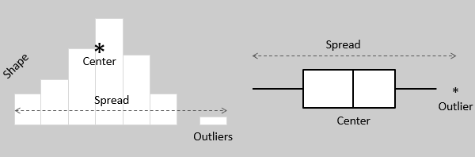
Visualizing distributions of continuous variables

Slide 17
Histogram basics
X axis: a range of equal-size numeric bins spanning the spread/range of values for a numeric variable
Y axis: the frequency that your data contains numbers in each bin

Slide 18
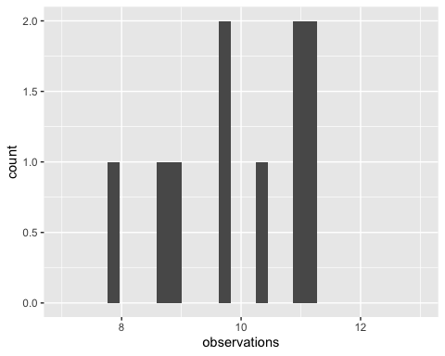
10 observations

Slide 19
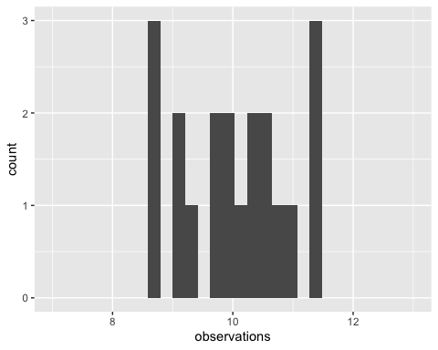
20 observations

Slide 20
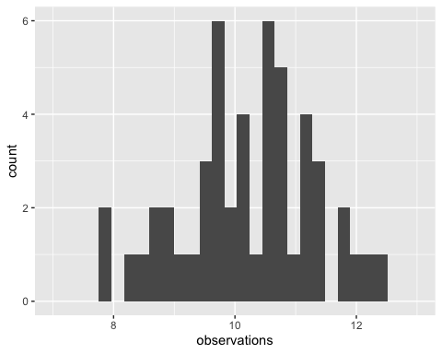
50 observations

Slide 21
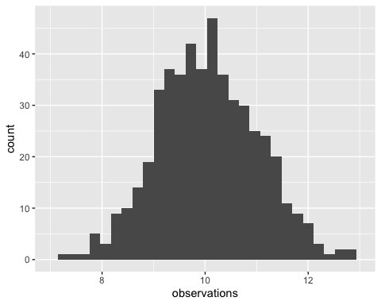
500 observations

Slide 22
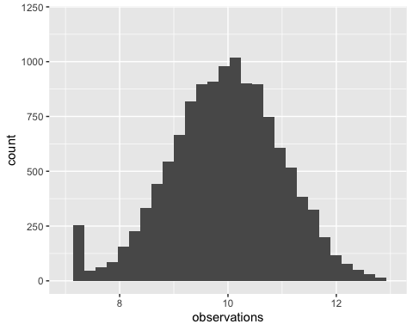
15000 observations plus outliers

Slide 23
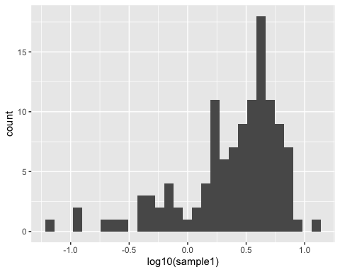
Real gene expression data

Slide 24
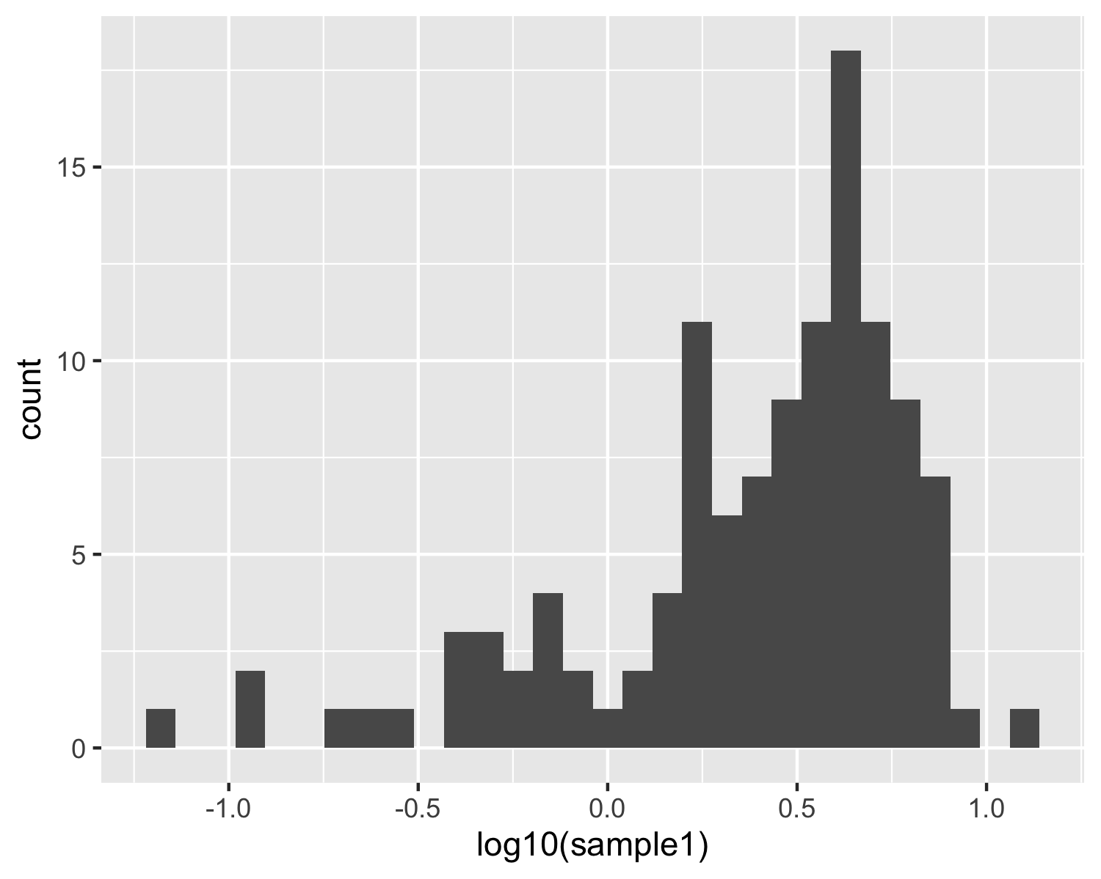
Describe this distribution
What is the “average” (mean) gene expression value?
What is the highest value shown?
How many genes look to be outliers?
what cutoff would you use to define an outlier?

Slide 25
The dplyr package
dplyr aims to provide a function for each basic verb of data manipulation.
Three categories based on the component of the dataset that they work with
Rows: filter, slice, arrange
Columns: rename, mutate, select
Grouped rows: summarise

Slide 26
Into the Tidyverse
dplyr and readr functions are part of a larger “Tidyverse” grammar, which share common features and functionality
Lets you work with elements of your data (columns) as if they were actual objects in your workspace
The most obvious difference is the use of bare words (not quoted) when referring to column names!

Slide 27
Basic EDA tasks
Identify anomalies and, in some cases, remove outliers
Common approach: consistently drop data points that don’t fit with the distribution

Slide 28
Subsetting data
Common to need to subset tabular data using specific criteria
e.g. pattern matching, numeric thresholds
dplyr package has convenient functions to allow subsetting without relying on column or row names or indexes
filter function will return the rows of your data frame that meet your criteria
filter(expr, sample1 > -0.5) # function: filter "Subset rows using column values" # input: your data frame or tibble # here, "sample1 > -0.5" is your criterion # any rows failing criteria this will be dropped

Slide 29
Dropping outliers
exp_filt = filter(expr, sample1 > -0.5) select(exp_filt,sample1,sample2) %>% summary()
## sample1 sample2 ## Min. :-0.4590 Min. :-5.703 ## 1st Qu.: 0.7226 1st Qu.: 0.756 ## Median : 2.6873 Median : 2.907 ## Mean : 2.8391 Mean : 2.556 ## 3rd Qu.: 4.4338 3rd Qu.: 4.531 ## Max. :12.5946 Max. : 8.160
#note that sample2 is unaffected by this and will still have outliers!

Slide 30
Pipes in R (%>%)
Tidyverse collection of packages provides a way to combine manipulations of data with %>%
Functions that support pipes will assume their first argument is passed via a pipe if not provided explicitly
#non-pipe way data_frame2 <- first_funct(data_frame1,arg1,arg2) data_frame3 <- second_funct(data_frame2,some_arg) # piped version data_frame3 = data_frame1 %>% first_funct(arg1,arg2) %>% second_funct(some_arg)

Slide 31
Why use pipes in R?
Code can be more legible and easy to follow and maintain when pipes are used
If you need to apply multiple functions to some data, each function call would normally require the creation of a new variable, which is avoided by a pipe

Slide 32
A genotype pipe
Let’s use a series of pipes to filter Ryan’s genotypes
geno <- "data/Morin_genotypes.txt" ryan <- read_tsv(geno,col_types = "ccic") %>% #load the file without assigning to a variable filter(genotype != "--") %>% #drop rows with missing genotype, i.e. -- filter(str_length(genotype)>1) #drop rows with only one allele reported

Slide 33
Introduction to categorical variables
ryan$Homozygous = grepl("AA|GG|CC|TT|II",ryan$genotype) # create logical column that is TRUE for all homozygous rows homozyg_by_chrom = table(ryan$Homozygous,ryan$chromosome) # tabulate TRUE/FALSE per chromosome homozyg_by_chrom[,c(19:23)]
## ## 6 7 8 9 X ## FALSE 17919 14641 15279 13071 125 ## TRUE 43619 34970 32667 28796 326
What’s wrong with this picture?

Slide 34
Introduction to categorical variables
ryan$Homozygous = grepl("AA|GG|CC|TT|II",ryan$genotype) # create logical column that is TRUE for all homozygous rows homozyg_by_chrom = table(ryan$Homozygous,ryan$chromosome) # tabulate TRUE/FALSE per chromosome homozyg_by_chrom[,c(19:23)]
## ## 6 7 8 9 X ## FALSE 17919 14641 15279 13071 125 ## TRUE 43619 34970 32667 28796 326
What’s wrong with this picture?
Why does it look like Ryan has two X chromosomes???

Slide 35
Introduction to categorical variables
ryan$Sex_chrom = grepl("X|Y",ryan$chromosome) # assign autosomes and sex chromosomes to different categories table(ryan$Homozygous,ryan$Sex_chrom)
## ## FALSE TRUE ## FALSE 269313 125 ## TRUE 637518 326
# tabulate between autosomes and sex chromosomes
New hypothesis from our data: Ryan is female
How can we test this hypothesis using statistics?
To be covered in the lab

Slide 36
Working with data in tidy format
The Tidyverse set of packages are the most useful when data is in a tidy format
There are three interrelated rules which make a dataset tidy:
Each variable must have its own column
Each observation must have its own row
Each value must have its own cell

Slide 37
Benefits of using a tidy data format
Consistent data structure means the same tools/functions will work consistently across related/similar data sets
Variables in columns takes advantage of R’s vectorised functions
Works well with pipes and other features of the Tidyverse that we will explore later (e.g. plotting methods)

Slide 38
Is this tidy?
## # A tibble: 6 x 3 ## X1 sample1 sample2 ## <chr> <dbl> <dbl> ## 1 GeneID:1 0.412 1.33 ## 2 GeneID:10 -3.01 -4.12 ## 3 GeneID:100 7.75 7.21 ## 4 GeneID:1000 2.40 1.24 ## 5 GeneID:10000 4.16 4.44 ## 6 GeneID:100009613 -5.82 -5.70

Slide 39
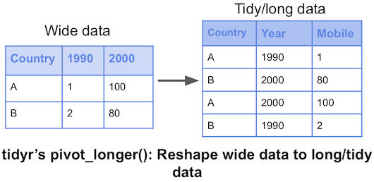
How to make something tidy
We have to identify any columns representing observations of the same variable and convert to a categorical variable
A wider matrix will become longer as columns become sets of duplicated rows
Convert using the related functions pivot_longer or pivot_wider

Slide 40
pivot_longer/wider syntax
long_df = pivot_longer(wide_df, cols=columns to bring together, names_to="name of new categorical column storing old column names", values_to"name of the column storing our values") wide_df = pivot_wider(long_df, id_cols=columns you want to leave alone, names_from = name_of_column_to_pivot, values_from = column_with_measurement_values)

Slide 41
Gene expression in a tidy format
# let's give our gene column to a useful name using dplyr expr = expr %>% rename("Gene_ID"="X1") # use pivot_longer function to bring sample1 and sample2 columns into one column exp_tidy = pivot_longer(expr,-Gene_ID,names_to="sample",values_to="expression")

Slide 42
Gene expression in a tidy format
## # A tibble: 6 x 3 ## Gene_ID sample expression ## <chr> <chr> <dbl> ## 1 GeneID:1 sample1 0.412 ## 2 GeneID:1 sample2 1.33 ## 3 GeneID:10 sample1 -3.01 ## 4 GeneID:10 sample2 -4.12 ## 5 GeneID:100 sample1 7.75 ## 6 GeneID:100 sample2 7.21

Slide 43
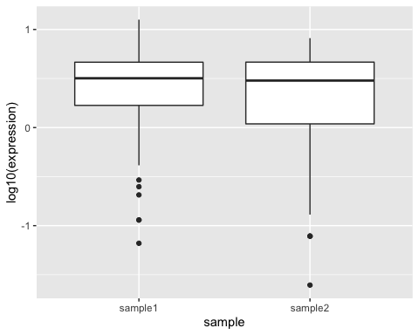
Comparing distributions using box plots
Box plots graphically represent the spread, locality and skew of a distribution but are more
More useful than histogram if we want to consider the distribution of a numeric variable as it relates to a categorical variable (i.e. compare the distribution between 2 or more categories)

Slide 44
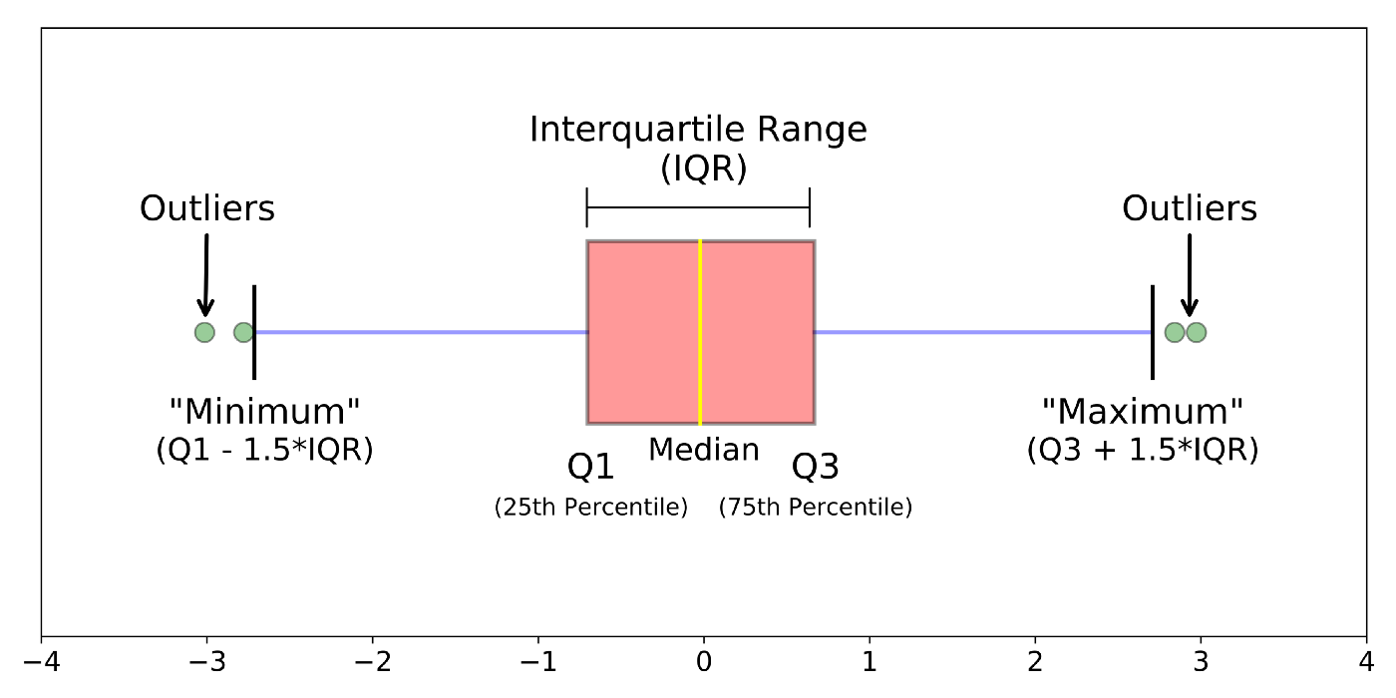
Anatomy of a box plot

Slide 45
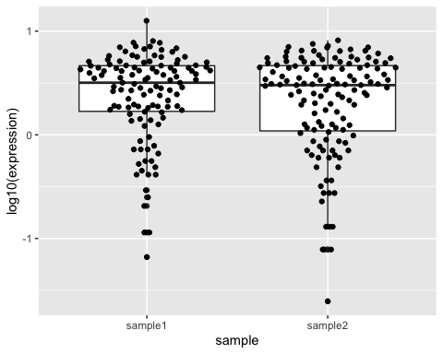
Overlaying points on box plots
Cousins of the generic box plot can be used to show the full data more clearly
This example overlays all points with a quasi-random X coordinate to force the density of points to be somewhat interpretable

Slide 46
Subsetting by column
In some scenarios you may need to selectively retain/drop only certain columns from a data frame
This requires the select verb
Reminder: you must refer to your columns using unquoted names, as if each was the name of an R variable in your environment

Slide 47
Example
covid_file <- "data/covid19_cases_worldwide_monthly.csv" covid <- read_csv(covid_file) head(covid,5)
## # A tibble: 5 x 7 ## year month territory continent cases deaths population ## <dbl> <chr> <chr> <chr> <dbl> <dbl> <dbl> ## 1 2020 Jan Afghanistan Asia 0 0 38041757 ## 2 2020 Jan Algeria Africa 0 0 43053054 ## 3 2020 Jan Armenia Europe 0 0 2957728 ## 4 2020 Jan Australia Oceania 7 0 25203200 ## 5 2020 Jan Austria Europe 0 0 8858775

Slide 48
Example
#explicitly retain these columns: month, territory, cases, deaths covid_trim = covid %>% select(month,territory,cases,deaths) head(covid_trim)
## # A tibble: 6 x 4 ## month territory cases deaths ## <chr> <chr> <dbl> <dbl> ## 1 Jan Afghanistan 0 0 ## 2 Jan Algeria 0 0 ## 3 Jan Armenia 0 0 ## 4 Jan Australia 7 0 ## 5 Jan Austria 0 0 ## 6 Jan Azerbaijan 0 0

Slide 49
Modifying a data frame with dplyr
The dplyr verb mutate allows you to create new columns in a data frame based on the output of an operation or function
Can be numerical/logical/string operations
Can involve one or more columns
Function must work in a vectorized context
Syntax:
df = mutate(df,new_colname = some_func(one_col))

Slide 50
Adding a column to our COVID data
covid_trim = mutate(covid_trim,death_rate = deaths/cases) head(covid_trim)
## # A tibble: 6 x 5 ## month territory cases deaths death_rate ## <chr> <chr> <dbl> <dbl> <dbl> ## 1 Jan Afghanistan 0 0 NaN ## 2 Jan Algeria 0 0 NaN ## 3 Jan Armenia 0 0 NaN ## 4 Jan Australia 7 0 0 ## 5 Jan Austria 0 0 NaN ## 6 Jan Azerbaijan 0 0 NaN
#Problem: dividing by zero gives us NaN, which can cause problems later

Slide 51
More robust implementation
We can combine the if_else function with mutate to conditionally modify the data frame with a different result depending on the data itself
Syntax: if_else(condition,do_if_true,do_if_false)
covid_trim = mutate(covid_trim,death_rate = if_else(cases>0,deaths/cases,0)) # equivalent to doing this for every row: # if(cases>0){ # death_rate = deaths/cases # }else{ # death_rate = 0 # }

Slide 52
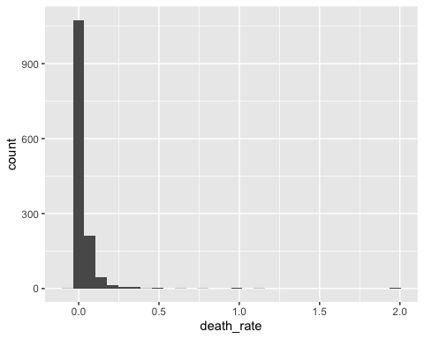
Outliers? Concerns?

Slide 53
Outliers? Concerns?
filter(covid_trim,death_rate>1)
## # A tibble: 3 x 5 ## month territory cases deaths death_rate ## <chr> <chr> <dbl> <dbl> <dbl> ## 1 May Sint_Maarten 1 2 2 ## 2 Aug Fiji 1 2 2 ## 3 Aug Luxembourg 9 10 1.11

Slide 54
Mutating our genotype data frame
ryan = ryan %>% mutate( Homozygous=grepl("AA|GG|CC|TT|II",genotype) ) %>% # create logical column that is TRUE for all homozygous rows mutate( Sex_chrom=grepl("X|Y",chromosome) ) head(ryan)
## # A tibble: 6 x 6 ## rsid chromosome position genotype Homozygous Sex_chrom ## <chr> <chr> <int> <chr> <lgl> <lgl> ## 1 rs3094315 1 752566 AA TRUE FALSE ## 2 rs3131972 1 752721 GG TRUE FALSE ## 3 rs11240777 1 798959 GG TRUE FALSE ## 4 rs6681049 1 800007 CC TRUE FALSE ## 5 rs4970383 1 838555 AC FALSE FALSE ## 6 rs4475691 1 846808 CC TRUE FALSE

Slide 55
Should we be worried?
table(ryan$Homozygous,ryan$Sex_chrom)
## ## FALSE TRUE ## FALSE 269313 125 ## TRUE 637518 326
Difficult to conclude why we’re seeing heterozygous SNPs on the X chromosome without other examples of similar data
A good comparitor would be similar data from a female

Slide 56
Ryan vs some rando named Ashley
ash=read_tsv("data/genome_Ashley_Bodily.txt",col_types = "ccic") ash = ash %>% mutate( Homozygous=grepl("AA|GG|CC|TT|II",genotype) ) %>% # create logical column that is TRUE for all homozygous rows mutate( Sex_chrom=grepl("X|Y",chromosome) ) table(ash$Homozygous,ash$Sex_chrom)
## ## FALSE TRUE ## FALSE 289297 9199 ## TRUE 643544 18574

Slide 57
Mutating more than one column at a time
ash=read_tsv("data/genome_Ashley_Bodily.txt", col_types = "ccic") ash = ash %>% mutate( Homozygous=grepl("AA|GG|CC|TT|II",genotype), Sex_chrom=grepl("X|Y",chromosome) ) table(ash$Homozygous,ash$Sex_chrom)
## ## FALSE TRUE ## FALSE 289297 9199 ## TRUE 643544 18574

Slide 58

Excel works similarly but mutate is tied to the same row

Slide 59
arrange: a better way to reorder rows
In exploratory analysis situations and for visualizations you will commonly want your rows ordered a specific way
Instead of the order function, we can use the more powerful Tidyverse equivalent: arrange
Syntax:
arrange(df, FirstColumn, columnTieBreaker, Another_column)

Slide 60
Data to arrange
## firstname surname birth_year ## 1 Matt Smith 1982 ## 2 Aaron Smith 2000 ## 3 Sarah-Jane Smith 1973 ## 4 Sarit Kim 1998 ## 5 Juanita Velculescu 1986 ## 6 Sandeep Dave 1978

Slide 61
Data to arrange
Let’s order rows based on surname only
arrange(dat,surname)
## firstname surname birth_year ## 1 Sandeep Dave 1978 ## 2 Sarit Kim 1998 ## 3 Matt Smith 1982 ## 4 Aaron Smith 2000 ## 5 Sarah-Jane Smith 1973 ## 6 Juanita Velculescu 1986

Slide 62
Data to arrange
Let’s order rows based on surname then use firstname to break ties
arrange(dat,surname,firstname)
## firstname surname birth_year ## 1 Sandeep Dave 1978 ## 2 Sarit Kim 1998 ## 3 Aaron Smith 2000 ## 4 Matt Smith 1982 ## 5 Sarah-Jane Smith 1973 ## 6 Juanita Velculescu 1986

Slide 63
Tidyverse vs “base R” equivalent
All things we can accomplish using Tidyverse syntax are possible in base R
Just because we can doesn’t mean we should use the other syntax
base R is generally, if not always, harder to read and debug
dat[order(dat$surname,dat$firstname),]
## firstname surname birth_year ## 6 Sandeep Dave 1978 ## 4 Sarit Kim 1998 ## 2 Aaron Smith 2000 ## 1 Matt Smith 1982 ## 3 Sarah-Jane Smith 1973 ## 5 Juanita Velculescu 1986

Slide 64
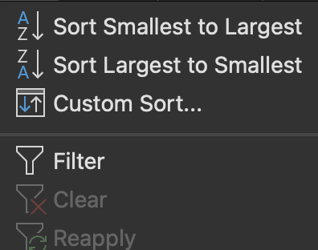
Sort(arrange) and Filter (filter)

Slide 65
Recap
Function | Goal
filter | Keep only rows matching certain criteria
select | Keep only columns of specified name (or naming pattern)
mutate | Create one or more new columns based on the output of operations/functions
pivot_longer | Bring together columns to convert data to tidy format
pivot_wider | Separate column into multiple columns for readability
arrange | Reorder rows based on one or more columns

