Slide 1
MBB 243 - Lecture 8
Ryan Morin

Slide 2
FINAL EXAM CANCELLED
Second midterm will be held in class instead of our lab
April 8 2:30 - 4:30

Slide 3
Learning goals for the week
Manipulate data frames in R using the dplyr package
Group rows using group_by() and nest_by()
Compute aggregate statistics using summarize()
Differentiate the behaviour of mutate() and summarize()
Understand how join functions can be used to combine data frames with shared variables
Understand some common pitfalls of the different types of join and alternatives

Slide 4
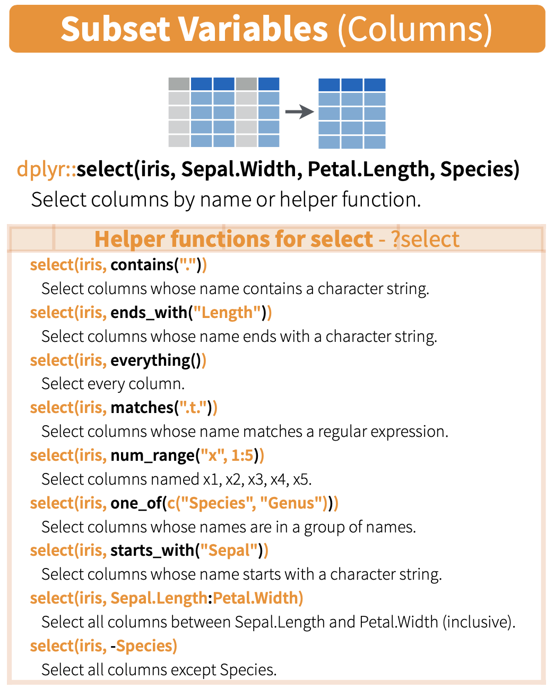
dplyr::select cheat sheet

Slide 5
Ryan vs some rando named Ashley
ash <- read_tsv("data/genome_Ashley_Bodily.txt",col_types = "ccic") ash <- ash %>% mutate( Homozygous = grepl("AA|GG|CC|TT|II",genotype) ) %>% # create logical column that is TRUE for all homozygous rows mutate( Sex_chrom = grepl("X|Y",chromosome) ) table(ash$Homozygous,ash$Sex_chrom)
## ## FALSE TRUE ## FALSE 289297 9199 ## TRUE 643544 18574

Slide 6
Mutating more than one column at a time
ash=read_tsv("data/genome_Ashley_Bodily.txt", col_types = "ccic") ash = ash %>% mutate( Homozygous = grepl("AA|GG|CC|TT|II",genotype), Sex_chrom = grepl("X|Y",chromosome) ) table(ash$Homozygous,ash$Sex_chrom)
## ## FALSE TRUE ## FALSE 289297 9199 ## TRUE 643544 18574

Slide 7

Excel works similarly but mutate is tied to the same row

Slide 8
arrange: a better way to reorder rows
In exploratory analysis situations and for visualizations you will commonly want your rows ordered a specific way
Instead of the order function, we can use the more powerful Tidyverse equivalent: arrange
Syntax:
arrange(df, FirstColumn, columnTieBreaker, Another_column)

Slide 9
Data to arrange
## firstname surname birth_year ## 1 Matt Smith 1982 ## 2 Aaron Smith 2000 ## 3 Sarah-Jane Smith 1973 ## 4 Sarit Kim 1998 ## 5 Juanita Velculescu 1986 ## 6 Sandeep Dave 1978

Slide 10
Data to arrange
Let’s order rows based on surname only
arrange(dat,surname)
## firstname surname birth_year ## 1 Sandeep Dave 1978 ## 2 Sarit Kim 1998 ## 3 Matt Smith 1982 ## 4 Aaron Smith 2000 ## 5 Sarah-Jane Smith 1973 ## 6 Juanita Velculescu 1986

Slide 11
Data to arrange
Let’s order rows based on surname then use firstname to break ties
arrange(dat,surname,firstname)
## firstname surname birth_year ## 1 Sandeep Dave 1978 ## 2 Sarit Kim 1998 ## 3 Aaron Smith 2000 ## 4 Matt Smith 1982 ## 5 Sarah-Jane Smith 1973 ## 6 Juanita Velculescu 1986

Slide 12
Tidyverse vs “base R” equivalent
All things we can accomplish using Tidyverse syntax are possible in base R
Just because we can doesn’t mean we should use the other syntax
base R is generally, if not always, harder to read and debug
dat[order(dat$surname,dat$firstname),]
## firstname surname birth_year ## 6 Sandeep Dave 1978 ## 4 Sarit Kim 1998 ## 2 Aaron Smith 2000 ## 1 Matt Smith 1982 ## 3 Sarah-Jane Smith 1973 ## 5 Juanita Velculescu 1986

Slide 13
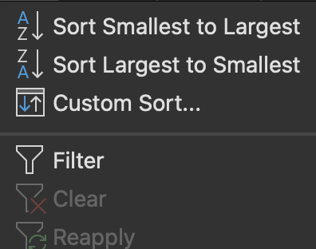
Sort(arrange) and Filter (filter)

Slide 14
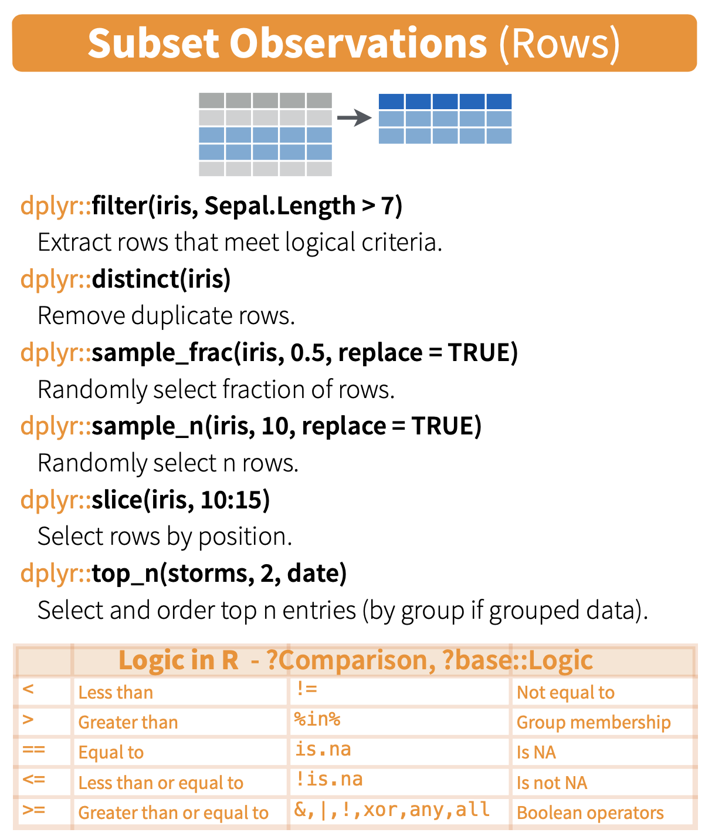
Subsetting cheat sheet

Slide 15
Recap from last week
Function | Goal
filter | Keep only rows matching certain criteria
select | Keep only columns of specified name (or naming pattern)
mutate | Create one or more new columns based on the output of operations/functions
pivot_longer | Bring together columns to convert data to tidy format
pivot_wider | Separate column into multiple columns for readability
arrange | Reorder rows based on one or more columns

Slide 16
Some syntax options for pipes
function(arg1,arg2) # the usual # equivalent to above because piped data # is considered first positional argument arg1 %>% function1(arg2) arg2 %>% function1(arg1,.) # ensures the pipe is treated as the second argument arg2 %>% function1(argname1=arg1,argname2=.) # you can use the . to represent the piped data both with named and positional arguments

Slide 17
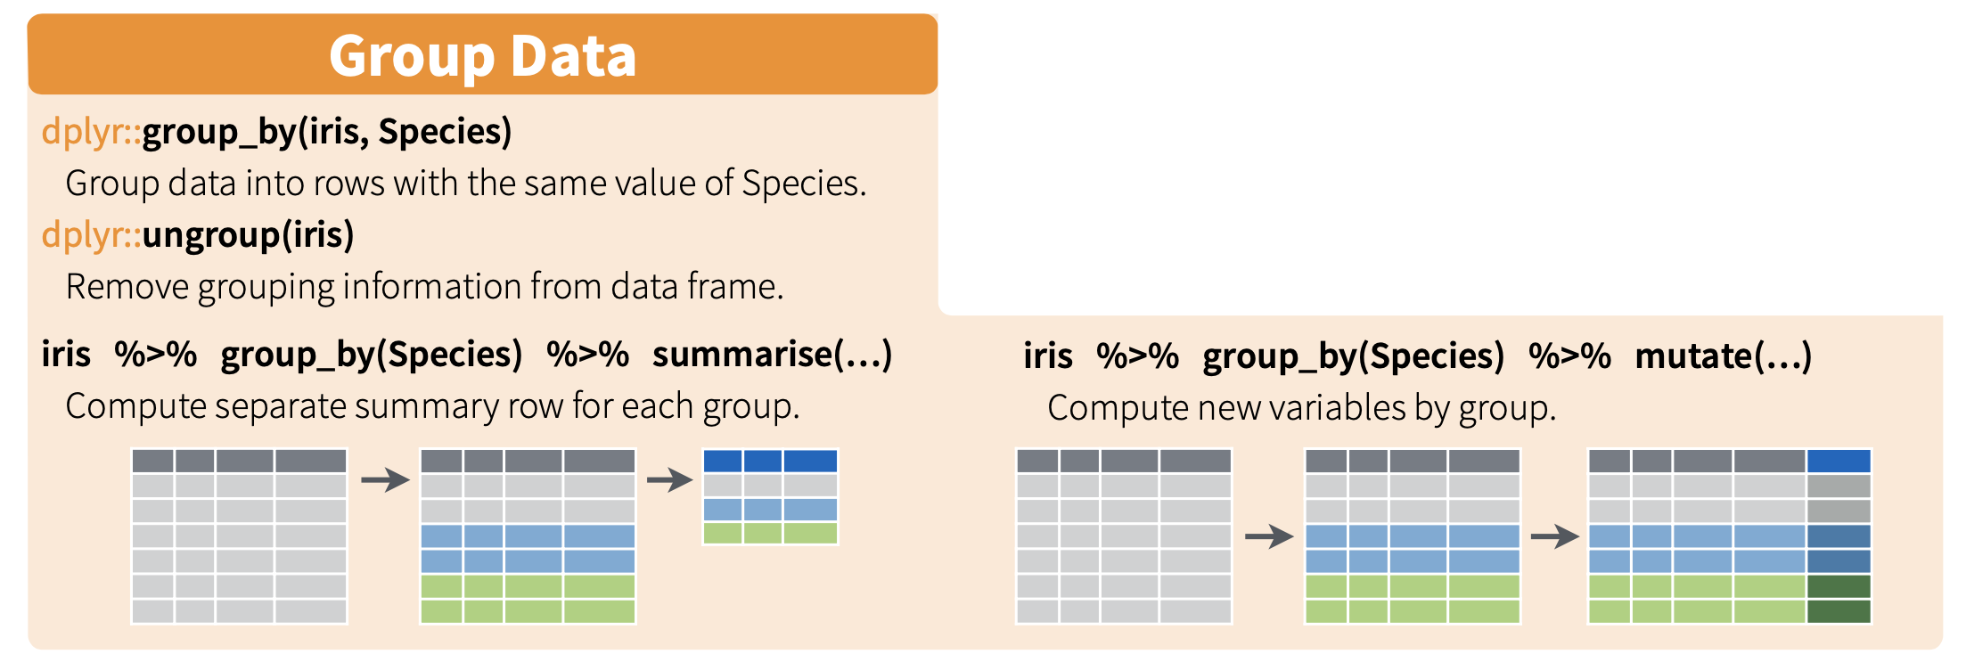
Grouping cheatsheet

Slide 18
Getting a Grip on Grouping
## Letters Numbers sound ## 1 A 1 ay ## 2 a 3 ay ## 3 eh 2 ay ## 4 B 6 bee ## 5 b 6 bee ## 6 bee 5 bee ## 7 beta 5 bee ## 8 c 1 see ## 9 C 2 see ## 10 Z 3 zed ## 11 z 3 zed ## 12 zeta 5 zed ## 13 Zeta 5 zed

Slide 19
Nesting - like grouping but not
nest_by() is closely related to group_by(). However, instead of storing the group structure in the metadata, it is made explicit in the data, giving each group key a single row along with a list-column of data frames that contain all the other data. nest_by() returns a rowwise data frame, which makes operations on the grouped data particularly elegant. See vignette("rowwise") for more details.

Slide 20
Nesting - like grouping but not
In essence, nest_by puts a series of individual data frames into a list named data as a column in a new data frame
nested_things <- nest_by(things, sound) print(nested_things)
## # A tibble: 4 x 2 ## # Rowwise: sound ## sound data ## <chr> <list<tibble[,2]>> ## 1 ay [3 × 2] ## 2 bee [4 × 2] ## 3 see [2 × 2] ## 4 zed [4 × 2]

Slide 21
A single nested group
unnest(nested_things[4,],cols=c(data))
## # A tibble: 4 x 3 ## # Groups: sound [1] ## sound Letters Numbers ## <chr> <chr> <dbl> ## 1 zed Z 3 ## 2 zed z 3 ## 3 zed zeta 5 ## 4 zed Zeta 5

Slide 22
working with nested data
You can use functions that work on data frames to perform analyses per-group on your nested data
e.g. count how many members are in each group
nested_things = mutate(nested_things, num_rows = nrow(data)) print(nested_things)
## # A tibble: 4 x 3 ## # Rowwise: sound ## sound data num_rows ## <chr> <list<tibble[,2]>> <int> ## 1 ay [3 × 2] 3 ## 2 bee [4 × 2] 4 ## 3 see [2 × 2] 2 ## 4 zed [4 × 2] 4

Slide 23
What about columns of nested data frames?
Functions that work with vectors can also be used but the syntax becomes unruly
nested_things = mutate(nested_things, Average = mean(data$Numbers)) print(nested_things)
## # A tibble: 4 x 4 ## # Rowwise: sound ## sound data num_rows Average ## <chr> <list<tibble[,2]>> <int> <dbl> ## 1 ay [3 × 2] 3 2 ## 2 bee [4 × 2] 4 5.5 ## 3 see [2 × 2] 2 1.5 ## 4 zed [4 × 2] 4 4

Slide 24
Reversing with unnest_longer
We can get (some of) our original data frame structure back with unnest_longer
Any new columns we created will be duplicated across all rows per group
The nested columns remain nested in a tibble
unnest_longer(nested_things,col="data")
## # A tibble: 13 x 4 ## sound data$Letters $Numbers num_rows Average ## <chr> <chr> <dbl> <int> <dbl> ## 1 ay A 1 3 2 ## 2 ay a 3 3 2 ## 3 ay eh 2 3 2 ## 4 bee B 6 4 5.5 ## 5 bee b 6 4 5.5 ## 6 bee bee 5 4 5.5 ## 7 bee beta 5 4 5.5 ## 8 see c 1 2 1.5 ## 9 see C 2 2 1.5 ## 10 zed Z 3 4 4 ## 11 zed z 3 4 4 ## 12 zed zeta 5 4 4 ## 13 zed Zeta 5 4 4

Slide 25
The better way: Grouping
Although visually useful to understand how groups work, it’s unnecessary to reformat your data frame using nesting
Grouped data looks identical to the data without grouping but behaves differently
## # A tibble: 13 x 3 ## # Groups: sound [4] ## Letters Numbers sound ## <chr> <dbl> <chr> ## 1 A 1 ay ## 2 a 3 ay ## 3 eh 2 ay ## 4 B 6 bee ## 5 b 6 bee ## 6 bee 5 bee ## 7 beta 5 bee ## 8 c 1 see ## 9 C 2 see ## 10 Z 3 zed ## 11 z 3 zed ## 12 zeta 5 zed ## 13 Zeta 5 zed

Slide 26
Putting grouping to work
summarize is a one-stop shop to allow functions to be applied within individual groups
Most tidyverse functions ignore grouping but if you don’t need the grouping you should reverse it when you’re done, just in case
# Use the mean() function per group to create a new column named Average summarize(grouped_things,Average=mean(Numbers))
## # A tibble: 4 x 2 ## sound Average ## <chr> <dbl> ## 1 ay 2 ## 2 bee 5.5 ## 3 see 1.5 ## 4 zed 4

Slide 27
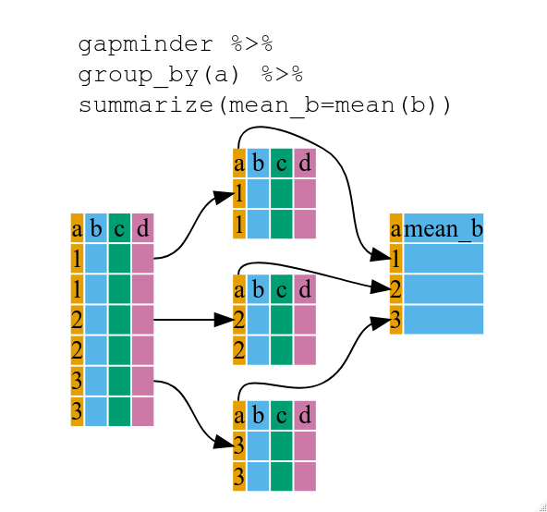
Summary of summarize
Summarize returns only your grouping column and one additional column for the output of each function you ran on the groups
The number of rows in your result is equal to the number of groups
As a result, you lose all columns that weren’t used in the grouping

Slide 28
COVID data
## # A tibble: 6 x 7 ## year month territory continent cases deaths population ## <dbl> <chr> <chr> <chr> <dbl> <dbl> <dbl> ## 1 2020 Jan Afghanistan Asia 0 0 38041757 ## 2 2020 Jan Algeria Africa 0 0 43053054 ## 3 2020 Jan Armenia Europe 0 0 2957728 ## 4 2020 Jan Australia Oceania 7 0 25203200 ## 5 2020 Jan Austria Europe 0 0 8858775 ## 6 2020 Jan Azerbaijan Europe 0 0 10047719

Slide 29
Pop quiz
summarized_covid <- covid %>% group_by(continent) %>% summarize(people=sum(population) )
How many rows will we have in summarized_covid?
How many columns and what will they contain?

Slide 30
Pop quiz
How many rows will we have in summarized_covid?
How many columns and what will they contain?
## # A tibble: 5 x 2 ## continent people ## <chr> <dbl> ## 1 Africa 8472139474 ## 2 America 7548008655 ## 3 Asia 35337946686 ## 4 Europe 5849933978 ## 5 Oceania 302605840

Slide 31
More examples
# Use the mean() function per group to create a new column named Average summarize(grouped_things, high=max(Numbers), #max value per group low=min(Numbers), #min value per group group_size=n(), # number of rows total=sum(Numbers), #sum the values )
## # A tibble: 4 x 5 ## sound high low group_size total ## <chr> <dbl> <dbl> <int> <dbl> ## 1 ay 3 1 3 6 ## 2 bee 6 5 4 22 ## 3 see 2 1 2 3 ## 4 zed 5 3 4 16

Slide 32
Groups can involve multiple variables
This example groups by multiple variables
deaths_per_continent_per_month <- covid %>% group_by(continent, month) %>% summarize(deaths = sum(deaths))
## `summarise()` has grouped output by 'continent'. You can override using the `.groups` argument.

Slide 33
Groups can involve multiple variables
deaths_per_continent_per_month
## # A tibble: 40 x 3 ## # Groups: continent [5] ## continent month deaths ## <chr> <chr> <dbl> ## 1 Africa Apr 1425 ## 2 Africa Aug 10274 ## 3 Africa Feb 0 ## 4 Africa Jan 0 ## 5 Africa Jul 9433 ## 6 Africa Jun 5807 ## 7 Africa Mar 166 ## 8 Africa May 2480 ## 9 America Apr 70904 ## 10 America Aug 112185 ## # … with 30 more rows

Slide 34
Combining with mutate
Reminder: mutate allows you to create new columns using data in rows
With grouped data, it can be used to add a new column that modifies each row based on its group
deaths_per_continent_per_month %>% mutate(total_deaths = sum(deaths))
## # A tibble: 40 x 4 ## # Groups: continent [5] ## continent month deaths total_deaths ## <chr> <chr> <dbl> <dbl> ## 1 Africa Apr 1425 29585 ## 2 Africa Aug 10274 29585 ## 3 Africa Feb 0 29585 ## 4 Africa Jan 0 29585 ## 5 Africa Jul 9433 29585 ## 6 Africa Jun 5807 29585 ## 7 Africa Mar 166 29585 ## 8 Africa May 2480 29585 ## 9 America Apr 70904 467767 ## 10 America Aug 112185 467767 ## # … with 30 more rows

Slide 35
Combining with mutate
Now we have the denominator for each group
deaths_per_continent_per_month %>% mutate(total_deaths = sum(deaths), pct_deaths = 100 * deaths / total_deaths) %>% select(continent,month,pct_deaths)
## # A tibble: 40 x 3 ## # Groups: continent [5] ## continent month pct_deaths ## <chr> <chr> <dbl> ## 1 Africa Apr 4.82 ## 2 Africa Aug 34.7 ## 3 Africa Feb 0 ## 4 Africa Jan 0 ## 5 Africa Jul 31.9 ## 6 Africa Jun 19.6 ## 7 Africa Mar 0.561 ## 8 Africa May 8.38 ## 9 America Apr 15.2 ## 10 America Aug 24.0 ## # … with 30 more rows

Slide 36
(How) are these different?
deaths_per_continent_per_month %>% mutate(total_deaths = sum(deaths))
VS
deaths_per_continent_per_month %>% ungroup() %>% mutate(total_deaths = sum(deaths))

Slide 37
Recap: summarize and mutate
Both mutate and summarize can apply functions to variables in grouped data
summarize returns one row per group and one new column for each summarized variable (plus your grouping columns)
mutate manipulates the original data frame, duplicating the result for all rows in the same group

Slide 38

Intermission

Slide 39
Bringing related data together
Commonly we will start with data in more than one file with common variables between those files
Simple scenarios are readily solved
Same number of rows, different observations in the columns
Same number of columns, different observations in the rows

Slide 40
The bind functions
Think of binding as stapling or stacking data frames together (bind rows = stack rows on rows)
dplyr has a few functions that implement/replace the base R cbind and rbind so we’ll jump right to the dplyr ones
bind_rows is similar to the UNIX cat utility
top3 <- head(covid,3) last3 <- tail(covid,3) #a new data frame with all the rows from the data frames we gave it combined = bind_rows(top3,last3)

Slide 41
result
## # A tibble: 6 x 7 ## year month territory continent cases deaths population ## <dbl> <chr> <chr> <chr> <dbl> <dbl> <dbl> ## 1 2020 Jan Afghanistan Asia 0 0 38041757 ## 2 2020 Jan Algeria Africa 0 0 43053054 ## 3 2020 Jan Armenia Europe 0 0 2957728 ## 4 2020 Aug Yemen Asia 227 77 29161922 ## 5 2020 Aug Zambia Africa 6470 138 17861034 ## 6 2020 Aug Zimbabwe Africa 3320 143 14645473

Slide 42
Smart binding handles column differences
top3 <- top3 %>% select(-population) # drop the population last3 <- last3 %>% select(-year) #drop the year #a new data frame with all unique columns and NA filling in missing data bind_rows(top3,last3) %>% select(year,month,population)
## # A tibble: 6 x 3 ## year month population ## <dbl> <chr> <dbl> ## 1 2020 Jan NA ## 2 2020 Jan NA ## 3 2020 Jan NA ## 4 NA Aug 29161922 ## 5 NA Aug 17861034 ## 6 NA Aug 14645473

Slide 43
Gene expression example
What is common between these two data frames? What is different?
How would bind_rows deal with this?
gexp1=read_csv(file="data/GSE125966_part1.csv") gexp2=read_csv(file="data/GSE125966_part2.csv") colnames(gexp1)
## [1] "gene" "sample12"
colnames(gexp2)
## [1] "gene" "sample23"
dim(gexp1)
## [1] 27675 2
dim(gexp2)
## [1] 27675 2

Slide 44
Not what we wanted
test_bind = bind_rows(gexp1,gexp2) test_bind %>% head(3)
## # A tibble: 3 x 3 ## gene sample12 sample23 ## <chr> <dbl> <dbl> ## 1 GeneID:1 1.47 NA ## 2 GeneID:10 -5.98 NA ## 3 GeneID:100 5.43 NA
test_bind %>% tail(3)
## # A tibble: 3 x 3 ## gene sample12 sample23 ## <chr> <dbl> <dbl> ## 1 GeneID:9993 NA 4.14 ## 2 GeneID:9994 NA 5.98 ## 3 GeneID:9997 NA 6.32

Slide 45
One option: bind_cols
Shared rows but different data in the columns is a job for bind_cols, in theory
new_gexp = bind_cols(gexp1,gexp2)
## New names: ## * gene -> gene...1 ## * gene -> gene...3
head(new_gexp,2)
## # A tibble: 2 x 4 ## gene...1 sample12 gene...3 sample23 ## <chr> <dbl> <chr> <dbl> ## 1 GeneID:1 1.47 GeneID:1 1.28 ## 2 GeneID:10 -5.98 GeneID:10 -3.19

Slide 46
Not the best option
Though bind_cols can be used here, there are some major drawbacks
If the rows aren’t in the same order, your data will not be comparable between the columns from the starting data!
You will also end up with a duplicated (and renamed) column for any shared column
#let's rearrange gexp1 to see what happens gexp1r = arrange(gexp1,sample12) new_gexp = bind_cols(gexp1r,gexp2)
## New names: ## * gene -> gene...1 ## * gene -> gene...3

Slide 47
Result
head(new_gexp,5)
## # A tibble: 5 x 4 ## gene...1 sample12 gene...3 sample23 ## <chr> <dbl> <chr> <dbl> ## 1 GeneID:10 -5.98 GeneID:1 1.28 ## 2 GeneID:100009613 -5.98 GeneID:10 -3.19 ## 3 GeneID:10002 -5.98 GeneID:100 7.04 ## 4 GeneID:100033416 -5.98 GeneID:1000 1.46 ## 5 GeneID:100033422 -5.98 GeneID:10000 5.42

Slide 48
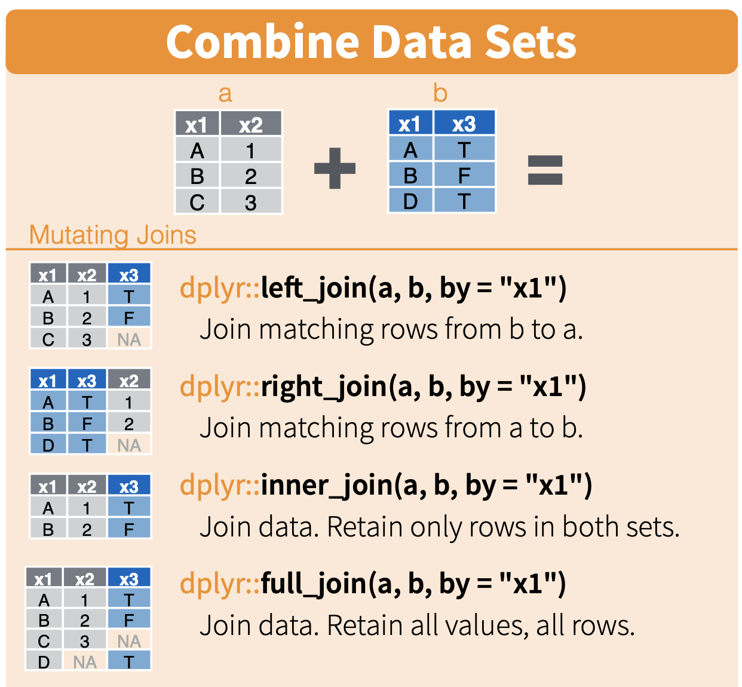
The join functions are better

Slide 49
Using join instead of bind_cols
Notice that all join functions automatically decide which columns to use as keys to link the data frames
You can specify the join column(s) to avoid unexpected behaviour
#reminder: our data frames have gene in a different order! join_gexp = full_join(gexp1r,gexp2)
## Joining, by = "gene"
# the explicit equivalent is shown below # join_gexp = full_join(gexp1r,gexp2,by=c("gene"))

Slide 50
Result with join
colnames(join_gexp)
## [1] "gene" "sample12" "sample23"
head(join_gexp)
## # A tibble: 6 x 3 ## gene sample12 sample23 ## <chr> <dbl> <dbl> ## 1 GeneID:10 -5.98 -3.19 ## 2 GeneID:100009613 -5.98 -5.99 ## 3 GeneID:10002 -5.98 -4.41 ## 4 GeneID:100033416 -5.98 -2.82 ## 5 GeneID:100033422 -5.98 -5.99 ## 6 GeneID:100033424 -5.98 -5.99

Slide 51
Gotchas and FYIs
Joining on a column with non-unique values is almost always a mistake and should be avoided
Notice that columns present in both but not used in the join will be renamed slightly (colname.x for the first, colname.y for the second set)
left_join(things,head(things,3),by="sound")
## Letters.x Numbers.x sound Letters.y Numbers.y ## 1 A 1 ay A 1 ## 2 A 1 ay a 3 ## 3 A 1 ay eh 2 ## 4 a 3 ay A 1 ## 5 a 3 ay a 3 ## 6 a 3 ay eh 2 ## 7 eh 2 ay A 1 ## 8 eh 2 ay a 3 ## 9 eh 2 ay eh 2 ## 10 B 6 bee <NA> NA ## 11 b 6 bee <NA> NA ## 12 bee 5 bee <NA> NA ## 13 beta 5 bee <NA> NA ## 14 c 1 see <NA> NA ## 15 C 2 see <NA> NA ## 16 Z 3 zed <NA> NA ## 17 z 3 zed <NA> NA ## 18 zeta 5 zed <NA> NA ## 19 Zeta 5 zed <NA> NA
#new data frame will have repetition of rows for any repetitions of values in the join column

Slide 52
Gotchas and FYIs
In a X_join, rows that can’t be joined are retained in the file on X side (e.g. left = your first argument) so your output should have the same number of rows as that data frame unless something went wrong (e.g. duplication in the join columns)
left_join(things,head(things,3),by="Letters")
## Letters Numbers.x sound.x Numbers.y sound.y ## 1 A 1 ay 1 ay ## 2 a 3 ay 3 ay ## 3 eh 2 ay 2 ay ## 4 B 6 bee NA <NA> ## 5 b 6 bee NA <NA> ## 6 bee 5 bee NA <NA> ## 7 beta 5 bee NA <NA> ## 8 c 1 see NA <NA> ## 9 C 2 see NA <NA> ## 10 Z 3 zed NA <NA> ## 11 z 3 zed NA <NA> ## 12 zeta 5 zed NA <NA> ## 13 Zeta 5 zed NA <NA>
#new data frame will have repetition of rows for any repetitions of values in the join column

Slide 53
Other flavours of join
More common applications involve other join types (e.g. left_join and right_join), which allow you to join data frames that don’t share your joining key across every row
Common use case for left_join is to add columns to your data frame using a second data frame that contains more rows
Only the shared/joinable rows will be retained
When in doubt, usually left_join is suitable

Slide 54
Annotating our genes
Let’s revisit our gene ID data from week two
We have four different gene IDs and we only want to add Symbol
We can add these to our data frame using left_join
gene_info = read_tsv("data/gene_id.txt") colnames(gene_info)=c("Ensembl_ID","Symbol","HGNC","gene_id")

Slide 55
Annotating our genes
gene_info = gene_info %>% select(Symbol,gene_id) %>% filter(!is.na(gene_id) & !is.na(Symbol)) %>% group_by(gene_id) %>% slice_head() # drop rows missing a gene_id to avoid issues later # Be sure your data frame has unique rows for your join column!!! head(gene_info)
## # A tibble: 6 x 2 ## # Groups: gene_id [6] ## Symbol gene_id ## <chr> <dbl> ## 1 A1BG 1 ## 2 A2M 2 ## 3 A2MP1 3 ## 4 NAT1 9 ## 5 NAT2 10 ## 6 SERPINA3 12

Slide 56
Annotating our genes
left_join(join_gexp,gene_info) # This fails with the following error: # Error: `by` must be supplied when `x` and `y` have no common variables. # use by = character()` to perform a cross-join.

Slide 57
Annotating our genes
What went wrong now? How do we fix this?
left_join(join_gexp,gene_info,by=c("gene"="gene_id")) # explicitly tell the join to consider gene and gene_id as equivalent # you could have instead renamed one of the columns if you wanted # This also fails with an even scarier error message # Error: Can't join on `x$gene` x `y$gene` because of incompatible types. ℹ #`x$gene` is of type <character>>. ℹ `y$gene` is of type <double>>. Run #`rlang::last_error()` to see where the error occurred.

Slide 58
Joining using a pipe
We can manipulate one of our input data frames on-the-fly using a pipe to pass it to the join
Here we’ll use mutate to update the column type to be compatible with our other data
Now what went wrong?
filter(gene_info,!is.na(gene_id)) %>% mutate(gene_id=as.character(gene_id)) %>% left_join(join_gexp,.,by=c("gene"="gene_id")) %>% head() # The . represents the incoming data

Slide 59
Almost there, I promise!
Our ID format in the original data frame has “GeneID” before every numeric ID for some ungodly reason
This is fixable in a slightly more convoluted pipe using a string operation
Here I’ll go ahead and use mutate to create a column with a new name
mutate(gene_info,gene_id=as.character(gene_id)) %>% mutate(gene = paste0("GeneID:",gene_id)) %>% select(-gene_id) %>% #drop old column head()

Slide 60
It works!
Note that we no longer need to be explicit about which columns to use for the join
annotated = mutate(gene_info,gene_id=as.character(gene_id)) %>% mutate(gene = paste0("GeneID:",gene_id)) %>% left_join(join_gexp,.)
## Joining, by = "gene"
head(annotated)
## # A tibble: 6 x 5 ## gene sample12 sample23 Symbol gene_id ## <chr> <dbl> <dbl> <chr> <chr> ## 1 GeneID:10 -5.98 -3.19 NAT2 10 ## 2 GeneID:100009613 -5.98 -5.99 <NA> <NA> ## 3 GeneID:10002 -5.98 -4.41 NR2E3 10002 ## 4 GeneID:100033416 -5.98 -2.82 <NA> <NA> ## 5 GeneID:100033422 -5.98 -5.99 SNORD116-10 100033422 ## 6 GeneID:100033424 -5.98 -5.99 <NA> <NA>
dim(annotated)
## [1] 27675 5
dim(join_gexp)
## [1] 27675 3
# This sanity check helps assure you that you didn't lose OR accidentally gain rows

Slide 61
Now we have useful gene names
Why might we have NA for some genes still?
How could we deal with this, assuming we wanted only rows with actual gene names available?
arrange(annotated,-sample12)
## # A tibble: 27,675 x 5 ## gene sample12 sample23 Symbol gene_id ## <chr> <dbl> <dbl> <chr> <chr> ## 1 GeneID:378938 15.2 14.7 MALAT1 378938 ## 2 GeneID:60 13.8 14.5 ACTB 60 ## 3 GeneID:79026 13.1 13.3 AHNAK 79026 ## 4 GeneID:6023 13.0 12.2 RMRP 6023 ## 5 GeneID:6080 12.6 12.6 <NA> <NA> ## 6 GeneID:57674 12.5 13.1 RNF213 57674 ## 7 GeneID:5660 12.2 13.0 PSAP 5660 ## 8 GeneID:23524 11.8 10.9 SRRM2 23524 ## 9 GeneID:3312 11.7 11.5 HSPA8 3312 ## 10 GeneID:567 11.7 12.8 B2M 567 ## # … with 27,665 more rows

