Slide 1
MBB 243 - Lecture 09
Ryan Morin

Slide 2
Learning goals for the week
Basic plotting types and aesthetics with ggplot
Renounce pie charts for life
Some common techniques for formatting and manipulating data for making usful plots
Putting ggplot to work and learning to tame some of it’s quirks

Slide 3
Data viz: a key part of EDA
As we discussed earlier, exploratory data analysis reqires visualization of your variables
ggplot2 is an integral part of tidyverse and plays nicely with tidy data so is an excellent tool for interactive data visualization
Mastering data visualization in R means you can generate publication-quality figures and finally abandon Excel, at least for data presentation purposes

Slide 4
ggplot2 procedure
We build a plot in layers in a series of steps, first by calling ggplot() and providing some data (directly as a data frame or via a pipe)
In the call to ggplot() or in subsequent geom calls, we map some aesthetics to the variables
Each geometry geom call adds a plot layer to represent your data
New layers will share the coordinate system
Legends and axes are set up for you but you can provide a theme to the plot and/or adjust the layout with calls to theme functions

Slide 5
Deconsructing a toy car example
# tell ggplot we will be using the mpg data set that is bundled with this package # this creates an empty graph that is useless without a plotting function ggplot(data = mpg) + # The + allows us to add on or more layers to our plot geom_point(mapping = aes(x = displ, y = hwy)) # geom_point will create an x/y scatter plot # the mapping argument is always coupled with aesthetics aes() # and is used to set variables for the axes and additional mappings (e.g. colour)

Slide 6
Data
Fuel economy (mpg) of a large variety of consumer vehicles
select(mpg,displ,hwy,class,manufacturer) %>% slice_sample(n = 6)
## # A tibble: 6 x 4 ## displ hwy class manufacturer ## <dbl> <int> <chr> <chr> ## 1 2 29 compact volkswagen ## 2 5.7 23 2seater chevrolet ## 3 4.7 12 pickup dodge ## 4 4.7 17 suv dodge ## 5 3 26 midsize toyota ## 6 1.8 35 compact toyota

Slide 7
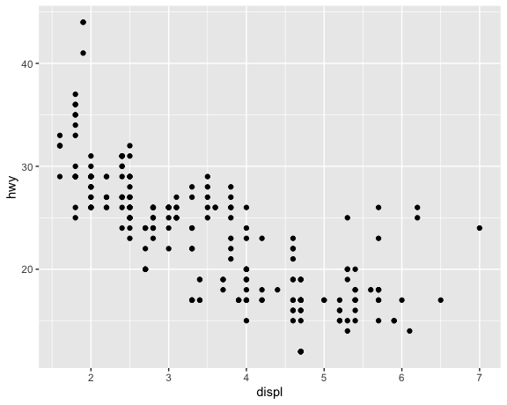
Viz

Slide 8
Tweaking the basic plot
Map a colour to the points based on another variable
# note: we can drop mapping= as long as aes() is the first/only argument ggplot(data = mpg) + geom_point(mapping = aes(x = displ, y = hwy, colour = manufacturer))

Slide 9
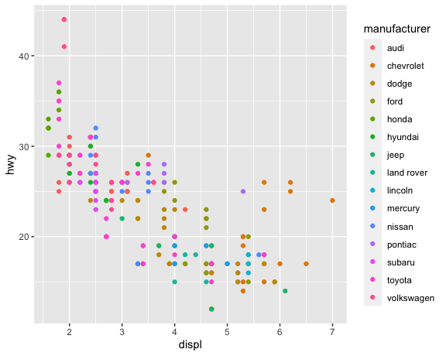

Slide 10
Common mistake
You can globally control plot features instead of mapping them to variables
Only works in the expected way if you specify outside aes()
ggplot(data = mpg) + geom_point(mapping = aes(x = displ, y = hwy, colour = "blue"))

Slide 11
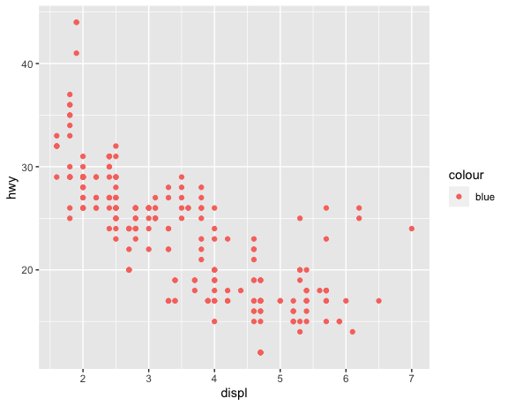

Slide 12
The correct approach
You can globally control plot features instead of mapping them to variables
Only works in the expected way if you specify outside aes()
ggplot(data = mpg) + geom_point(mapping = aes(x = displ, y = hwy), colour = "blue")

Slide 13
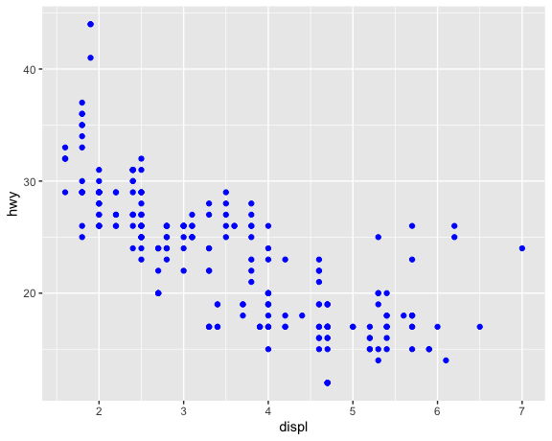

Slide 14
Tweaking the basic plot
Map a colour to the points based on another variable
Shape your points based on yet ANOTHER variable
# This code throws this warning at you: # The shape palette can deal with a maximum of 6 discrete values because more than 6 becomes difficult to discriminate; you have 7. Consider specifying shapes manually if you must have them. # Removed 62 rows containing missing values* ggplot(data = mpg) + geom_point(aes(x = displ, y = hwy, colour = manufacturer, shape = class)) + theme(legend.position="bottom")

Slide 15
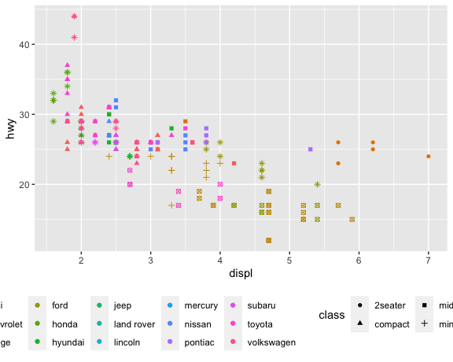

Slide 16
Tweaking the basic plot
Map a colour to the points based on another variable
Make the grey background go away by changing the theme
# other nice options to try out: # theme_classic() # theme_cowplot() #requires the cowplot library ggplot(data = mpg) + geom_point(aes(x = displ, y = hwy, colour = manufacturer)) + theme_minimal()

Slide 17
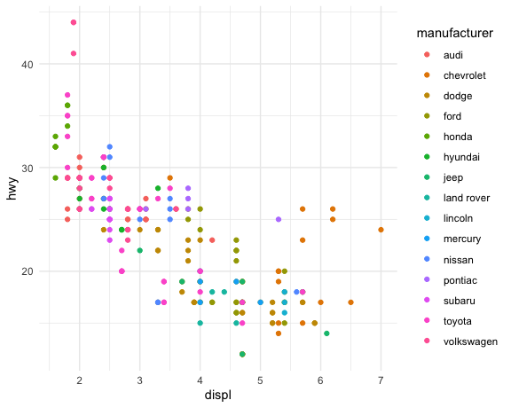

Slide 18
Controlling how colours are mapped
Map your colour to a continuous numeric value (rather than categorical)
Automatic behaviour if your variable is numeric, which may not actually be what you want
Controlling the colour scale will be covered in the lab
ggplot(data = mpg) + geom_point(aes(x = displ, y = hwy, colour = cyl)) + theme_cowplot()

Slide 19
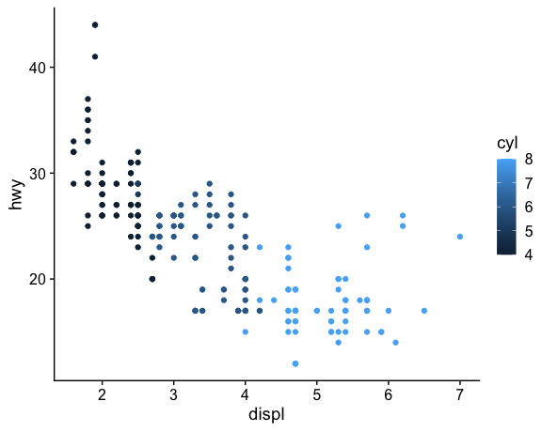

Slide 20
Overriding default colouring
You can prevent a continuous colour scale from being used by converting the type of your variable
Categorical variables should be factors
Variable must have a sensible number of discrete values for this to work
ggplot(data = mpg) + geom_point(aes(x = displ, y = hwy, colour = factor(cyl))) + theme_cowplot()

Slide 21
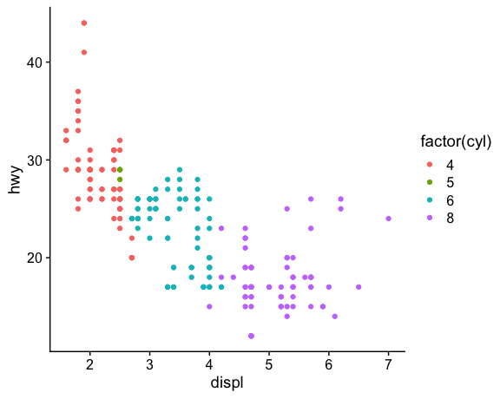
Does this imply another plot type?

Slide 22
Notes about aesthetics
Shape, size and colour and alpha (transparency) can all be associated with variables
Colour/shape are more useful for categorical variables
Size and colour gradiants are more useful for continuous variables
Scale range for size/color gradients are automatically determined
Getting too ambitious with mapping more than one at a time usually results in a mess
ggplot(data = mpg) + geom_point(aes(x = displ, y = hwy, colour = factor(cyl),size=cty,shape=drv,alpha=year))

Slide 23
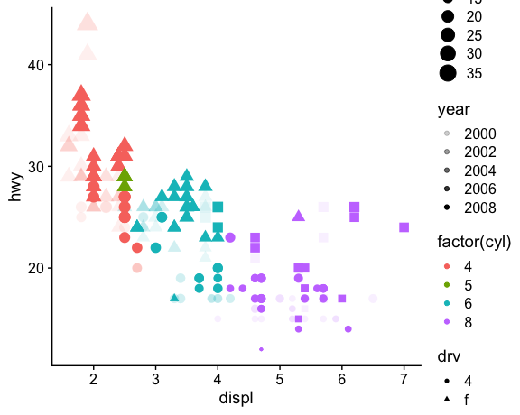
Too much?

Slide 24
Fitting trend lines to your data
In this example, we’ve shifted the aesthetic mapping to the call to ggplot, which causes them to be considered ‘global’ until they are changed
geom_smooth is used here to fit a linear model to the data and add the linear representation for each group
groups are implicitly assigned based on your colour assignment
ggplot(data = mpg,mapping = aes(x = displ, y = hwy, colour = factor(cyl))) + geom_point() + geom_smooth(method = "lm", se = FALSE)

Slide 25
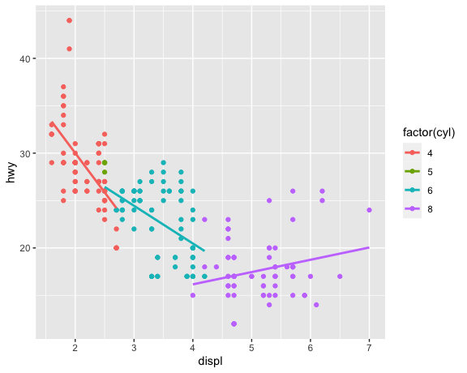

Slide 26
Altering aesthetic mapping by layer
Sometimes the aesthetics mapped in earlier layers cause a subsequent geom to misbehave
Explicitly defining aes() with each geom is one option
You can also use inherit.aes=FALSE if you only want to disable the global aesthetic in one layer
ggplot(data = mpg) + geom_point(mapping = aes(x = displ, y = hwy, colour = factor(cyl))) + geom_smooth(method = "lm", se = FALSE, mapping = aes(x = displ, y = hwy))

Slide 27
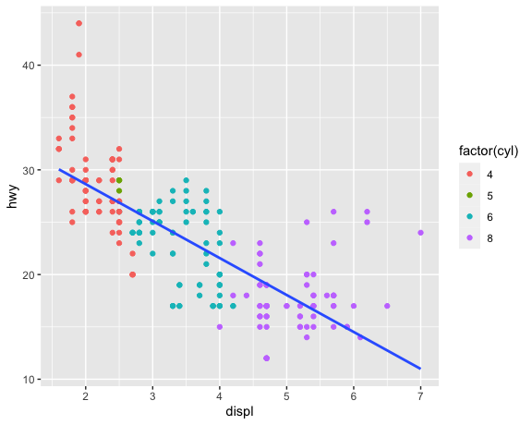

Slide 28
Choosing the right plot type
Scatter plots are a good place to start but may not convey the information in the way you want
Coloured scatterplots may help you recognize if a categorical variable is associated with one or more continuous variables
With this information, you can switch to plots that group data and show the distribution such as box plots or histograms*

Slide 29
Box plot of car fuel economy
# Note: we're converting cyl to a factor representation on-the-fly ggplot(data = mpg) + geom_boxplot(aes(x = factor(cyl), y = hwy, colour = factor(cyl)))

Slide 30
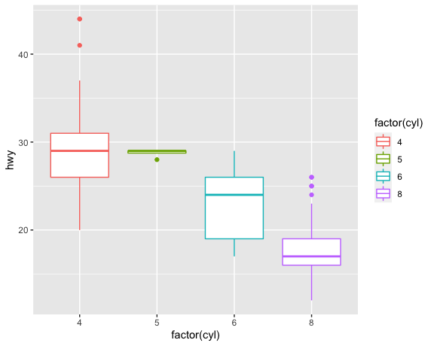

Slide 31
More layer ridiculousness
There are a few things wrong with this layering that highlight some common errors
Thoughts on what causes the x scale to behave this way?
How do we fix it?
ggplot(data = mpg) + geom_boxplot(mapping = aes(x = factor(cyl), y = hwy, colour = factor(cyl))) + geom_point(mapping = aes(x = cyl, y = hwy, colour = factor(cyl))) + theme_cowplot()

Slide 32
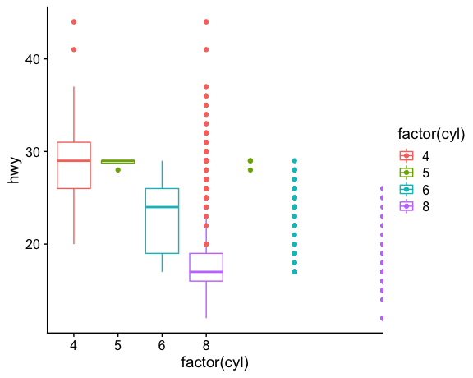

Slide 33
Consistency is key
X axis scale will be numeric if the data are numeric, which allows the order to be determined “naturally” but will create a gap where a X value is missing whereas factors are not treated as numeric for axes
Since the aesthetics are shared, we can move them to the first ggplot call so they are inherited
ggplot(data = mpg, aes(x = cyl, y = hwy, colour = factor(cyl))) + geom_boxplot() + geom_point() + theme_cowplot()

Slide 34
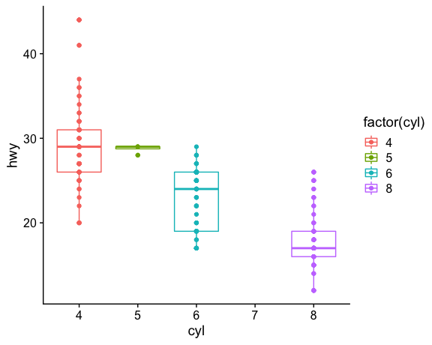

Slide 35
Quasirandom instead of just points
Overlaying points on a boxplot is more informative when you add some randomness to the x coordinate to spread them out
ggplot(data = mpg, aes(x = factor(cyl), y = hwy, colour = factor(cyl))) + geom_boxplot(outlier.shape = NA) + ggbeeswarm::geom_quasirandom() + theme_cowplot()

Slide 36
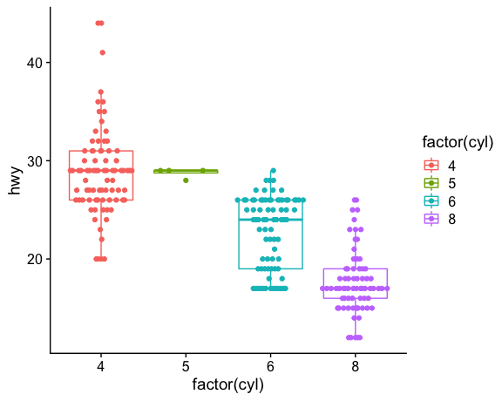

Slide 37
Tidying some biological data
Here we’ll combine the gene expression for two samples to make a tidy table
gexp1=read_csv(file="data/GSE125966_part1.csv") %>% rename("expression"=2) %>% mutate(sample_id="sample12") gexp2=read_csv(file="data/GSE125966_part2.csv") %>% rename("expression"=2) %>% mutate(sample_id="sample23") two_gexp = bind_rows(gexp1,gexp2) head(two_gexp,6)
## # A tibble: 6 x 3 ## gene expression sample_id ## <chr> <dbl> <chr> ## 1 GeneID:1 1.47 sample12 ## 2 GeneID:10 -5.98 sample12 ## 3 GeneID:100 5.43 sample12 ## 4 GeneID:1000 3.20 sample12 ## 5 GeneID:10000 5.28 sample12 ## 6 GeneID:100009613 -5.98 sample12

Slide 38
Tweaking axes
You will sometimes need to limit/adjust the range of data points used in your plot
Axes can be truncated manually if desired
ggplot(two_gexp,aes(x=expression)) + geom_histogram() + xlim(c(-4,15)) + facet_wrap(~sample_id,nrow=2)

Slide 39
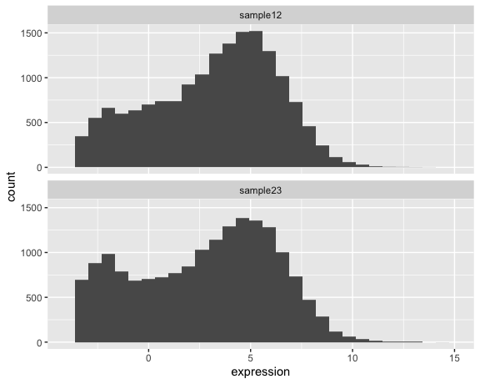

Slide 40
Tweaking axes
You will sometimes need to limit/adjust the range of data points used in your plot
Axes can be truncated manually if desired
Usually the better option is to filter your data up-front
dplyr::filter(two_gexp,expression > -4 ) %>% ggplot(aes(x=expression)) + geom_histogram(aes(colour=sample_id)) + facet_wrap(~sample_id,nrow=2)

Slide 41
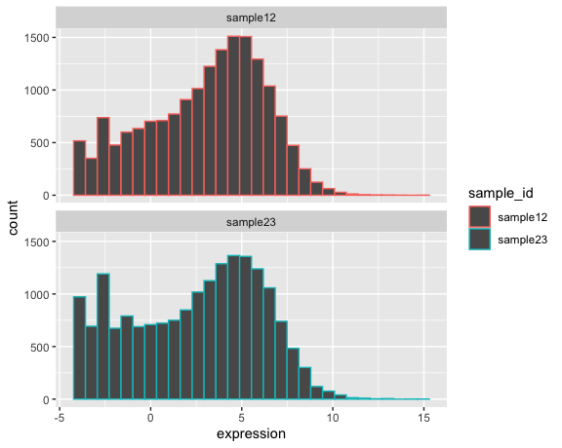

Slide 42
Colour vs fill
The colour aesthetic usually means the outline of a shape
For shapes that are hollow, you must specify fill
dplyr::filter(two_gexp,expression > -4 ) %>% ggplot(aes(x=expression)) + geom_histogram(aes(fill=sample_id)) + facet_wrap(~sample_id,nrow=2)

Slide 43
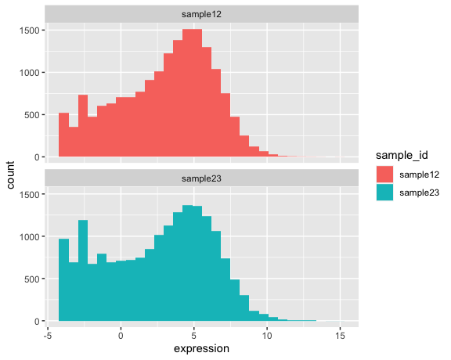

Slide 44
Boxplot with many points
Plotting thousands of data points is easy (even if not often useful in this form)
Crowding can somewhat be mitigated by setting a low alpha to make points semi-transparent
dplyr::filter(two_gexp,expression > -4) %>% group_by(sample_id) %>% slice_sample(n=2000) %>% ggplot(aes(x=sample_id,y=expression)) + geom_boxplot(outlier.shape = NA) + geom_quasirandom(alpha=0.2)

Slide 45
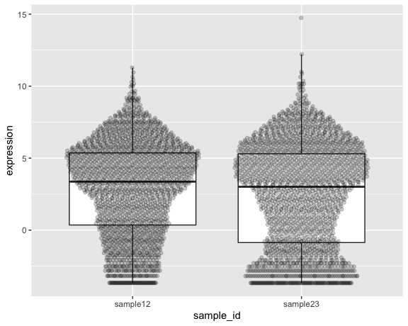

Slide 46
Popular alternative: violin plots
I’m less of a fan but these are used a lot as an alternative to box plots
dplyr::filter(two_gexp,expression > -4) %>% mutate(logexp=log(expression)) %>% group_by(sample_id) %>% slice_sample(n=2000) %>% ggplot(aes(x=sample_id,y=expression)) + geom_violin(aes(fill=sample_id))
## Warning in log(expression): NaNs produced

Slide 47
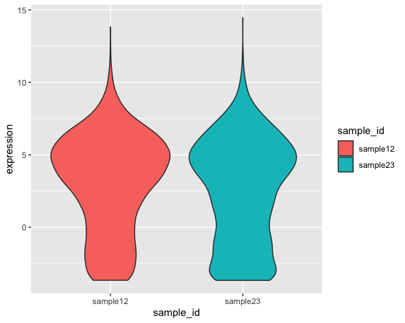

Slide 48
When tidy is too tidy
There are some scenarios in which you want to compare related variables between samples
Requires mapping aesthetics to subsets of the same column
Difficult to accomplish in a tidy format but can be dealt with with pivots or combinations of filter/join
paired_exp = pivot_wider(two_gexp, id_cols = "gene", names_from = "sample_id", values_from="expression")

Slide 49
Comparing two samples
ggplot(paired_exp,aes(x=sample12,y=sample23)) + geom_point(alpha=0.2) + xlim(c(-4,15)) + ylim(c(-4,15)) + theme_cowplot()
## Warning: Removed 11347 rows containing missing values (geom_point).

Slide 50
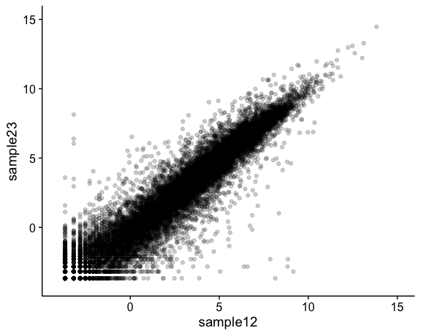

Slide 51
Adding useful colouring
We can derive a new column that will allow the points to be coloured based on the relationship between the two variables using mutate
paired_exp = paired_exp %>% mutate(diff=sample23-sample12) # calculate the difference between the two values ggplot(paired_exp,aes(x=sample12,y=sample23)) + geom_point(aes(colour=diff)) + scale_colour_continuous(type="viridis")

Slide 52
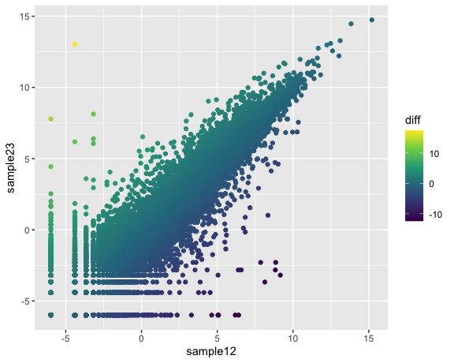

Slide 53
What can we learn from this?
Which genes are likely more highly expressed in sample23?
Which genes are likely more highly expressed in sample12?

Slide 54
Okay… what about normal charts?
Bar plots?
Pie charts?
Line charts?

Slide 55
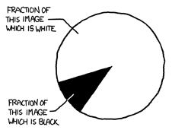
No pie charts!
Pie charts are a terrible way to represent any type of data
Human brains cannot convert wedges to area accurately, especially when differences are subtle
Bar charts can always replace pie charts and are always better
3D exploding pie charts are nonsense

Slide 56
Basic line chart with title
cd <- "data/covid19_cases_provinces_weekly.csv" canada <- read_csv(cd) # adding a title is as simple as layering a call to ggtitle() ggplot(canada, aes(x = week, y = cases, colour = province)) + geom_line() + ggtitle("COVID19 cases in Canada by province")

Slide 57
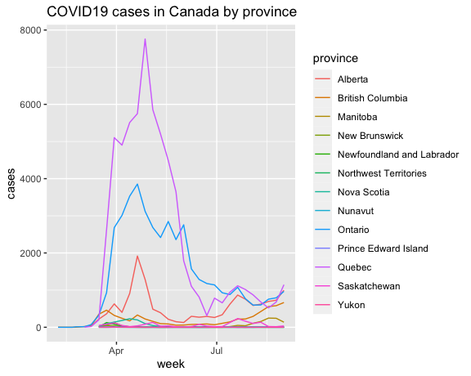

Slide 58
Adding points as a new layer
ggplot(canada, aes(x = week, y = cases, colour = province)) + geom_line() + geom_point()

Slide 59
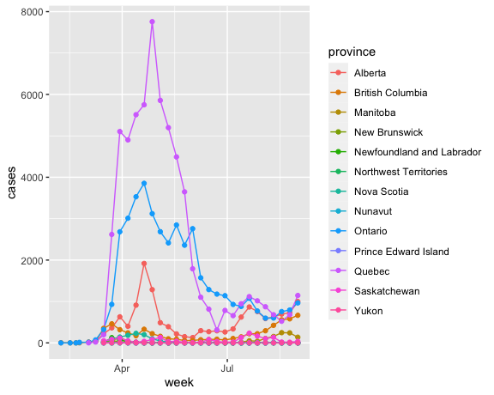

Slide 60
When are line charts (un)acceptable?
Is your X axis a continuous numeric value?
if no, then don’t use a line chart
Consider bar chart or boxplot instead.
Do you want to show the actual change between adjacent points instead of the trend?
if no, then consider a scatter plot with some smoothing

Slide 61
Smoothing instead of a line plot
ggplot(canada, aes(x = week, y = cases, colour = province)) + geom_point() + geom_smooth(stat="smooth",span=0.3)

Slide 62
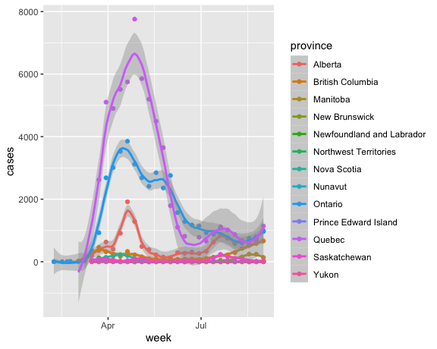

Slide 63
#change span to affect how much the line is affected by individual points

Slide 64
Preparing a basic bar chart
Let’s make a bar chart that shows percentages (i.e. the heights sum to 100)
This is the equivalent to a pie chart but representing the wedges as bars
We will represent the COVID19 deaths per province so first we need per-province totals and a denominator
canada_deaths = canada %>% group_by(province) %>% summarize(province_deaths=sum(deaths)) %>% ungroup() %>% mutate(country_deaths=sum(province_deaths))

Slide 65
Plotting the data
In ggplot, geom_bar naturally wants to plot the total number of occurrences in each group, which is not usually what we actually want
Instead, we can use geom_col (column chart?)
Note what our X axis labels look like when the group names are longer
# note that we can use mutate-like syntax within `aes` to calculate a new value for plotting but notice how it affects your axis labels ggplot(canada_deaths, aes(x=province, y=100*province_deaths/country_deaths)) + geom_col()

Slide 66
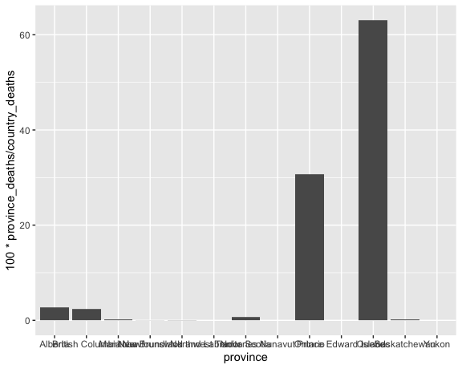

Slide 67
A prettier version
# note that we can use mutate-like syntax within `aes` to calculate # a new value for plotting but notice how it affects your axis labels ggplot(canada_deaths,aes(x=province,y=100*province_deaths/country_deaths, colour=province, fill=province)) + geom_col() + theme(axis.text.x = element_text(angle = 90, vjust = 0.5, hjust=1))

Slide 68
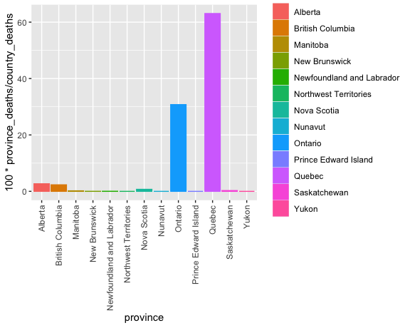

Slide 69
What if we adjust for population?
canada_deaths_pop = canada %>% group_by(province) %>% mutate(province_deaths=sum(deaths)) %>% slice_head() %>% ungroup() %>% mutate(death_per_million = 1000000 * province_deaths / population)

Slide 70
A more fair representation
# note that we can use mutate-like syntax within `aes` to calculate # a new value for plotting but notice how it affects your axis labels ggplot(canada_deaths_pop, aes(x=province, y=death_per_million, colour=province,fill=province)) + geom_col() + theme(axis.text.x = element_text(angle = 90, vjust = 0.5, hjust=1)) + theme(legend.position = 'none')

Slide 71
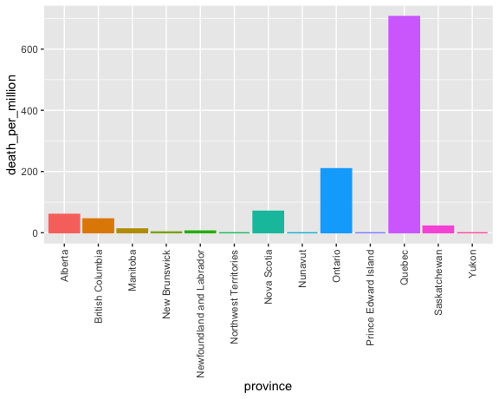

Slide 72
Altering the X axis order
Default order for axis is numeric or alphabetical (for character) ordering whereas factors are ordered based on the order of their “levels”
Factor levels are set when you define a factor vector and default to numeric/alphabetic ordering
If we combine factor() with unique() it will instead set the order to be based on the order of the first occurrence of each value in the vector

Slide 73
Altering the X axis order
my_char = c("C","Z","C","A","D","E","Z","C") my_fac = factor(my_char) my_fac
## [1] C Z C A D E Z C ## Levels: A C D E Z
my_fac = factor(my_char,levels=unique(my_char)) my_fac
## [1] C Z C A D E Z C ## Levels: C Z A D E

Slide 74
Order X using the value of Y
#use arrange to order data frame canada_deaths_pop = arrange(canada_deaths_pop,death_per_million) %>% mutate( province_ordered= factor(province,levels=unique(province))) # ensure you change the y for all your aesthetics ggplot(canada_deaths_pop, aes(x=province_ordered, y=death_per_million, colour=province_ordered, fill=province_ordered)) + geom_col() + theme(axis.text.x = element_text(angle = 90, vjust = 0.5, hjust=1))

Slide 75
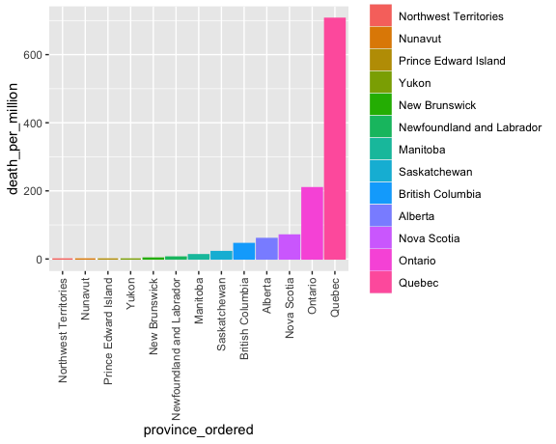

Slide 76
What if I like excel plots?
#library(ggthemes) filter(canada_deaths_pop, death_per_million>10) %>% ggplot(aes(x=province_ordered, y=death_per_million, fill=province_ordered)) + geom_col() + theme_excel(base_size = 12, base_family = "", horizontal = TRUE) + theme(axis.text.x = element_text(angle = 90, vjust = 0.5, hjust=1)) + scale_fill_excel()

Slide 77
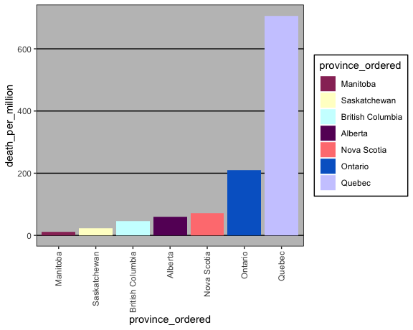

Slide 78
Recap
Each geometry has its own nuances that you will need to get comfortable with
Layering helps you build up complex plots, which makes each component easier to debug
Themes and scales both give you control over visuals such as labels and visual appearance/colours
The type of your variable affects how axes behave.
Try to consider whether something is a categorical variable and use factors when the answer is “yes”.

