Slide 1
Analysis of autologous binding preferences in RNA binding proteins
Bachelor’s project by Moritz Haderer
with contributions by Thomas Kapral and Arthur Theuer
Supervised by Bojan Žagrović
Žagrović research group at Max Perutz Labs Vienna
17.03.2022

Slide 2
Table of contents
The big picture
The dataset
Previous approaches and results
My project
Generalizing the notion of a “match”
FIMO
Preliminary results
Current topics
Acknowledgements

Slide 3
The big picture
Investigating binding preferences of RNA binding proteins (RBPs)
Complementarity hypothesis suggests higher affinity of RBPs for their own mRNAs
…UGCAAGCAAUAAGUCAUUGCCGUAUUA…
AAUAA
a MATCH in a random mRNA
an RBP
the RBP’s preferred motif
…AAUAAGCAAUAAGUCAUAAUAAUAUUA…
MATCHES in the autologous mRNA

Slide 4
The dataset

Slide 5
ATtRACT and HT-SELEX databases
HT-SELEX
Large experiment yielding 145 binding models for 86 RBPs
Motif lengths between 6 and 21 nt
contains structural and linear motifs
My analysis: linear motifs - 49 motifs
ATtRACT A daTabase of RNA binding proteins and AssoCiated moTifs
Collection of RBPs + motifs from various sources
Motif lengths between 4 and 12 nt
My analysis: Human RBPs determined by RNAcompete and SELEX
RNAcompete: 77 motifs SELEX: 44 motifs
77 + 44 + 49 = 170 RBPs used in analysis
Giudice G, Sánchez-Cabo F, Torroja C, Lara-Pezzi E. ATtRACT-a database of RNA-binding proteins and associated motifs. Database (Oxford). 2016;2016:baw035. Published 2016 Apr 7. doi:10.1093/database/baw035
Jolma A, Zhang J, Mondragón E, et al. Binding specificities of human RNA-binding proteins toward structured and linear RNA sequences. Genome Res. 2020;30(7):962-973. doi:10.1101/gr.258848.119

Slide 6
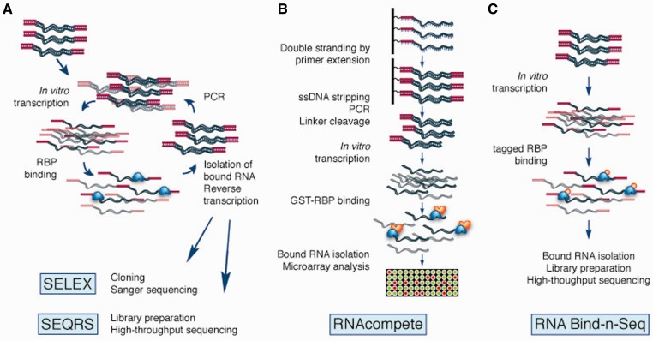
Figure 1: SELEX/HT-SELEX and RNAcompete experiments.
Cook KB, Hughes TR, Morris QD. High-throughput characterization of protein-RNA interactions. Brief Funct Genomics. 2015 Jan;14(1):74-89. doi: 10.1093/bfgp/elu047. Epub 2014 Dec 13. PMID: 25504152; PMCID: PMC4303715.
Notes:
SELEX: DNA pool is transcribed in vitro and RBP is added to the mix; unbound RNA is washed out; binders are reverse transcribed and used in another run;
HT-SELEX uses high throughput sequencing on binders after every run; monitor alternate binders
RNAcompete: Glutathione-S-transferase tagged RBP is incubated in a pool of RNA (RNA in excess). RNA competes for binding; binding sequences are eluted and hybridized to Microarray for analysis

Slide 7
MANE select transcriptome database
Joins Ensembl and RefSeq databases into one
contains transcripts of ~18 000 proteins of the human transcriptome (~98% of protein coding genes)
3’-UTR, coding sequence (CDS) and 5’-UTR available
serves as “background” in our analysis
— Does an RBP’s motif match the RBP’s own mRNA more closely than it matches any random mRNA from the whole transcript? —

Slide 8
Previous approaches and results
By Arthur Theuer and Thomas Kapral

Slide 9
Previous approaches
Looked at how frequently RBP motifs matched protein transcripts → notion of how well a transcript is “covered” by an RBP motif: coverage
Different approaches in determining coverage: exact matching, in-silico translation, position probability matrices
Calculated z-scores for motif-transcript-coverage
reported significant enrichment in autologous matching

Slide 10
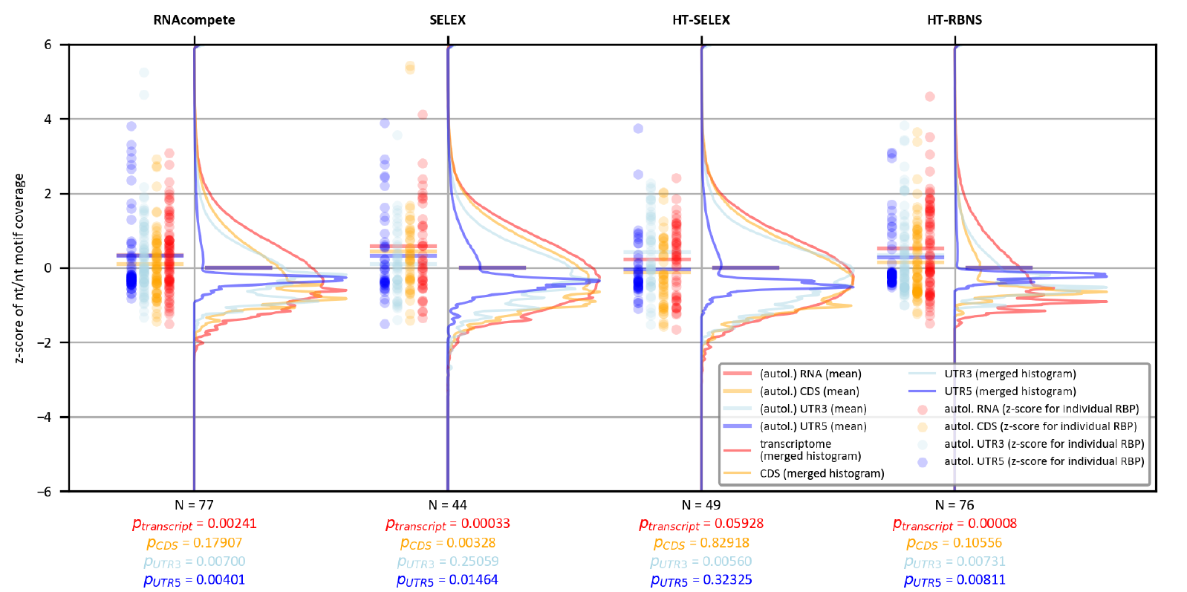

Slide 11
My project

Slide 12
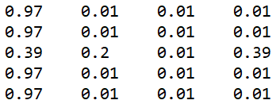
Generalizing the notion of a “match”
Problem? → in comes: The matrix
A C G U
…UGGCAGUAAGCAUCA…
NOT a MATCH in a transcript
Each letter has a probability
experimentally determined: very similar motifs are bound
above matrix’ favourite motifs: AAUAA and AAAAA
0.97 * 0.97 * 0.39 * 0.97 * 0.97 = 0.345
AAUAA
the RBP’s preferred motif
one of our RBPs

Slide 13
Computing a score
Let’s take a different matrix:
A C G U
0.2 0.3 0.4 0.1
0.5 0.2 0.3 0.0
0.1 0.4 0.0 0.5
0.8 0.0 0.1 0.1
0.6 0.1 0.0 0.3
We want to find meaningful matches a match = a high score for the motif
Determine a “good score”:
compute all possible scores and cut off bottom 95% → p-value of 0.05
Works for a short motif, but becomes inefficient quickly - different approach?
Approximate a cutoff → score most possibilities
…UGGCAGUAAGCAUCA…
What’s the score for this motif?
0.2 * 0.3 * 0.5 * 0.8 * 0.6 = 0.0144
Question: Is this a good score?

Slide 14
Types of matrices: PFM and PPM
Position frequency matrix (PFM)
Position probability matrix (PPM)
PFM is generated from the experiment
easily converted to PPM
PPM is converted to PSSM (see next slide)
A C G U
A C G U
1 3 5 1
3 3 1 3
3 0 4 3
2 5 2 1
4 5 1 0
0.1 0.3 0.5 0.1
0.3 0.3 0.1 0.3
0.3 0.0 0.4 0.3
0.2 0.5 0.2 0.1
0.4 0.5 0.1 0.0
Motif counts (PFM) divided by amount of motifs (here: 10)
Generated from motif counts in experiment

Slide 15
Types of matrices: Position-specific scoring matrix (aka. Position weight matrix)
Position-specific scoring matrix (PSSM aka. PWM)
uses “Log-likelihood ratios”: depends on the background nucleotide distribution A: 0.25 C: 0.25 G: 0.25 U:0.25
calculation: log2( 0.1 / 0.25 ) = -1.32
negative values: less likely than background would suggest
Used in my analysis for scoring a motif
A C G U
-1.32 0.26 1 -1.32
0.26 0.26 -1.32 0.26
0.26 -inf 0.67 0.26
-0.32 1 -0.32 -1.32
0.67 1 -1.32 -inf

Slide 16
Analysis tool: FIMO

Slide 17
FIMO - Find individual motif occurrences
Charles E. Grant, Timothy L. Bailey and William Stafford Noble, "FIMO: Scanning for occurrences of a given motif", Bioinformatics 27(7):1017-1018, 2011
Converts matrices to PSSMs (with log-likelihood ratios)
Runs every RBP motif matrix over every position of a sequence & calculates a score
Determines a p-value for every score
If p-value < user-specified p-value cutoff → MATCH!
…UGGCAGUAAGCAUCA…
…UGGCAGUAAGCAUCA…
…UGGCAGUAAGCAUCA…
…UGGCAGUAAGCAUCA…
Sequence: “UGGCAGUAAGCAUCA”
Motif “AGCAU” reaches a low enough p-value → MATCH!

Slide 18
FIMO found matches - what now?
Our 170 RBP motif matrices met every transcript (18 000~ protein transcripts)
For each RBP motif - transcript pair a coverage value is calculated:
Transcript: “UGGCAGUAAGCAUCA”
RBP motif “AGCAU” has a low enough p-value → MATCH!
Coverage: Transcript letters are turned into zeros: 00000000000000 → MATCHED part turned into ones: 00000000111110 → MEAN of sequence is calculated: sum = 5, length = 14 → mean = 5/14 = 0.36 ← coverage

Slide 19
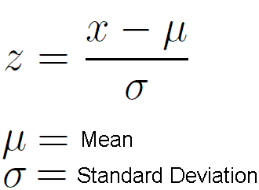
FIMO found matches - what now?
Each RBP motif now has 10 000~ coverage values (one per sequence)
z-score for each coverage value is calculated:
x = coverage
µ = mean of all coverages per RBP motif
σ = standard deviation of all coverages per RBP motif
— Finally: z-scores are plotted and their p-values calculated —

Slide 20
Preliminary results

Slide 21
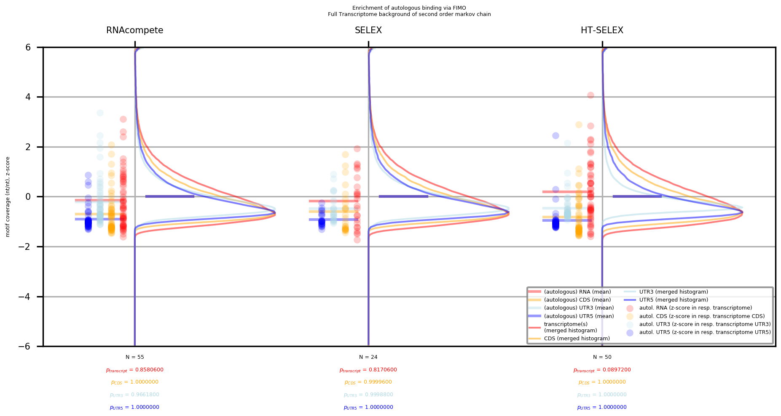

Slide 22
Current topics
P-value cutoff of 0.001 was too stringent to give meaningful results → how well does the RBP motif have to fit the sequence?
Less stringent cutoff leads to more “valid” matches → less smoothly distributed results?
FIMO analysis with a p-value cutoff of 0.01 yielded 100gb~ of data → code needs to be adapted to handle it without RAM problems

Slide 23
Acknowledgements
Many thanks to …
Bojan Žagrović for supervising my project
Thomas Kapral for the invaluable support and the technical groundwork
Arthur Theuer for laying the foundation for my project

Slide 24
Thanks for the attention!

