Slide 1
Domain generalized contrastive learning in medical imaging
Moritz Haderer

Slide 2
Outline
The What and the How
Domain generalization
Paper review:
Overview
Method
Algorithm
Results
Open questions
Summary

Slide 3
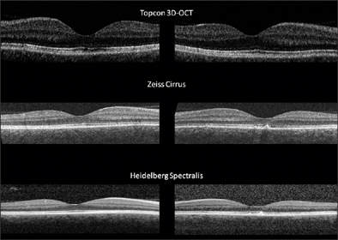
Motivation: OCT imaging with domain shifts
Optical coherence tomography (OCT)
Task: Segmentation of disease markers
Different OCT scanners produce different results:
IRENE A. BARBAZETTO, MD, SANDRINE A. ZWEIFEL, MD, MICHAEL ENGELBERT, MD, PhD, K. BAILEY FREUND, MD, JASON S. SLAKTER, MD. (2009). Spectral-domain Optical Coherence Tomography: A Real-world Comparison. In Retinal Physician, Issue: June 2009

Slide 4
Motivation: OCT imaging with domain shifts
Optical coherence tomography (OCT)
Task: Segmentation of disease markers
Problems:
Domain shift
Lots of unannotated data
Need for contrastive setting
Different OCT scanners produce different results:
IRENE A. BARBAZETTO, MD, SANDRINE A. ZWEIFEL, MD, MICHAEL ENGELBERT, MD, PhD, K. BAILEY FREUND, MD, JASON S. SLAKTER, MD. (2009). Spectral-domain Optical Coherence Tomography: A Real-world Comparison. In Retinal Physician, Issue: June 2009

Slide 5
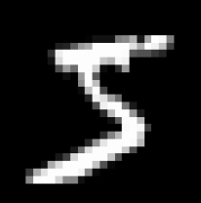

Domain adaptation
Vocab: Source and Target domain
S
T

Slide 6
Domain adaptation
Vocab: Source and Target domain
Goal: Accurate predictions despite varying input distributions
S
Prediction: 5
T

Slide 7
Domain adaptation
Vocab: Source and Target domain
Goal: Accurate predictions despite varying input distributions
Methods:
Style transfer: take it from domain 2 to domain 1
Prediction: 5
S
T

Slide 8
Domain adaptation
Vocab: Source and Target domain
Goal: Accurate predictions despite varying input distributions
Methods:
Style transfer: take it from domain 2 to domain 1
Domain invariance: learn what a 5 looks like no matter the domain
S
Prediction: 5
T

Slide 9
Domain adaptation
Vocab: Source and Target domain
Goal: Accurate predictions despite varying input distributions
Methods:
Style transfer: take it from domain 2 to domain 1
Domain invariance: learn what a 5 looks like no matter the domain
Benefit: More generalized model
S
Prediction: 5
T

Slide 10
Domain adaptation
Vocab: Source and Target domain
Goal: Accurate predictions despite varying input distributions
Methods:
Style transfer: take it from domain 2 to domain 1
Domain invariance: learn what a 5 looks like no matter the domain
Benefit: More generalized model
S
Prediction: 5
T

Slide 11
Paper: Noise transfer for unsupervised domain adaptation of retinal OCT images

Slide 12
High-level overview
Koch, V., Holmberg, O., Spitzer, H., Schiefelbein, J., Asani, B., Hafner, M., & Theis, F. J. (2022). Noise transfer for unsupervised domain adaptation of retinal OCT images (Vol. 13432, pp. 699–708).
IRENE A. BARBAZETTO, MD, SANDRINE A. ZWEIFEL, MD, MICHAEL ENGELBERT, MD, PhD, K. BAILEY FREUND, MD, JASON S. SLAKTER, MD. (2009). Spectral-domain Optical Coherence Tomography: A Real-world Comparison. In Retinal Physician, Issue: June 2009

Slide 13
High-level overview
Noise is decisive factor
Koch, V., Holmberg, O., Spitzer, H., Schiefelbein, J., Asani, B., Hafner, M., & Theis, F. J. (2022). Noise transfer for unsupervised domain adaptation of retinal OCT images (Vol. 13432, pp. 699–708).
IRENE A. BARBAZETTO, MD, SANDRINE A. ZWEIFEL, MD, MICHAEL ENGELBERT, MD, PhD, K. BAILEY FREUND, MD, JASON S. SLAKTER, MD. (2009). Spectral-domain Optical Coherence Tomography: A Real-world Comparison. In Retinal Physician, Issue: June 2009

Slide 14
High-level overview
Noise is decisive factor
Source: labeled
Target: unlabeled
Koch, V., Holmberg, O., Spitzer, H., Schiefelbein, J., Asani, B., Hafner, M., & Theis, F. J. (2022). Noise transfer for unsupervised domain adaptation of retinal OCT images (Vol. 13432, pp. 699–708).
IRENE A. BARBAZETTO, MD, SANDRINE A. ZWEIFEL, MD, MICHAEL ENGELBERT, MD, PhD, K. BAILEY FREUND, MD, JASON S. SLAKTER, MD. (2009). Spectral-domain Optical Coherence Tomography: A Real-world Comparison. In Retinal Physician, Issue: June 2009

Slide 15
High-level overview
Noise is decisive factor
Source: labeled
Target: unlabeled
Goals:
Good model for all domains
Koch, V., Holmberg, O., Spitzer, H., Schiefelbein, J., Asani, B., Hafner, M., & Theis, F. J. (2022). Noise transfer for unsupervised domain adaptation of retinal OCT images (Vol. 13432, pp. 699–708).
IRENE A. BARBAZETTO, MD, SANDRINE A. ZWEIFEL, MD, MICHAEL ENGELBERT, MD, PhD, K. BAILEY FREUND, MD, JASON S. SLAKTER, MD. (2009). Spectral-domain Optical Coherence Tomography: A Real-world Comparison. In Retinal Physician, Issue: June 2009

Slide 16
High-level overview
Noise is decisive factor
Source: labeled
Target: unlabeled
Goals:
Good model for all domains
Koch, V., Holmberg, O., Spitzer, H., Schiefelbein, J., Asani, B., Hafner, M., & Theis, F. J. (2022). Noise transfer for unsupervised domain adaptation of retinal OCT images (Vol. 13432, pp. 699–708).
IRENE A. BARBAZETTO, MD, SANDRINE A. ZWEIFEL, MD, MICHAEL ENGELBERT, MD, PhD, K. BAILEY FREUND, MD, JASON S. SLAKTER, MD. (2009). Spectral-domain Optical Coherence Tomography: A Real-world Comparison. In Retinal Physician, Issue: June 2009

Slide 17
High-level overview
Noise is decisive factor
Source: labeled
Target: unlabeled
Goals:
Good model for all domains
Segment disease markers
Koch, V., Holmberg, O., Spitzer, H., Schiefelbein, J., Asani, B., Hafner, M., & Theis, F. J. (2022). Noise transfer for unsupervised domain adaptation of retinal OCT images (Vol. 13432, pp. 699–708).
IRENE A. BARBAZETTO, MD, SANDRINE A. ZWEIFEL, MD, MICHAEL ENGELBERT, MD, PhD, K. BAILEY FREUND, MD, JASON S. SLAKTER, MD. (2009). Spectral-domain Optical Coherence Tomography: A Real-world Comparison. In Retinal Physician, Issue: June 2009

Slide 18
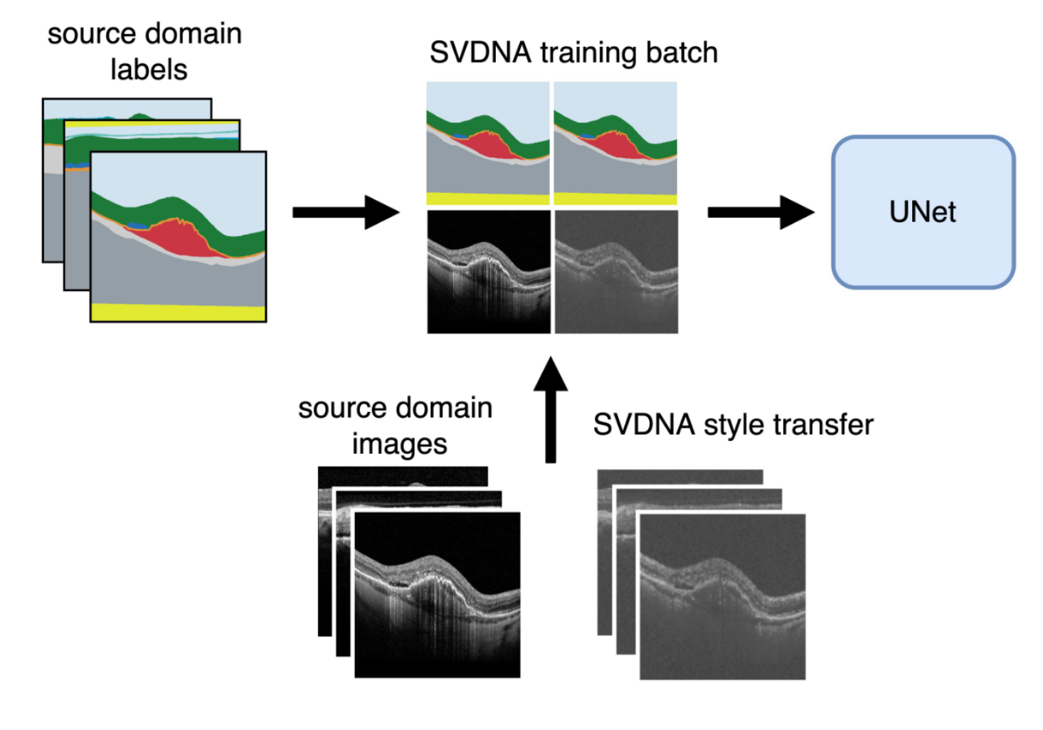
Method
SVDNA: SVD noise adaptation
Koch, V., Holmberg, O., Spitzer, H., Schiefelbein, J., Asani, B., Hafner, M., & Theis, F. J. (2022). Noise transfer for unsupervised domain adaptation of retinal OCT images (Vol. 13432, pp. 699–708).

Slide 19
Method
Novel: style transfer for OCT-noise
SVDNA: SVD noise adaptation
Koch, V., Holmberg, O., Spitzer, H., Schiefelbein, J., Asani, B., Hafner, M., & Theis, F. J. (2022). Noise transfer for unsupervised domain adaptation of retinal OCT images (Vol. 13432, pp. 699–708).

Slide 20
Method
Novel: style transfer for OCT-noise
Benefits:
Easy implementation
Framed as augmentation step
SVDNA: SVD noise adaptation
Koch, V., Holmberg, O., Spitzer, H., Schiefelbein, J., Asani, B., Hafner, M., & Theis, F. J. (2022). Noise transfer for unsupervised domain adaptation of retinal OCT images (Vol. 13432, pp. 699–708).

Slide 21
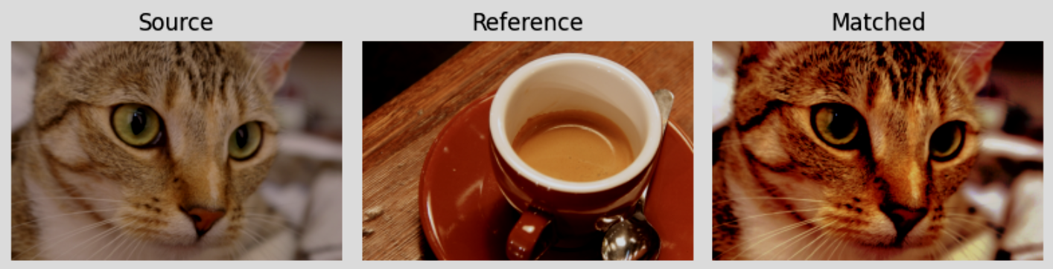
Method
Novel: style transfer for OCT-noise
Benefits:
Easy implementation
Framed as augmentation step
Histogram matching after SVDNA step
SVDNA: SVD noise adaptation
Histogram matching figure: https://scikit-image.org/docs/stable/auto_examples/color_exposure/plot_histogram_matching.html
Koch, V., Holmberg, O., Spitzer, H., Schiefelbein, J., Asani, B., Hafner, M., & Theis, F. J. (2022). Noise transfer for unsupervised domain adaptation of retinal OCT images (Vol. 13432, pp. 699–708).

Slide 22
Noise transfer
Noise from
unlabeled target domain (im_{target})
transferred to
labeled source domain (im_{source})
Koch, V., Holmberg, O., Spitzer, H., Schiefelbein, J., Asani, B., Hafner, M., & Theis, F. J. (2022). Noise transfer for unsupervised domain adaptation of retinal OCT images (Vol. 13432, pp. 699–708).

Slide 23
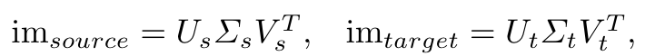
Noise transfer
Noise from
unlabeled target domain (im_{target})
transferred to
labeled source domain (im_{source})
Koch, V., Holmberg, O., Spitzer, H., Schiefelbein, J., Asani, B., Hafner, M., & Theis, F. J. (2022). Noise transfer for unsupervised domain adaptation of retinal OCT images (Vol. 13432, pp. 699–708).

Slide 24

Noise transfer
Noise from
unlabeled target domain (im_{target})
transferred to
labeled source domain (im_{source})
Koch, V., Holmberg, O., Spitzer, H., Schiefelbein, J., Asani, B., Hafner, M., & Theis, F. J. (2022). Noise transfer for unsupervised domain adaptation of retinal OCT images (Vol. 13432, pp. 699–708).

Slide 25
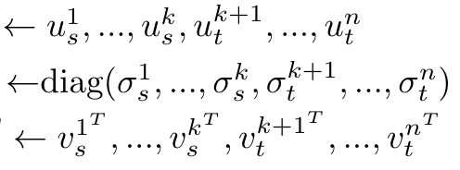
Noise transfer
Noise from
unlabeled target domain (im_{target})
transferred to
labeled source domain (im_{source})
Koch, V., Holmberg, O., Spitzer, H., Schiefelbein, J., Asani, B., Hafner, M., & Theis, F. J. (2022). Noise transfer for unsupervised domain adaptation of retinal OCT images (Vol. 13432, pp. 699–708).

Slide 26

Noise transfer
Noise from
unlabeled target domain (im_{target})
transferred to
labeled source domain (im_{source})
Koch, V., Holmberg, O., Spitzer, H., Schiefelbein, J., Asani, B., Hafner, M., & Theis, F. J. (2022). Noise transfer for unsupervised domain adaptation of retinal OCT images (Vol. 13432, pp. 699–708).

Slide 27
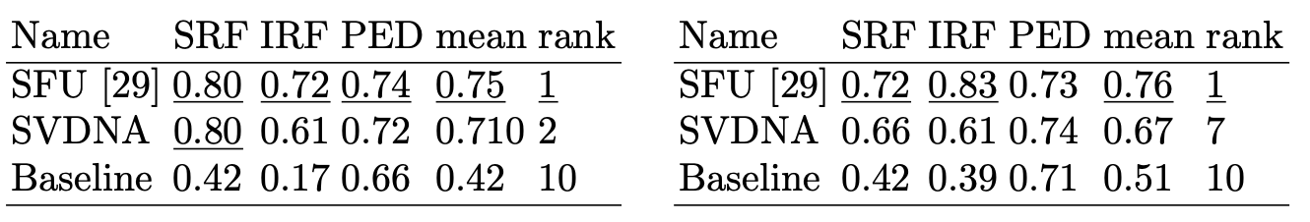
Results
U-Net learns to segment 13 disease markers
Model tested on RETOUCH dataset
Segmentation of 3 disease markers (IRF, SRF, PED)
SFU: Supervised OCT segmentation model
Target domain 1
Target domain 2
Koch, V., Holmberg, O., Spitzer, H., Schiefelbein, J., Asani, B., Hafner, M., & Theis, F. J. (2022). Noise transfer for unsupervised domain adaptation of retinal OCT images (Vol. 13432, pp. 699–708).
Hrvoje Bogunovic et al. 2019. RETOUCH -The Retinal OCT Fluid Detection and Segmentation Benchmark and Challenge, IEEE Transactions on Medical Imaging, vol 38(8), pp. 1858-1874, 2019.

Slide 28
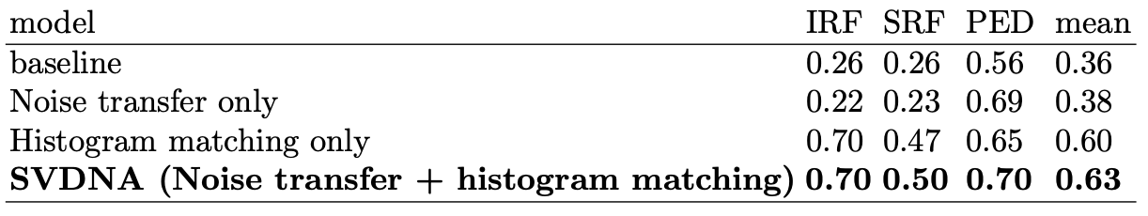
Open questions – ablation study
Why large performance difference for disease markers?
dice score
Koch, V., Holmberg, O., Spitzer, H., Schiefelbein, J., Asani, B., Hafner, M., & Theis, F. J. (2022). Noise transfer for unsupervised domain adaptation of retinal OCT images (Vol. 13432, pp. 699–708).

Slide 29
Open questions – ablation study
Why large performance difference for disease markers?
Histogram matching makes large difference
dice score
Koch, V., Holmberg, O., Spitzer, H., Schiefelbein, J., Asani, B., Hafner, M., & Theis, F. J. (2022). Noise transfer for unsupervised domain adaptation of retinal OCT images (Vol. 13432, pp. 699–708).

Slide 30
Open questions – ablation study
Why large performance difference for disease markers?
Histogram matching makes large difference
Highly diseased target: more false negatives by artifact introduction?
dice score
Koch, V., Holmberg, O., Spitzer, H., Schiefelbein, J., Asani, B., Hafner, M., & Theis, F. J. (2022). Noise transfer for unsupervised domain adaptation of retinal OCT images (Vol. 13432, pp. 699–708).

Slide 31
Open questions – ablation study
Why large performance difference for disease markers?
Histogram matching makes large difference
Highly diseased target: more false negatives by artifact introduction?
Integrate SVDNA into unlabeled contrastive setting
dice score
Koch, V., Holmberg, O., Spitzer, H., Schiefelbein, J., Asani, B., Hafner, M., & Theis, F. J. (2022). Noise transfer for unsupervised domain adaptation of retinal OCT images (Vol. 13432, pp. 699–708).

Slide 32
Summary
OCT imaging in ML-diagnostics
Unlabeled data from different domains:
Increase accuracy despite domain shift
SVDNA:
Image noise transfer via SVD
Domain generalized OCT-scan segmentation
Useful for contrastive setting?

Slide 33
Thank you!

