Slide 1
Europeanization: EU and Nation-States
ES/SOC 237
February 16, 2019

Slide 2
Plan for the Class
News Reports
Previous class recap
An attempt to understand what the EU is and does
First step to explore Europeanization

Slide 3
Previous Class Recap
State
Nation
Nation-State

Slide 4
But first,
what is the European Union?

Slide 5

The European Union is a political and economic union of 28 European countries
Notes:
© Copyright PresentationGo.com – The free PowerPoint template library

Slide 6
The EU countries:
Austria
Belgium
Bulgaria
Croatia
Cyprus
Czech Republic
Denmark
Estonia
Finland
France
Germany
Greece
Hungary
Ireland
Italy
Latvia
Lithuania
Luxembourg
Malta
Netherlands
Poland
Portugal
Romania
Slovakia
Slovenia
Spain
Sweden
United Kingdom
Notes:
© Copyright PresentationGo.com – The free PowerPoint template library

Slide 7
What countries are not in the EU?
Iceland
Norway
Switzerland
Turkey
Belarus
Ukraine
Moldova
Andorra
Lichtenstein
Monaco
San Marino
Vatican
Bosnia and Herzegovina
Serbia
Montenegro
Kosovo
Albania
Notes:
© Copyright PresentationGo.com – The free PowerPoint template library

Slide 8
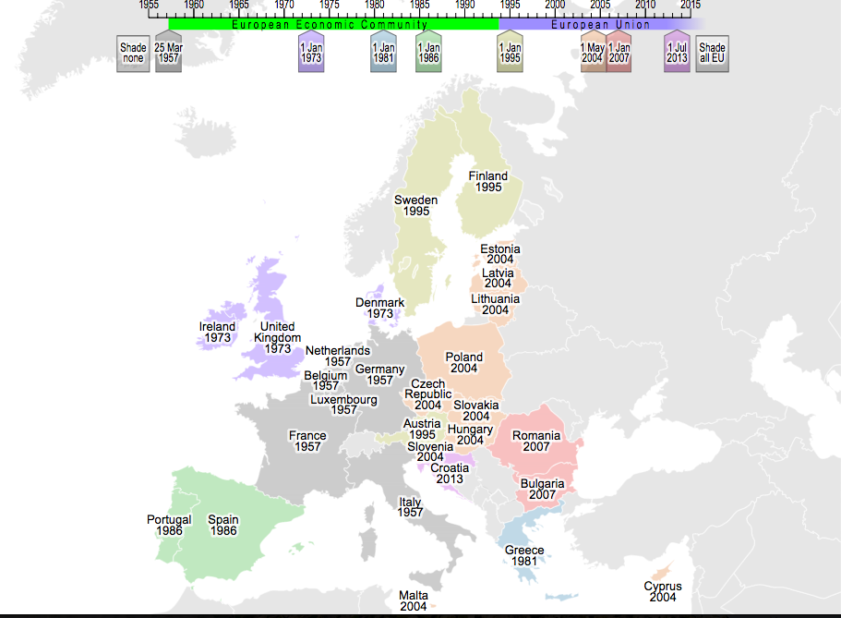
Bringing Europe Together

Slide 9
EU at a glance
What is the European Union? | BBC Newsbeat
https://www.youtube.com/watch?v=8G1cds52Ko0
The European Union Explained*
https://www.youtube.com/watch?v=O37yJBFRrfg&t=123s
At home with the European institutions
https://www.youtube.com/watch?v=5fL9SPNRCrg
The EU institutions explained by their Presidents
https://www.youtube.com/watch?v=d0diZ48_q7U

Slide 10
What is Europeanization?
Contested and multifaceted concept
Internal vs. External
Top-down, horizontal, two-way
No Europeanization concept is exclusive, rather complementary

Slide 11
What is Europeanization?
A single European culture (Roman Empire, Christianity, Renaissance, Baroque age, Enlightenment, French revolution)
Europeanization of the Earth (colonization, soft power) – exporting norms and values
European continental identity, which is above national identities
EU-nization (internal, external – cooperation or coercion?)

Slide 12
Explanations of Europeanization
Two major studies:
How member states shape EU policies, politics, and polity
How the EU triggers change in member state policies, politics, and polity

Slide 13
Europeanization: internally
Increasing size and power of the EU
Changing conditions of membership and action
Stereotypes: North/South and East/West
Test to integrate peripheral nations
Top-down
Horizontal (bottom-up)
Two-way

Slide 14

National governments and other domestic actors
European Union
through its institutions
The EU's
Acquis Communautaire

Slide 15
Competences of the EU
Treaty on the Functioning of the European Union (Lisbon, 2007):
Exclusive | Shared | Supporting
"The Union has exclusive competence to make directives and conclude international agreements when provided for in a Union legislative act" | 1. "Member States cannot exercise competence in areas where the Union has done so" | "The Union can carry out actions to support, coordinate or supplement Member States' actions in"
 | 2. “Union exercise of competence shall not result in Member States being prevented from exercising theirs in"
 | 3. "The Union coordinates Member States policies or implements supplemental to theirs common policies, not covered elsewhere"

Slide 16
Exclusive Competences
the customs union
the establishing of the competition rules necessary for the functioning of the internal market
monetary policy for the Member States whose currency is the euro
the conservation of marine biological resources under the common fisheries policy
Common Commercial Policy
conclusion of certain international agreements

Slide 17
Shared Competences
1. the internal market social policy, for the aspects defined in this Treaty economic, social and territorial cohesion agriculture and fisheries, excluding the conservation of marine biological resources environment consumer protection transport trans-European networks energy the area of freedom, security and justice common safety concerns in public health matters, for the aspects defined in this Treaty | 2. research, technological development and (outer) space development cooperation, humanitarian aid
 | 3. coordination of economic, employment and social policies common foreign, security and defence policies

Slide 18
Supporting Competences
the protection and improvement of human health
industry
culture
tourism
education, youth, sport and vocational training
civil protection (disaster prevention)
administrative cooperation

Slide 19
Top-Down
How the EU triggers domestic change in member states and third countries
Created by Eurocrats
Shared beliefs and norms are first consolidated at the EU policy level
Maximization, optimization or minimization?
Spill-over effect (ECSC => EEC)

Slide 20
Top-Down
Rationalist approach: EU makes domestic changes happen by changing opportunity structures for domestic actors (cost-benefit: additional resources)
Constructivist approach: logic of appropriateness: actors are guided by their understanding of socially accepted behavior (local actors – advocacy, NGOs – will push for compliance) – Environmental Policy
More efficient administrations are better takers (Denmark, UK, Sweden vs. France, Italy, Greece)
Case of third countries: Copenhagen criteria, ENP

Slide 21
National governments and other domestic actors
European Union
through its institutions
Triggers domestic change
The EU's
Acquis Communautaire
Misfit in domestic policies, politics, or polity

Slide 22
Bottom-Up
How states upload their preferences at the EU level
2 studies:
intergovernmental conferences
daily decision-making
Rationalist approach: actors have fixed and predefined interests, which they lobby
Constructivist approach: actors are open to persuasion (can change their interests in presence of good arguments)

Slide 23
Bottom-Up
Rationalist approach:
Intergovernmentalism – states with more votes at the EU Council are better positioned, they form winning coalitions and act through concessions (package deals and side payments) and threats (Common Fisheries Policy – fishing quotas and access to fishing areas)
Constructivist approach:
States are more successful in shaping policy outcomes, if their arguments resonate well with the beliefs and norms of other actors (CAP Luxembourg – wanted to limit the EU budget spent on CAP)

Slide 24
National governments and other domestic actors
European Union
through its institutions
Misfit between EU policies, politics or polity and states’ preferences
The EU's
Acquis Communautaire
Triggers change in the EU

Slide 25
Two-Way: Sequential Perspective
Member states, which have enough powers to upload their preferences successfully, have fewer difficulties in downloading them

