Slide 1
Dynamic Multi-core Interference Mitigation
Dynamic Mitigation of Multi-Core Interference in Safety-Critical Systems

Slide 2
Agenda
Multi-Core Architecture & Interference
Mitigation Strategies
Dynamic Mitigation using WebAssembly
Concept Demonstrator
Evaluation

Slide 3
Multi-Core ArchitectureS

Slide 4
Multi-Core Architectures
State of the Art since early 2000 in Workstations, Servers, Embedded, …
Avionics still using Single-Core or Single-Active Core in the 2020s
Why?
Notes:
-There is a large gap in the success of multi-core processors between general-purpose systems and avionivs. Why?

Slide 5
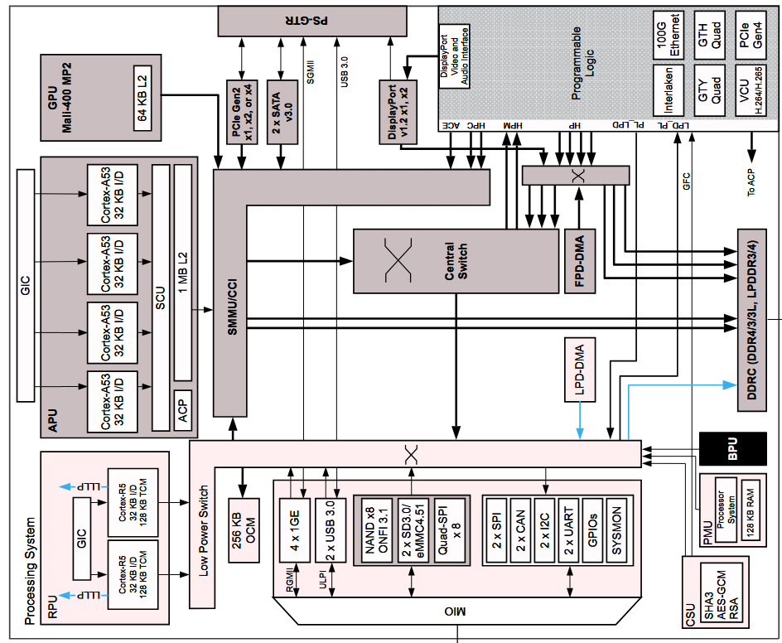
Multi-Core Interference
Advantage
More: Compute Power
Less: Power, Size, Weight
Enabled by Caches, Interconnects
  → Shared Resources
Problem
Shared Resources need Arbitration / Allocation policies
→ Temporal Interference between Cores
AMD/Xilinx Zynq UltraScale+ MPSoC Embedded Design Methodology Guide (UG1228)
Notes:
Multi-Core processors are awesome, we want to use them. But the enabler of theses advantages is at the same time the troublemaker in critical-systems

Slide 6
Multi-Core Interference
Notes:
Just a few examples of interference channels in COTS hardware.

Slide 7
Mitigation Strategies

Slide 8
Mitigation Strategies
Static Mitigation
Cache Partitioning
Schedulability Analysis
Disabling Secondary Cores (Single-Active Core)
→ Causes a lot of performance degradation
→ Often only mitigates a specific Interference Channel
→ Requires intricate knowledge of Hardware Implementation
Notes:
Can we do something about it? Yes, static mitigation techniques exist. But they impede directly on the multi-core advantages and are difficult to apply in general.

Slide 9
Mitigation Strategies
Trade-Off has to be made
It’s Not
Multi-Core
Multi-Core Advantages
Single-Core
Multi-Core
Temporal Determinism
Multi-Core Interference
Notes:
Trade-Off between Single Core Temporal Determinsim and Multi-Core Advantages. What if we could do the trade-off at runtime?

Slide 10
Mitigation Strategies
Naïve Idea
Interference degrades Execution Speed
Execution Speed is observable
Interference is caused by Software Execution
Software Execution is controllable
Notes:
Introduce ingredients of dynamic mitigation

Slide 11
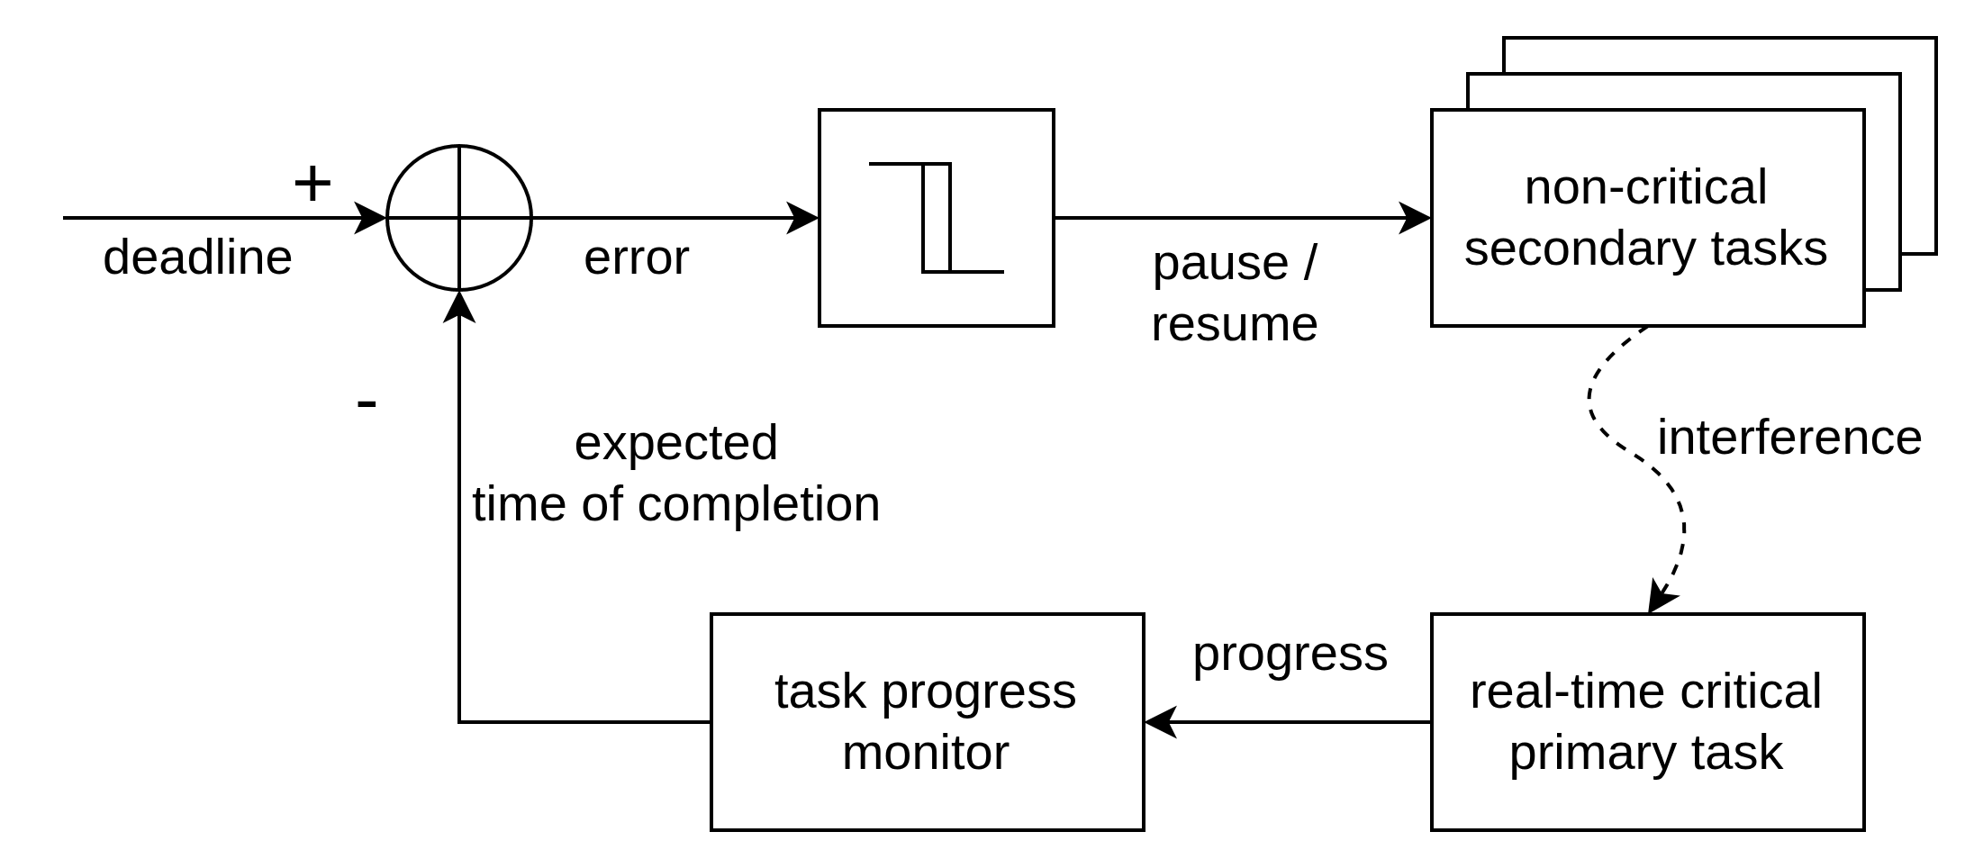
Mitigation Strategies
Dynamic Mitigation
Measure Computational Progress
Extrapolate throughput to
exp. Time-of-Completion
Control-Loop to keep deadline
Activate Mitigation if necessary
Notes:
Lets bake a control law.

Slide 12
Mitigation Strategies
Advantages
Disadvantages
Independent of interference channel mechanism
Catches all interference caused by software
No hardware knowledge required
Only one Critical Task can run at any time
All other Tasks have to be considered Non-Critical
Notes:
Advantages of dynamic mitigation in contrast to static techniques.

Slide 13
Mitigation Strategies
Dynamic Mitigation
How to measure the Computational Progress?
In Software: Checkpoints
  In known Intervals (fixed amount of Compute between Checkpoints)
  → Intrusive to the Application
In Hardware: Performance Monitoring Unit
  I.e. via Instruction Counting
  → Causes tight coupling between Software and Hardware
Notes:
How can we actually observe the progress? Checkpoints and PMU is already known, but has drawbacks that must be taken into account, but in virtual hardware (interpreter) it becomes easy.

Slide 14
Dynamic mitigation with WebAssembly

Slide 15
WebAssembly
Virtual Instruction Set Architecture
  Not Programming Language
Open, Formal Specification
Strict Spatial Isolation
Strict Type-Checking and Validation at Runtime
→ Potentially valuable for Avionics?
Notes:
Short overview over what makes wasm suitable for safety critical

Slide 16
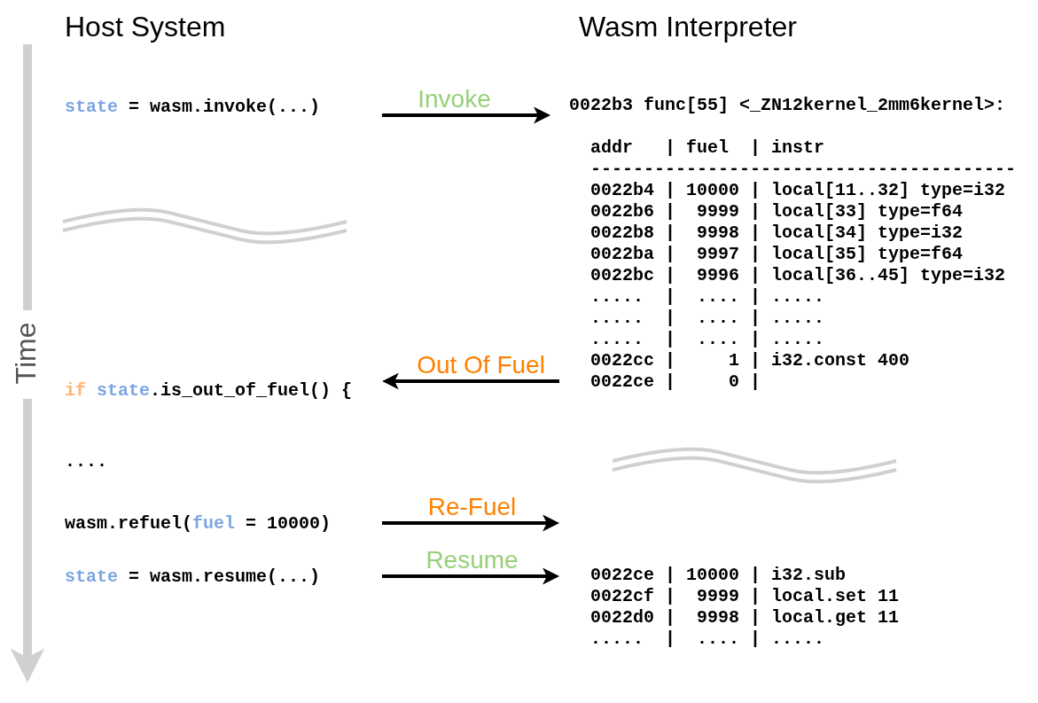
WebAssembly
Fuel Mechanism
Notes:
How does fuel work?

Slide 17
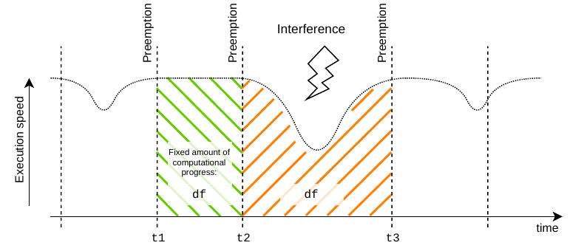
Dynamic Mitigation with WebAssembly
Wasm Fuel Consumption equals Computational Progress
df := const. Amount of Fuel
throughput = df/dt
Notes:
How does fuel-based observation behave in the context of interference.

Slide 18
Concept Demonstrator

Slide 19
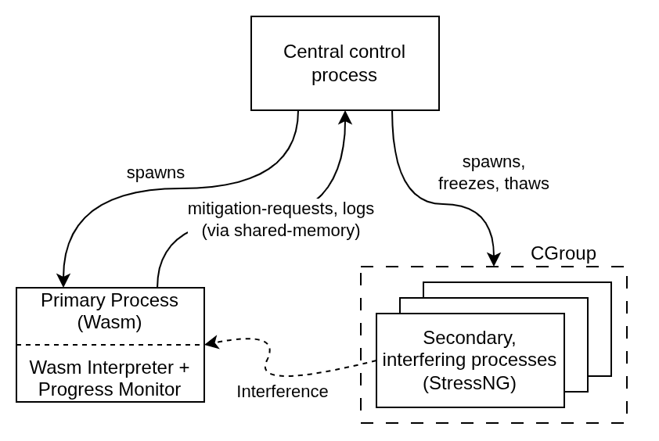
Concept Demonstrator
Linux based
DLR Wasm Interpreter with a Resumable Fuel Mechanism
StressNG for heavy interference
→ Goal: Show Qualitative Feasibility
Notes:
Goal: Show that the idea works in principle, accepting that this specific implementation is not production grade

Slide 20
Evaluation

Slide 21
Evaluation
Can WebAssembly Fuel be used to detect Multi-Core Interference?
Is the Dynamic Mitigation Strategy effective?
How efficient is the Dynamic Mitigation?
Notes:
First quantitative evaluation of the approach.
What are the questions we want to answer.

Slide 22
Evaluation
Detect Interference
Empirical Evaluation of Computational Throughput
→ WebAssembly Fuel can be used to detect Interference
Description | Without Interference | With Interference
Mean Throughput | 19.8 ns / fuel | 29.3 ns / fuel
Median Throughput | 9.8 ns / fuel | 9.9 ns / fuel
Median Throughput, only Outliers | 310 ns / fuel | 610 ns / fuel
Notes:
Yes, we can use WASM Fuel to observe progress and interference at runtime.

Slide 23
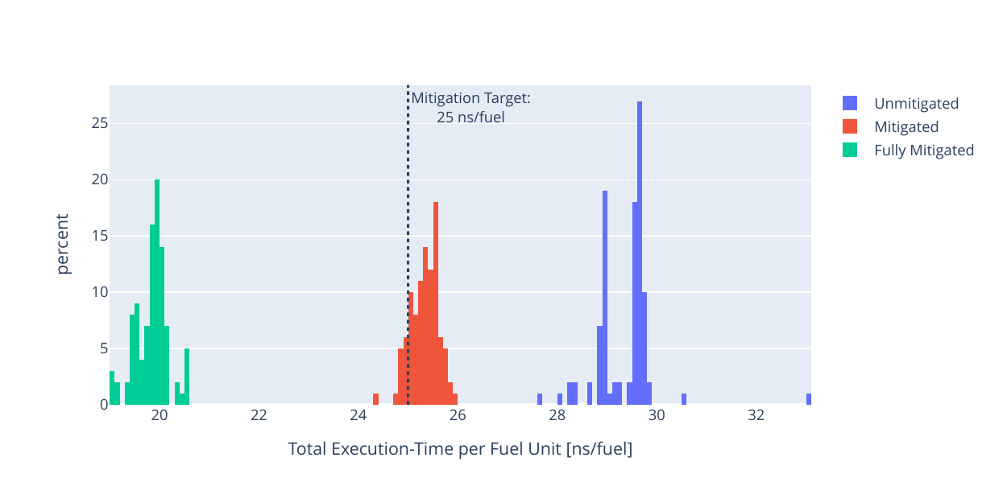
Evaluation
Efficacy 1 / 2
Statistical Evaluation of N = 100 Runs
→ Dynamic Mitigation is effective
Notes:
The control-loop is effective.

Slide 24
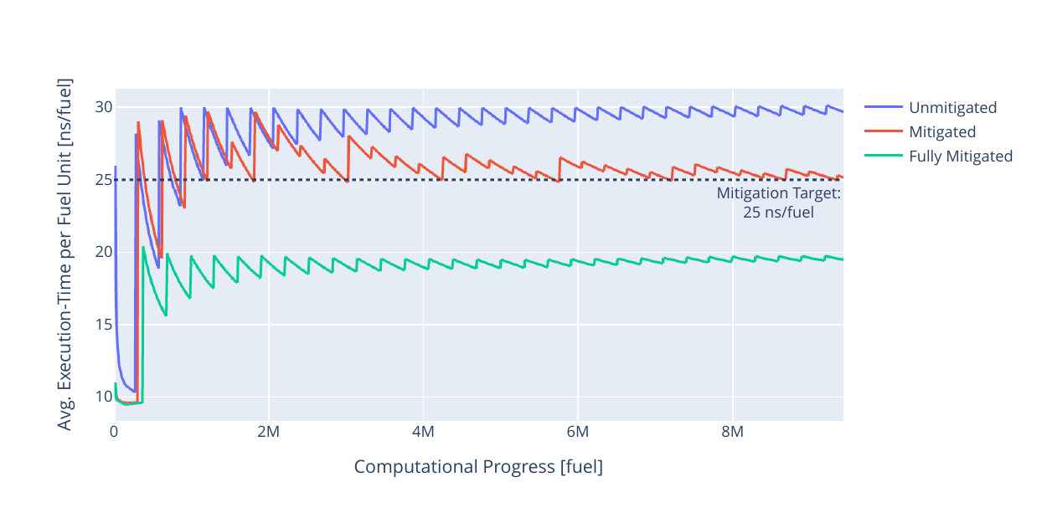
Evaluation
Efficacy 2 / 2
Example: Single Run
Notes:
Just an specific example to show the control loop is working.

Slide 25
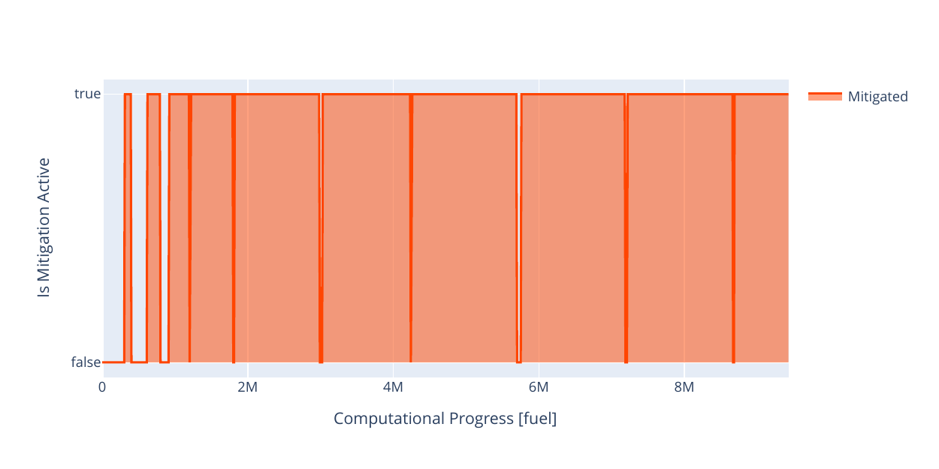
Evaluation
Efficiency
Mitigation Activity
→ Less than 10% of Compute on secondary Core remaining
Notes:
But it is not efficient. Only a small fraction of multi-core advantages are preserved.

Slide 26
Limitations & Outlook

Slide 27
Limitations
General
Significant Performance Impact due to Interpretation
Only a single Task at any time can be considered “Critical”
Interference originating from the Hardware (DMA, etc) can not be mitigated
Demonstrator Specific
Assumption of 1 Wasm Instr. ~ 1 Fuel Unit not accurate
Current Primary and Secondary Test Tasks not realistic
Linux based Demonstrator not a suitable Testbed to answer Questions quantitatively
Notes:
limitations

Slide 28
Outlook
Dynamic Mitigation is promising, but much more Research is necessary
Future Work:
  Port Demonstrator to Bare-Metal setup with proper Tracing
  Switch Test Tasks for more realistic, or more nuanced Tasks
Next Research Requestion:
→ Does this Dynamic Mitigation Approach entail any Temporal Guarantees?
Notes:
What next?

Slide 29
Imprint
Topic: Dynamic Mitigation of Multi-Core Interference in Safety-Critical Systems
Date: 2026-02-19
Author: Moritz Meier
Wanja Zaeske
Umut Durak
Institute: Flight Systems (Braunschweig)
Image sources: All images “DLR (CC BY-NC-ND 3.0)” unless otherwise stated

