Slide 1
Competition and market definition in local markets
Moritz Schwarz
PhD Candidate, University of Vienna
Masaryk University, 31 Oct 2023

Slide 2
Definition: antitrust market
Competition economists are usually interested in antitrust markets and consider two dimensions
Product market
Geographic market
SSNIP test finds an antitrust market if a hypothetical price increase of 5-10% is profitable for a given set of products and geographical area
Conceptually, start with narrowest market definition and if SSNIP is not profitable increase set of products and geographical area until it is
In practice, case law or other tools are used more often than SSNIP

Slide 3
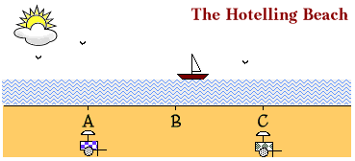
Definition: local market
Can think of a local market as a geographical area where a SSNIP starting from a minimal area is “quickly” profitable
“Space matters” in local markets, i.e., actually limits exchange
Compare with early spatial models: Von Thünen, Hotelling, Salop

Slide 4
Why engage in local market analysis?
Many markets are local markets
raw materials: raw wood, cement
daily needs: gas stations, groceries, ATMs, (lawyers...)
In recent years, many mergers involving local markets
Firms and competition authorities need precise economic analysis to assess competition in local markets
Top-down (say national) analysis too imprecise, risk of false negatives
Parameters of competition partly local, so assessment and remedies can be location-specific

Slide 5
The economics of local markets
When does space matter?
Demand:
Space differentiates products (expect price > marginal cost in oligopoly)
Total transport cost is large compared to consumers’ willingness to pay
Avg transport cost: opportunity cost of time, taste for travelling, costs like gas
Supply:
Space or regulation limit firm entry (friction generating oligopoly)
Product can only be transported to a limited extent
Main analytical tool for local market definition: catchment area

Slide 6
Definition: catchment area
A catchment area (CA) is a polygon drawn on the map such that its area includes all points “relevant” to a given location or starting point
In economics, “relevance” is based on exchange of goods and services
Starting point
Firm-centric approach
Customer-centric approach
Usually, a simple rule is used for drawing catchment areas around starting points
Clustering-approaches also exist, but less common in practice

Slide 7
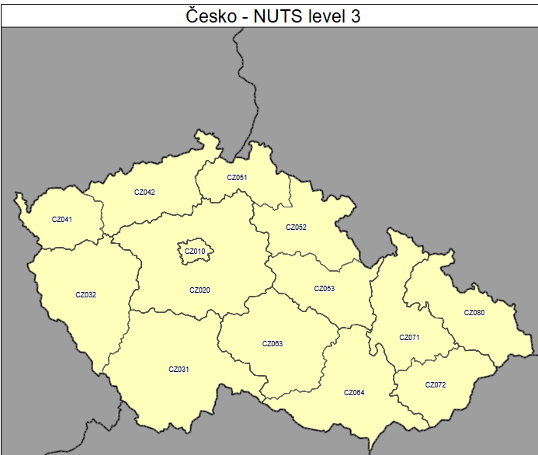
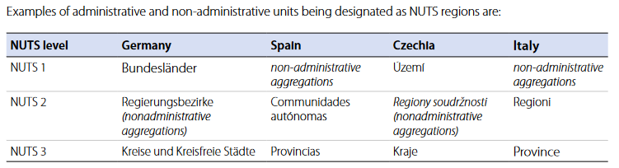
Example rule: regions
Administrative boundaries
Similar and often more easily available: NUTS regions

Slide 8
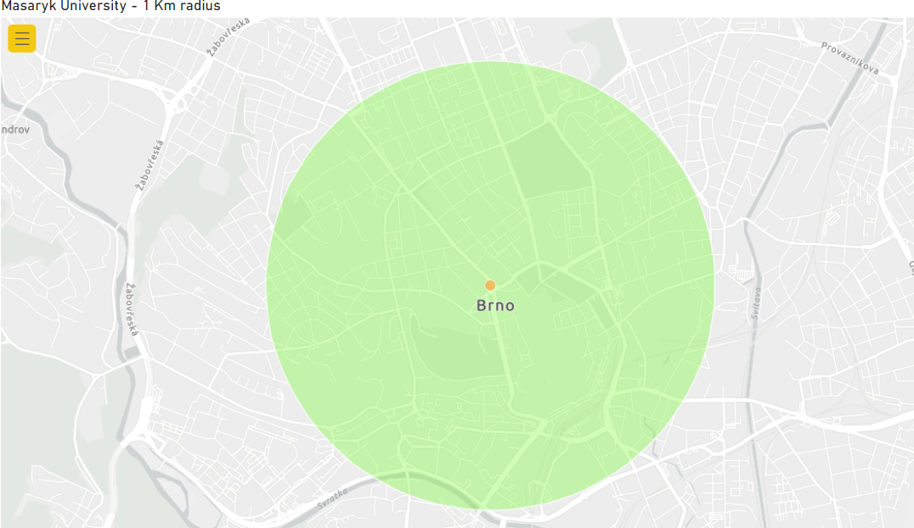
Example rule: distance as the crow flies
Usually, consumers do not stop buying at administrative boundaries
Outer edges of polygon mark isodistance
Starting point + chosen radius

Slide 9
Example rule: distance based on surrounding
Distance taking into account streets, rivers, mountains etc.
Reasonable approximation of driving time may be possible
Still, CAs based on actual driving time are more precise

Slide 10
Example rules: distance based on driving time
Exact driving time depends also on speed limits and congestion
Outer edges of polygon mark an isochrone
Need to reflect if other transport options are practical (walking, ship, train)

Slide 11
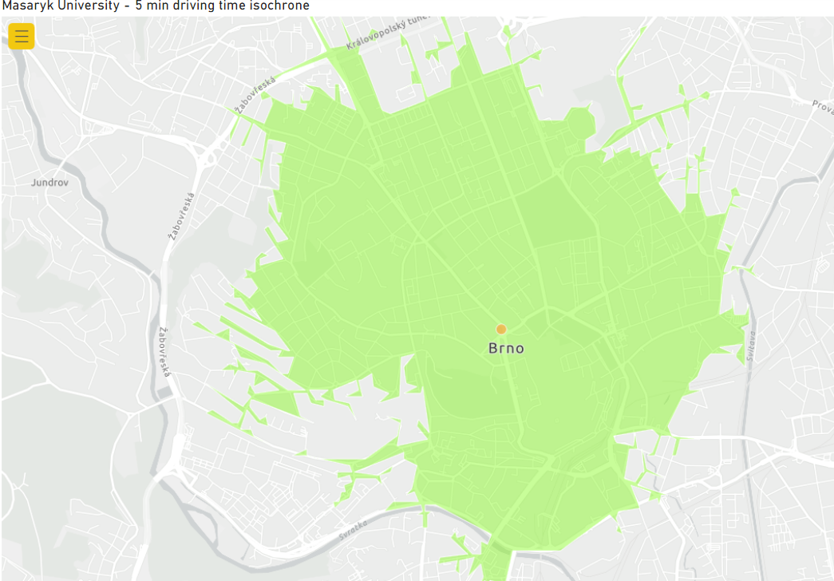
Example isochrone

Slide 12
Market definition with catchment areas
Firm-centric approach: two firms compete directly in the same market if and only if their catchment areas overlap.
Firm A
Firm B

Slide 13
Market definition with catchment areas
Chain of Substitution: Non-overlapping firms may still exert an indirect competitive constraint by directly constraining adjacent overlapping firms
Firm A
Firm B
Firm C

Slide 14
Consumer-centric approach
Better reflects consumer choices and thus competition (home-store)
In B2C markets, however, the analysis often becomes non-tractable
In B2B markets when there are few buyers, but many sellers it is the opposite (firm-centric approach is not tractable)
Buyer A
Buyer B

Slide 15
Calculation of local market shares
Number of Competitors. Count number of stores by firm in CA
Turnover. Optimally, have turnover on store-level or at least have store characteristics. Then predict turnover for stores with missing turnover from stores with turnover from characteristics. Last resort: multiply with average firm-specific turnover
Weighting. Can be sensible to apply weighting (e.g., quantity-area for raw wood, or brand, size, distance for supermarkets)
Consider taking into account stores from across the border or online retailers (at least in the competitive assessment)

Slide 16
Special case: cities
For some goods, many CAs overlap, especially in cities
Competition authorities have thus in the past considered regarding the area of a city (and potentially its suburban areas) as a single market
Idea: consumer moves through the city weekly so she might consider buying in stores that are further away from her home too (e.g., those close to her office)
Clustering of largely overlapping CAs can make sense outside of cities too, when it does not materially change the conclusion but simplifies the analysis

Slide 17
Special case: other important routes
In some local markets (e.g., gas stations), a segment of consumers moves along certain routes (like highways)
(Delta)MS in sequence of competitors can be higher than with CA
Subcase 1: only firm in CA → no delta
Subcase 2: several firms in CA, but some are unintuitive to reach (e.g., other side of highway) consumer may not view them as substitutes →can underestimate market share of parties
In either case analyzing the local market in the order the consumer becomes aware of stores is more realistic (compare Google search results!)

Slide 18

Market definition: Implementation
Data
Geodata (coordinates of stores, shapefiles of regions, geodatabase of roads and speed limits)
Store characteristics (brand, product offering, capacity, quantities, turnover)
Costumer surveys or industry data on radius, i.e., km distance or minutes of travelling time
(Population density, supply data, satellite pictures on natural resources)
Geo-software and programming languages
E.g., ArcGis, Geopandas, Power BI, Stata, R
Robustness checks (radius, weighting, etc.)

Slide 19
Competitive Assessment
Unilateral effects
Overlap analysis. Market share or HHI analysis (level and increment)
Chain of Substitution. Non-overlapping firms might still exert indirect competitive constraints. Different for different pairs of firms (non-transitivity)
Define thresholds for critical areas (e.g., market share>40%, delta>20%-points) Remedy: merging parties offer divestment of stores in critical areas
Analysis of important routes
Coordinated effects
Price ranking
Price cycles
Timing of price changes (propagation: price leadership, reactions, etc.)
Prevalence of the same set of competitors across CAs
Implicit assumption so far: degree of product differentiation other than space is limited, uniform transport cost (can be incorporated with surveys, though)

Slide 20
Case study: EG-OMV (cleared with remedies)
Case B8-77/21 in front of German competition authority (BKartA)
Market for retail of fuel (gas stations)
Local market analysis identified several “critical areas”
Merging parties submitted remedy to divest stations in critical areas

Slide 21
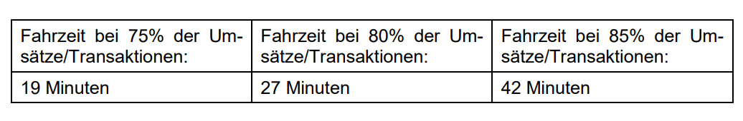
EG-OMV: radius
BKartA’s approach to choosing a radius:
Collect customer data (from loyalty cards, also non-merging competitors)
take all zip codes of customers of the station
Calculate distance between station and population-center of zip code
Order zip codes by driving time and calculate cumulative turnover shares
Average over all stations, result (p. 35 of decision):
Final choice of (uniform) radius for comp assessment: 20, 30min driving time
Remark: stations across the border were not considered

Slide 22
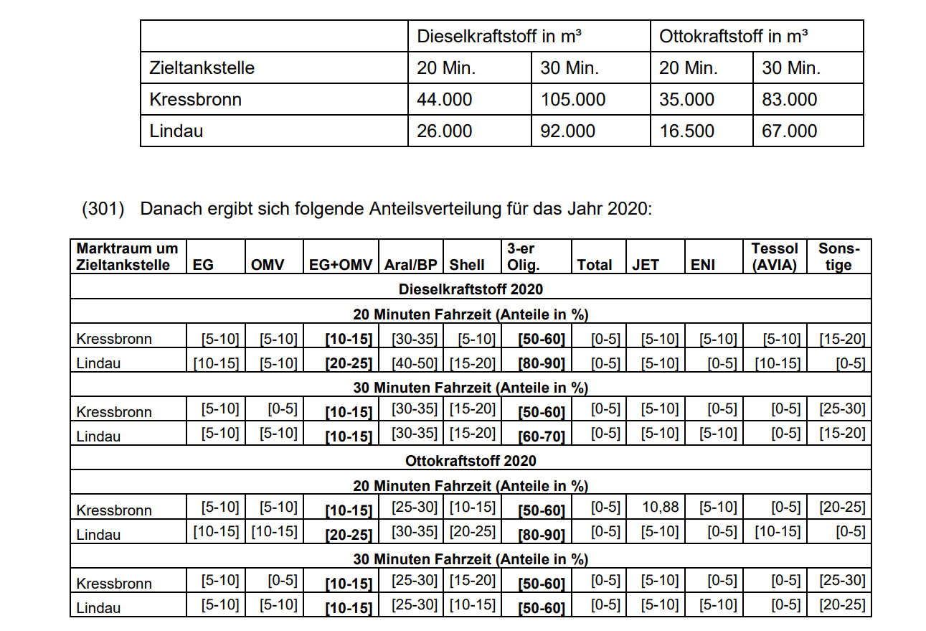
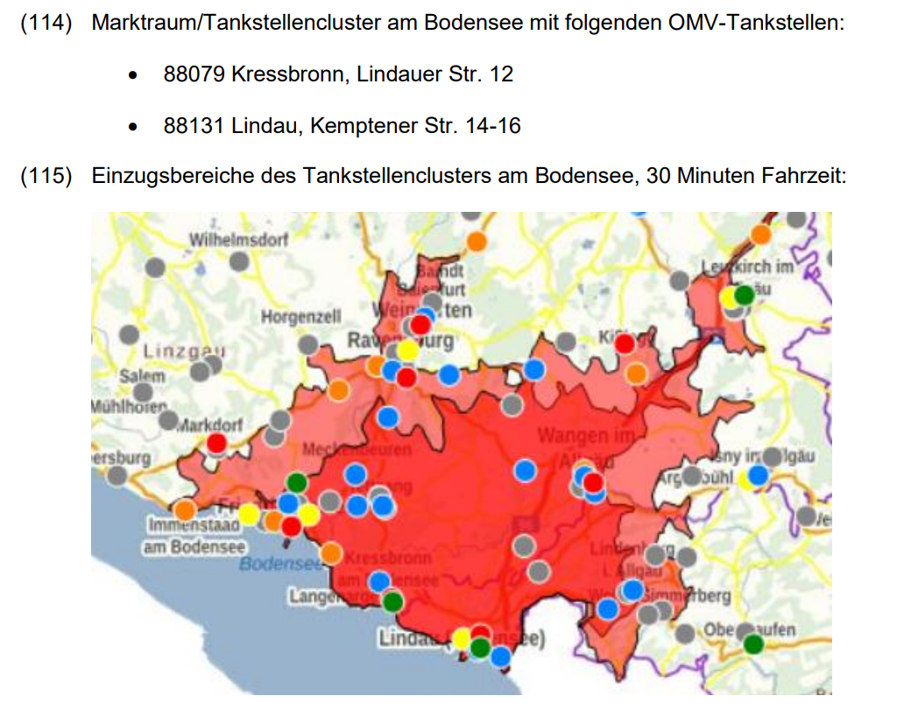
EG-OMV
Example critical area: Bodensee

Slide 23
Case Study: Sainsbury’s-Asda (blocked)
Case in front of UK comp authority (CMA)
Top 5 UK Retailers ; 1. Tesco. £53.2bn ; 2. Sainsbury's. £29.0bn ; 3. Asda. £22.8bn ; 4. Amazon. £19.4bn ; 5. Morrisons. £17.6bn
537 critical stores → CMA found only remedy was to prohibit merger
The CMA’s analysis of local markets included
CA’s weighted by product differentiation, size, distance (from store exit survey)
‘out-of-market constraints’, stores located further away, online delivered groceries, non-supermarket retailers
GUPPIs by store

Slide 24
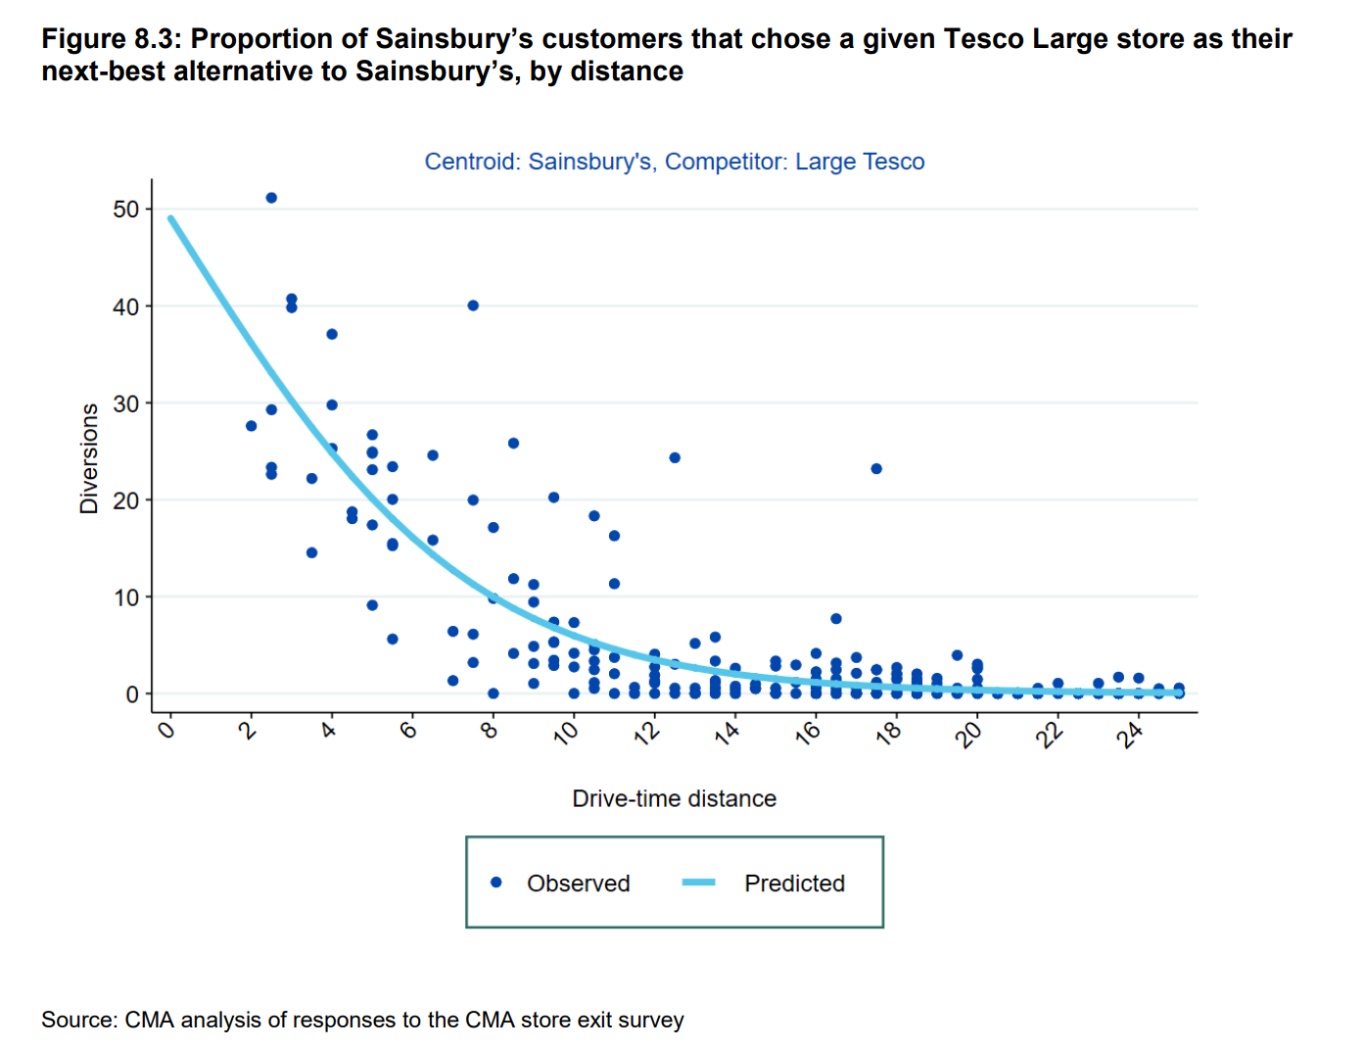
Sainsbury’s-Asda
CMA analysis of the relationship between distance and diversion

Slide 25
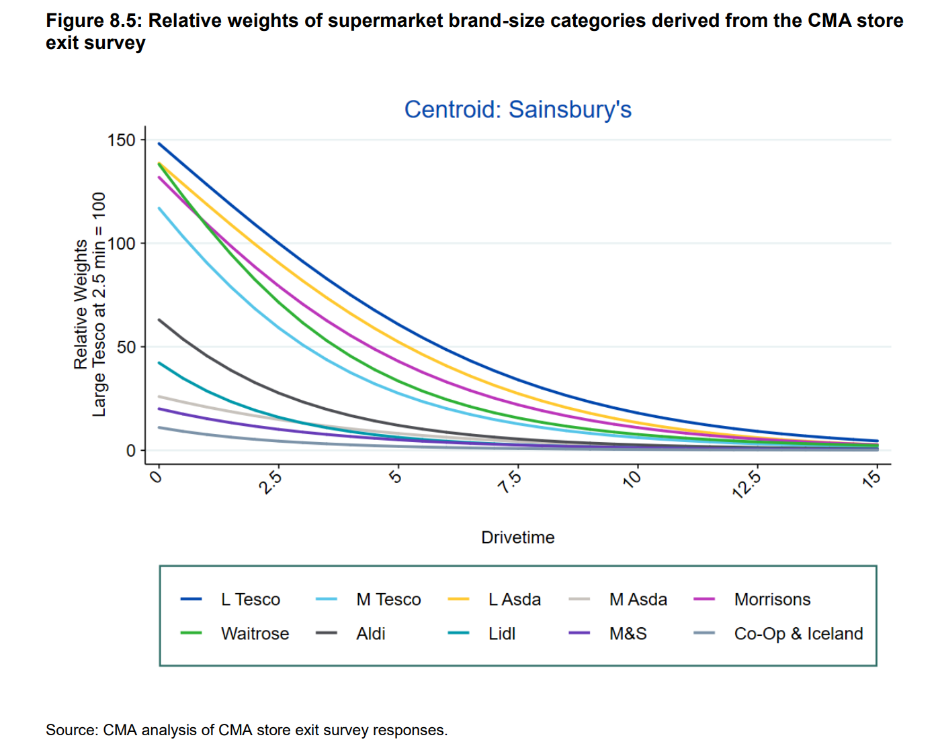
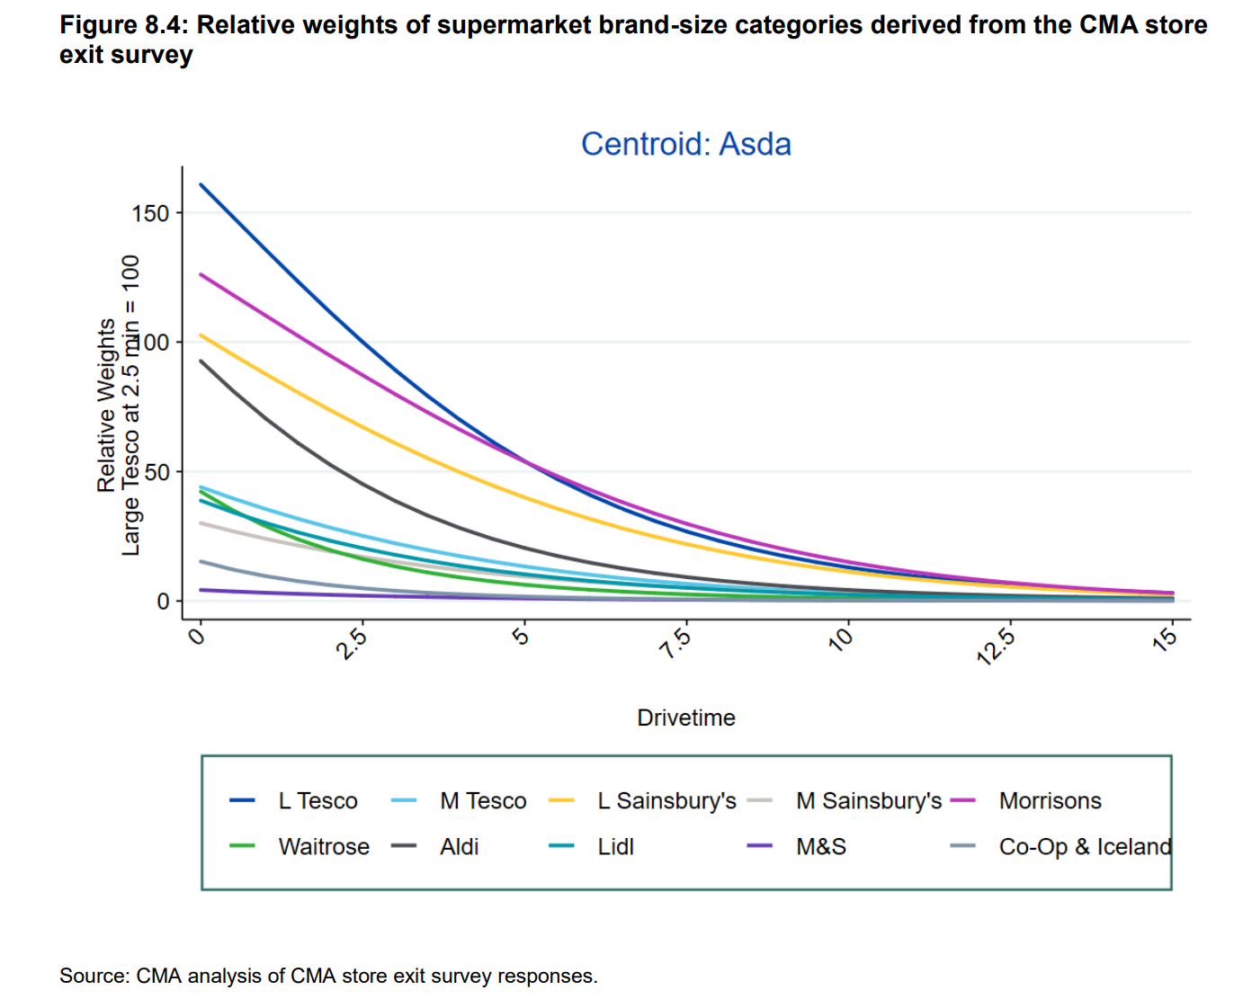
Sainsbury’s-Asda
The CMA’s approach to weighted CAs

Slide 26
A few academic references
Pennerstorfer, D., & Yontcheva, B. (2021). Local market definition in competition analysis: An application to entry models. Economics Letters, 198, 109678.
Verboven, Frank, and Biliana Yontcheva, “Private Monopoly and Restricted Entry - Evidence from the Notary Profession,” CEPR Discussion Paper No. DP17367, 2022.

