Slide 1
Competition and market definition in local markets
Moritz Schwarz
Austrian Federal Competition Authority
Masaryk University, 23 Nov 2021

Slide 2
Definition: antitrust market
Competition economists are usually interested in antitrust markets and consider two dimensions
Product market
Geographic market
SSNIP test finds an antitrust market if a hypothetical price increase of 5-10% is profitable for a given set of products and geographical area
Conceptually, start with narrowest market definition and if SSNIP is not profitable increase set of products and geographical area until it is
In practice, case law or other tools are used more often than SSNIP

Slide 3
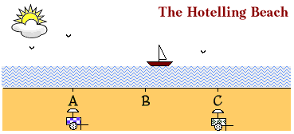
Definition: local market
Can think of a local market as a geographical area where a SSNIP starting from a minimal area is “quickly” profitable
“Space matters” in local markets, i.e., actually limits exchange
Compare with models of spatial competition: Von Thünen, Hotelling, Salop

Slide 4
Why engage in local market analysis?
Many markets are local markets
raw materials: raw wood, cement
daily needs: gas stations, groceries, ATMs
In recent years many mergers involving local markets
Firms and competition authorities need precise economic analysis to assess competition in local markets
Top-down (say national) analysis too imprecise, risk of false negatives
Parameters of competition partly local, so assessment and remedies can be location-specific

Slide 5
The economics of local markets
Space as a market friction (reason for imperfect competition and price above marginal cost)
Space influences trading decisions via several channels
Transport cost
Relatively high ratio of transport cost and price of good
Opportunity cost of time
Also: “spontaneity” of preferences or production (exchange cannot be well planned or delayed, e.g., when products cannot be stored after production → lower elasticity of demand)
Main analytical tool for local market definition: catchment area

Slide 6
Definition: catchment area
A catchment area (CA) is a polygon drawn on the map such that its area includes all points “relevant” to a given location or starting point.
In economics, “relevance” is based on exchange of goods and services
Starting point
Firm-centric approach
Customer-centric approach
Usually, a simple rule is used for drawing catchment areas around starting point
Clustering-approaches also exist, but they are not common

Slide 7
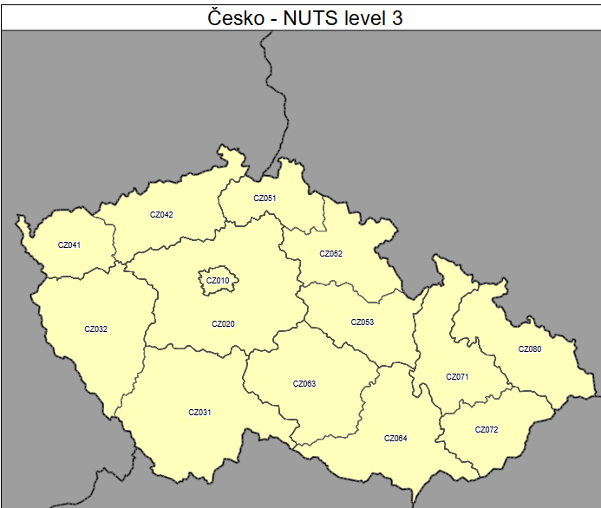
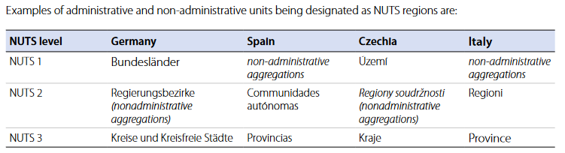
Example rule: regions
Administrative boundaries
Similar and often more easily available: NUTS regions

Slide 8
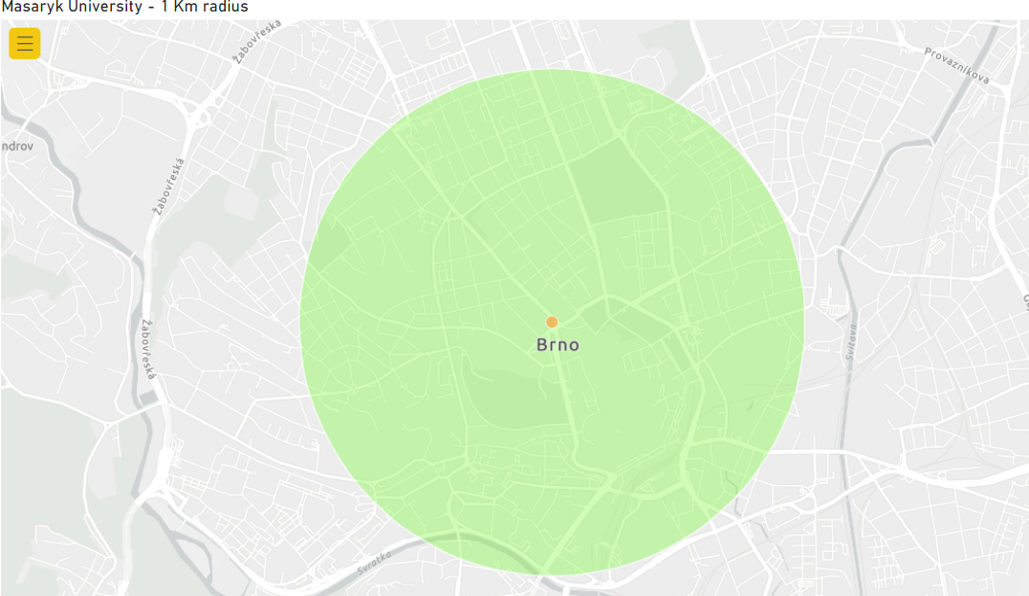
Example rule: distance as the crow flies
Usually, consumers do not stop buying at administrative boundaries
Outer edges of polygone marks isodistance
Starting point + given radius

Slide 9
Example rule: distance based on surrounding
Distance taking into account streets, rivers, mountains etc.
Reasonable approximation of driving time may be possible
Still, CAs based on actual driving time are more precise

Slide 10
Example rules: Distance based on driving time
Exact driving time depends also on speed limits and congestion
Outer edges of polygone mark an isochrone
Reflect if other transport options are practical (walking, ship, train)

Slide 11
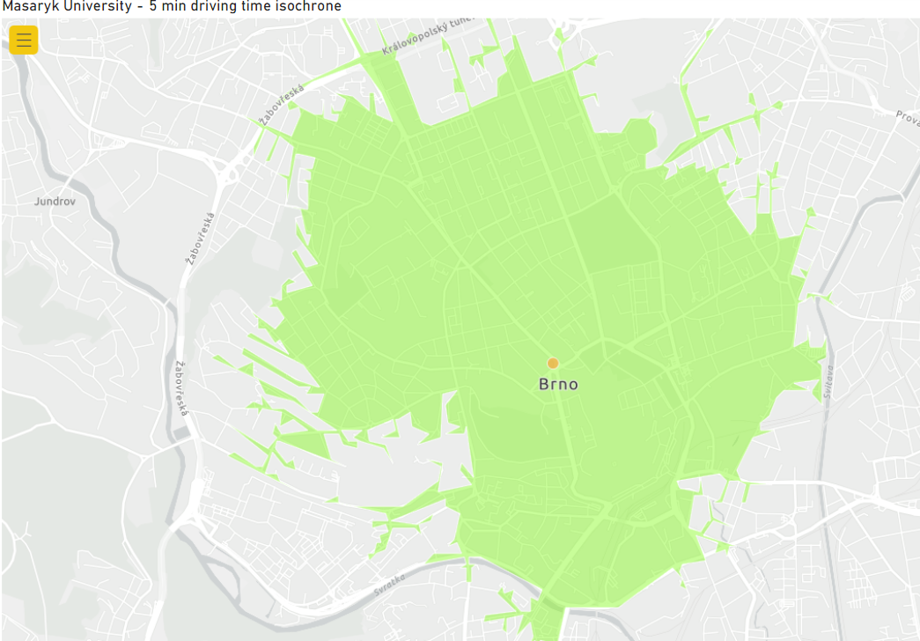
Example isochrone

Slide 12
Market definition with catchment areas
Firm-centric approach: If and only if the catchment areas of two firms overlap, they are supposed to compete directly with each other in the same market.
Firm A
Firm B

Slide 13
Market definition with catchment areas
Chain of Substitution: Non-overlapping firms may still exert an indirect competitive constraint by directly constraining adjacent overlapping firms.
Firm A
Firm B
Firm C

Slide 14
Consumer-centric approach
Better reflects consumer choices and thus competition (home-store)
In B2C markets, however, the analysis often becomes non-tractable
In B2B markets when there are few buyers, but many sellers it is the opposite (firm-centric approach is not tractable)
Buyer A
Buyer B

Slide 15
Calculation of local market shares
# Competitors. Count number of stores by firm in CA.
Turnover. Optimally, have turnover on store-level or at least have store characteristics. Then predict turnover for stores with missing turnover from stores with turnover from characteristics. Last resort: multiply with average firm-specific turnover.
Weighing. Can be sensible to apply a quantity-area weighing (e.g., raw wood). Needs assumption or data on density of demand/supply.
Consider taking into account stores from across the border (e.g., gas stations) or online retailers

Slide 16
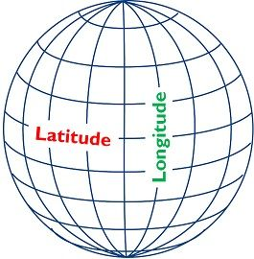
Market definition: Implementation
Data
Geodata (coordinates of stores, shapefiles of regions, geodatabase of roads and speed limits)
Store characteristics (brand, product offering, capacity turnover)
(Population density, supply data, satellite pictures on natural resources)
Consumer surveys or industry study on distance/travelling time
Geo-software and programming language
E.g., Arcgis, Geopandas, Power BI, Stata, R

Slide 17
Special case: cities
For some goods, many CAs overlap in cities
Competition authorities have thus in the past considered regarding the area of a city (and potentially its suburban areas) as a single market
Idea: consumer moves through the city weekly so she might consider buying in stores that are further away from her home too

Slide 18
Competitive Assessment
Unilateral effects
Overlap analysis. Market share or HHI analysis (level and increment).
Chain of Substitution. Non-overlapping firms might still exert indirect competitive constraints. Different for different pairs of firms (non-transitivity.)
Define thresholds for critical areas (e.g., market share>40%, delta>20%) Remedy: merging parties offer divestment of stores in critical areas
Coordinated effects
Price cycles
Timing of price changes (price leadership, reactions etc.)
Price ranking
Prevalence of the same set of competitors across CAs
Implicit assumption: degree of product differentiation is limited.

Slide 19
Example: gas stations
Highway and non-highway stations
Diesel and gasoline stations, LPG marinas
# fuel dispensers can be used to predict turnover of stores of non-merging parties, which in turn can be used for market shares

