Slide 1

an introduction to metagenomics
Moritz buck
moritz.buck@ebc.uu.se
Based on Anders Andersson’s slides
@MetaMoritz

Slide 2
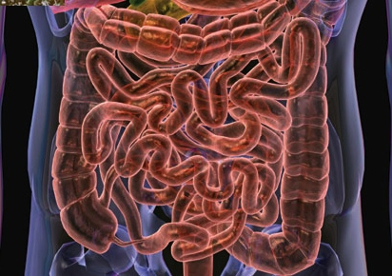
microbiome of the human gut
1kg microflora
~30 trillion cells (3x human cells)
100-1000 bacterial types
3 million encoded genes (100x human)

Slide 3
microbiome of the human gut
1kg microflora
~30 trillion cells (3x human cells)
100-1000 bacterial types
3 million encoded genes (100x human)
=> 2x10²³ cells

Slide 4
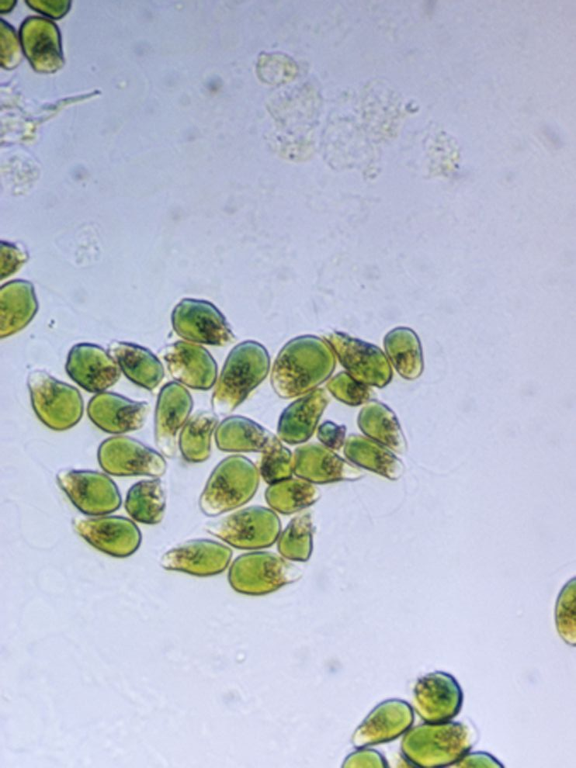
global microbiome
~5x10³⁰ prokaryotes on earth
Biomass very difficult to estimate … ~560 billion tonnes C for eukaryotes, prokaryotes are estimated between 5-100% of that …
Most abundant in number, Prochlorococcus, is estimated to 10²⁷ cells, producing up to 20% of the worlds 0₂

Slide 5
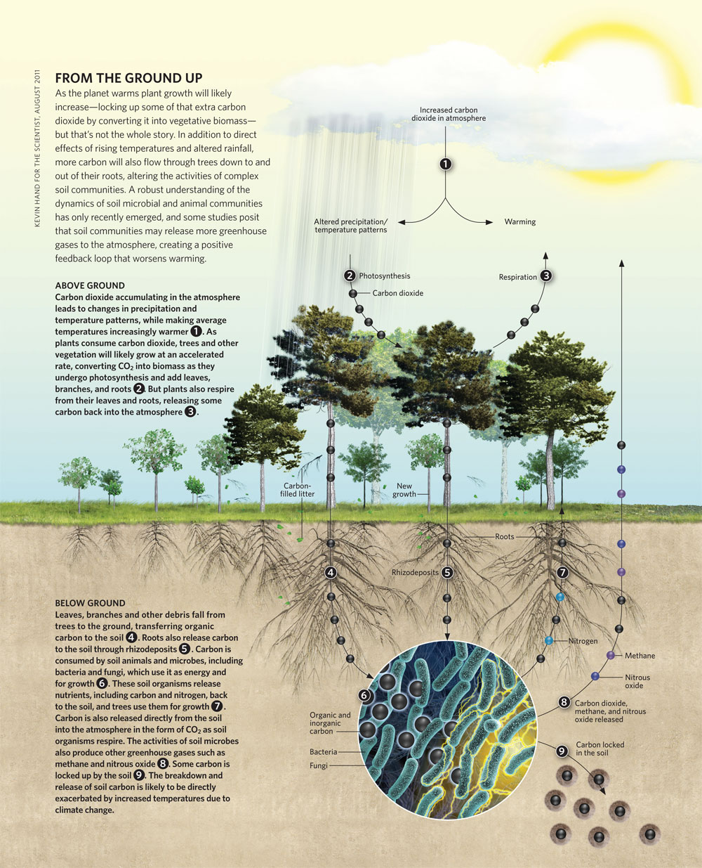

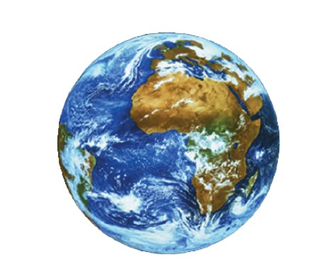
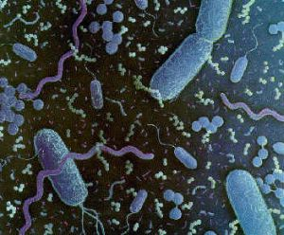
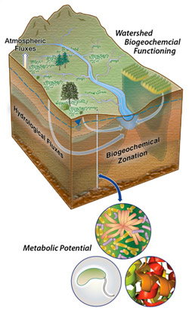
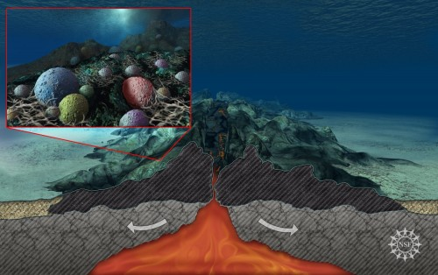
soil 26x10²⁸
ocean 12x10²⁸
sub-seafloor 2.9-50x10²⁹
Total 5x10³⁰
sub-surface 2.5-25x10²⁹

Slide 6
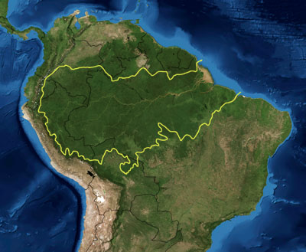
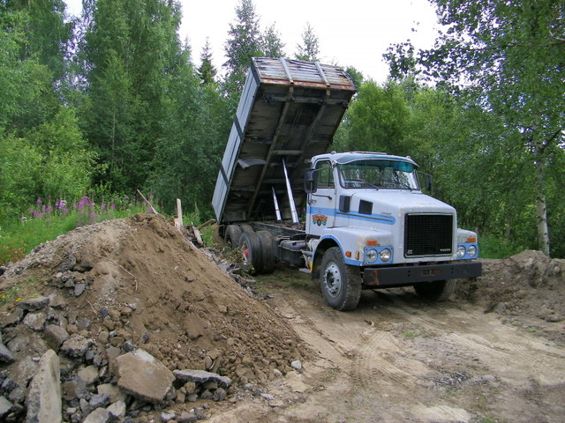
global microbiome
Amazonas rainforest
1 ton soil
0.1 million plant species
1 million bacterial species
3 billion unique genes
3 billion unique genes

Slide 7
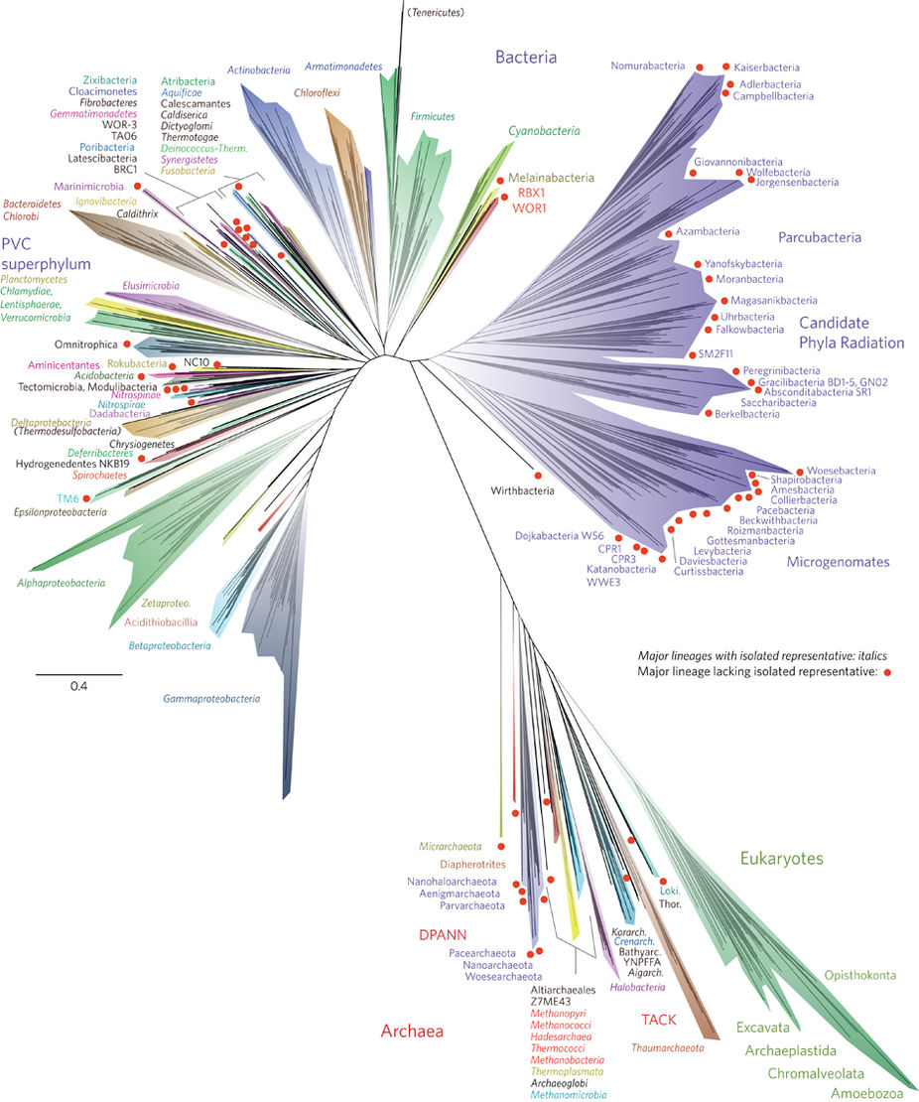
Microbes are hard to grow
Hug et al, Nature 2017

Slide 8
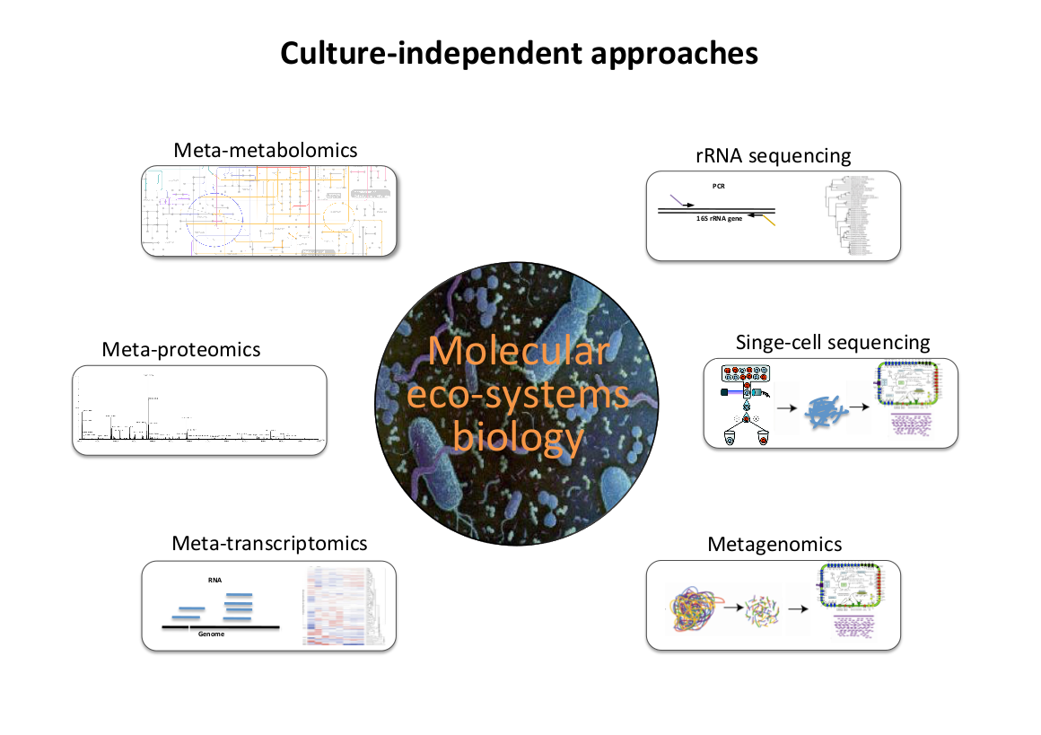

Slide 9
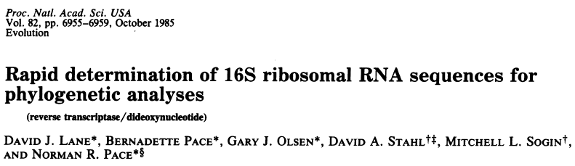
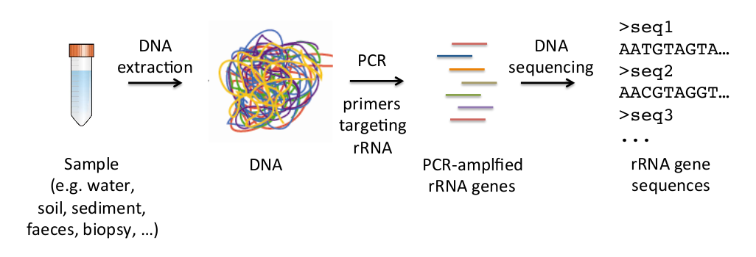
Targeted metagenomics
Sari’s lecture after lunch

Slide 10
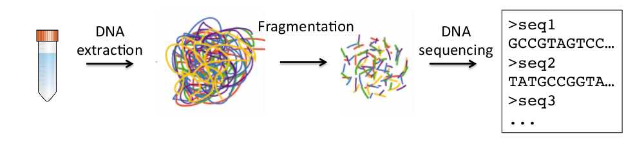
Shotgun metagenomics

Slide 11
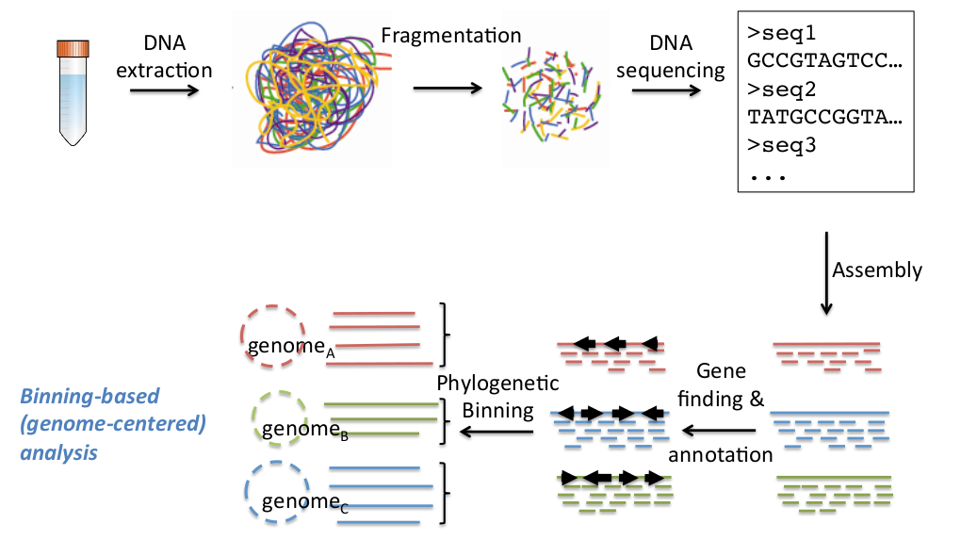
Possible workflows

Slide 12
what makes metagenomics hard?
Big data
Always changing
No standard solutions
Very question dependent
Some of the tools can be ‘archaic’

Slide 13
How I want to course to go
We have a diversity of skill, so I want us to work in groups
We will follow a number of workflows, I will present tools and approaches and we will together use them
Occasionally, look at some scripts
If you have particular aspects you want to jump deeper in let me know, we can add things to a certain point

