Slide 1
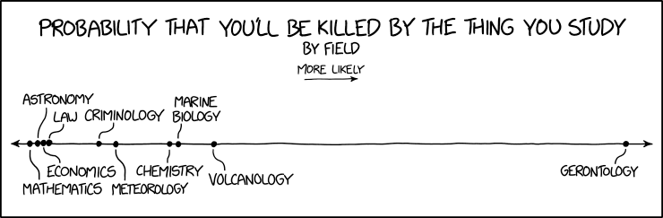
METAGENOMICS ?
Image credit: xkcd

Slide 2



Metagenomic workflows
SLU Metagenomic course 2019
@metamoritz
@moritzbuck
@metamoritz

Slide 3
Before the computer
Get sample
Extract DNA
Prep library
Send to Sequencing facility
????
PROFIT

Slide 4
Dream-quest of unknown metagenome
From an environment with the power of genomics we want to know:
  Who is in the environment? (taxonomy)
  How many of each? (abundance)
  What can they do they? (genetic potential)
  What are they doing? (expression analysis)
  What do they eat? (metabolism)
  Where do they come from? (evolution and ecology)

Slide 5
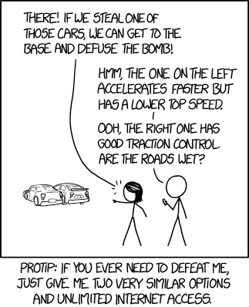
Sequencing strategies
Targeted, a.k.a. amplicon /metabarcoding/edna
Shotgun sequencing:
  Short reads (HiSeq, NovaSeq, all Illumina basically)
  Long reads (PacBio, Nanopore, …)
Metatranscriptomic
Functional metagenomics
...
Image credit: xkcd

Slide 6

Amplicon vs. Shotgun
Biases :
  Extraction
  Amplification
  16s copy numbers
Functional trait to taxonomy
Taxonomical resolution
Reliance on databases

Slide 7
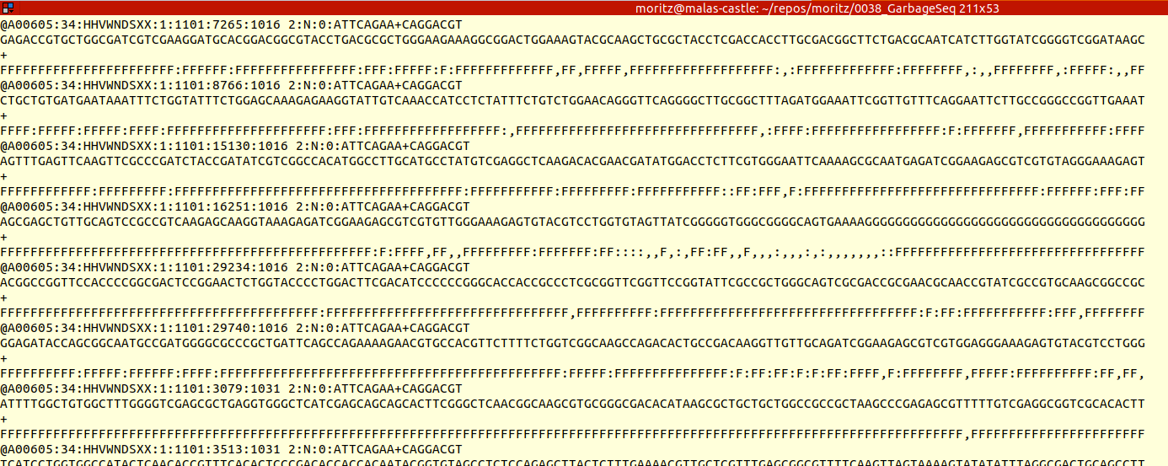
What you get from your shotgun?
Load and load of reads

Slide 8
What are those reads?
The inventory approach:
Annotating the reads directly
Heavily relying on databases
Good for well known microbiomes (western european poop, agricultural soils)
Dangerous for others as methods tend to overclassify

Slide 9
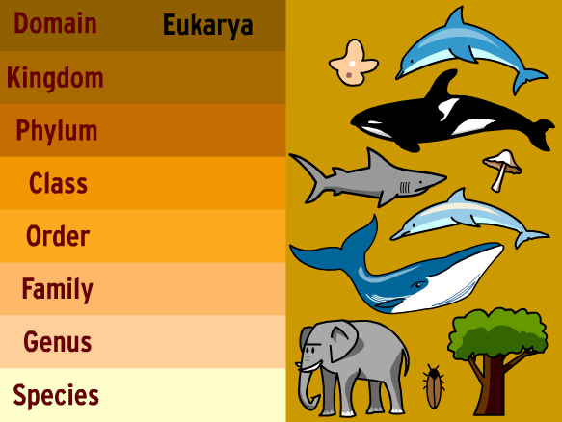
What are those reads?
Taxonomically :
  Kraken
  Kaiju
Functionally :
  Blast …
  Megan
  Humann

Slide 10
Assembly based approaches
Turning the reads into genes and more! (aka The Contig):
Full length coding sequences
Pieces of genomes
Or anything else made of DNA
Increases specificity of previous approaches, but might lose some sensitivity (e.g. not everything assembles)

Slide 11
Linking reads to contigs
The dark art of mapping.
  Normally, quantitative information gets lost during assembly, we need to “map back”. Read based approaches “map” to databases
Mappers :
bowtie/bwa/bwa2
Bbmap
Squeeze…
RNA/DNA euk or prok, all different!
=> pile-ups!

Slide 12
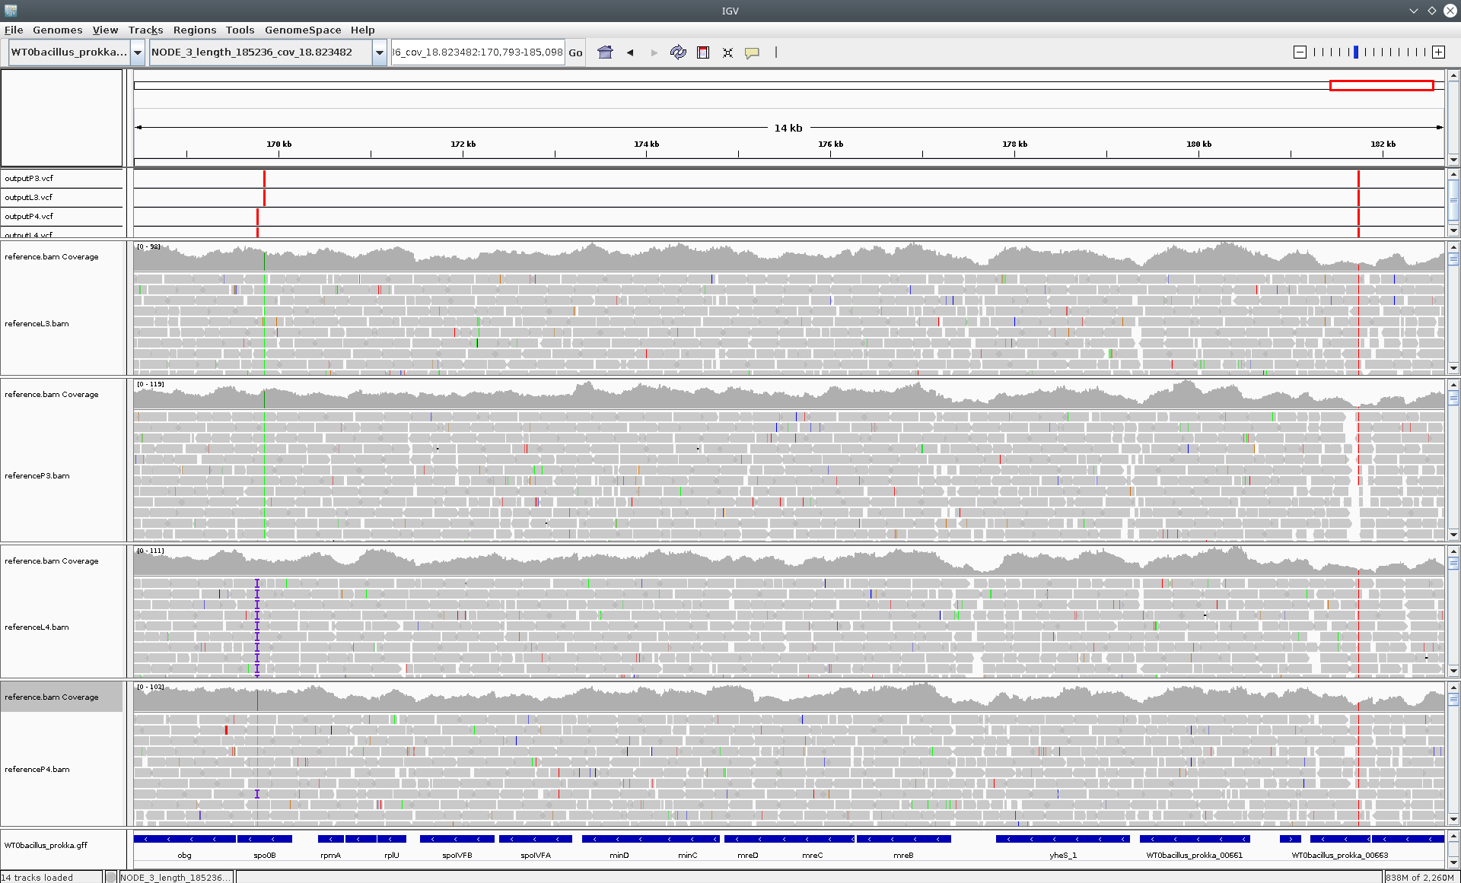
The pile-up
Viz software: IGV
Image credit: Pilar Lòpez-Hernàndez et al.

Slide 13
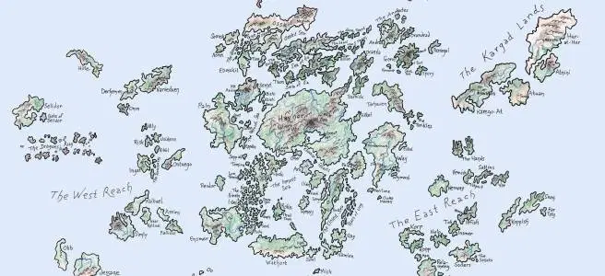
The gene atlas approach
If you only care about genes:
Predict genes and annotate genes:
  Functionally
  Taxonomically
Gene clustering:
  By similarity
  Into COGs
  Into families
Quantify and analyse diversity

Slide 14
The king discipline
Genome-resolved metagenomics:
Cluster contigs into bins
Identify possible genomes
Quantify completeness/redundancy
Assign taxonomy
Have fun?

Slide 15
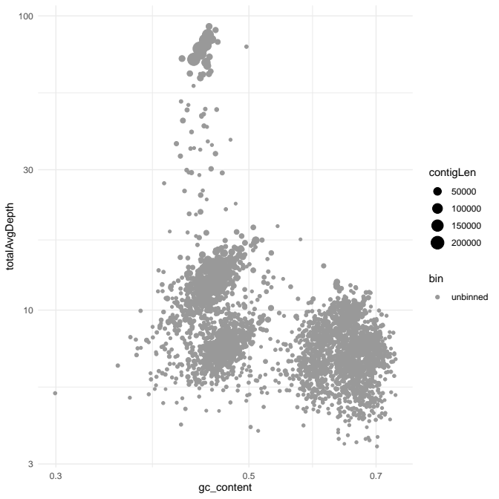
Clustering contigs
Binning:

Slide 16
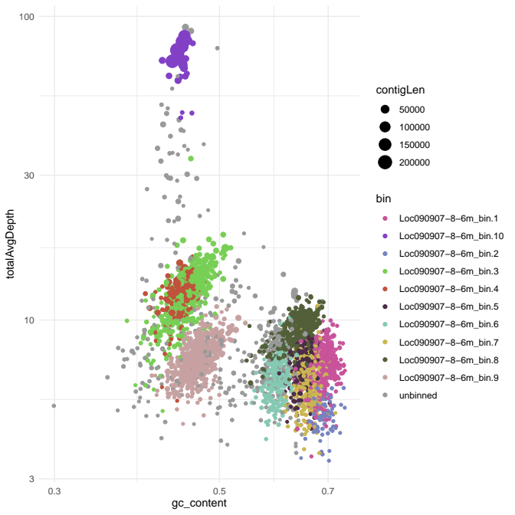
Clustering contigs
Binning:

Slide 17
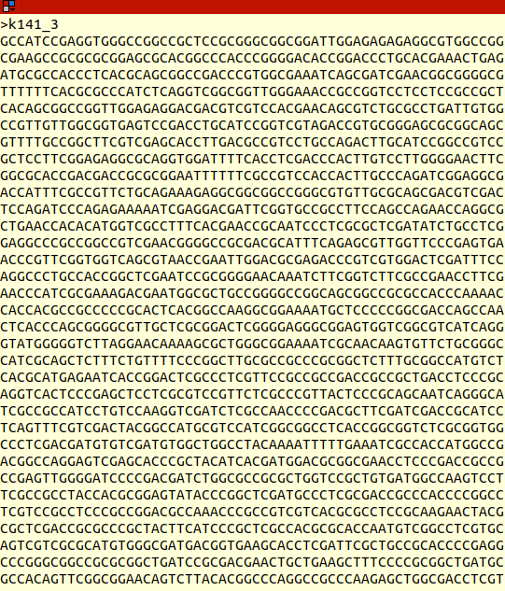
What is a genome?
How to recognize a genome:
  Size and coding-density
  Similarity to known genome
  Universal single copy genes

Slide 18
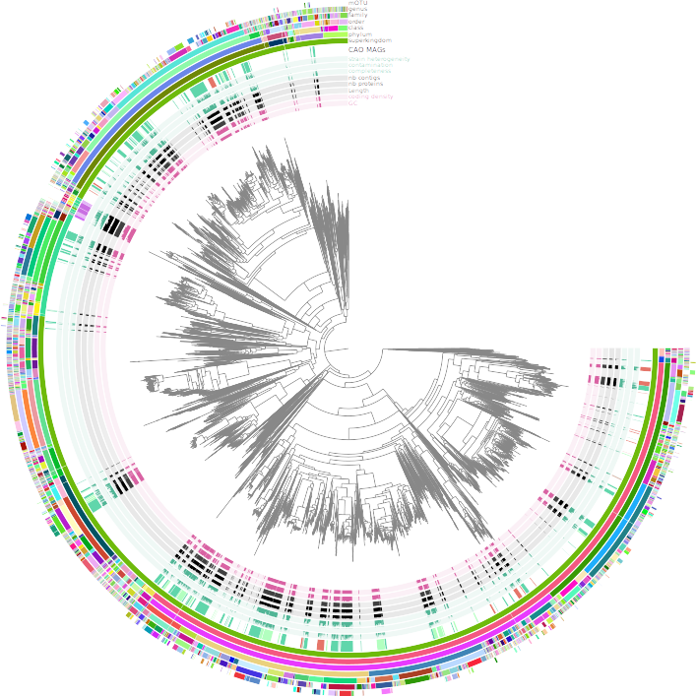
Putting it into phylogenomics context!

Slide 19
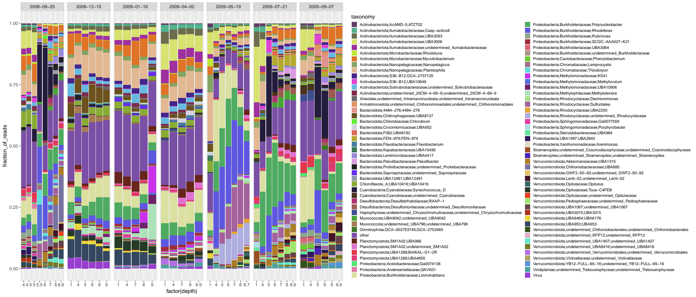
Quantifying it
Mapping read to the bins:
  Statistics
  Diversity metrics
  Network analysis

Slide 20
The tutorials
Checking your reads, aka fastQC and k-mer contents (Domenico)
Let’s assemble some metagenome! (me)
And get some genomes out of it! (me)
What’s in them genomes, metabolic reconstruction (Maliheh)
Where are those genes, phylogenies and co (Chris)

Slide 21
So vamonos!
https://twitter.com/kareem_carr/status/1193651468324225025

