Slide 1
AMPLICON PROCESSING
Host-microbe interactions in the gut
Fernando Puente-Sánchez, Nov 2024

Slide 2
SEQUENCING PLATFORMS
Illumina: Paired end (two reads per amplicon, have to be merged). Short amplicons (2x300 reads, less than 600 bp amplicons). Cheap, high quality.
PacBio: Single end, long amplicons (15-20 kbp, multi-gene amplicons). Expensive, high quality.
MinION: Single end, long amplicons (variable length). Portable, in-house. Cheap, low quality (improving).

Slide 3
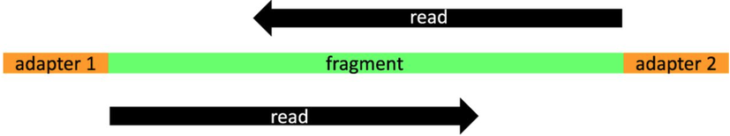
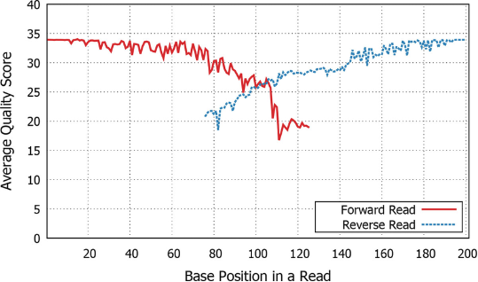
PAIRED END READS
Renaud, Stenzel, Kelso, 2014
Kwoon, Lee, Yoon, 2014

Slide 4
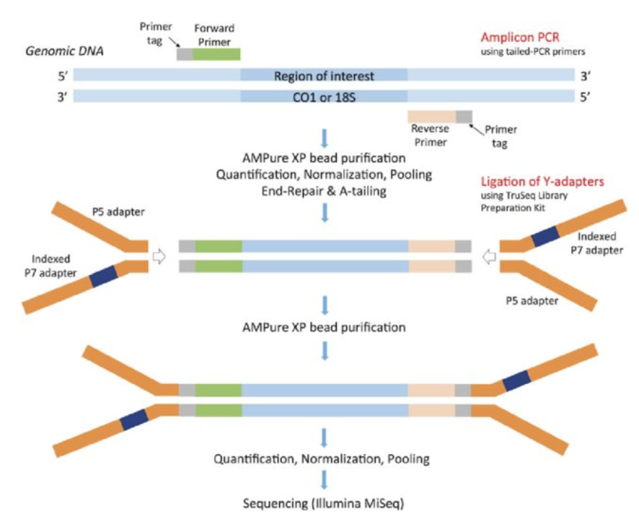
ANATOMY OF AN AMPLICON SEQUENCING PRODUCT (Illumina)
Leray, Haenel, Bourlat 2017

Slide 5
PRIMERS
Forward and reverse primers for PCR, targeting a conserved region of our gene of interest
PCR conditions designed to allow the primer to hybridize with the template DNA even if there are small mismatches
What we have in the PCR product is the sequence of the primer, not the sequence of the original template (they may have small differences) so we should remove them

Slide 6
ADAPTORS
Extra sequences necessary for library preparation and sequencing.
  Bind to the flow cell
  Allow for PCR enrichment and cluster generation
  Allow for indexing or “barcoding”
No biological information, we must ensure they have been removed

Slide 7
BARCODES
Many samples are sequenced together
Barcodes: short DNA sequences added during library preparation to distinguish between different samples
These get also sequenced and we need to make sure they are removed

Slide 8
PRE-PROCESSING
What we want:
  Demultiplexed reads: sequences assigned to the right sample and barcodes removed
  Adaptors removed
  Primers removed
  One (single end) or two (paired end) fastq(.gz) files per sample
What we usually get:
  Depends
  Normally the sequencing facility will do demultiplexing and adaptor removal
  Normally the sequencing facility will NOT remove primers
  Always ask what you are getting exactly!!!

Slide 9
DEMULTIPLEXING
Example of an Illumina MiSeq run without demultiplexing
Forward and reverse reads
  ALWAYS fwd and rev files should contain the same sequence names in the same order
Adaptors have been removed
Barcodes have been removed BUT reads have not been demultiplexed

Slide 10
FASTQ FILE (forward)
4 lines per sequence
  Name (always starts with @)
  Sequence
  Separator (plus sign)
  Qualities: one character per base in the sequence, indicating how confident base calling was. Each character can be translated to a numerical value indicating the expected probability that the base was wrongly called.

Slide 11

FASTQ FILE (forward)
FASTQ FILE (barcode)
FASTQ FILE (reverse)
Note that the reverse reads will be in reverse complement orientation with respect to the forward reads

Slide 12
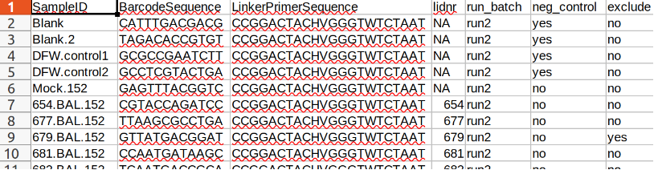
DEMULTIPLEXING
We should have an extra table with the barcode that corresponds to each sample
So we read the fwd, rev and barcode files in parallel, and write each sequence to a different file depending on its barcode (be sure to also check reverse complement orientations)

Slide 13
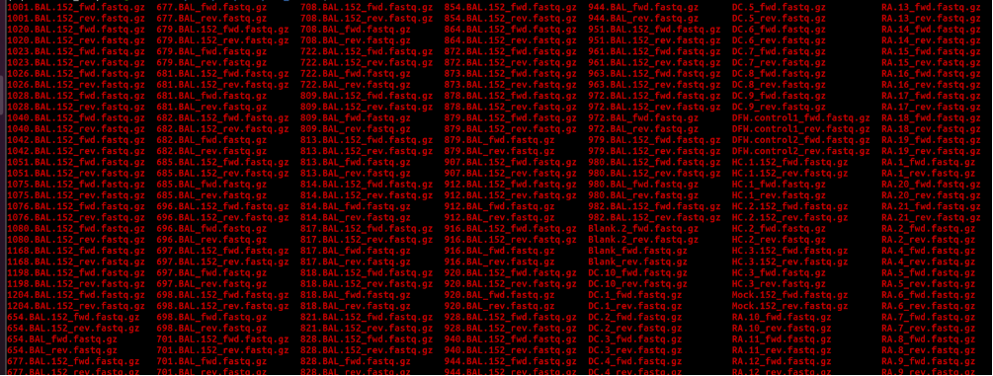
DEMULTIPLEXING

Slide 14
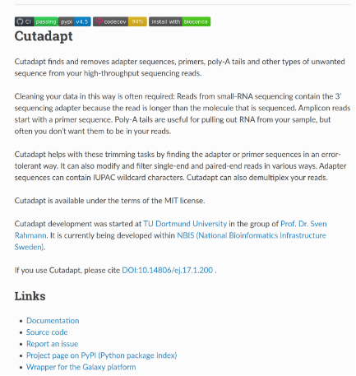
REMOVING PRIMERS/ADAPTERS
(or just trim the 5’/3’ end of your reads: dirty but often good enough)

Slide 15
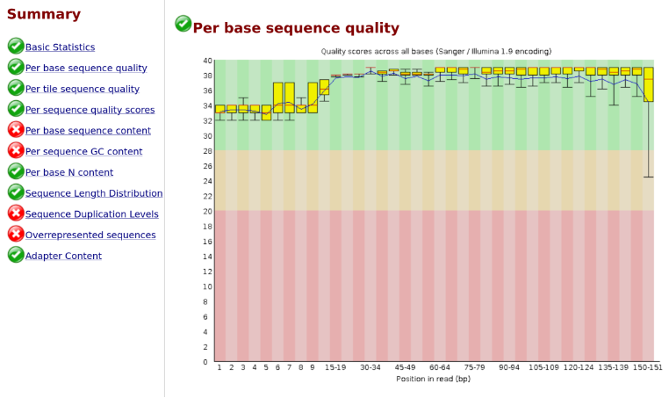
QUALITY CONTROL

Slide 16
QUALITY CONTROL
FastQC expects random shotgun reads, and amplicons are not random
(all reads come from the same region)
So it will complain about non-standard GC,
duplication levels and overrepresented seqs
THIS IS FINE

Slide 17
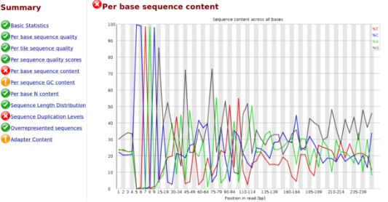
QUALITY CONTROL

Slide 18
QUALITY CONTROL
Per-base sequence content is a bit more tricky
It won’t be fully random, since this is an amplicon from a
quite conserved region (even if it is called “hypervariable” it is still
conserved enough to be useful for phylogeny)
But if we see zero randomness (100% base content of a single base) at
the beginning, then our primers were probably not removed

Slide 19
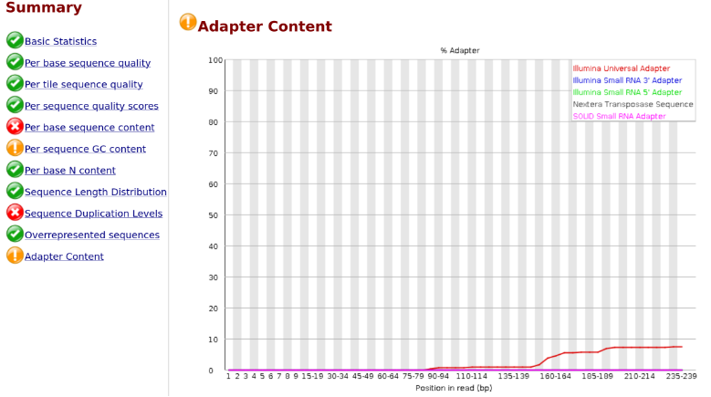
QUALITY CONTROL

Slide 20
QUALITY CONTROL
Ideally the adaptor should be exactly at the end, and already removed
But if library preparation is not perfect, we can get shorter inserts
and adapter dimers/trimers/etc so we end up sequencing the adapters
for some reads
Not the end of the world as long as we still have enough good
quality reads after quality filtering

Slide 21
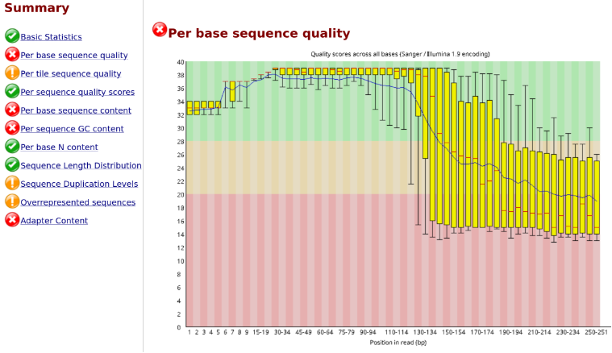
QUALITY CONTROL

Slide 22
QUALITY CONTROL
In other cases we can get a steep drop in quality at the end of our reads
This is expected to an extent (particularly for reverse reads) but this
example is too extreme
We can do quality filtering afterwards, and see if we still have enough
good quality reads

Slide 23
DADA2
Process input amplicon reads from different samples in order to generate an amplicon sequence variant (ASV) table
ASV → assume that every unique sequence (after quality filtering and error correction) represents a different category of organisms. Track independently groups diferring only 1 bp in their amplicon sequences. Maximum possible resolution using amplicons!
Requires high quality reads: Illumina + PacBio, but not (yet) MinION
What amplicons? 16S rRNA gene, 18S, ITS… you may need to adjust some parameters for eg ITS...

Slide 24
OTUs/ASVs/Phylotypes...
- OTUs (Operational Taxonomic Units): compare your amplicons amongst themselves. Group together those that are similar enough. Each group is considered to represent a different category of organisms.
Reference free
Internally consistent
Difficult to compare between studies

Slide 25
OTUs/ASVs/Phylotypes...
- ASVs (Amplicon Sequence Variants): ASVs ARE OTUs.
OTUs group together “similar enough” amplicons.
For ASVs “similar enough” just becomes “identical”
ASVs are conceptually identical to OTUs, just a fancy rebranding to make users cooler.
ASVs have more resolution that traditional 97/99% similarity OTUs. But higher level clustering may still be useful if you know what you are doing.

Slide 26
OTUs/ASVs/Phylotypes...
- Phylotypes (genus, family, phylum...): compare your amplicons to an external reference database. Each amplicon inherits the taxonomic annotation of the bests reference hits. Amplicons with the same annotation are grouped together.
Depends on how well defined are the reference taxa
Lower resolution
Different levels of classification for the same amplicon (genus, family…)
We get names (eg Escherichia). People like names. And they can give us extra information.

Slide 27
Can I talk about species?
Probably not

Slide 28
Can I talk about species?
Probably not
(Exceptions may apply for certain amplicons and/or organisms)

Slide 29
DADA2
Trimming and quality filtering
  Adjust parameters to ensure overlap, high quality and sufficient sequences passing the filters
Error model learning
Sequence correction
Merging
Chimera removal
Taxonomic annotation of ASVs (phylotypes)

Slide 30
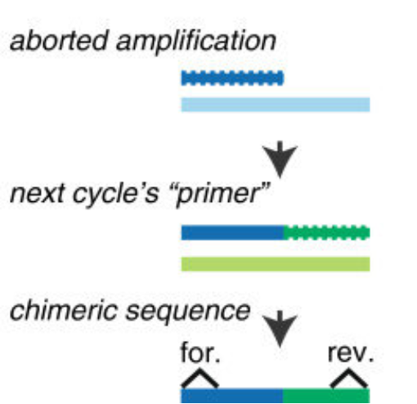
CHIMERAS
Fichot, Norman, 2013

Slide 31
DADA2
Output
  ASV table
  Taxonomic annotations (not technically part of DADA2 but usually produced)
  Data ready into R, can be fed to other libraries (phyloseq, vegan) and integrated with other metadata for plot production, ordinations, further analyses...

Slide 32
Multivariate Analysis
(aka ordinations)
Ecological datasets → lots of variables for each sample
ASV profile, environmental variables…
Lots of dimensions: how do we explain the relationships between samples and variables in a simple manner?
Reduce the dimensionality of our data so we can represent it in two (usually) dimensions without a catastrophic loss of information.

