Slide 1

Image credit:
PhD Comics

Slide 2



Some Metagenomic basics
SLU --- Host–microbe interactions in the gut 2024
@metamoritz
@moritzbuck
@metamoritz

Slide 3
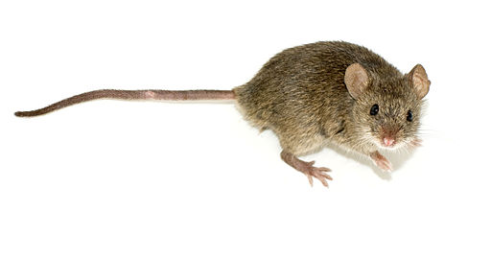
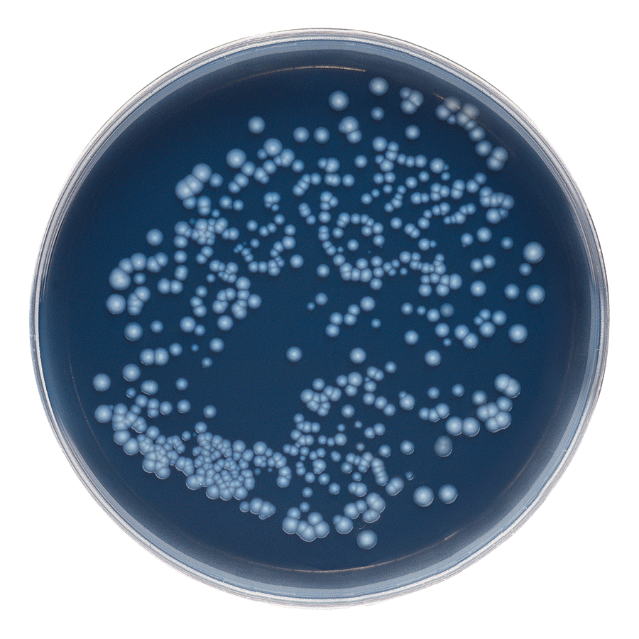
typical genomics
Single organism
Single genome

Slide 4
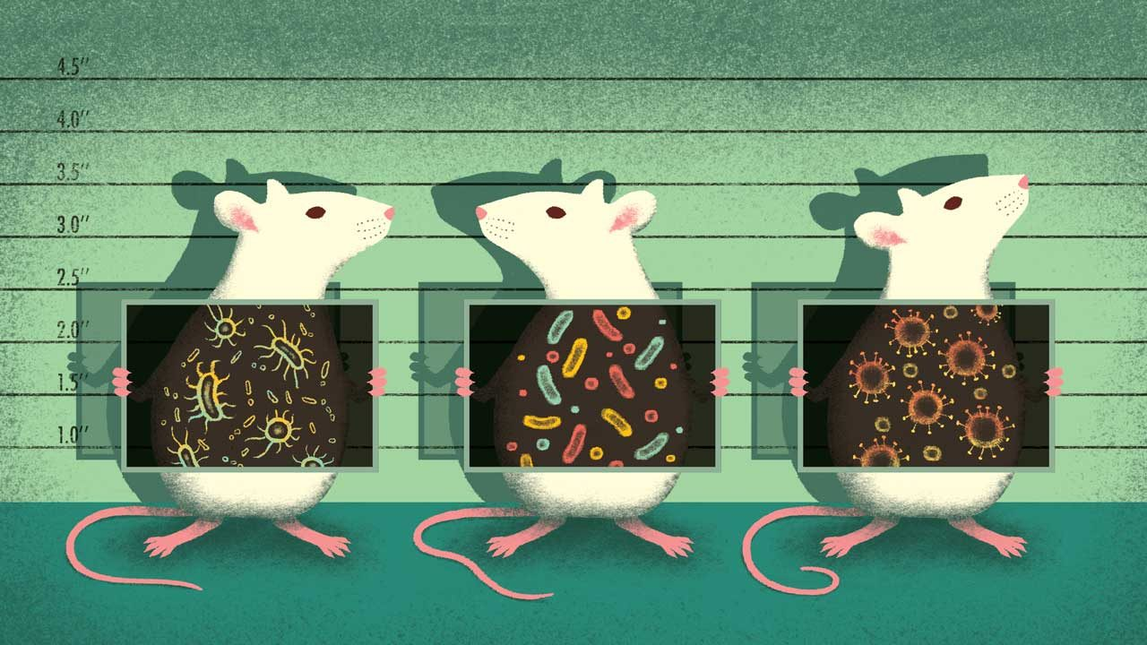
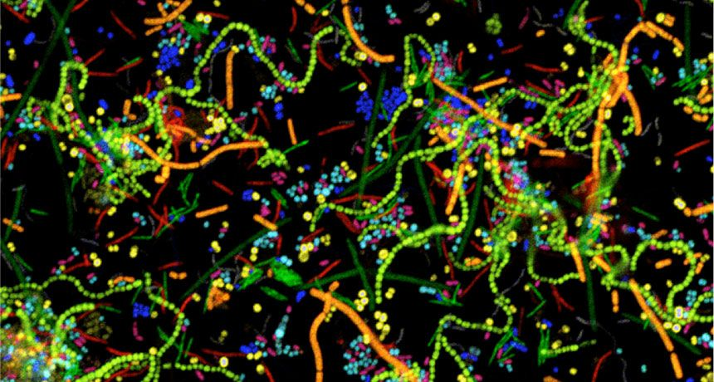
Meta- genomics
Many organisms
A Metagenome

Slide 5
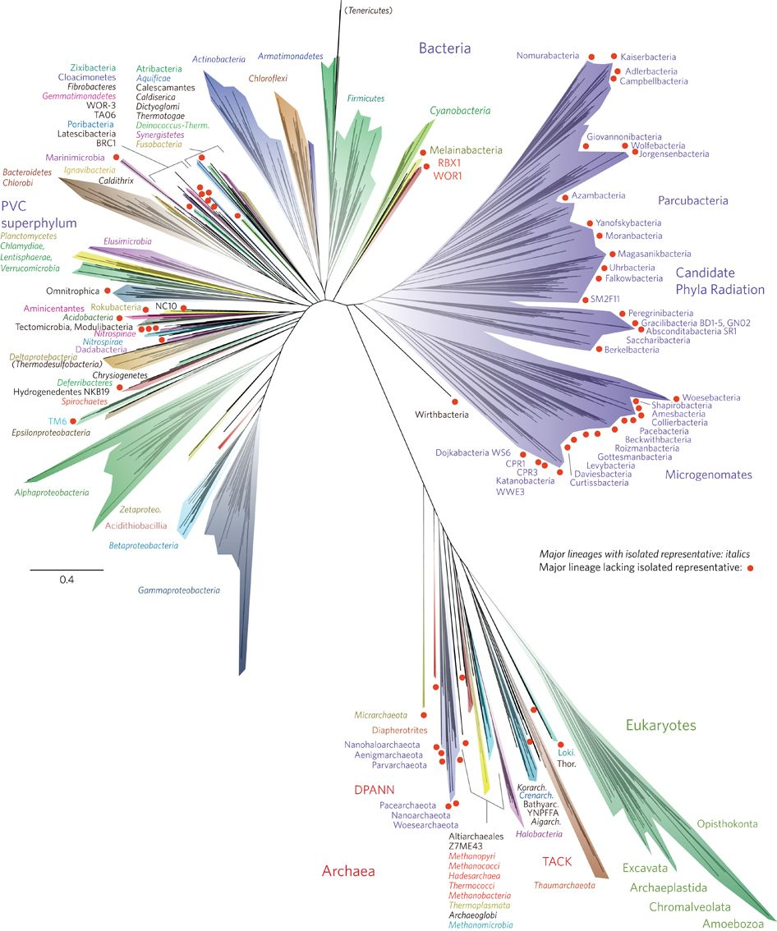
Why make our life complicated
It is hard/impossible to separate the organisms:
  Isolating (e.g. making a pure culture) microbes is hard
We want to study interaction
We want to study organisms in situ
It’s mainly about the microbes
Hug et al 2016 (10.1038/nmicrobiol.2016.48)

Slide 6
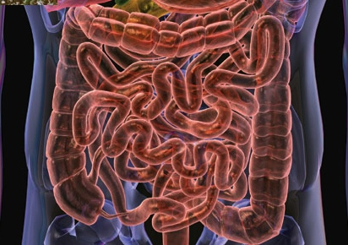
A human gut
10*10^13 (1.3 x human cells)
About 0.5% of dry weight
~150 species in every gut
300x human genes
But diverse from one to the other! More than 10 that many known gut species and genes
But only ~20% cultivated

Slide 7
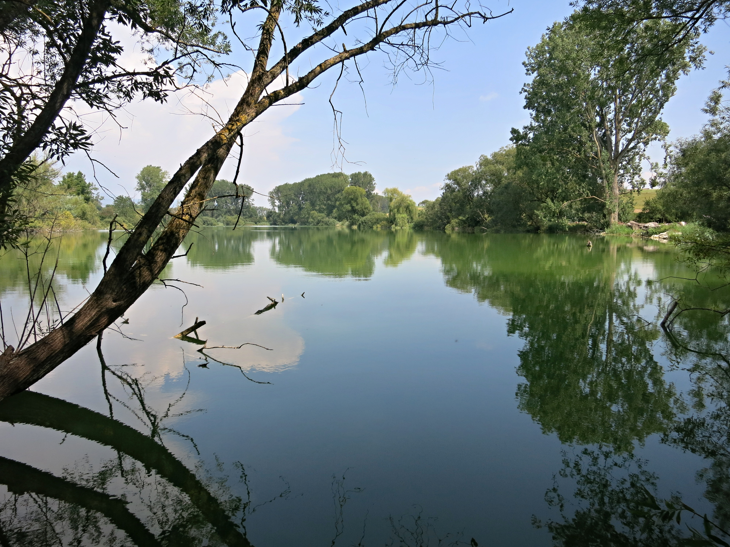
A lake
1.35*10^17 cells (a milion per mL)
About 135kg of dry weight
~700 species in the water
3.000.000 encoded genes
Only a couple of handfull are cultivated.

Slide 8
It all maters
They are everywhere
They do a lot of stuff:
  90% of disease in humans can be related to microbiomes
  Most nutrients that end up in your blood stream have been somewhat metabolized by some microbe
  Microbes do 2/3rds of carbon fixation in aquatic environments
  But also the majority of carbon emissions!

Slide 9
Before the computer
Get sample
Extract DNA
Prep library
Send to Sequencing facility
????
PROFIT

Slide 10
Dream-quest of unknown metagenome
From an environment with the power of genomics we want to know:
  Who is in the environment? (taxonomy)
  How many of each? (abundance)
  What can they do they? (genetic potential)
  What are they doing? (expression analysis)
  What do they eat? (metabolism)
  Where do they come from? (evolution and ecology)

Slide 11

Sequencing strategies
Targeted, a.k.a. amplicon /metabarcoding/edna
Shotgun sequencing:
  Short reads (HiSeq, NovaSeq, all Illumina basically)
  Long reads (PacBio, Nanopore, …)
Metatranscriptomic
Functional metagenomics
...
Image credit: xkcd

Slide 12

Shotgun and amplicon
Two main players:
Shotgun:
  The obvious approach
  Sequence all : make sense of it
  Computationally diverse methodologies
Amplicon:
  Pick a gene, sequence it
  Snapshot of a function or taxonomy
  Much cheaper, more depth
Image credit: xkcd

Slide 13
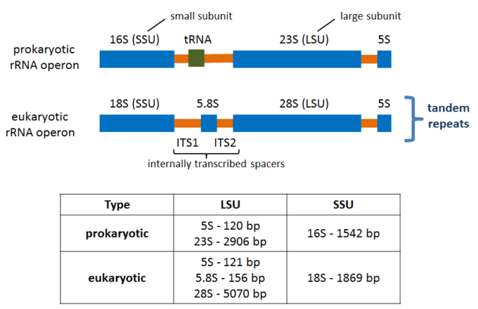
“metabarcoding”

Slide 14
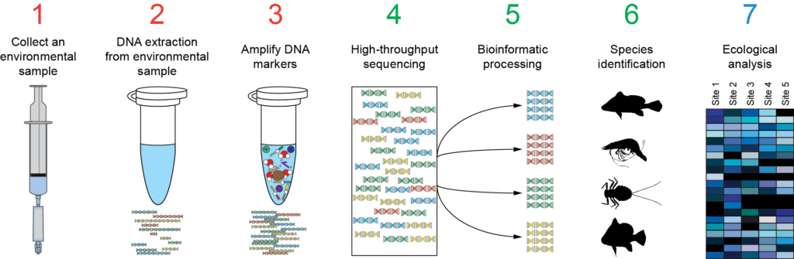
Amplicon

Slide 15

These few hours
Some 16s rRNA-gene amplicon!
  Setup R-studio
  Getting some data
  Using dada2 to process stuff
  and some other packages to make sense of it

Slide 16

Some ressources we will need
tinyurl.com/textboardmetagenomics

