Slide 1

of METAGENOMICS!!
Image credit: oots

Slide 2



Assembly
SLU Metagenomic course 2019 --- Moritz Buck
@metamoritz
@moritzbuck
@metamoritz

Slide 3
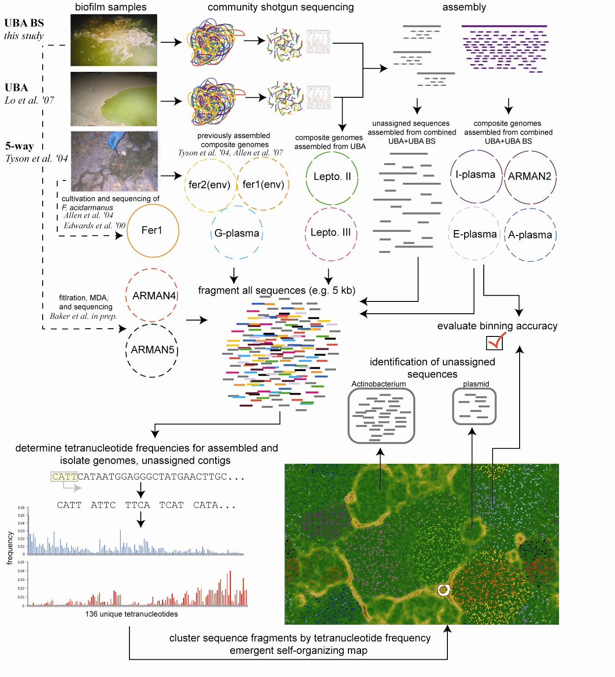

Shotgun Metagenomics
DNA
extraction
Fragmentation
DNA
sequencing
>seq1
GCCGTAGTCC…
>seq2
TATGCCGGTA…
>seq3
...

Slide 4
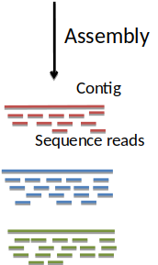
Shotgun Metagenomics
DNA
extraction
Fragmentation
DNA
sequencing
>seq1
GCCGTAGTCC…
>seq2
TATGCCGGTA…
>seq3
...
Reads: short nucleotide sequences coming out of the sequencer
Contigs: longer nucleotide sequence resulting of the assembly of many reads
Assembler: bioinformatic tool transforming one into the other

Slide 5

Overlap-consensus assembly
Reads:

Slide 6
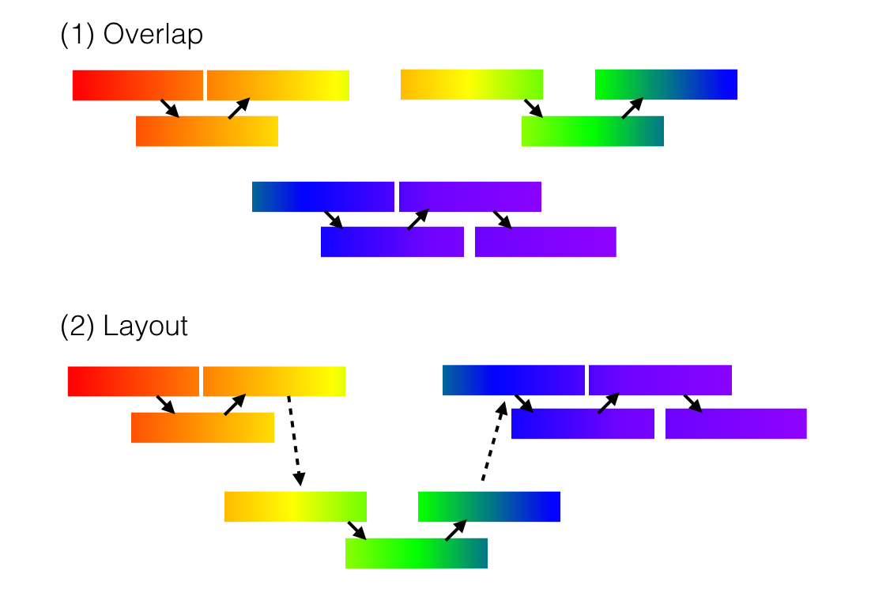
Overlap-consensus assembly
Reads:

Slide 7
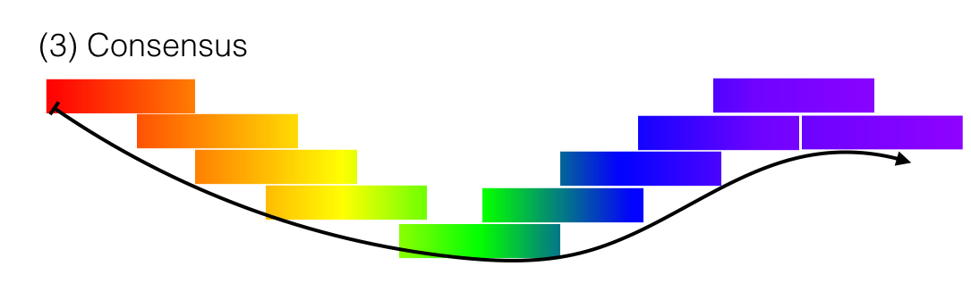
Overlap-consensus assembly

Slide 8
Some assemblers
Mainly for long read, some are “hybrids”
Canu
Falcon (not for bacteria)
Miniasm (fast, no consensus)
+ Racon (consensus)
= Unicycler
Old tools like bambus

Slide 9
de Bruijn assembly
Impossible for short reads, too slow.
Decompose all reads into k-mers, e.g. ‘k’-long words (if k=15, words with 15 letters)
  S=ACGTTCGA
  ACGT
  CGTT
  GTTC
  TTCG
  TCGA

Slide 10
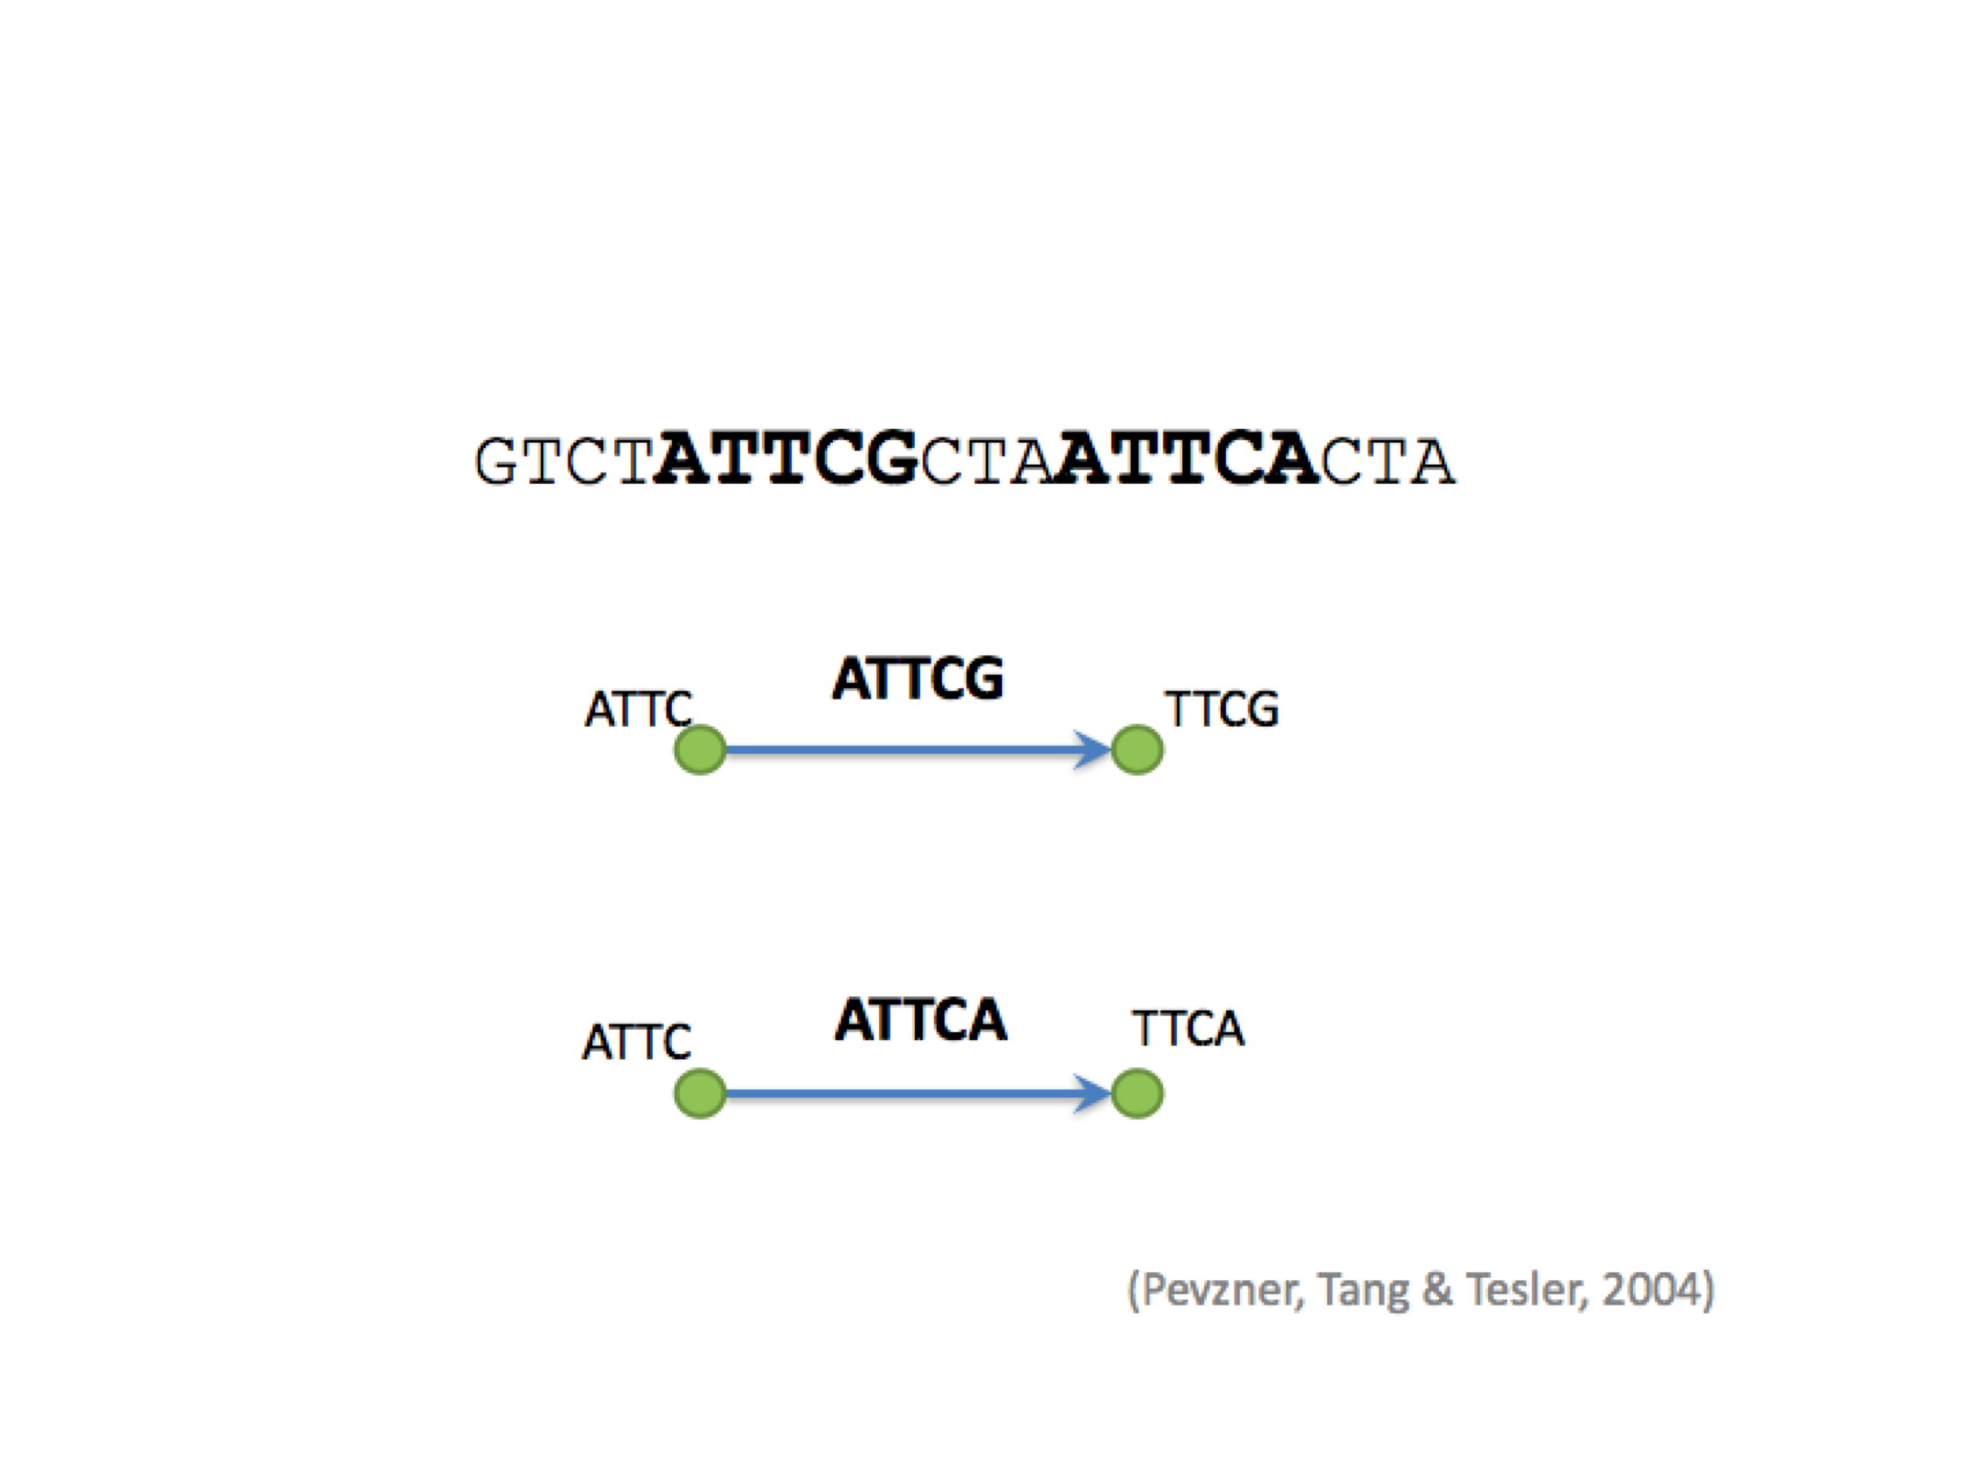
de Bruijn assembly

Slide 11
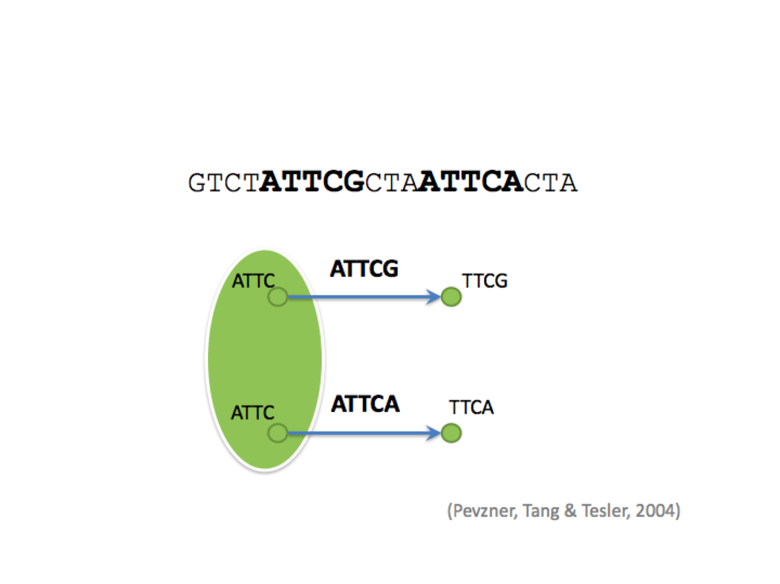
de Bruijn assembly

Slide 12
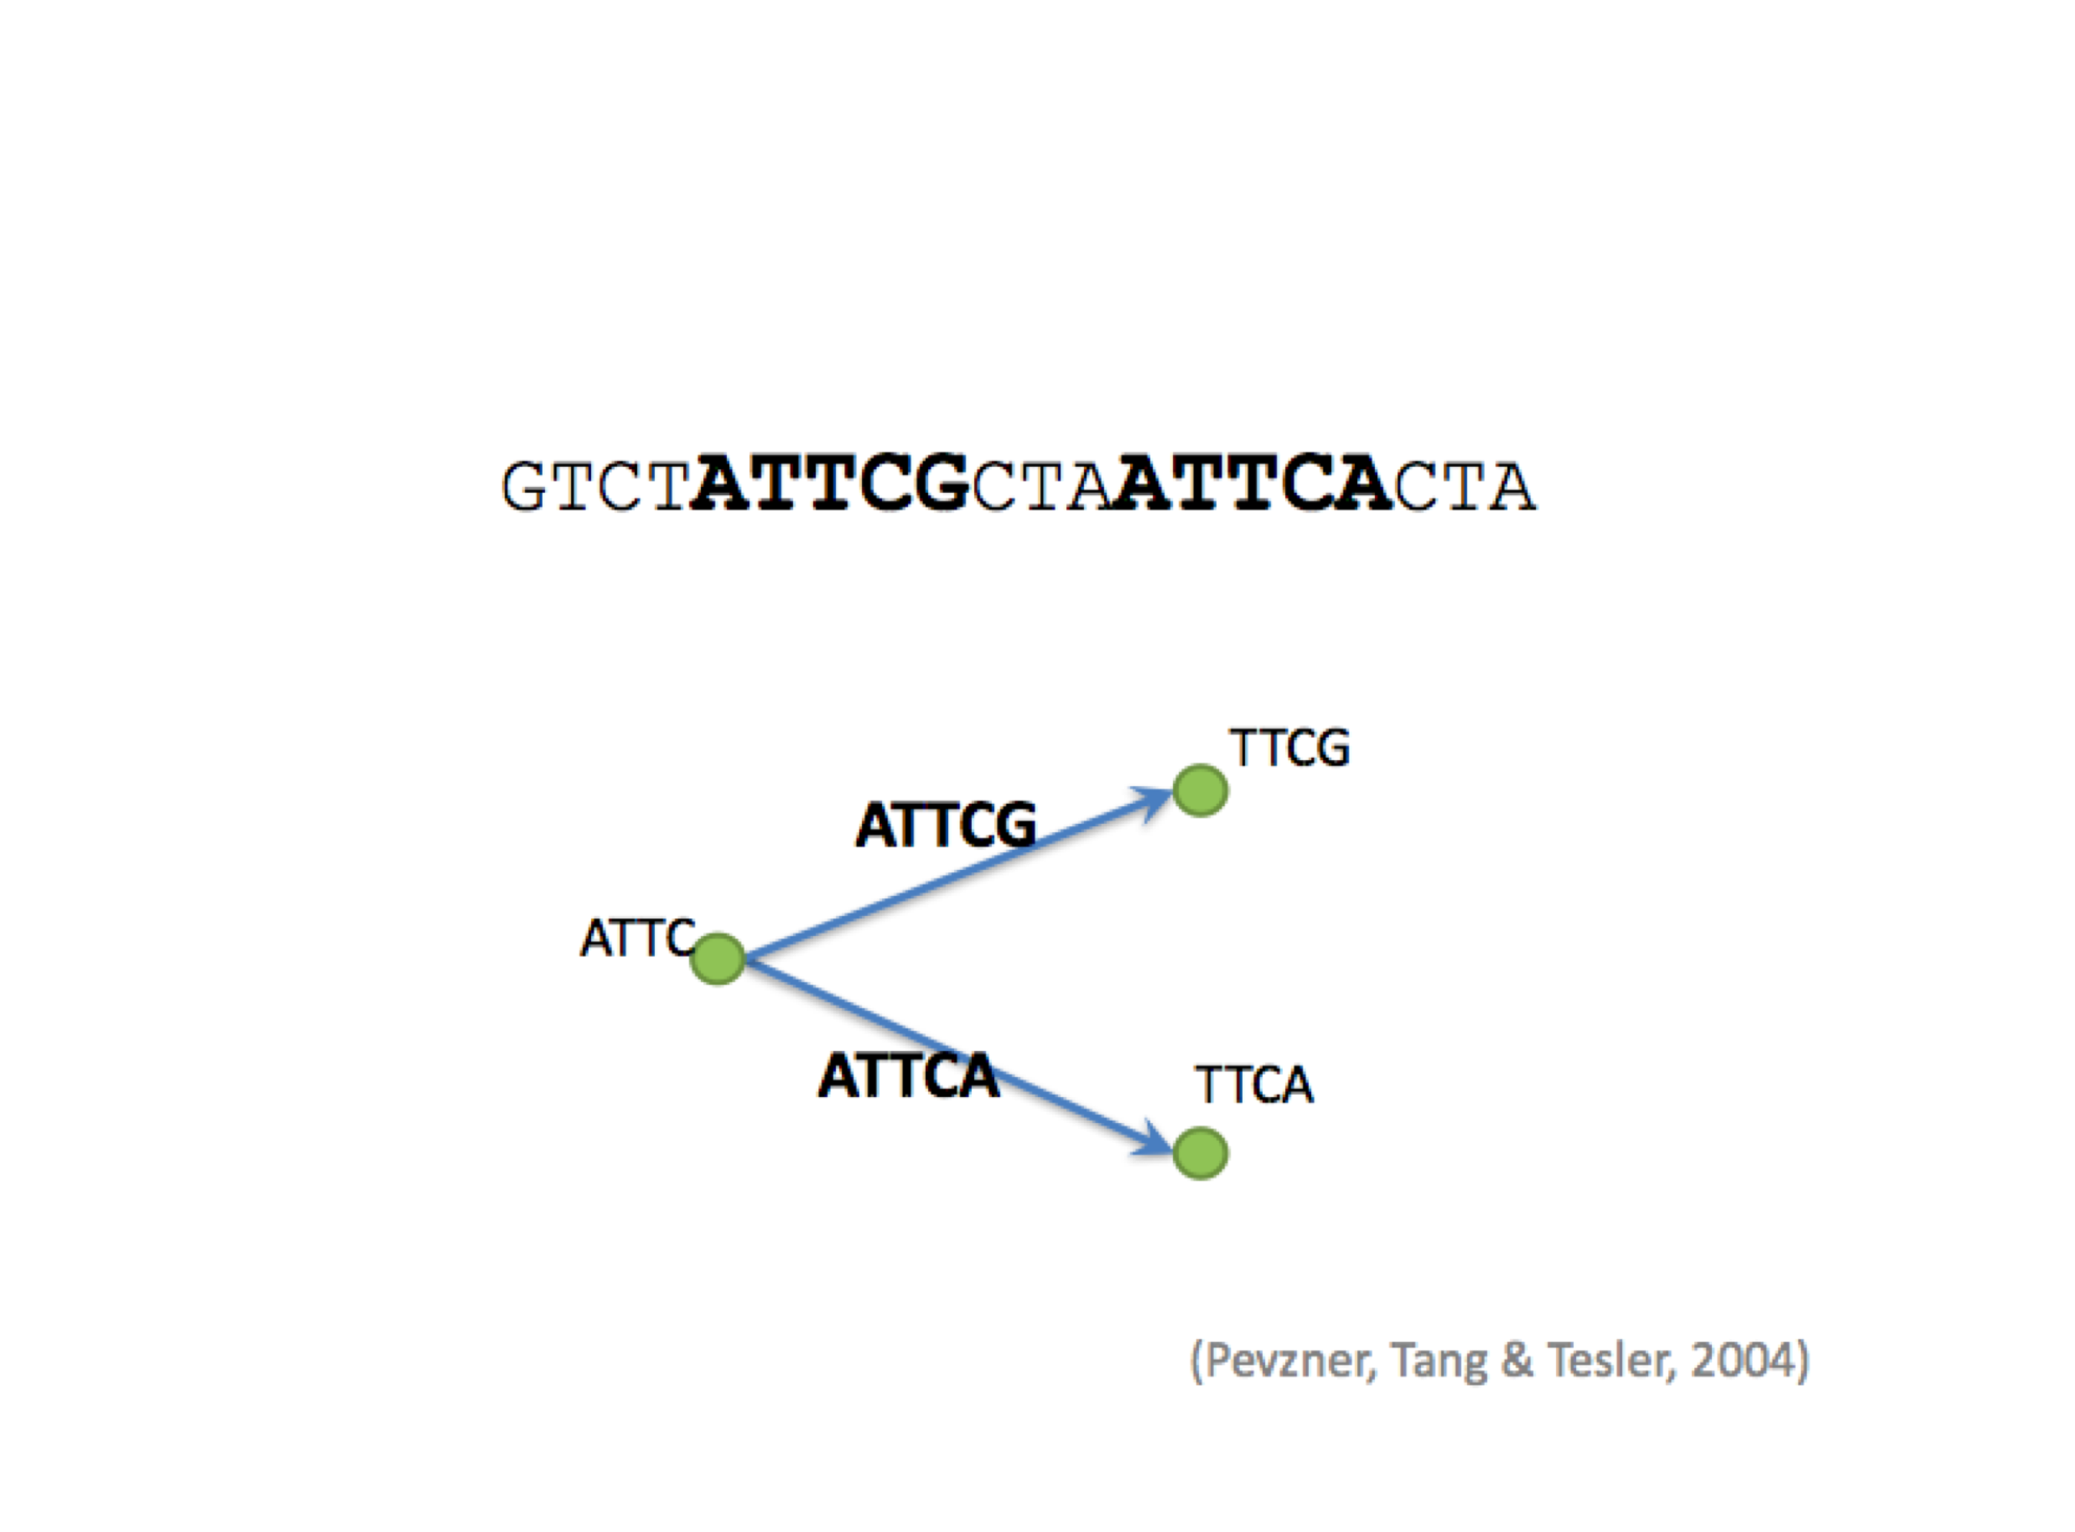
de Bruijn assembly

Slide 13
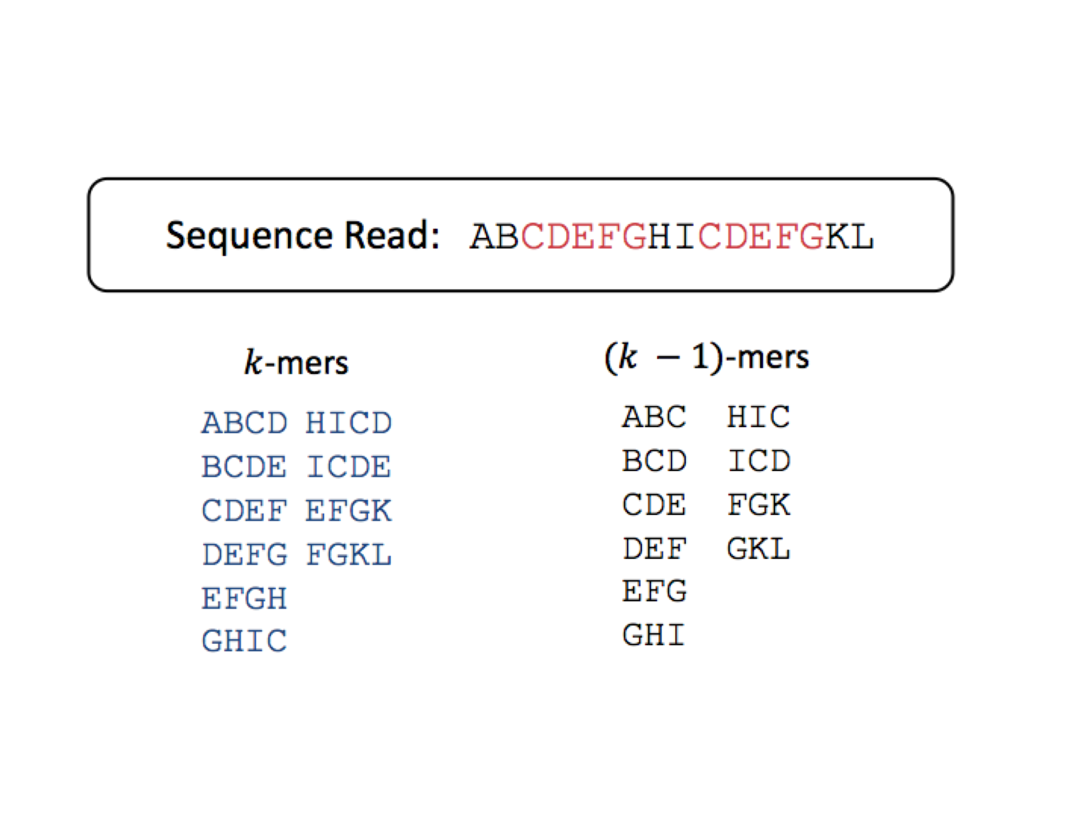
de Bruijn assembly

Slide 14
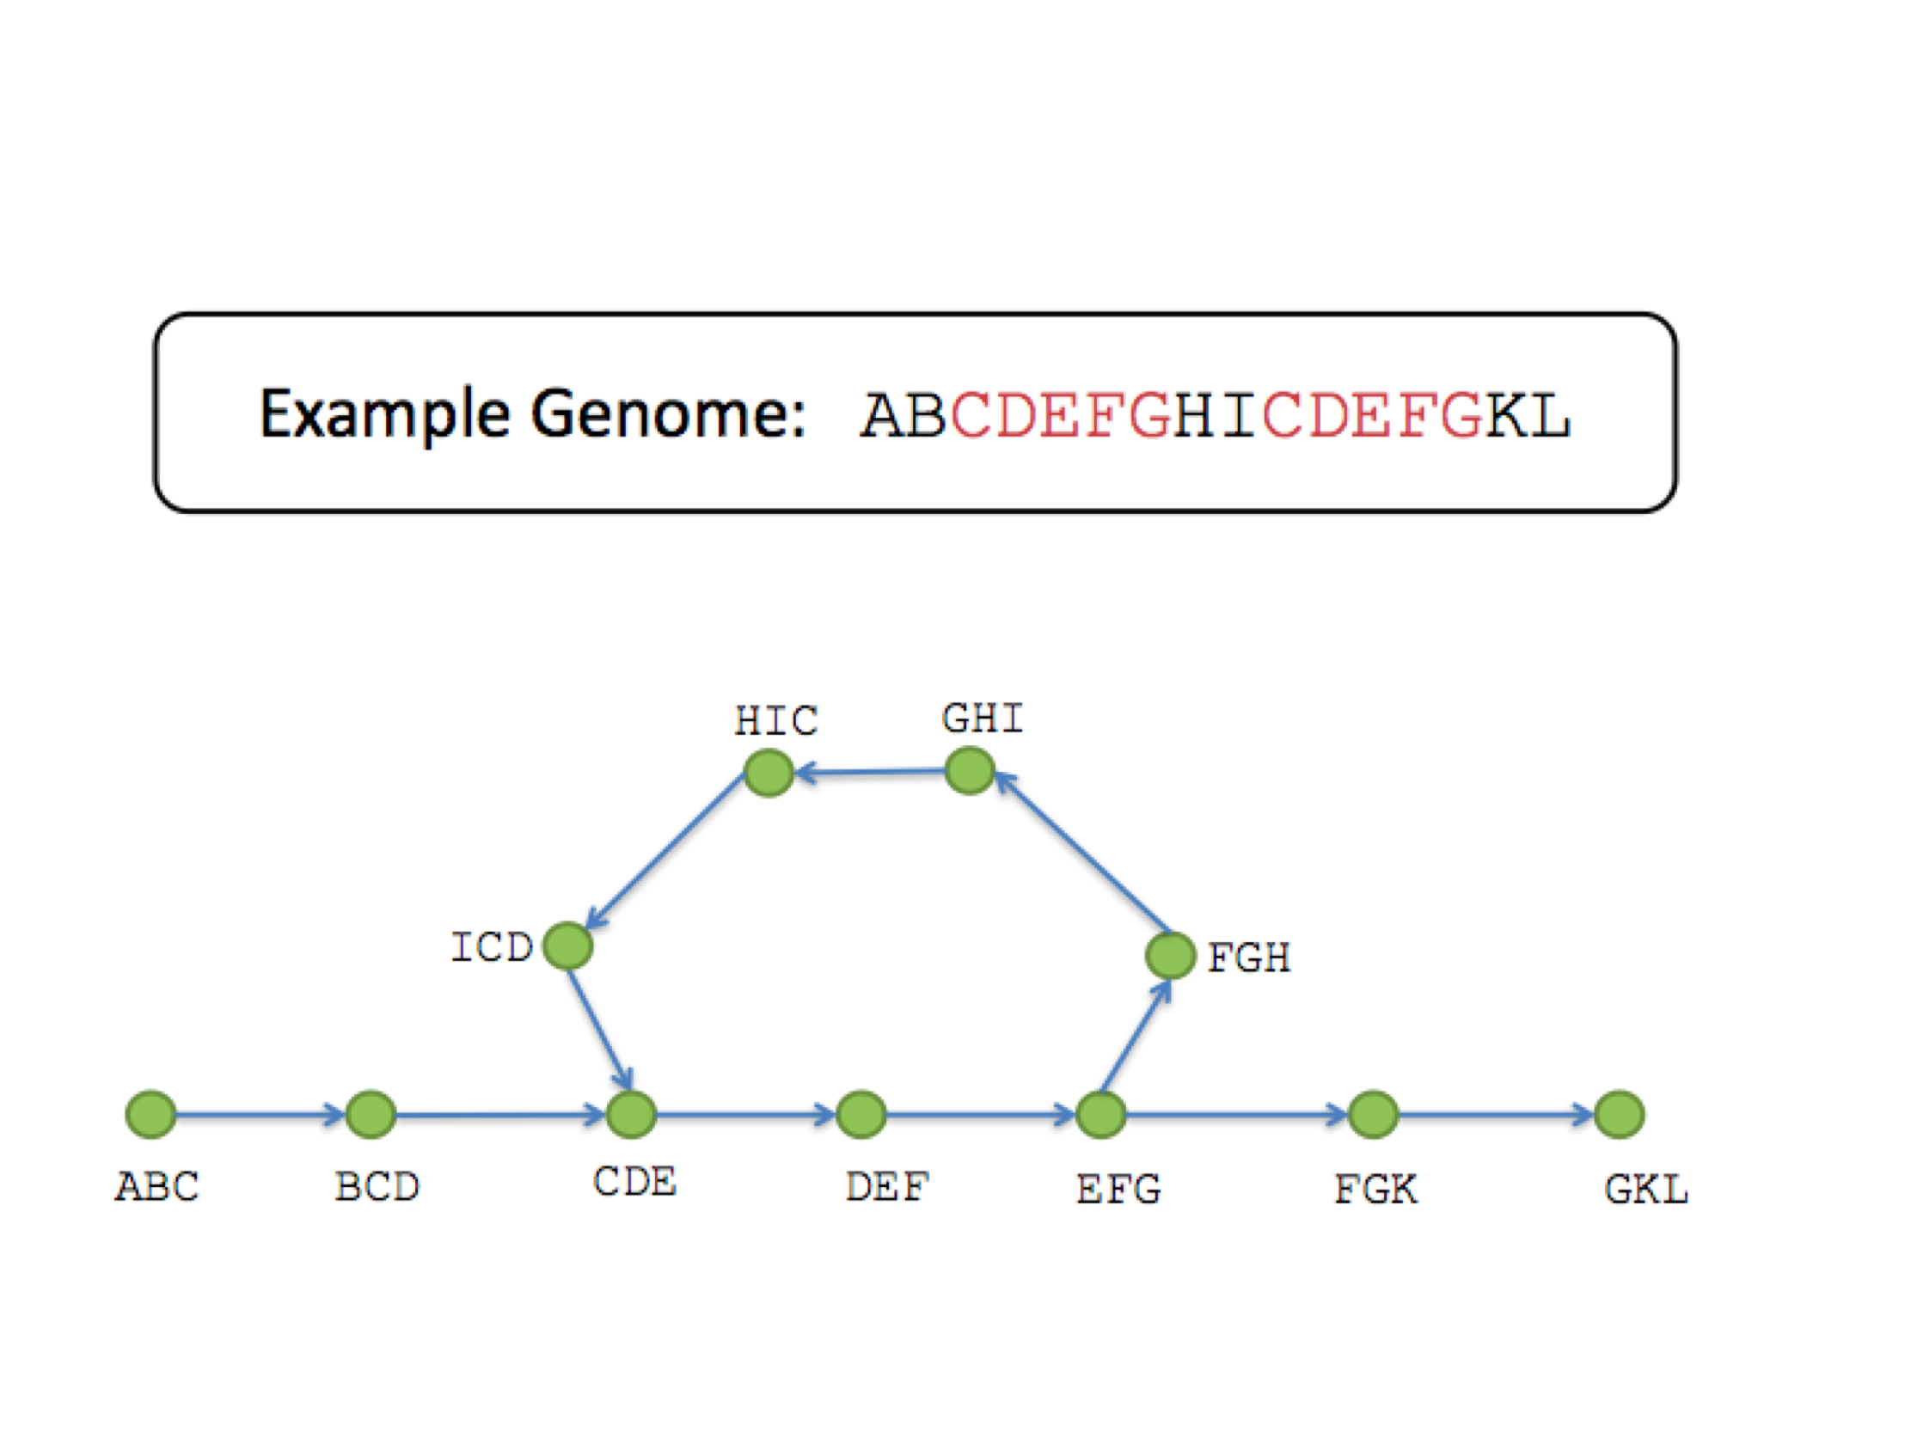
de Bruijn assembly

Slide 15
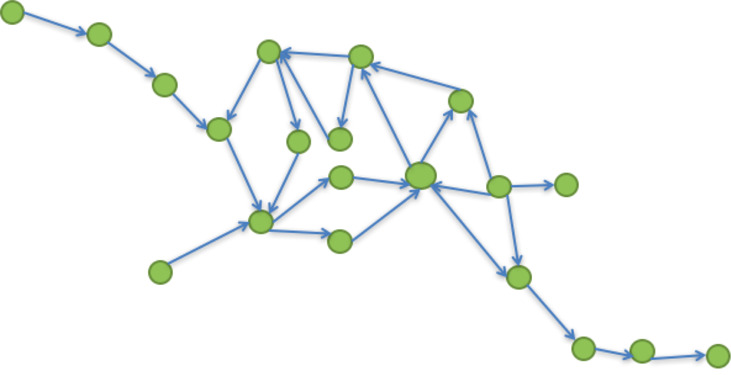
de Bruijn assembly

Slide 16
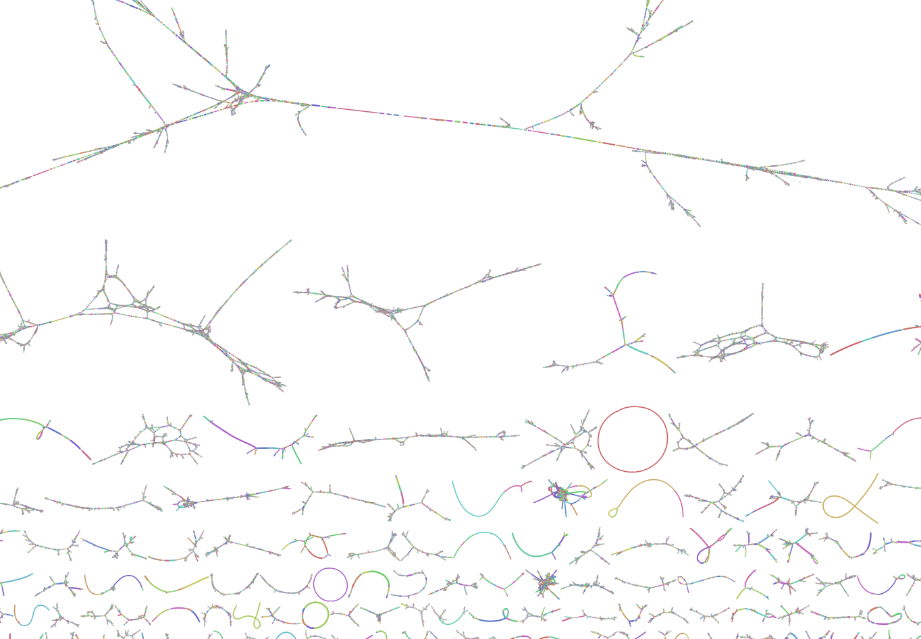
de Bruijn assembly

Slide 17
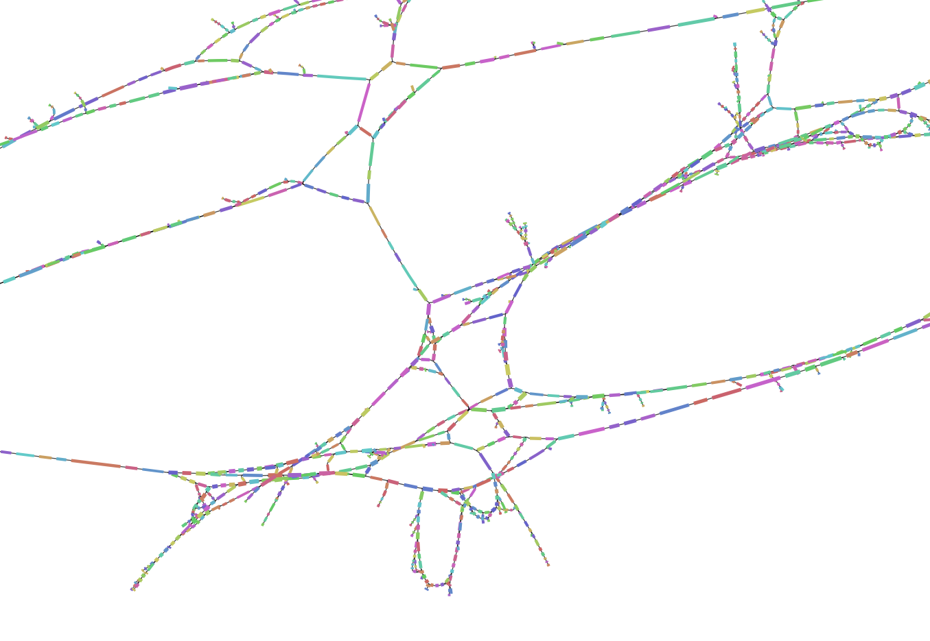
de Bruijn assembly

Slide 18
de Bruijn assembly
Understanding the parameters somewhat matters:
Smaller k-mers : more robust, more bubbles
Higher k-mers: more sensistive to errors, less bubbles
Many tools now use a range of k-mers
Filtering k-mers

Slide 19
Some more tools
SPAdes in all its flavours
Megahit
Unicycler
Ray
Flye (long reads)
Redbean (long reads)

Slide 20
Some more ressources
Nice comparison of long read assemblers: https://github.com/rrwick/Long-read-assembler-comparison
Description of many metagnome assembly tools: academic.oup.com/bib/advance-article/doi/10.1093/bib/bbz020/5363831
Metagenome “competition”: https://data.cami-challenge.org/

