Slide 1
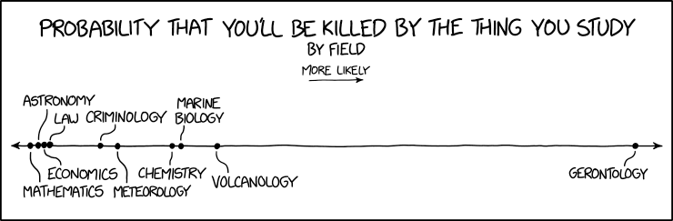
METAGENOMICS ?
Image credit: xkcd

Slide 2



Metagenomic workflows
SLU MetaOmics course 2025
@metamoritz
@moritzbuck
@metamoritz

Slide 3
Before the computer (c.f. many of your lectures)
Get sample
Extract DNA
Prep library
Send to Sequencing facility
????
PROFIT

Slide 4
Dream-quest of unknown metagenome
From an environment with the power of genomics we want to know:
  Who is in the environment? (taxonomy)
  How many of each? (abundance)
  What can they do they? (genetic potential)
  What are they doing? (expression analysis)
  What do they eat? (metabolism)
  Where do they come from? (evolution and ecology)

Slide 5
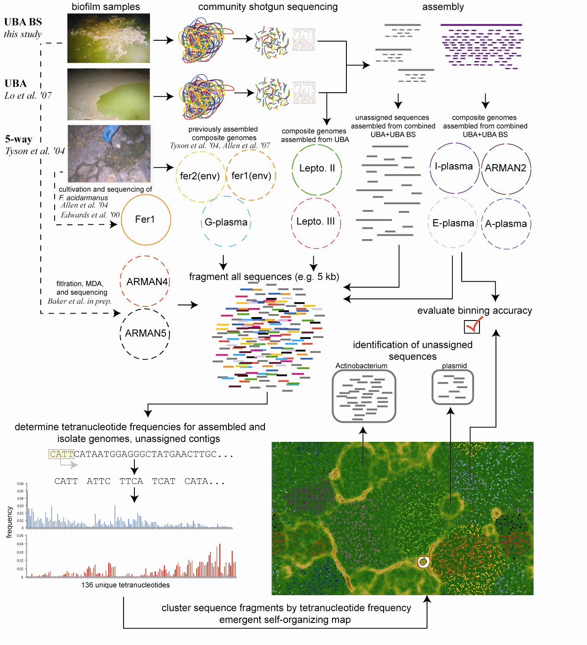

Shotgun Metagenomics
DNA
extraction
Fragmentation
DNA
sequencing
>seq1
GCCGTAGTCC…
>seq2
TATGCCGGTA…
>seq3
...

Slide 6
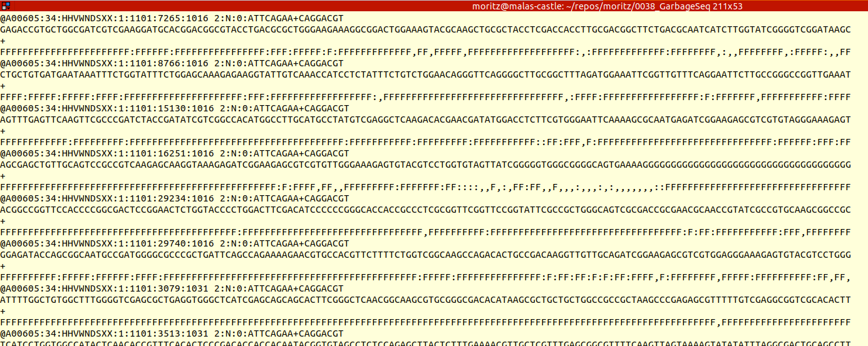
What you get from your shotgun?
Load and load of reads

Slide 7
What we gonna do with them reads? (Today)
Direct read processing:
Clean them
Taxonomically annotate them
Compare them to each other
Genome-resolved MG:
Assemble the reads
Map the reads to it
Cluster the contigs

Slide 8

… with them MAGs? (tomorrow)

Slide 9
Resources for today
etherpad.wikimedia.org/p/multiomics_2025
moritzbuck.github.io/MultiOmics_2025/

Slide 10
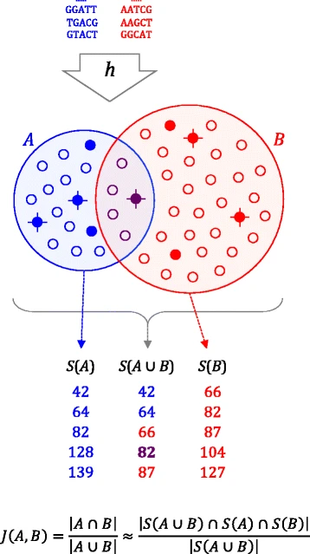
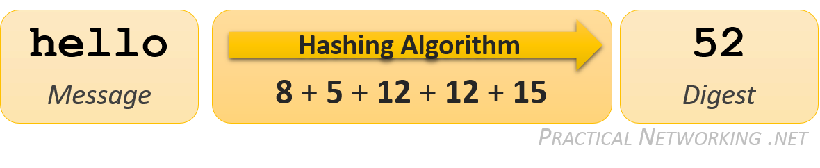
MinHash
Comparing:
Hashing:

Slide 11
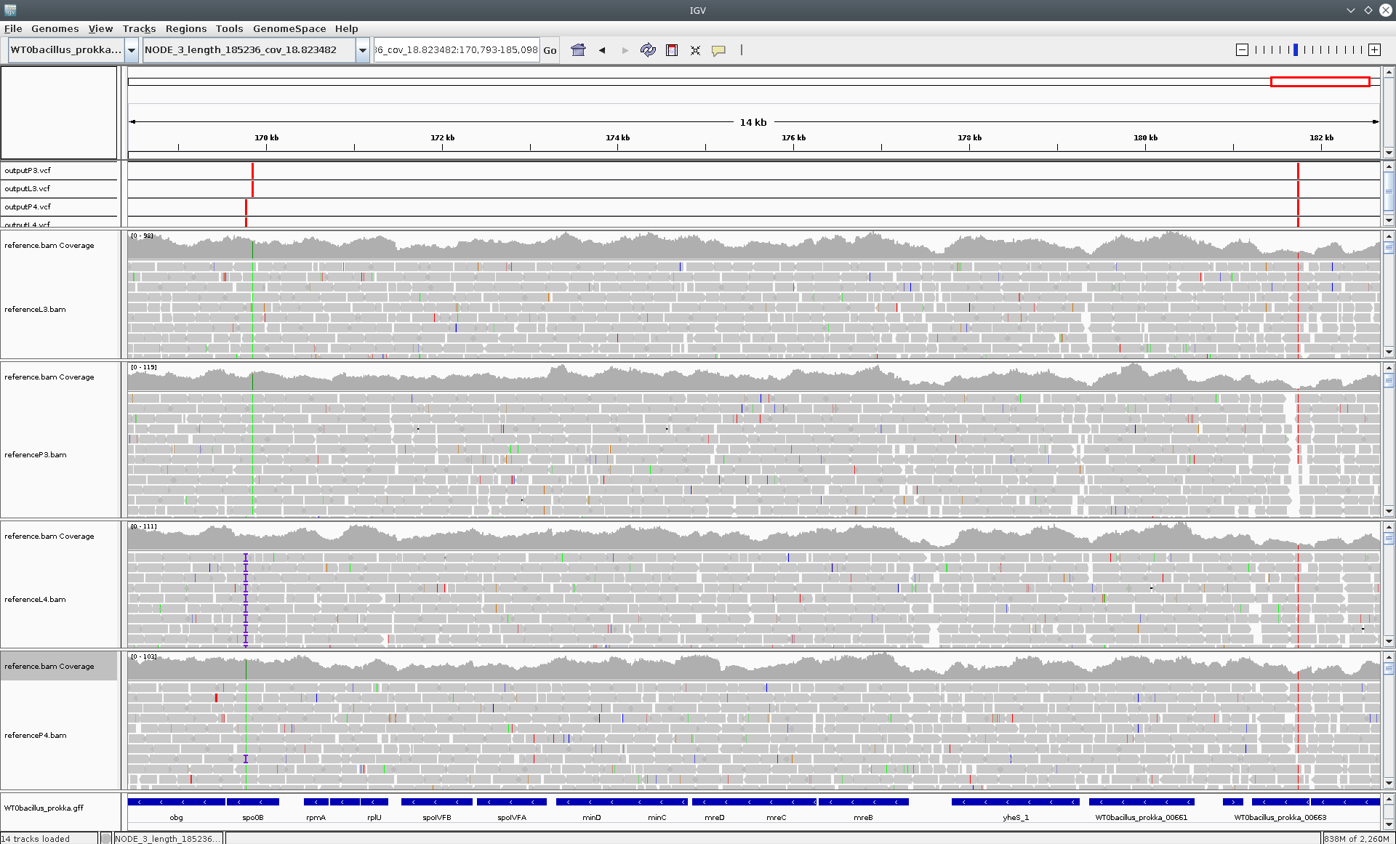
The pile-up
Viz software: IGV
Image credit: Pilar Lòpez-Hernàndez et al.

Slide 12
Assembly and vocab

Slide 13
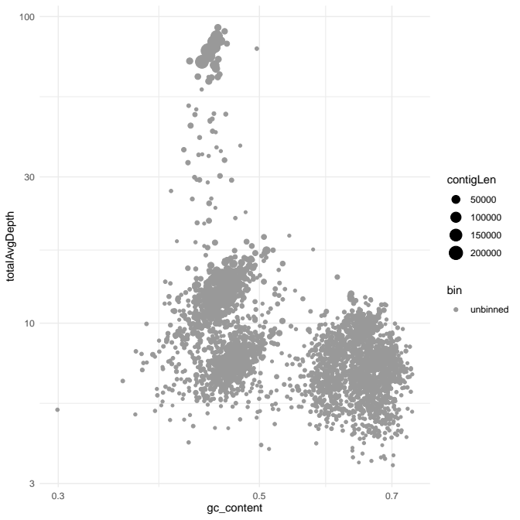
Clustering contigs
Binning:

Slide 14
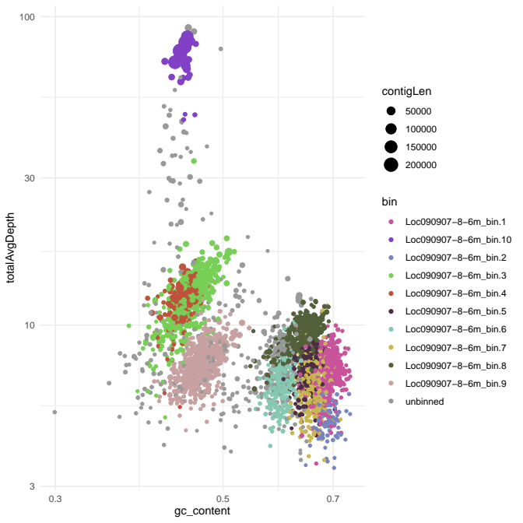
Clustering contigs
Binning:

Slide 15
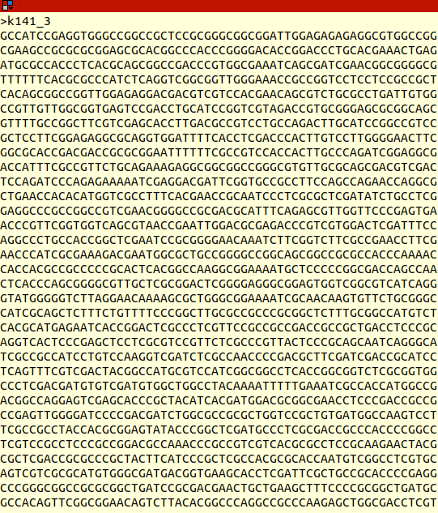
What is a genome?
How to recognize a genome:
  Size and coding-density
  Similarity to known genome
  Universal single copy genes

Slide 16
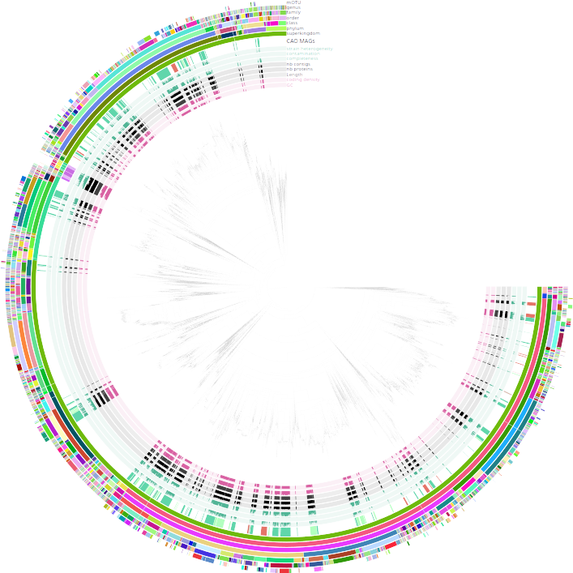
Putting it into phylogenomics context!

Slide 17
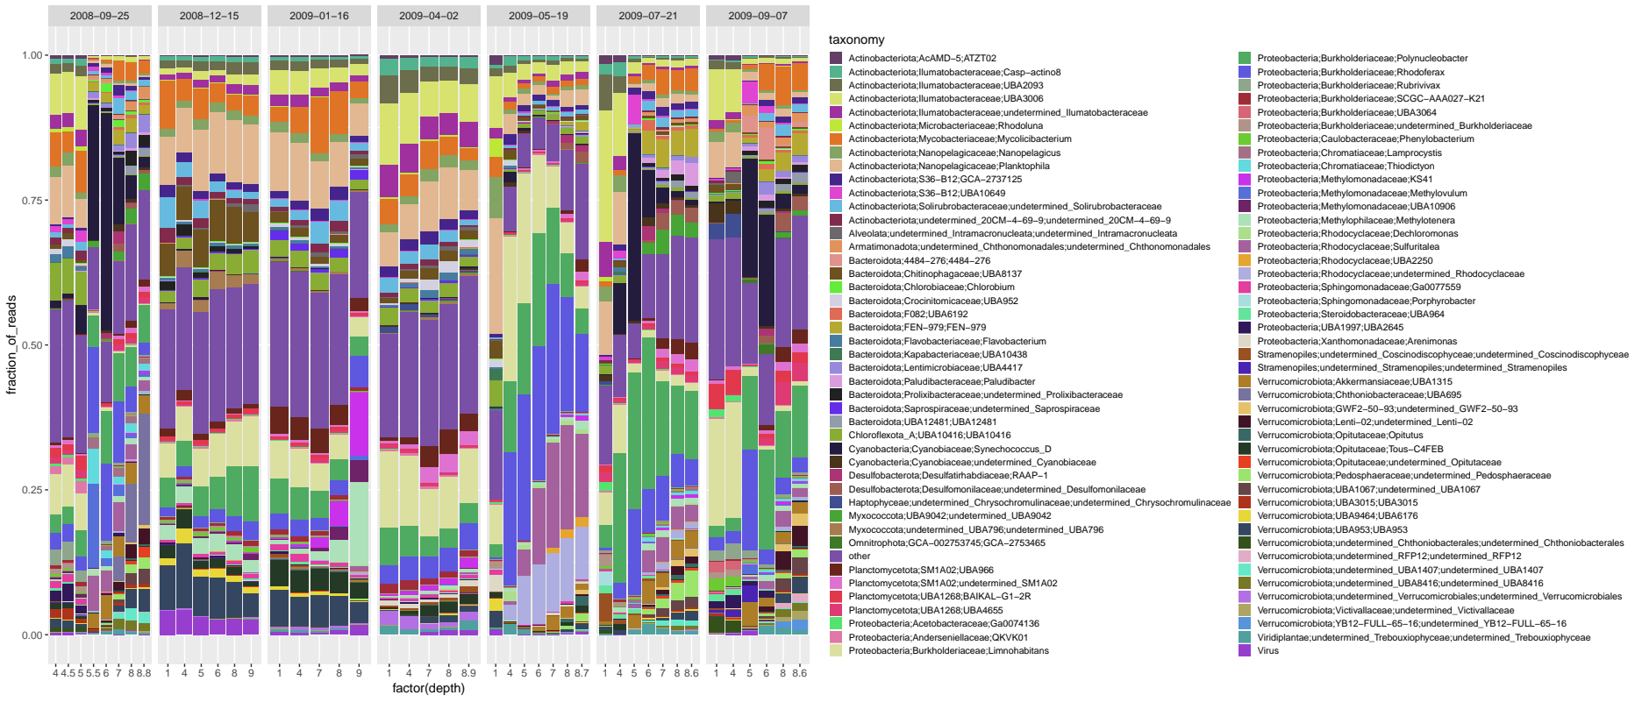
Quantifying it
Mapping read to the bins:
  Statistics
  Diversity metrics
  Network analysis

