Slide 1
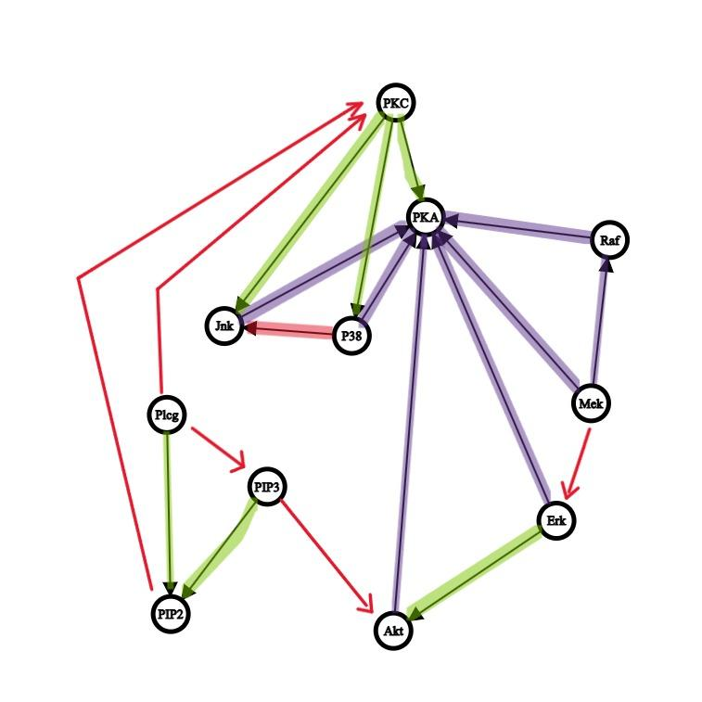
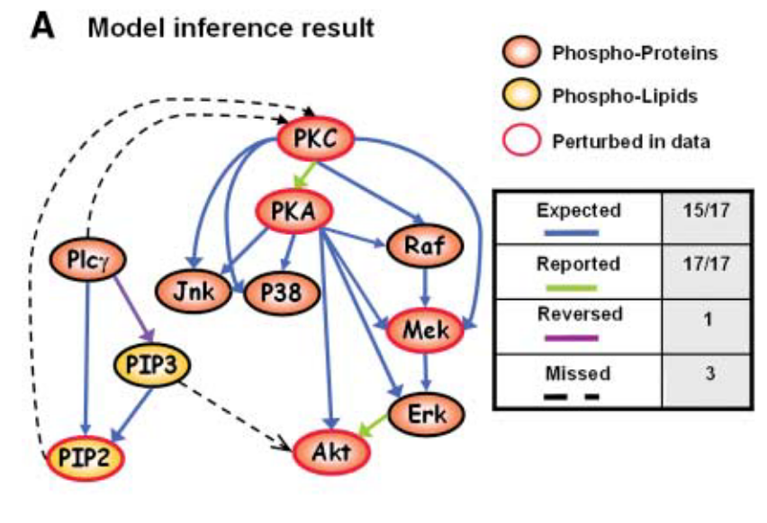
Learning DAGs with NoTEARS
Result vs. Ground Truth
Learn causality in data
Create a DAG
Problem: NP hard
Solution: continuous optimization problem (NoTears algorithm)

