Slide 1
Portrait Pigeon: an interactive photo wall for seniors
Moritz Gellner
Robin Brewer

Slide 2
Introduction
ANSWER PROBLEM SOLVING? WHY SOLVING IT?
Seniors difficulty with computers and GUIs
Lack of accessible communication platforms
Variety of abilities, need for customization

Slide 3
Related Work
ADD AUTHOR NAMES + YEARS, TYPE NAME OF DEVICE IN NOTES, ADD PAPERS FROM CLASS
Photos for seniors
Interactive photo walls
Lightweight communication platforms for seniors

Slide 4
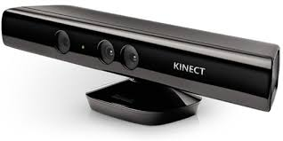
Our Approach
WHAT’D WE DO? + WHY IS IT NOVEL?

Slide 5
Initial Designs
WHAT WE ORIGINALLY PITCHED

Slide 6
Pilot Study
Tested in assisted living community
Difficulty knowing if hand positioned over target
Expectation for voice
Changes made/making: visual feedback, in future can incorporate voice

