Slide 1
Portrait Pigeon: an interactive photo wall for seniors
Moritz Gellner
Robin Brewer

Slide 2
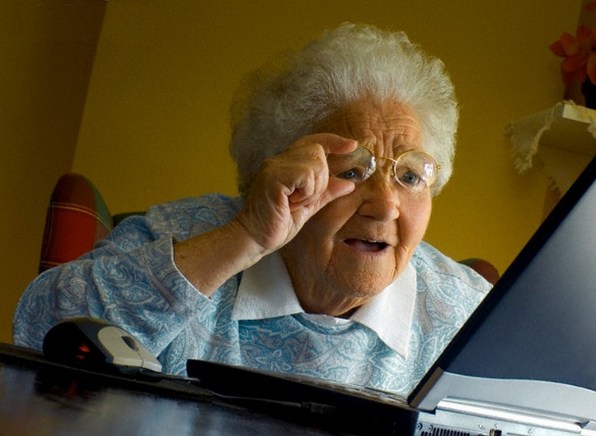
Introduction
PROBLEM:
Seniors difficulty with computers and GUIs
Need for customization to seniors different disabilities
Lack of accessible communication platforms
WHY SOLVE IT?
Closing the digital communication gap enables open lines for remote family communication
More social support → increased physical and mental health

Slide 3
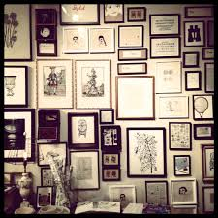
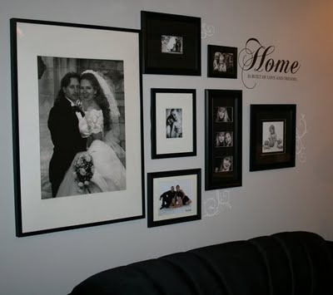
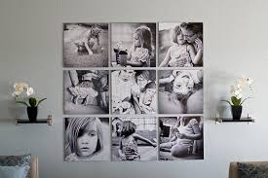
Photos for Seniors
Case study with households of older adults
Permanence of photo displays

Slide 4
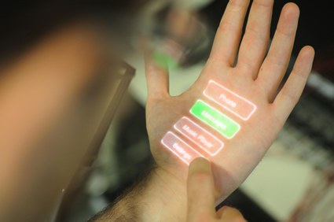
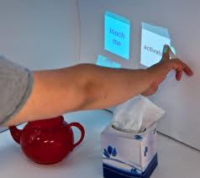
Interactive Surfaces
“Touch” walls, objects, or both for input (e.g. Skinput)
Gesture interactions to control wall displays

Slide 5
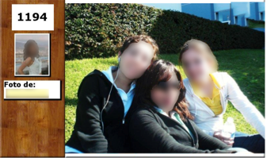
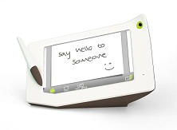
Lightweight messaging for seniors
Augmenting photo frames to display messages, e.g. Tlatloque
Situated message displays using photos and “scribbles”, e.g. Wavye

Slide 6
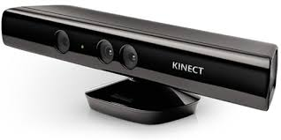
Our Approach
Developed an interactive messaging system w/depth camera to enable sending of messages by augmenting photo displays on walls

Slide 7
Contributions
How to customize whole-body gesture interactions to seniors with varying disabilities
Flexibly link different modes of lightweight messaging
Incorporate multiple feedback mechanisms

Slide 8
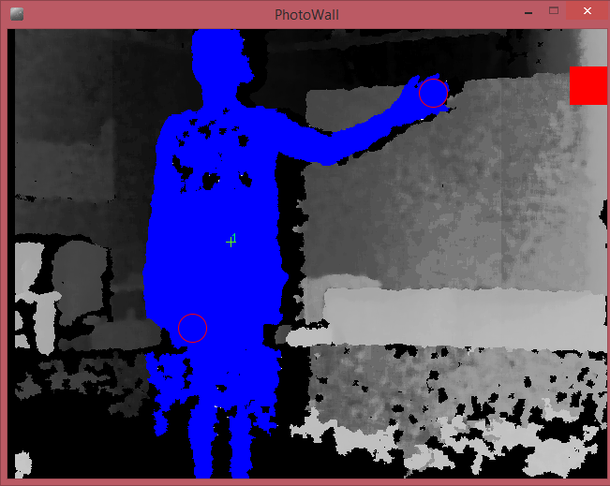
Initial Pilot Study
Email with pre-set messages, audio as feedback, quadrant recognition
Tested with 3 users at an independent and assisted living community
Feedback + observations:
Difficult to know where to stand
Expected voice input
No feedback displayed on who the message was sent to

Slide 9
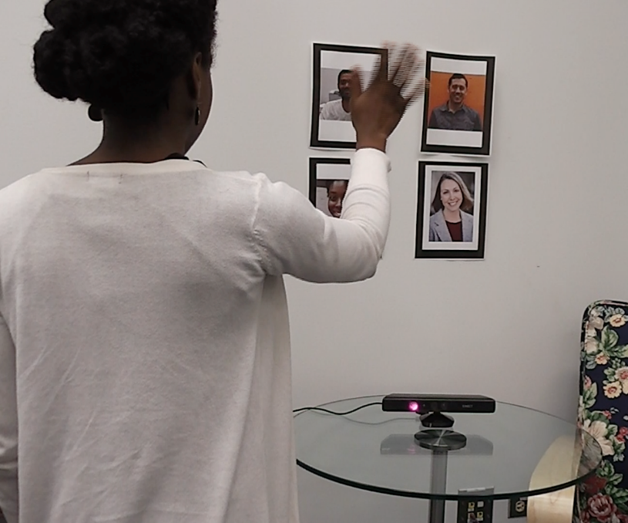
Current Implementation
Pre-set messages,
Feedback as audio and visual
Incorporates email and Twitter
Quadrant system

Slide 10
Future Work
Test visual feedback with seniors
Incorporate reciprocity
Add other communication platforms
Create setup wizard for quick modifications

Slide 11
References
Cornejo, R. et al. 2013. Enriching in-person encounters through social media: A study on family connectedness for the elderly. International Journal of Human-Computer Studies. 71, 9 (Sep. 2013), 889–899.
Corsten, C. et al. 2013. Instant User Interfaces: Repurposing Everyday Objects as Input Devices. Proceedings of the 2013 ACM international conference on Interactive tabletops and surfaces - ITS ’13 (2013), 71–80.
Harrison, C. et al. 2010. Skinput: Appropriating the Body as an Input Surface. ACM SIGCHI (2010), 453–462.
Lindley, S.E. 2011. Shades of lightweight: supporting cross-generational communication through home messaging. Universal Access in the Information Society. 11, 1 (Jun. 2011), 31–43.
Swan, L. and Taylor, A.S. 2008. Photo displays in the home. DIS ’08 (2008), 261–270.

