Slide 1
AGENT-BASED MODELING · SS 2026
Bank Run
Simulation
Agent-Based Contagion via Social Networks
Tim Haenicke & Moritz Graemer

Slide 2
02 FORSCHUNGSFRAGE
Research Question
How do noisy signals about bank solvency propagate through a social network
and when does rumour-driven withdrawal deplete the bank's liquidity?
I
Contagion
II
Bank Balance
III
Feedback Loop
declining balance amplifies rumours;
deposit insurance dampens the spread
calm → concerned → withdraw
propagates via weighted social links
reserve ratio determines when
withdrawals trigger illiquidity

Slide 3
03 MODELL-SETUP
The Story
THE BANK
SIGNALS & AGENTS
Holds all deposits of agents
Exogenous noisy signal → Watchers
x % kept liquid as reserve ratio
Watchers: receive external signal
(1–x) % locked in long-term assets
Sleepers: only hear from neighbours
Insiders (20%): direct health access
Solvency determined by banks behaviour
Signals weighted by sender credibility
Collapses when liquidity < withdrawals
Withdrawal reduces bank liquidity

Slide 4
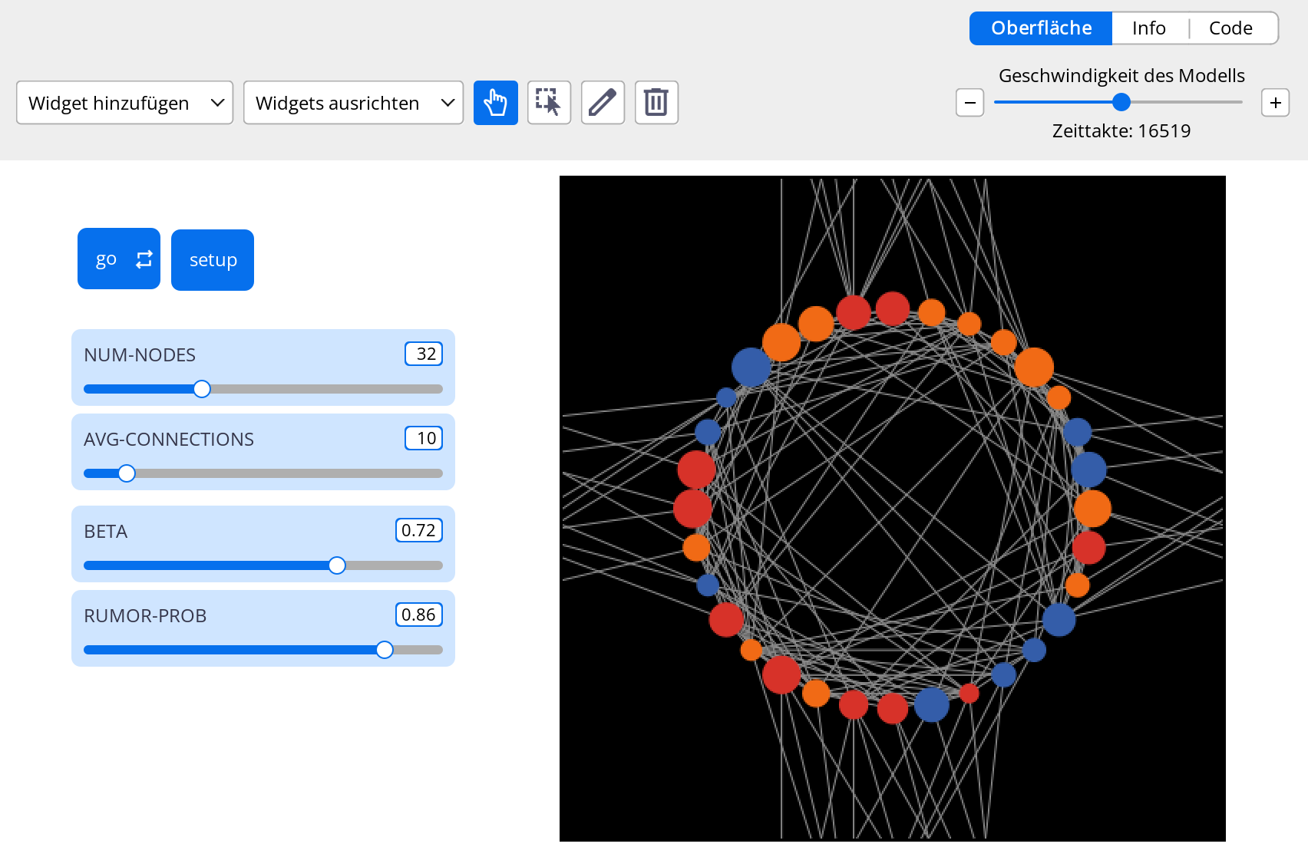
STATES:
calm
concerned
withdraw

Slide 5
04 PSEUDOCODE
Agent Decision Loop
SETUP
Create nodes: state · forgetfulness · naivety · credibility · insider?
Watts-Strogatz ring lattice + rewiring
GO
Each tick: spread-rumor → change-state → tick
SPREAD RUMOR
Watcher: draw p > function(bank liquidity) (inversely correlated to banks liquidity) → set state = ‚withdraw'
CHANGE STATE
Change State function: avg = Σ(signal × credibility) / n
else: forgetfulness may revert state
UPDATE BANK
withdrawals reduce reserve · if reserve < 0 → bank collapses

Slide 6
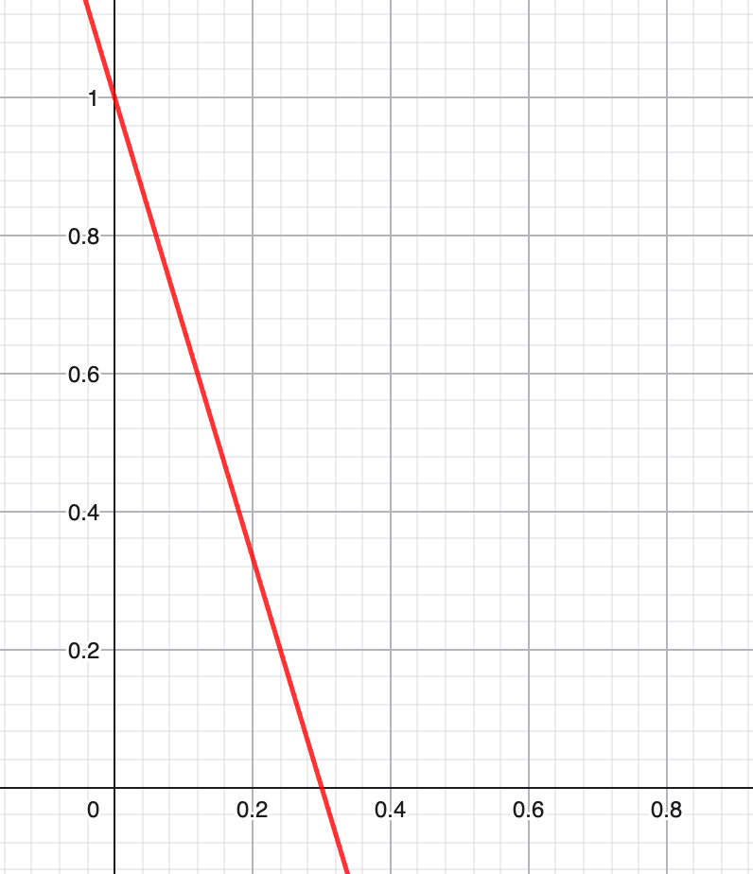
04 Implementation
Signaling Function of Bank to Watchers
signal-function s(% liquide assets of total assets)
$$signaltowatchers$$
$$s(l)$$
$$\frac{liquideassets}{totalassets}$$

Slide 7
05 LITERATUR
Literature Review
Diamond & Dybvig (1983)
Deng et al.
Bank Runs, Deposit Insurance, and Liquidity
Bank Runs in a Local Interaction Model
Foundation: self-fulfilling panic vs. fundamental runs
Spatial contagion → motivation for network topology
Elias
Ruano & Rajan
Bank Runs via Social Networks
Social Contagion & Bank Runs with LLM Depositors
Direct predecessor; social-link structure
LLM depositors; most recent
Santos & Nakane
Huang & Huang
Dynamic Bank Runs: An Agent-Based Approach
Connectionist Agent-Based Learning in Bank-Run Decision Making
ABM + balance sheet → our core extension
Learning agents; behavioural heterogeneity

Slide 8
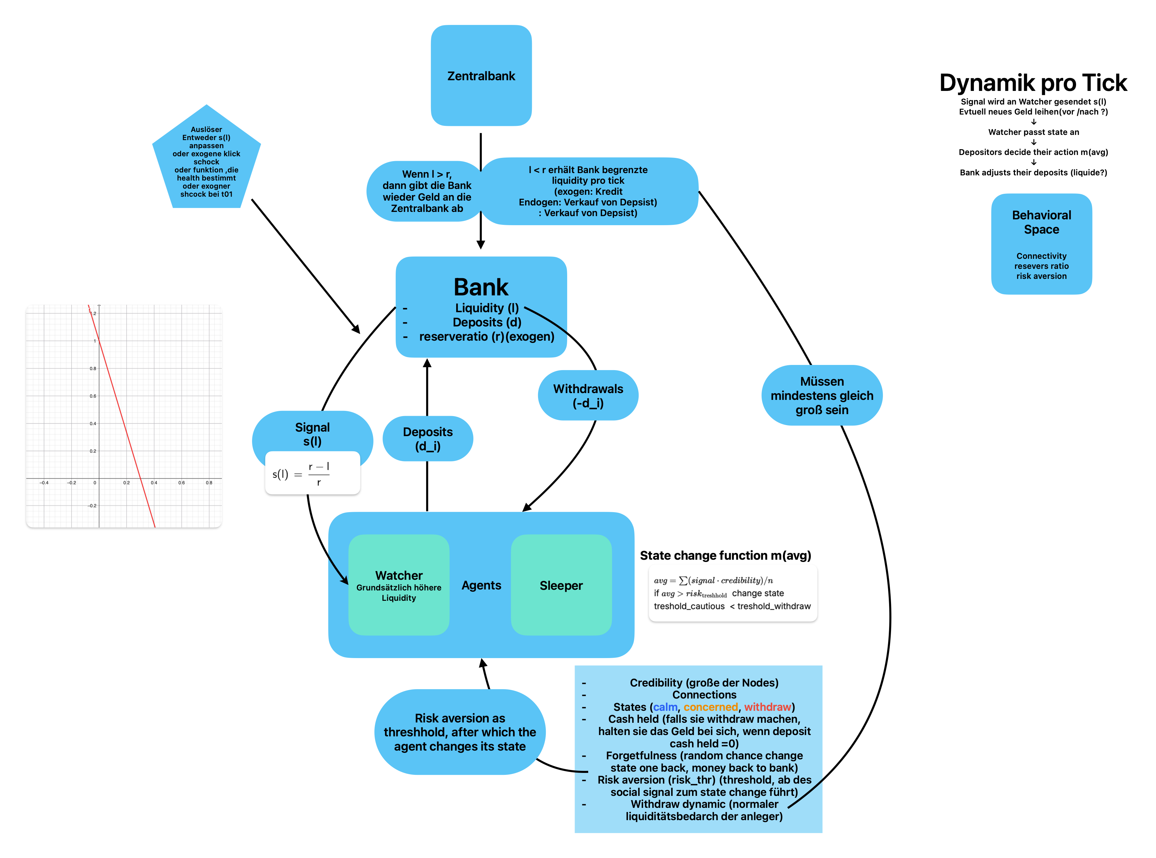
03 MODELL-SETUP
The Story

Slide 9
06 FORTSCHRITT
Implementation Timeline
2
4
6
8
Network
Insider Logic
Feedback Loop
Click Shocks
1
3
5
7
9
Literatur
Agent States
Bank Balance
Plotting
Extensions

