Slide 1
Scan To Mesh (STM)
Development of a C# Library for
Processing Microscopic 3D Scan Data
Demonstrated in the Unity Game Engine

Slide 2
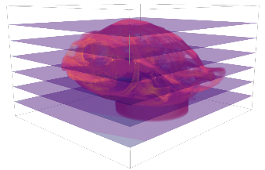

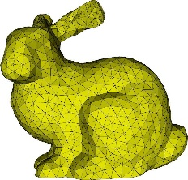
Overview
Pipeline for 3D-TIFF-Image Processing (Import, Processing, Mesh Generation, Visualiztion, Metadata Manipulation, Export)
Python < C# < Unity
Open-Source
STM
metadata

Slide 3

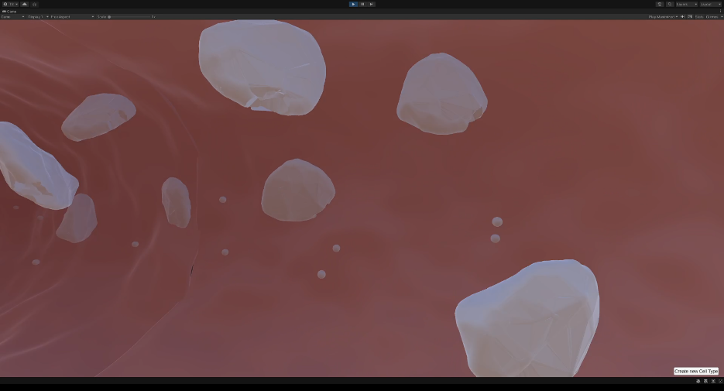
Virtual Platelet Project
Virtual Environment in Unity
Simulation of …
Blood Vessels
Cellular Interactions
Bone Marrow Environment
Cell Signaling Network
Focus on Blood Platelets →
Blood platelet simulation in Unity

Slide 4
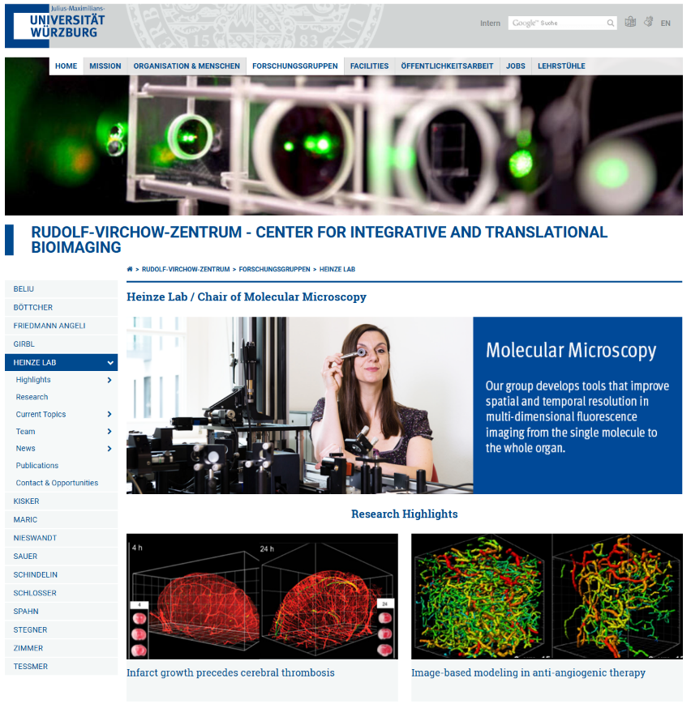
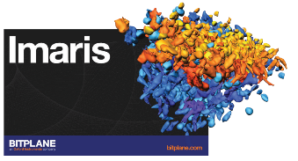

Virtual Platelet Project
Raw TIFF Files
Segmentation
Mesh Generation
Mesh Correction
Virtual Platelet Project
https://www.uni-wuerzburg.de/rvz/forschungsgruppen/heinze-lab/

Slide 5
Scan To Mesh
Raw TIFF Files
Raw TIFF Files
STM
Virtual Platelet Project
Virtual Platelet Project

Slide 6
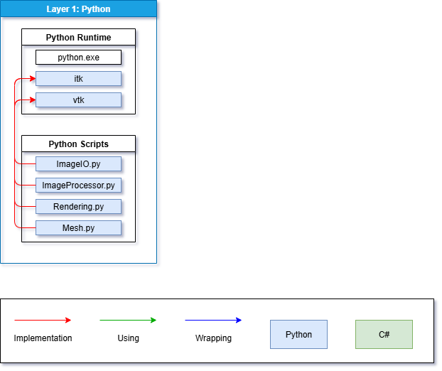
STM – Architecture (Python)
Standalone Python Environment
All Required Libraries (Insight Toolkit (ITK), Visualization Toolkit (VTK), …)
Implementation of Pipeline Steps in Python
Custom Image Processing Steps

Slide 7
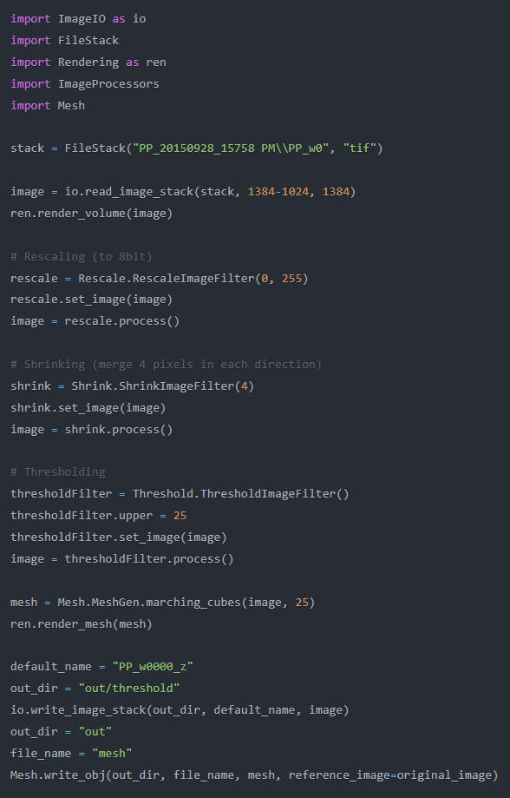
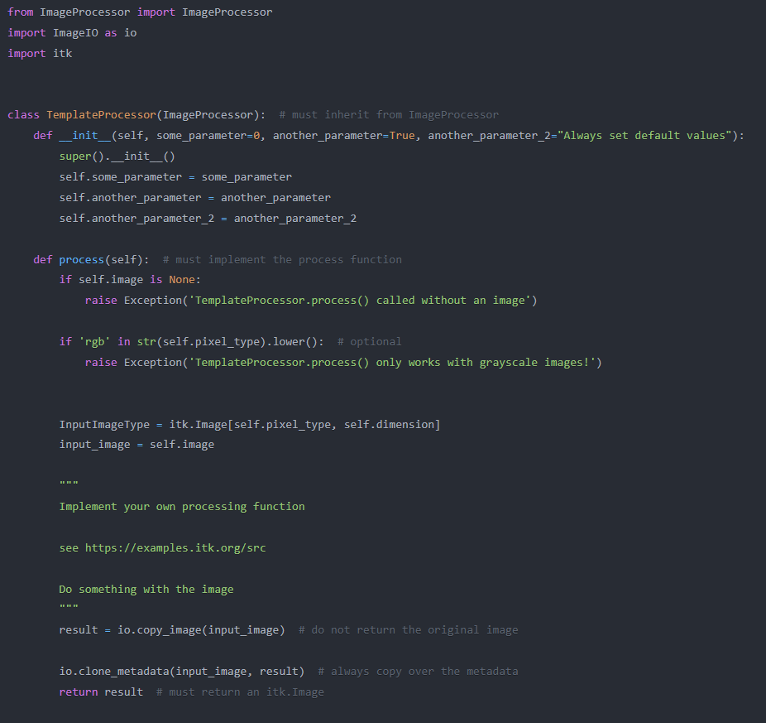
↑ Template for custom Image Processor
← Python Code Example for using STM

Slide 8
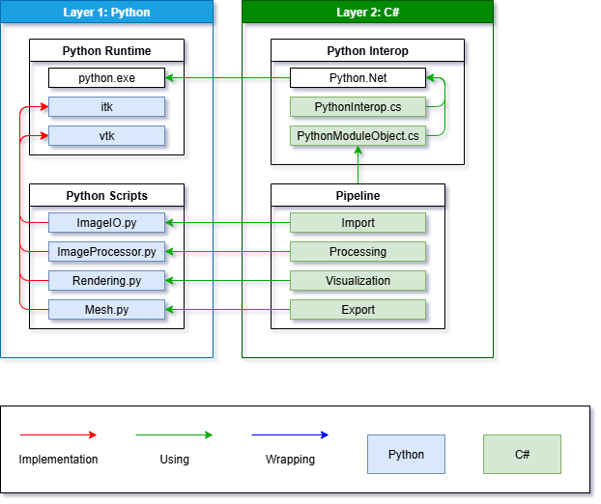
STM – Architecture (C#)
Python.Net for Python Code Execution
C# Classes Manage and Execute Python Code
Dynamic Loading of Image Processors
→ Build into C# Library (DLL)

Slide 9
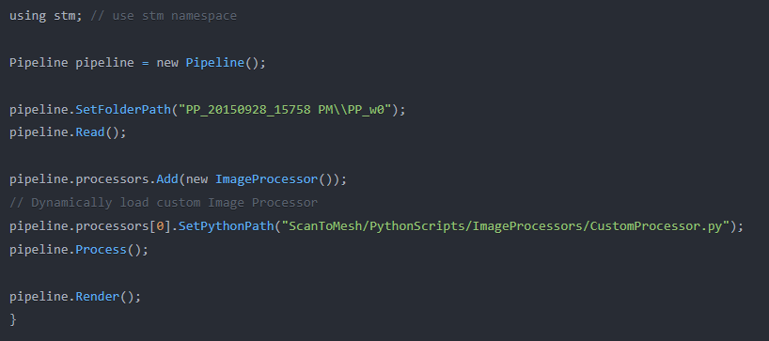
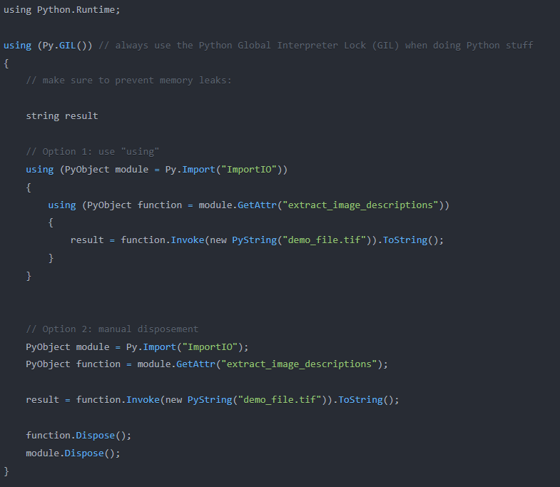
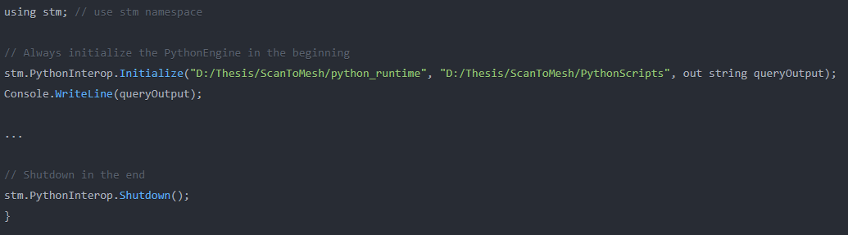
↑ Example Usage of STM-Pipeline in C#
↓ Python Engine Management Wrapper
↑ Executing Python Code and Managing Python Objects
in C# using Python.net

Slide 10
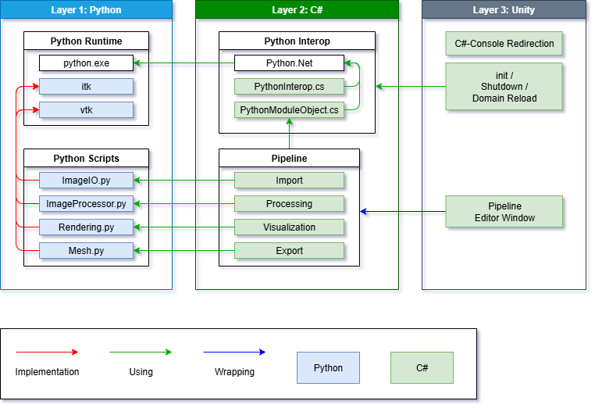
STM – Architecture (Unity)
Automatic Loading of DLLs
Automatic Management of Python Runtime
Redirection of C# Console.Write() Output
Custom GUI Editor Window for Using STM-Pipeline

Slide 11
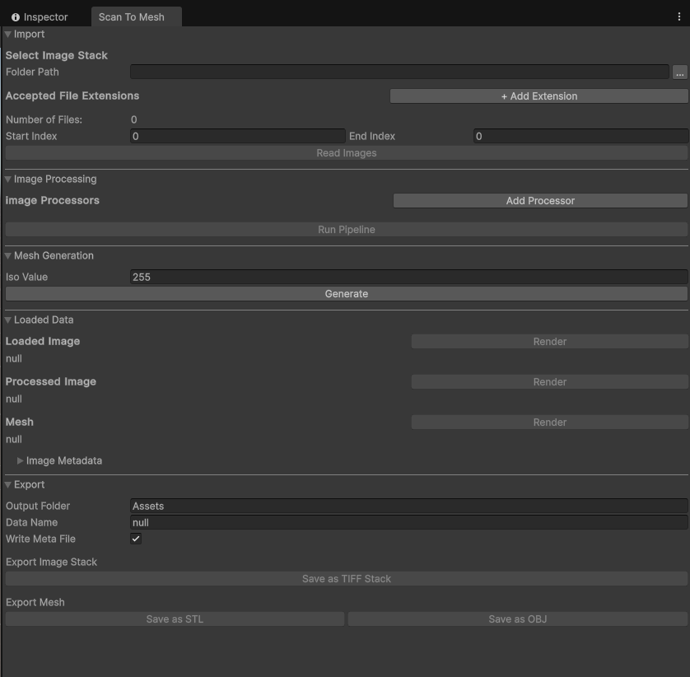
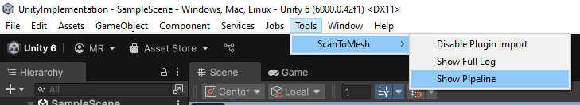
↑ Accessing STM in Unity
←
GUI for Using STM-Pipeline in Unity

Slide 12
References
Logos:
Unity: https://unity.com/legal/branding-trademarks
Imaris: https://imb.uq.edu.au/research/facilities/microscopy/training-manuals/microscopy-online-resources/image-analysis/imaris-bitplane
Blender: https://www.blender.org/about/logo/
Images:
Virtual Platelet Simulation: https://www.biozentrum.uni-wuerzburg.de/bioinfo/computing/virtual-platelet/
Image Stack: https://www.kitware.com/main/wp-content/uploads/2018/12/turtle.png
Stanford Bunny Mesh: https://www.researchgate.net/figure/Stanford-Bunny-54-Examples-for-the-meshes-of-Table-5-Here-we-show-S-2-left-and-S-6_fig1_265741784

