Slide 1
Reliable RSS measurement system in sensor networks for use in sequence detection
Moritz Schäfer | Maximilian Gotthardt
Telecommunication

Slide 2

Introduction
Wireless sensor networks
Collecting and relay any environmental data
Location information is important
In some cases relative physical sequence is enough
We assume one dimensional sequences
h

Slide 3
Motivation
Create measurement data for sequence detection in multihop sensor networks
  Multihop support
  Measurment management
  Measurment collection and transmission
  Automated node discovery

Slide 4
What's Multihop?
Sink Node 1
Not in Range
Node 3
Node 2
Node 4 is not in Range of Node 1

Slide 5
What's Multihop?
Node 1
Node 3
Node 2
Node 3 is not in Range of Node 1
Node 3 is in Range of Node 2
So data can reach Node 3 from
Node 1 via Node 2

Slide 6
Design
Sink node(Management)
  Node Detection
  Sender Selection
  RSS measurement
  Channel Selection
  Data Collection
Measurement nodes
  React on sink node

Slide 7
Design – Node Detection
Sink Node 1
Request for node ID
Node 1
Node 4
Node 3
Node 2

Slide 8
Design – Node Detection
Sink Node 1
Request for node ID
Node response for availability
Node 1
Node 4
Node 3
Node 2

Slide 9
Design – Sender Selection
Sink Node 1
Assign next sender
Node 1
Node 4
Node 3
Node 2

Slide 10
Design – RSS measurement
Sink Node 1
After assigning next
sender ...
Receivers "in range" are MEASURING RSS
Node 1
RSS
Node 4
Not in Range
No RSS
Node 3
RSS
Node 2

Slide 11

Design – Channel Switching
Sink Node 1
Broadcast to all nodes, the new Sender frequency
Node 1
Node 4
Node 3
Node 2

Slide 12
Design – Channel Switching
Sink Node 1
Broadcast to all nodes, the new Sender frequency
Nodes acknowledge on the “next” channel, that they changed
Node 1
Node 4
Node 3
Node 2

Slide 13
Design – Data Collection
Sink Node 1
Sending Data Request to all Nodes
Node 1
Node 4
Node 3
Node 2

Slide 14
Design – Data Collection
Sink Node 1
Sending Data Request to all Nodes
All measured Data from all nodes will be collected
Node 1
Node 4
Node 3
Node 2

Slide 15
Architecture
Protocols
  Dissemination
  Collection Tree Protocol
Message Acknowledgement
PC-Node communication

Slide 16
Architecture - Dissemination
Provides reliable broadcasting to every node in network
Detects when a node is missing a packet
For small data sizes
tos/lib/net/DisseminationUpdate.nc
interface DisseminationUpdate<t> {
command void change(t* newVal);
}
tos/lib/net/DisseminationValue.nc
interface DisseminationValue<t> {
command const t* get();
event void changed();
}

Slide 17
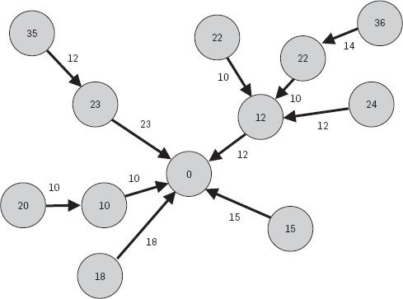
Architecture –
Collection Tree Protocol
Improves delivery reliability
  Acknowledgements for unicast packages
Sending data over closest nodes (parents) to the root (sync)
Using ETX for routing
  expected transmissions as its routing gradient

Slide 18
Architecture - Acknowledgments
Still in discussion
Strategies
  Sending Acknowledgments for all control packets
    Using Collection Tree Protocol
    Using direct transmission
    Using Disseminate
  Waiting after each control packets
    May be reliable, dependent on nodes
    May be slow

Slide 19
Testing
Can we collect all measurments?
Tests with
  Distance between node
  Obstacles
  Lower Transmision power

Slide 20
What we've done
Will be filled in with code and examples here...

Slide 21
Timetable
Milestone | Week | Goals | Success
Inital | 43-45 | Getting comfortable with environment: TinyOS, tmote, Communication Protocol, PC-Connectivity | Done
Milestone 1 | 46-49 | Node detection PC communication/GUI Sender Selection Data Collection
Milestone 2 | 50-2 | Channel Switching Implement Sequence Algorithm
Final | 3-6 | Testing Improvements Evaluation

Slide 22
Thank You

Slide 23
Extra Stuff CTP – Details
P: Routing pull.
C: Congestion notification.
THL: Time Has Lived.
ETX: The ETX routing metric of the single-hop sender.
origin: The originating address of the packet.
seqno: Origin sequence number.
collect_id: Higher-level protocol identifier.
data: the data payload, of zero or more bytes.
16-Bit
|P|C| reserved | THL
ETX
origin
seqno | collect_id
data ...

