Slide 1
The Berlin Real Estate Market: What Drives Prices?
IDS702 Final Project
Moritz Wilksch

Slide 2
The Research Question
Which factors determine the price of a listing?

Slide 3


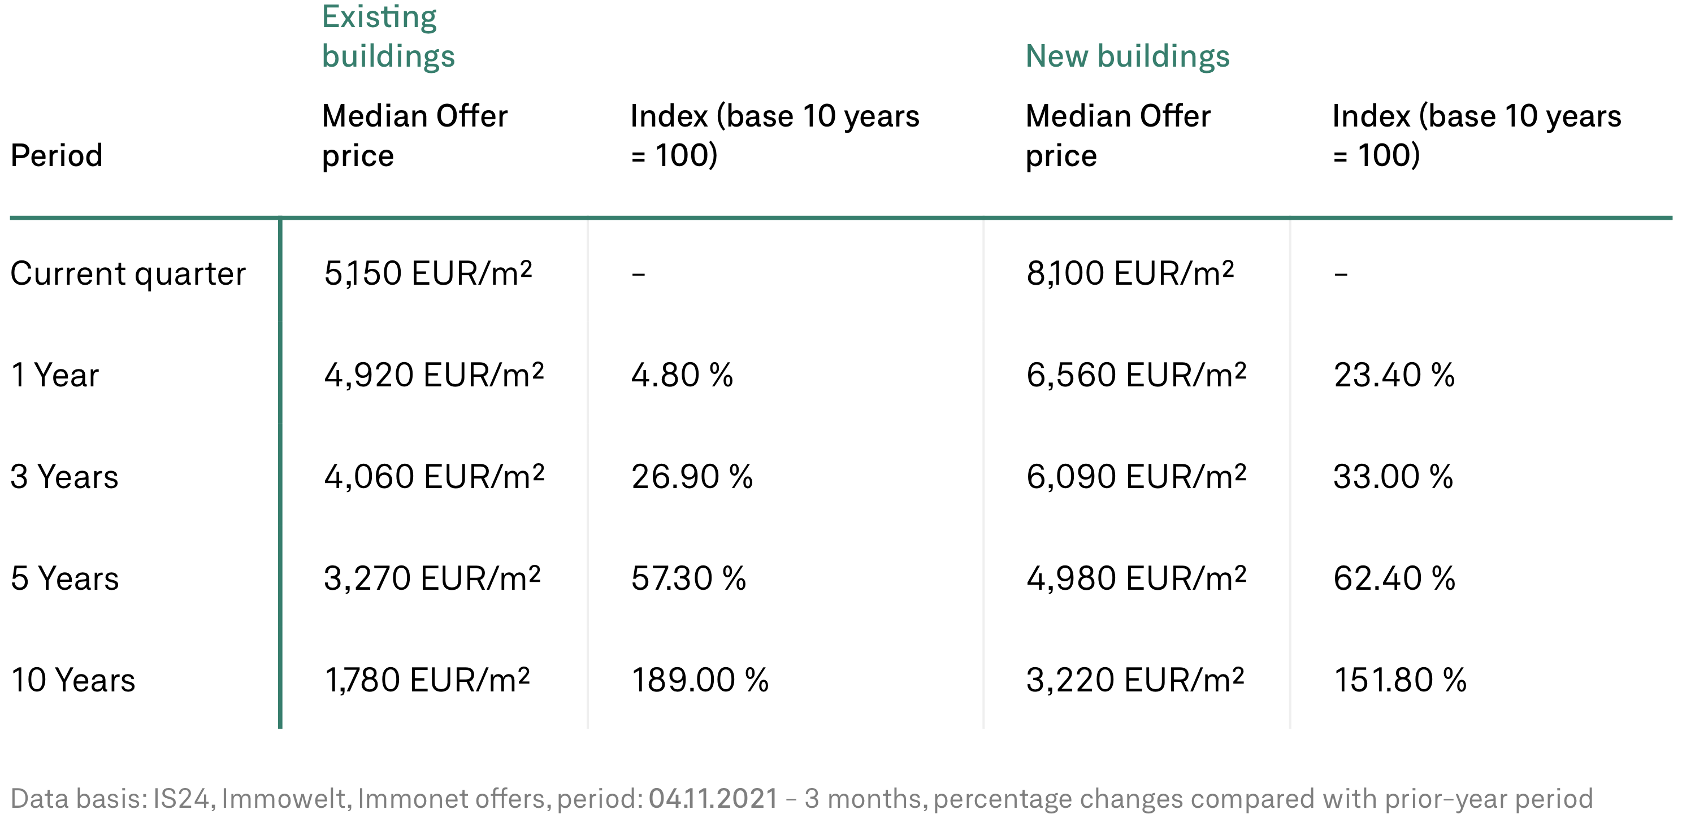
Background
The Market
The Data
Prices for buying and renting have doubled or tripled in the past 10 years [1]
Finding affordable housing is hard
Three largest online real estate marketplaces:
Scraped ~72k listings over 6 months
[1] https://guthmann.estate/en/market-report/berlin/

Slide 4
Methodology
Data Cleaning
Making missing values explicit
Outlier removal (dirty data from scrape)
Filtering: Rent prices vs. Purchase prices
EDA
Independent variables:
Object type
Private offer
Rooms
Size (sqm)
Zip code
Modeling
Hierarchical Linear Model
Varying intercepts (+slopes?) by location

Slide 5
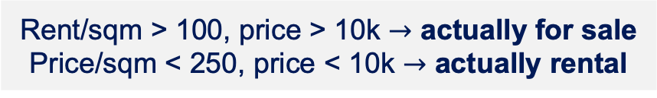
Data Cleaning
Problem
Solution
Several different object types
Focus on [shared] apartments, houses and temporary living
Implicit NAs
Make explicit for
Price = 0, sqm = 0, rooms = 0 or “k.A.”
Data entry error in square_meters
Remove outliers at the 99.9th percentile
Extreme outliers for rentals and sales
Rent/sqm > 100, price > 10k $→$ actually for sale
Price/sqm < 250, price < 10k $→$ actually rental

Slide 6
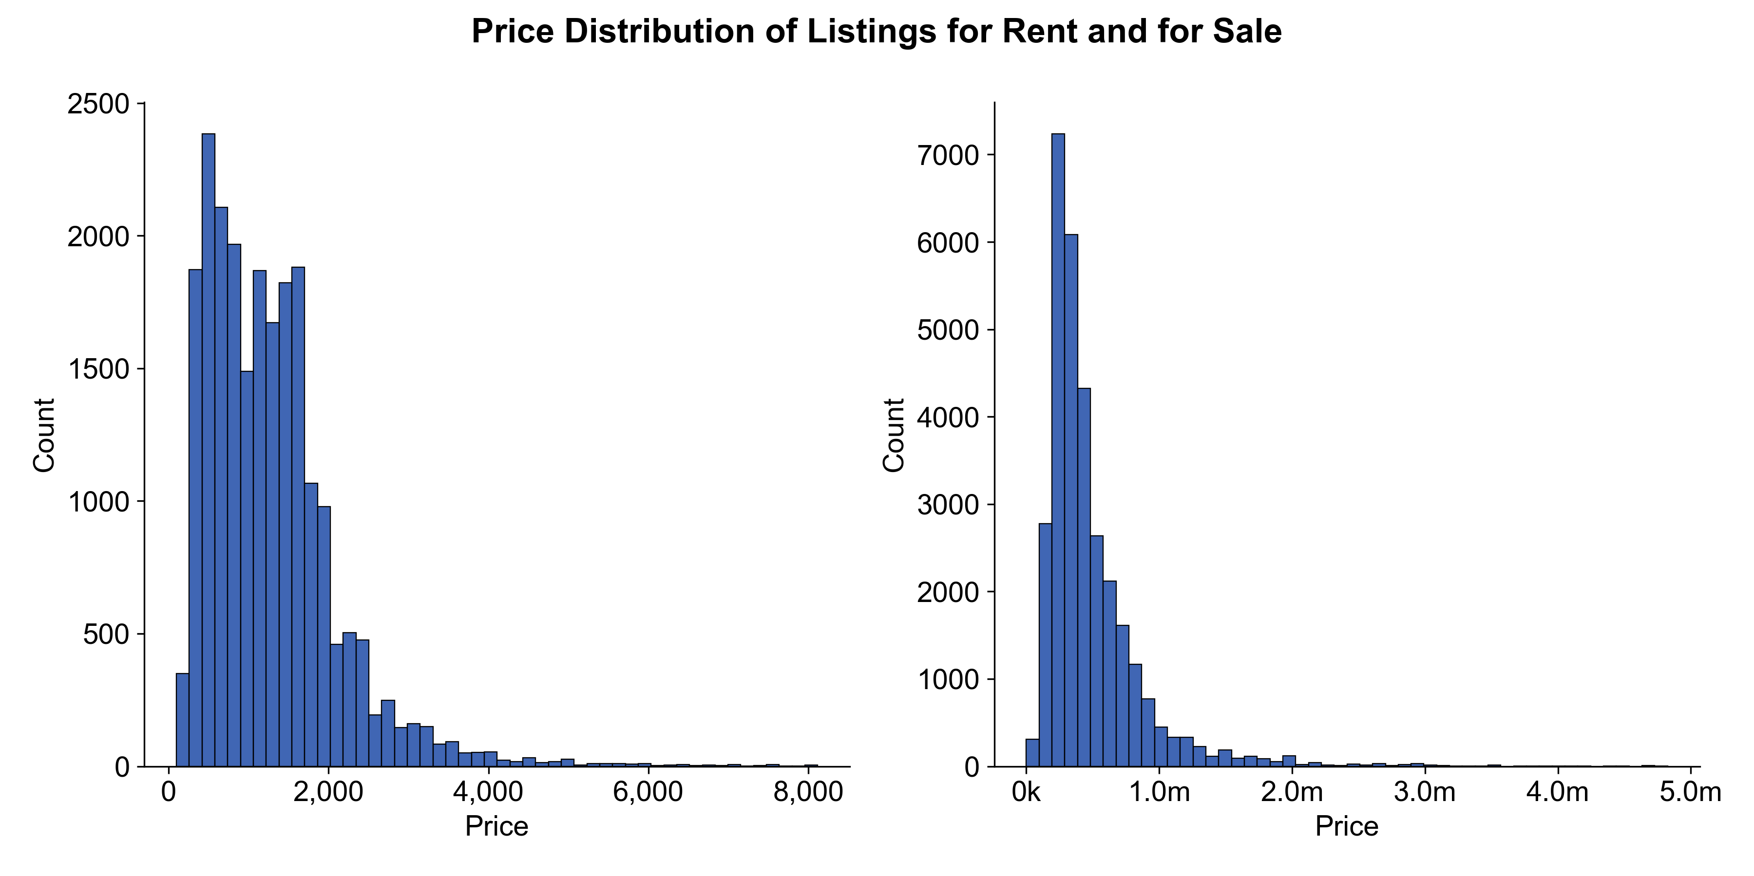
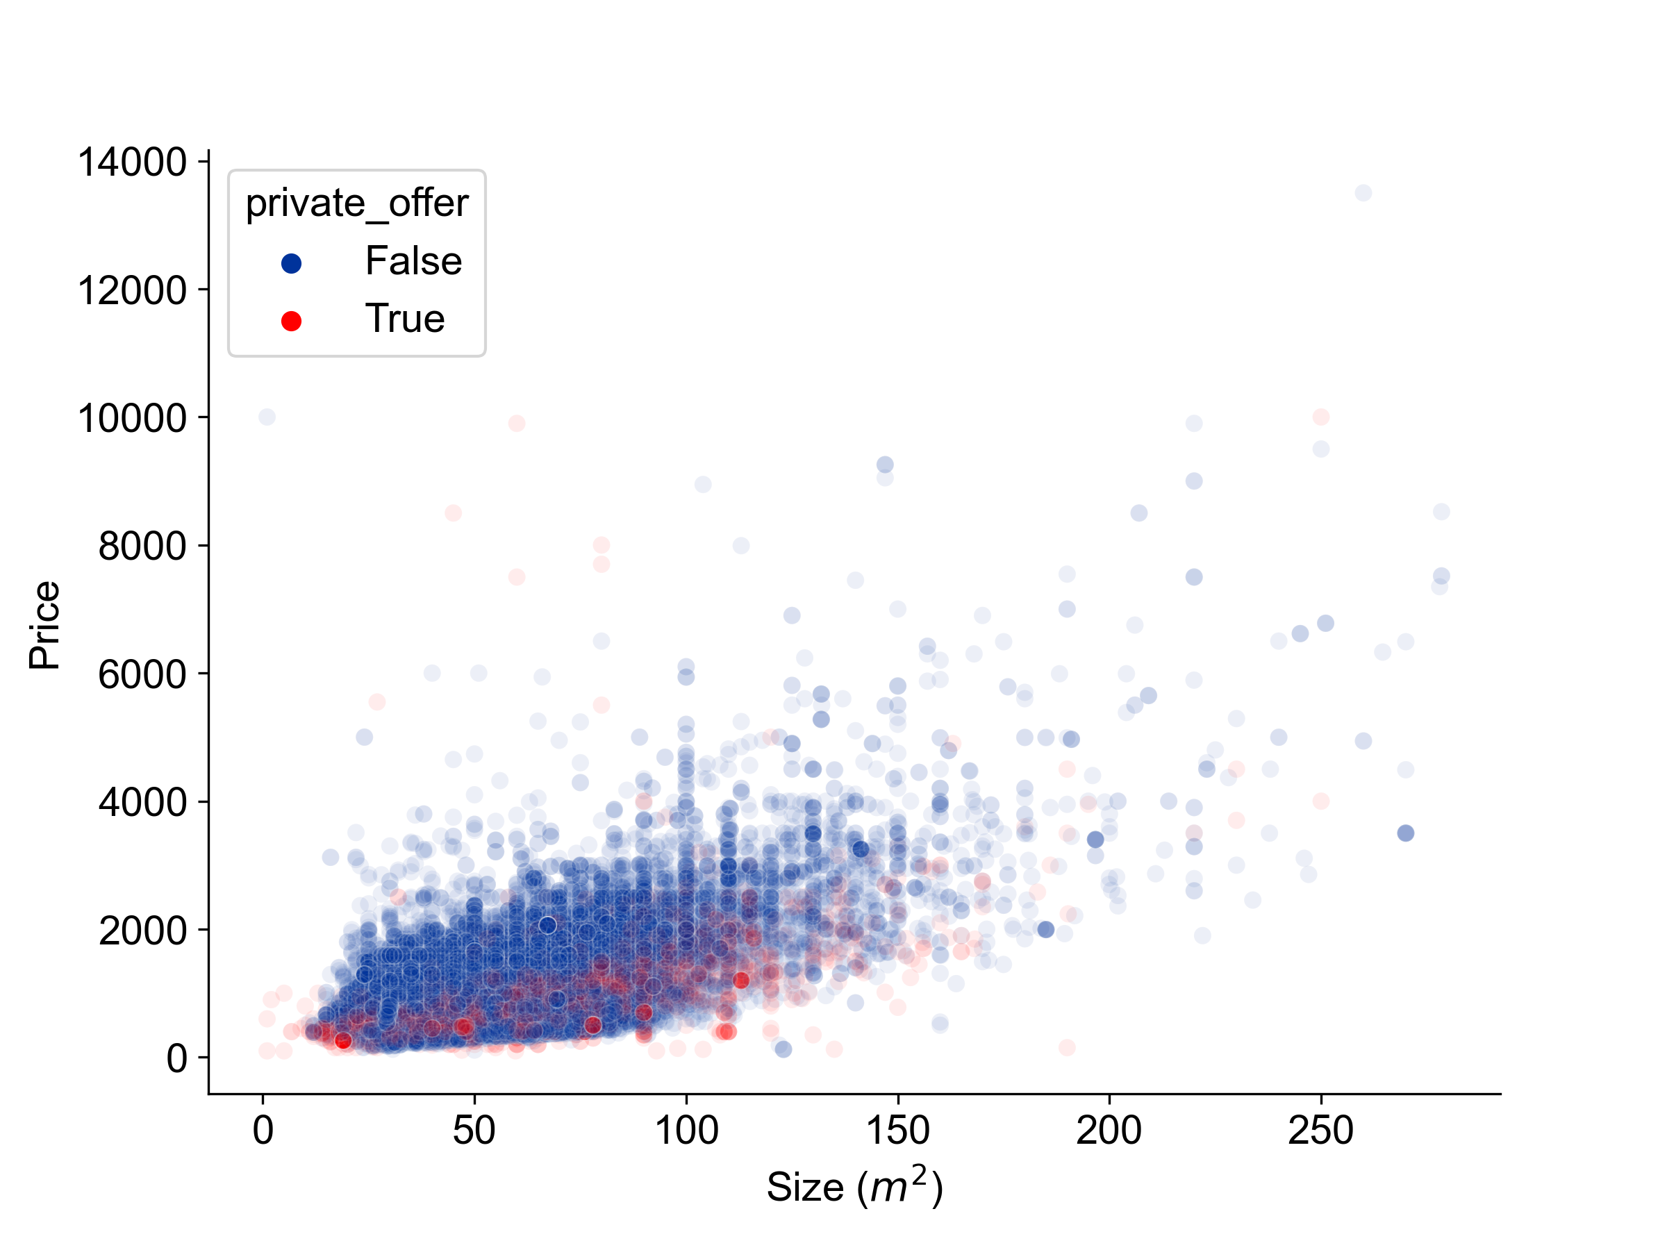
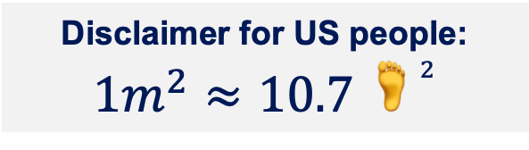
EDA
Price Distributions
Size and Price
Even after data cleaning: skewed price distributions
Somewhat linear trend
Private offers tend to have lower prices
Disclaimer for US people:
$$1m^{2}≈10.7 🦶^{2}$$

Slide 7
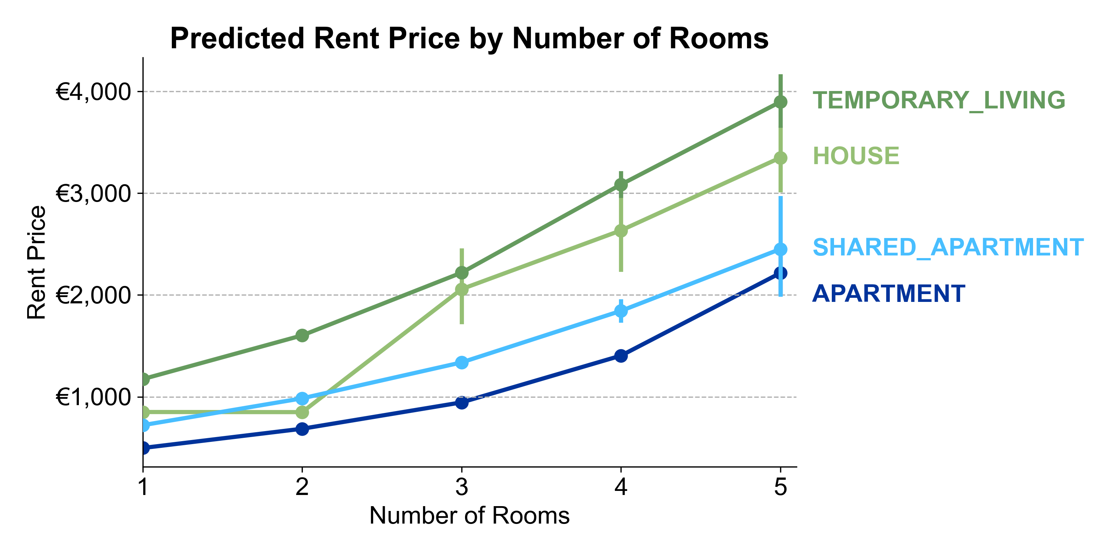
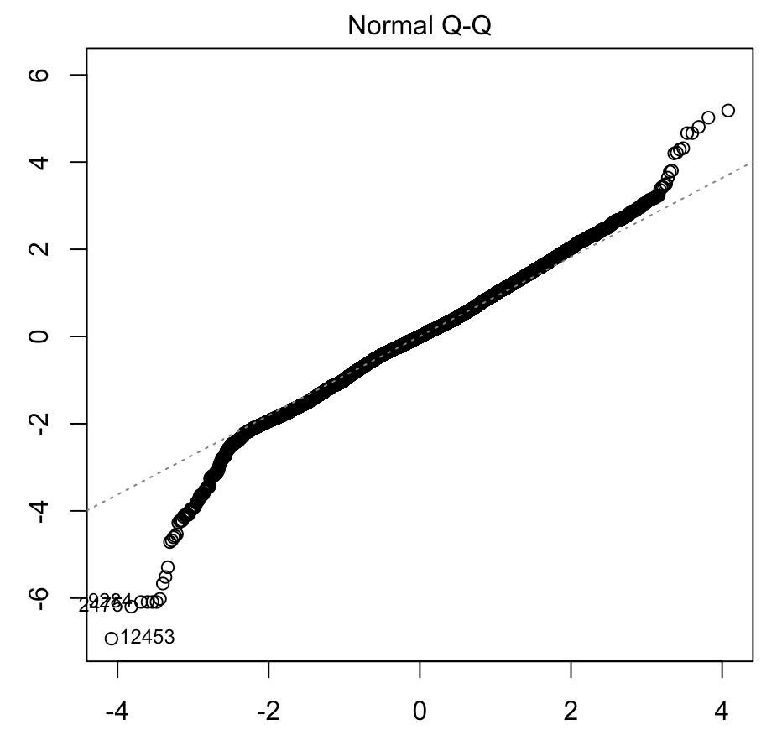

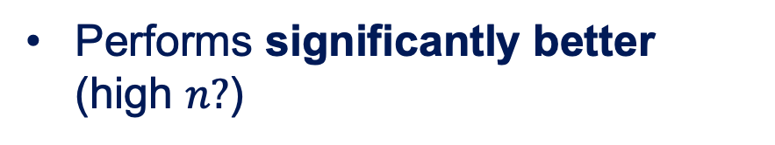

Modeling (Non-hierarchical)
EXPLORATORY
Log(price) ~ mean effects
Prediction Plot
$$R^{2}≈0.656$$
After removing 21 influential points, assumptions are satisfied…
… except for normality in the tails
Sqm $×$ Rooms Interaction
Performs significantly better (high $n?$)
☹️

Slide 8
Modeling (Hierarchical)
PRELIMINARY
Log(price) ~ mean effects
Prediction Plot

Slide 9
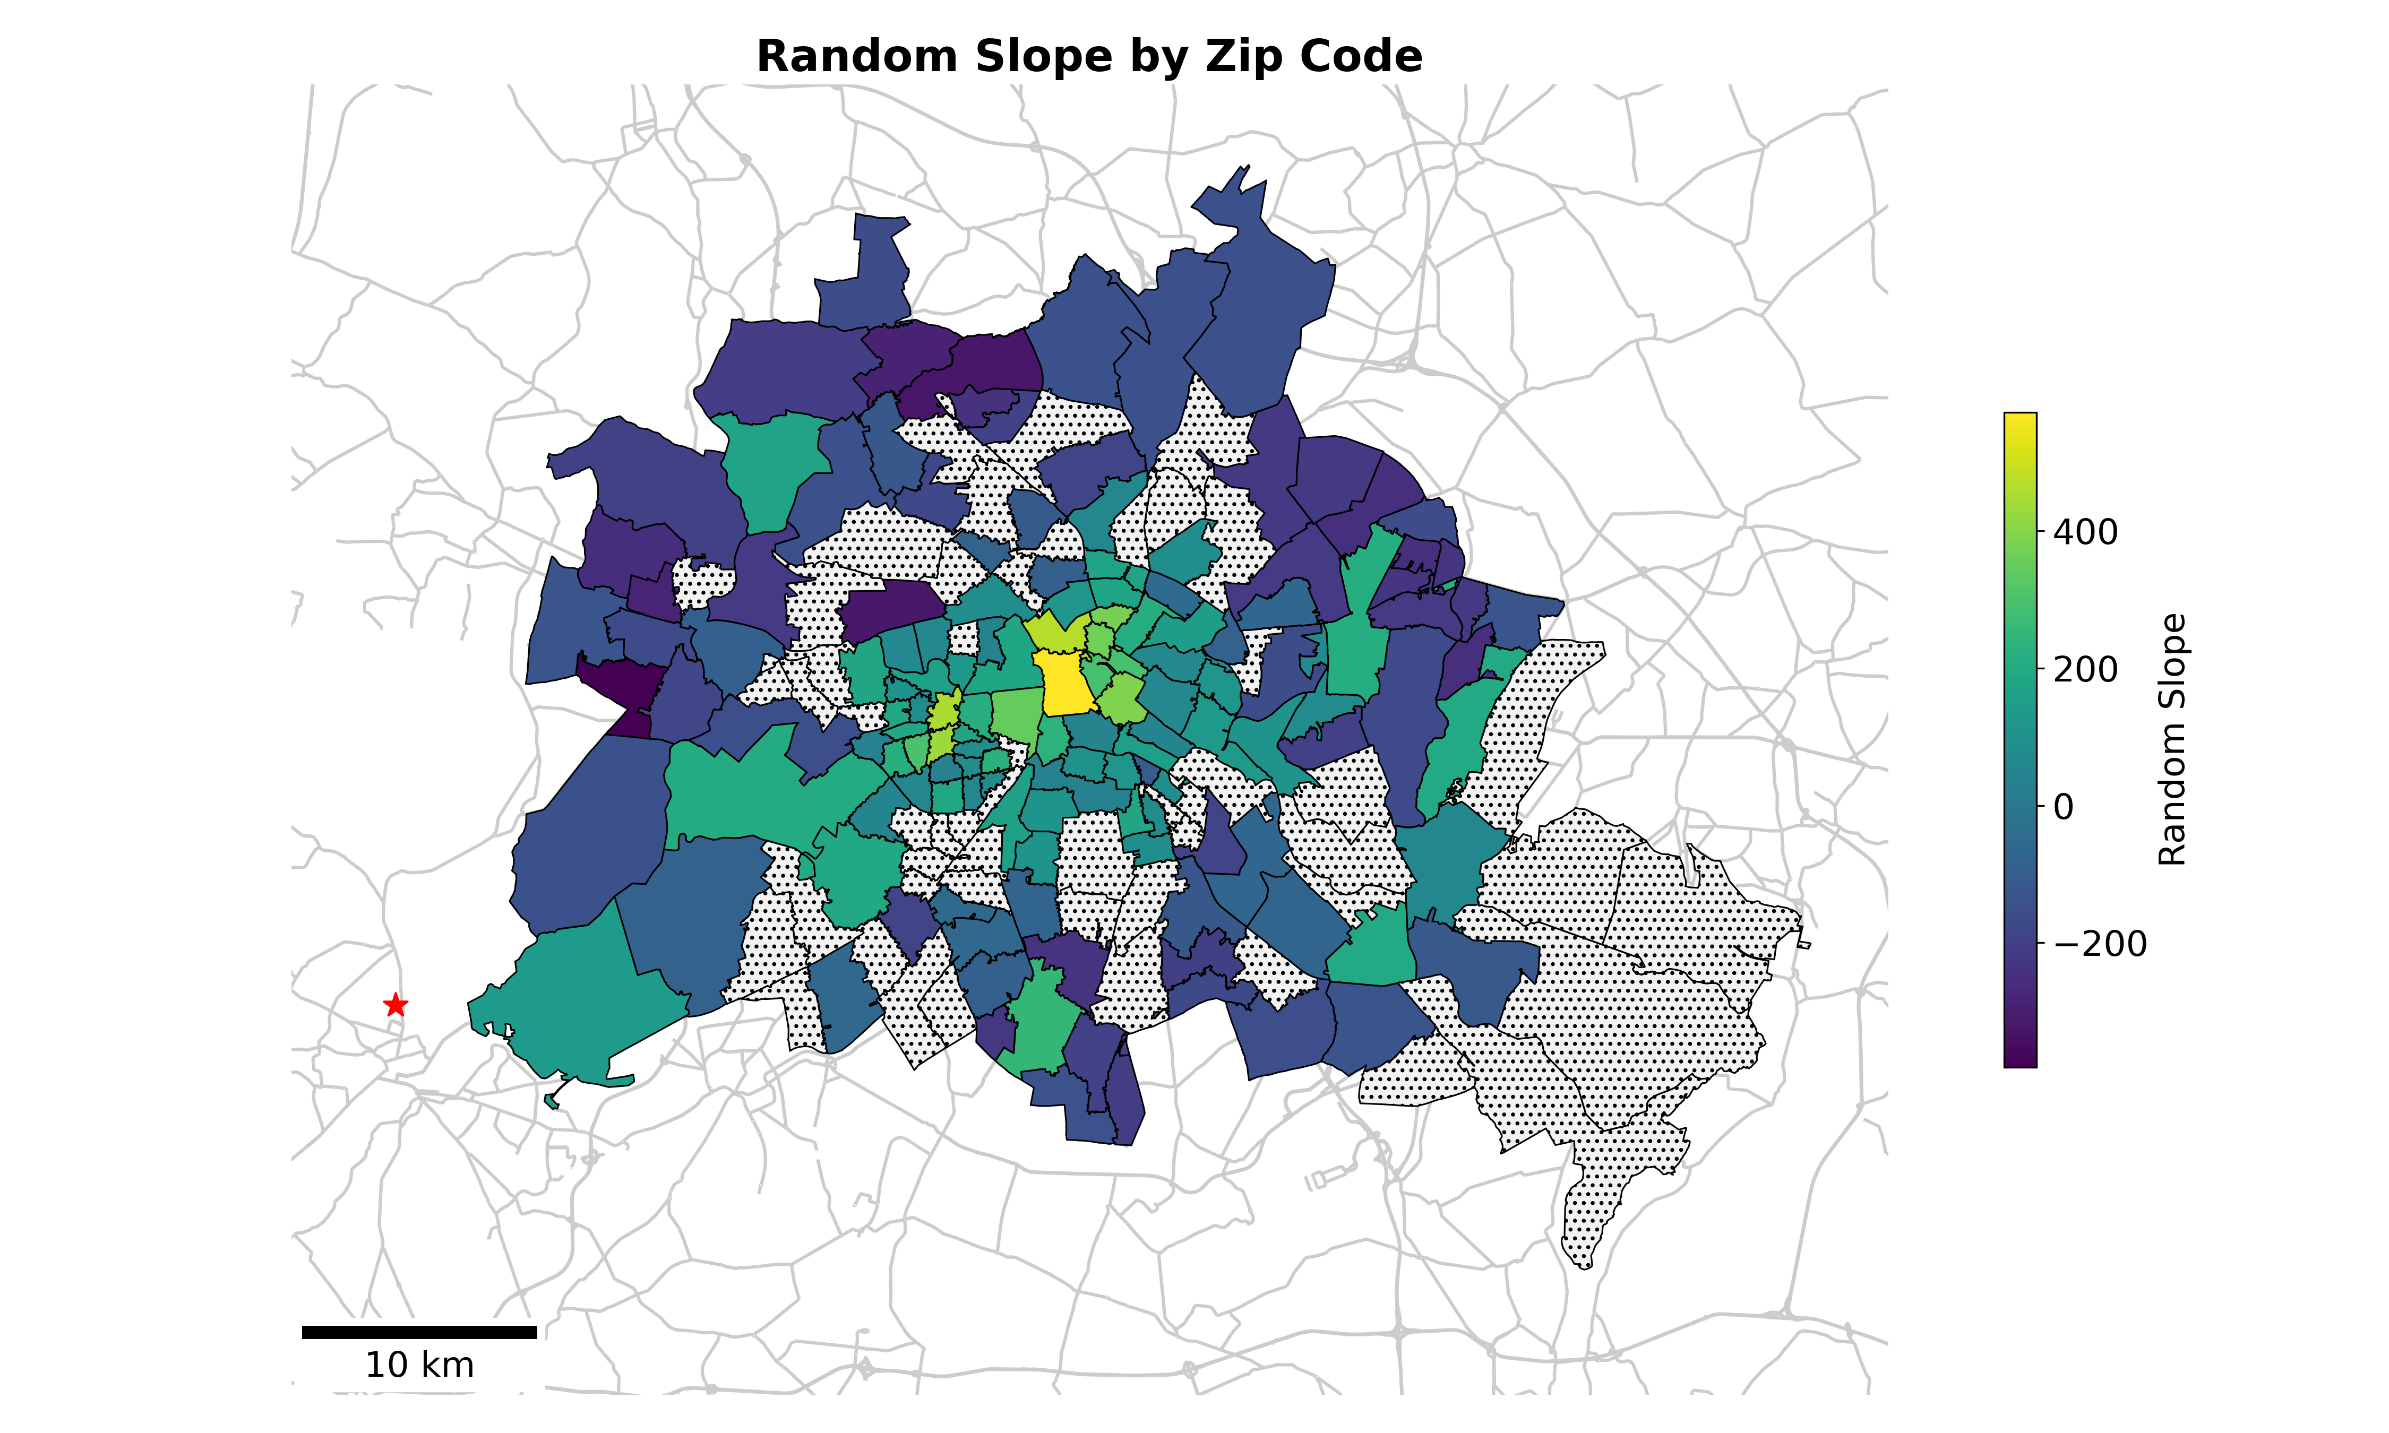
Modeling (Hierarchical)
PRELIMINARY
I live here

Slide 10
This is a Title
Univariate

