Slide 1
The Berlin Real Estate Market: What Drives Prices?
IDS702 Final Project
Moritz Wilksch

Slide 2
The Research Question
Which factors determine the price of a listing?

Slide 3


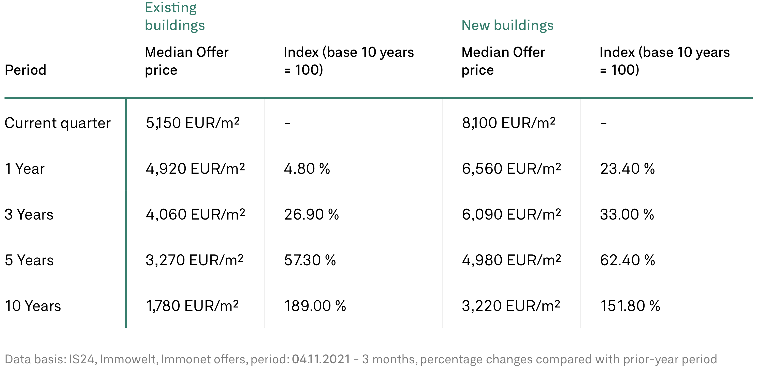
Background
The Market
The Data
Prices for buying and renting have doubled or tripled in the past 10 years [1]
Finding affordable housing is hard
Three largest online real estate marketplaces:
Scraped ~72k listings over 6 months
[1] https://guthmann.estate/en/market-report/berlin/

Slide 4
Methodology
EDA
Independent variables:
Object type
Private offer
Rooms
Size (sqm)
Zip code
Data Cleaning
Outlier removal (dirty data from scrape)
Transformations
Filtering: Rent prices vs. Purchase prices
Modeling
Hierarchical Linear Model
Varying intercepts (+slopes?) by location

Slide 5
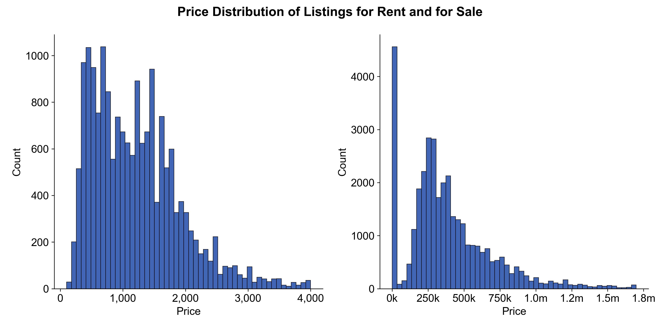
EDA
Price Distributions
Even after data cleaning: skewed and contains 0s

Slide 6
Results

Slide 7
This is a Title
Univariate

