Slide 1

PREDICT CRUDE OIL PRICES USING ENSEMBLE LEARNING
UNDER THE GUIDELINES OF
P.SRINIVAS REDDY
BY
NANDINI M (17R21A0540)
E.MAMATHA (18R25A0511)
CH.KEERTHANA (18R25A0508)
B.PRIYANKA (17R21A0505)

Slide 2

ABSTRACT
Crude oil is the world's most leading fuel. Now-a-days the oil price has been increasing in leaps and bounds due to certain reasons like inflation throughout the world. This has become a major problem in India where prices of LPG (Liquified Petroleum Gas), Petroleum, Diesel have been increasing. Hence these are derived or extracted from crude oil; India gets its source of crude oil from neighboring countries like Dubai and Saudi-Arabia. To predict the values of the petroleum and Diesel in the mere future, we have decided to use the Machine Learning algorithms and find which algorithm gives the most accurate results.
Keywords: Prediction, Oil Prices, Machine Learning Models.

Slide 3

PROPOSED SYSTEM
Develop a Machine Learning Model :
Apply ensemble learning.
Compare which model gives highest accuracy.

Slide 4
ADVANTAGES OF THE PROPOSED SYSTEM
The perfect time to buy crude oils.
Ensemble learning improves the model’s result.

Slide 5
THE DIVISION OF PROJECT INTO MODULES
Data Collection.
Data Preprocessing.
Model Building.
Analyze the model’s.
Test the Model.

Slide 6
DATA COLLECTION
Sources : Kaggle.
DataSet Size : 8223 rows, 2 columns.
Attributes : Date,Closing Value.
Training Set : 20% of total dataset.
Link : https://www.kaggle.com/rockbottom73/crude-oil-prices

Slide 7
DATA PREPROCESSING
Import the libraries.
Import the data set.
Take care of missing data.
Splitting the dataset into the training set and test set.

Slide 8
BUILDING THE MODEL
Creating Models:
Random Forest Regression.
Decision Tree Regression.
Linear Regression.
Support Vector Regression.
Train the above models with pre-processed data.

Slide 9
ANALYZE THE BUILT MODEL’S
R2 Score.
Root Mean Square Error.
Mean Square Error.
Mean Absolute Error.

Slide 10
TESTING THE DEVELOPED MODEL
The results of the model can be verified against the real value’s.

Slide 11
ALGORITHMS
Multiple Linear Regression.
Support Vector Regression.
Decision Tree Regression.
Random Forest Regression.

Slide 12
LINEAR REGRESSION
Y = a + bX1 + cX2 + .. .
Only one dependent variable and there can be any number of independent variables.

Slide 13
SUPPORT VECTOR REGRESSION

Slide 14
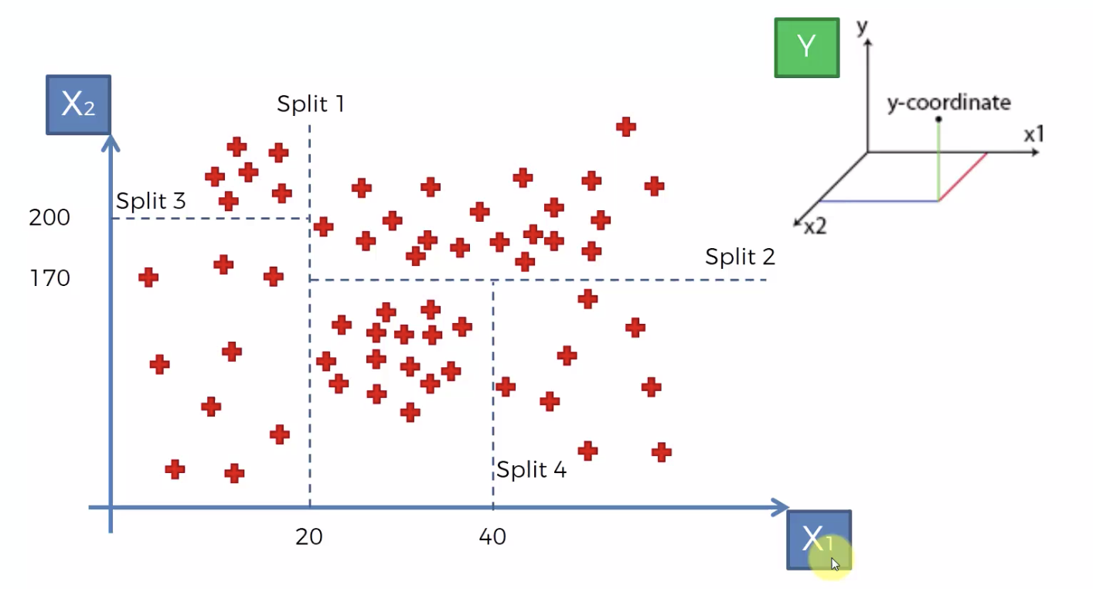
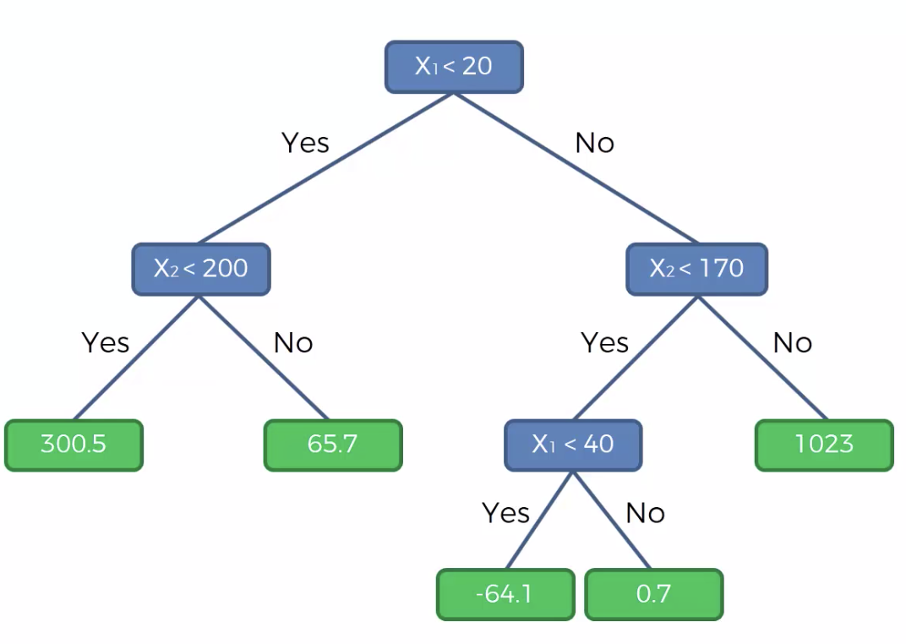
DECISION TREE REGRESSION

Slide 15
RANDOM FOREST REGRESSION

Slide 16
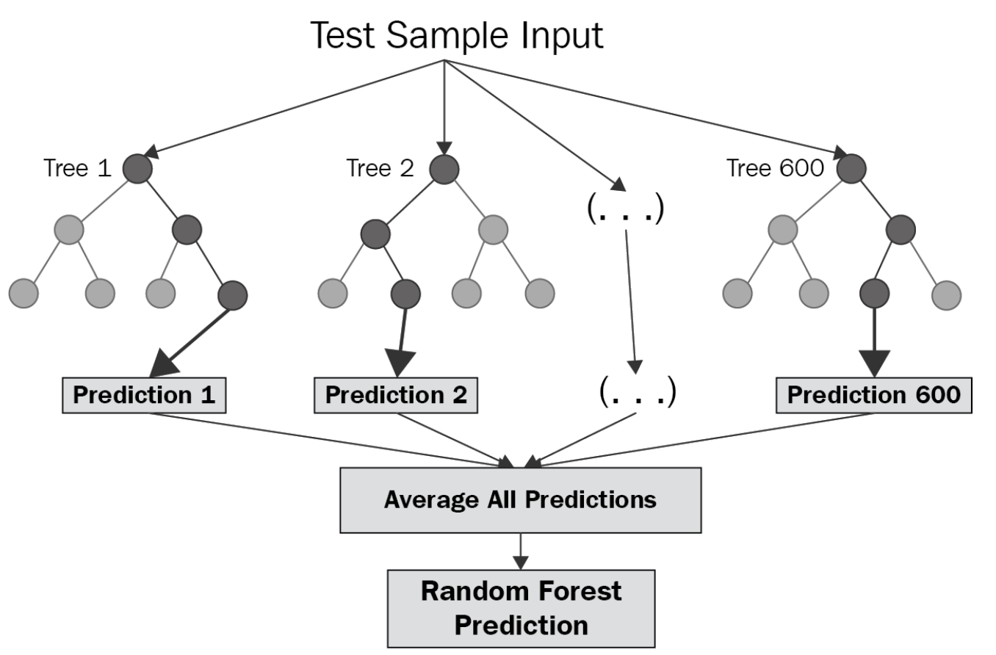
RANDOM FOREST REGRESSION

Slide 17
TECHNOLOGIES/SOFTWARES USED
Machine Learning.
Django.
Anaconda Navigator.

Slide 18
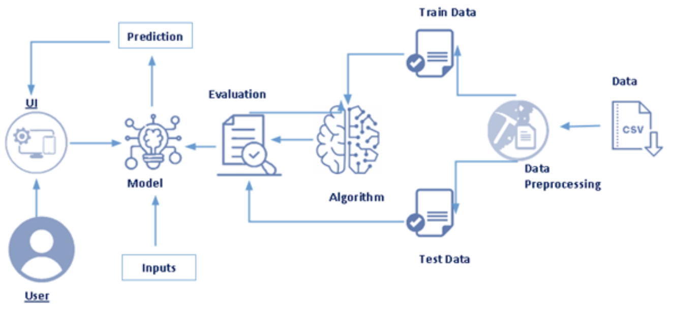
THE ARCHITECTURE DIAGRAM

Slide 19
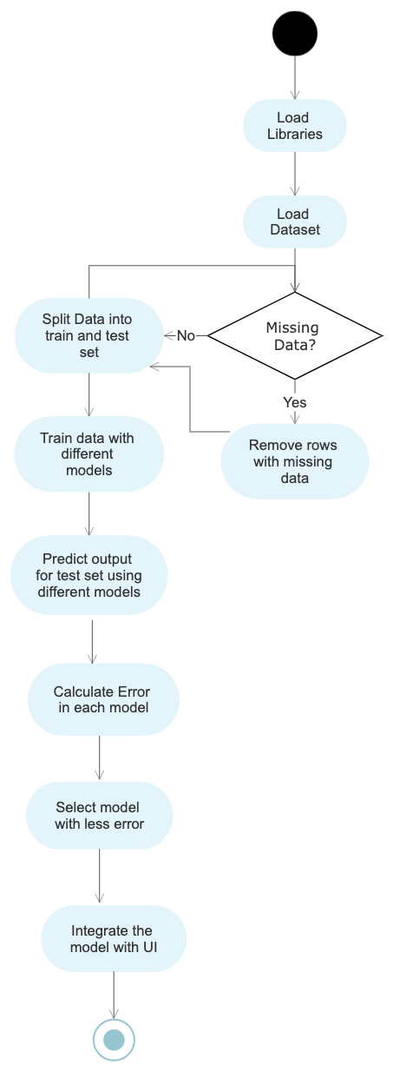
UML Diagram(Activity Diagram)

Slide 20
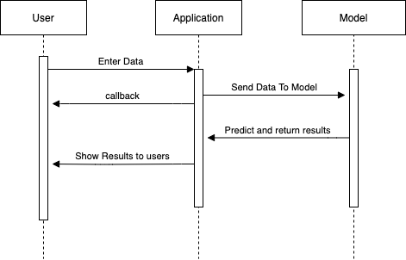
UML Diagram(Sequence Diagram)

Slide 21
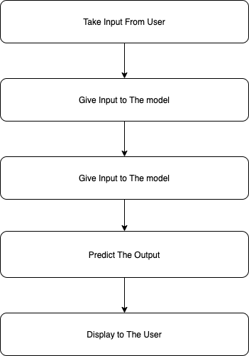
UML Diagram(Flow Chart Diagram)

Slide 22
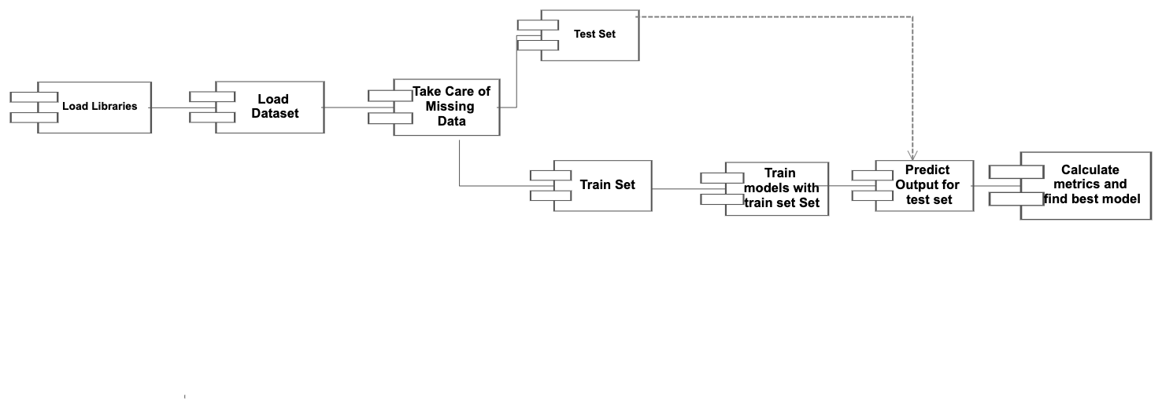
UML Diagram(Component Diagram)

Slide 23
THE ARCHITECTURE DIAGRAM

Slide 24
Regression Metrics for Machine Learning
Mean Square Error : 1 / N * sum for i to N (expected_val– pred_val)² .
Root Mean Square Error : sqrt(1 / N * sum for i to N (expected_val– pred_val)² ).
Mean Absolute Error : 1 / N * sum for i to N abs(expected_val– pred_val)² .
Perfect mean absolute error value, Root Mean Square Error value, Mean Square error value is 0.0.
R² Square : R2= 1- Error_Sumres / (Actual-Actual_Mean)²tot.
Perfect R² Square value is 1.

Slide 25
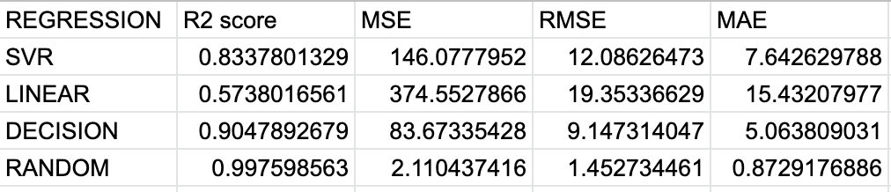
Values

Slide 26
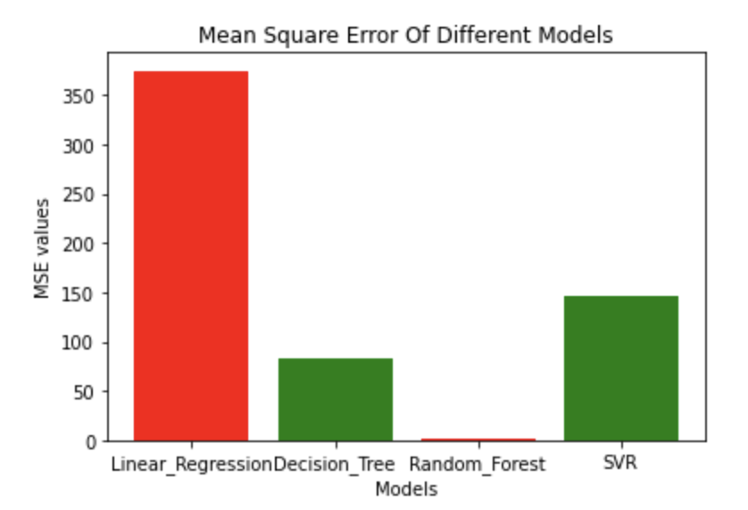
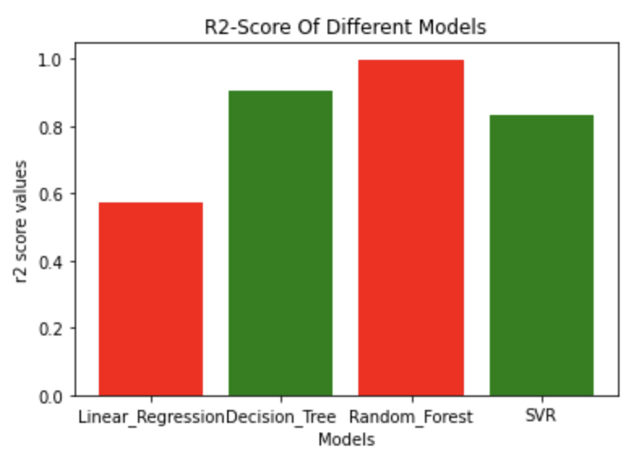
RESULTS
MSE For different Models R2-Score for Different Models

Slide 27
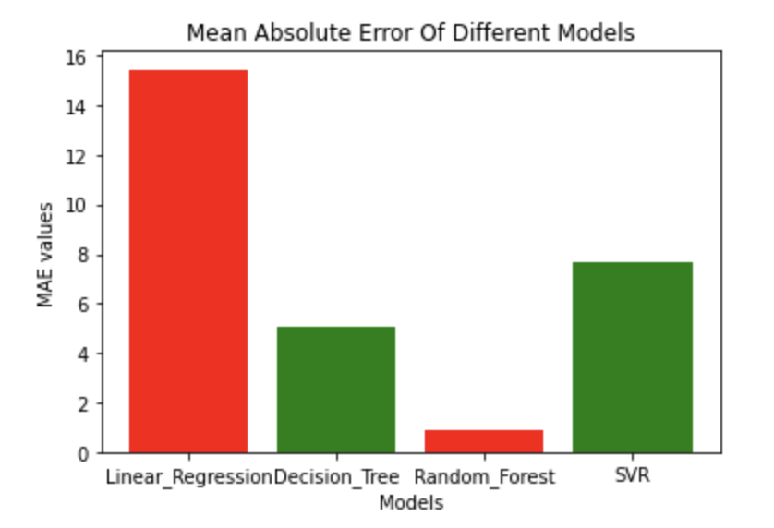
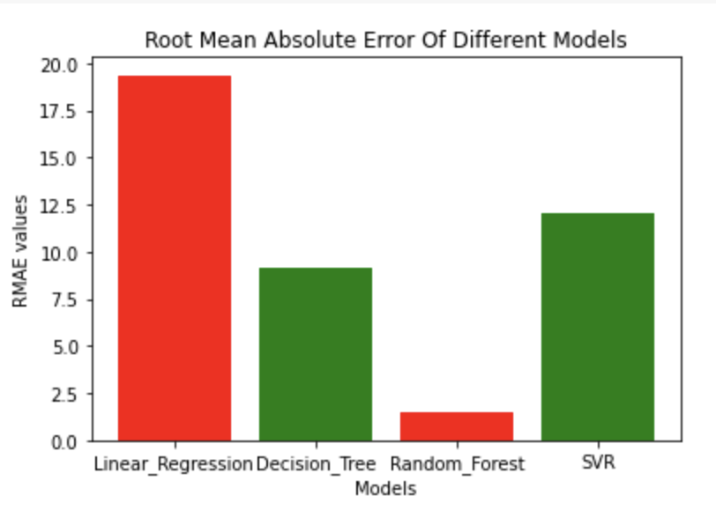
MAE for Different Models RMSE for Different Models

Slide 28
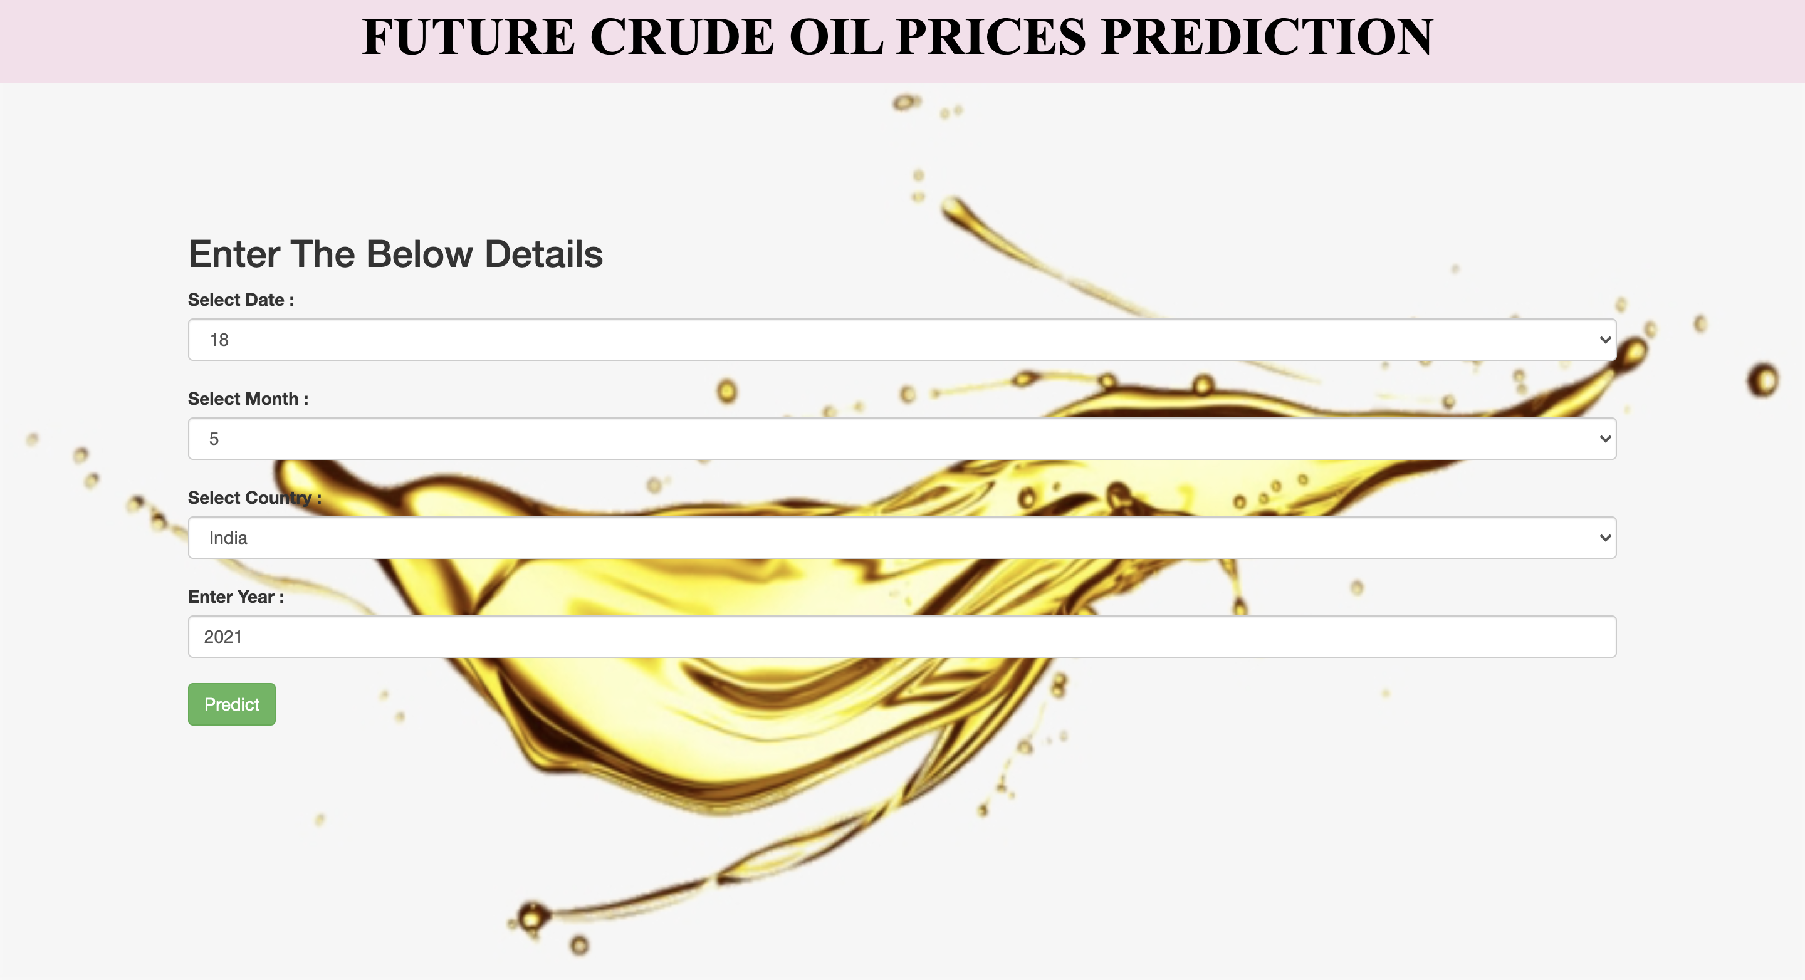

Slide 29


Slide 30
CONCLUSION & FUTURE WORK
Ensemble learning helps us to identify the various advantages and disadvantages of different machine learning model’s and help us to find the best one out.
In the future we can extend this project for not only crude oil prediction but also for many natural goods so that we can find when their prices are going to become expensive.

Slide 31
REFERENCES
https://ieeexplore.ieee.org/author/38196634500
https://www.sciencedirect.com/science/article/pii/S0957417417300957#!
https://ieeexplore.ieee.org/author/37530967400

Slide 32
QUERIES
WILL
BE
APPRECIATED
?

Slide 33
THANK YOU

