Slide 1
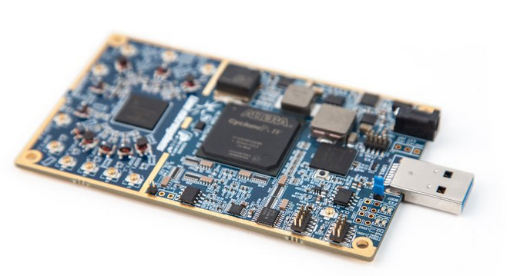

Wireless CTF
Prize:
Lime SDR – multi channel radio
Winner is the first to show us the result running in GNU Radio in real-time

Slide 2






Wireless Capture the Flag Contest
Can you help Joe recover a joint message from Ben and Martin?
During Ben’s GRCON Preamble, Joe noticed that both Ben and Martin were constantly looking at an envelope. The envelope was gray, and had 4 symbols written on it. When Ben left the stage, he gave the envelope to Joe, and then walked away muttering:
“Hamming would be mad, but we don’t give a F3C.”
Joe opened the envelope, which revealed the following unique codewords next to some pictures:
Can you help Joe recover the secret message from Ben and Martin? They are each transmitting portions of the message, but they aren’t sharing the spectrum very nicely. Thankfully, Joe’s got access to a four-channel SDR and some new GNU Radio blocks!
['0x50', '0x45', '0x52', '0x53', '0x50', '0x45', '0x43', '0x54', '0x41', '0x5f', '0x4c', '0x41', '0x42', '0x53', '0x5f', '0x57', '0x43', '0x54', '0x46', '0x5f', '0x47', '0x52', '0x43', '0x4f', '0x4e', '0x32', '0x30', '0x31', '0x39']
2
['0x66', '0x69', '0x72', '0x73', '0x74', '0x5f', '0x74', '0x6f', '0x5f', '0x73', '0x6f', '0x6c', '0x76', '0x65', '0x5f', '0x67', '0x65', '0x74', '0x73', '0x5f', '0x74', '0x68', '0x65', '0x5f', '0x70', '0x72', '0x69', '0x7a', '0x65']
ZMQ PUB streams available at 192.168.10.100:1234
sample rate: 100 kHz

Slide 3
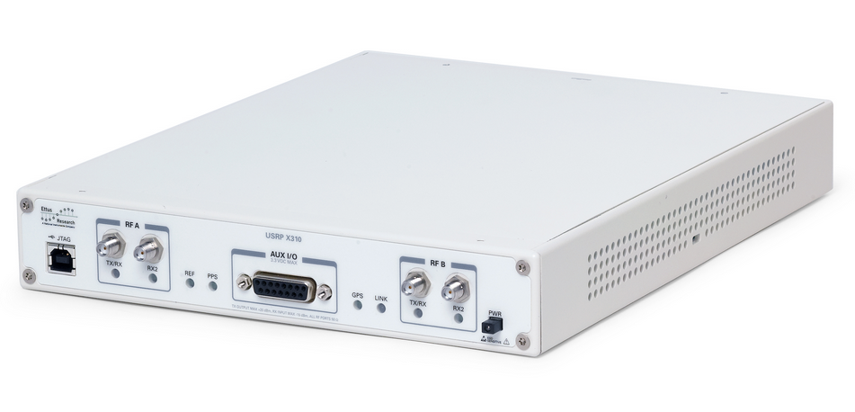

Contest
HINT: Tx is repetitive, so grabbing some data and moving along might be helpful
Setup
Message Pt 1
Message Pt 2
ZMQ PUB
192.168.10.100:1234
100 kSPS
Files located:
github.com/mormj/bfctfdata

