Slide 1





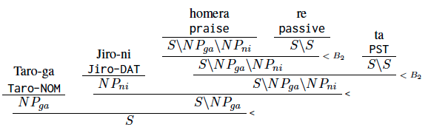
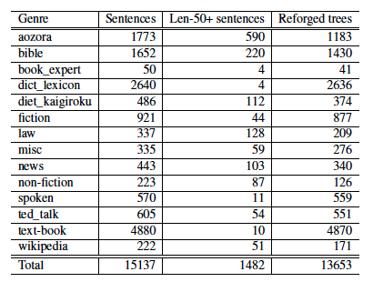
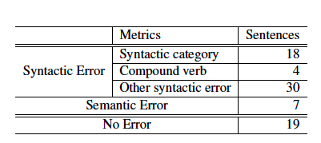
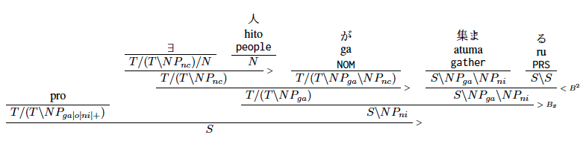
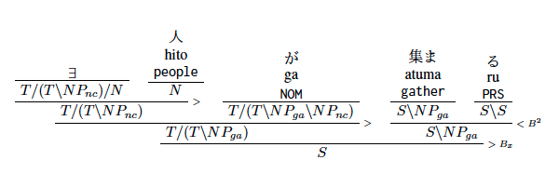
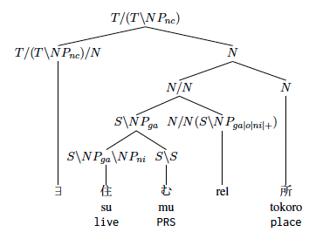

Reforging : A Method for Constructing a Linguistically
Valid Japanese CCG Treebank
Asa Tomita$^{1}$ Hitomi Yanaka$^{2}$ Daisuke Bekki $^{1}$
Ochanomizu University$^{1}$ The University of Tokyo$^{2}$
tomita.asa@is.ocha.ac.jp
Abstract
The linguistic validity of Combinatory Categorial Grammar (CCG; Steedman, 1996, 2000) parsing results relies on the validity of treebanks for training and evaluation data, so the treebank construction is crucial
We propose a method to generate a linguistically valid Japanese CCG treebank with detailed information by combining the strengths of ABCTreebank and Japanese CCG parser lightblue.
We manually evaluate CCG syntactic structures and semantic representations, and syntactically and semantically valid trees were produced for 19 of 56 sentences (33%).
Background
Japanese CCGbank [Uematsu et al., 2013]
was constructed by automatic conversion of Japanese dependency tree corpora.
ABCTreebank [Kubota et al., 2020]
was constructed by converting the Keyaki Treebank (phrase structured treebank) to ABC grammar tree.
lightblue [bekki,2010]
is a Japanese CCG parser that computes syntactic structures from lexicon and combinatory rules, so it does not require training and evaluation data.
It contains some empirical fallacies on predictions for passive and causative nestings.
Argument structures are assumed to be reliable because they were manually annotated.
It outputs CCG syntactic structures with detail syntactic feature and semantic representations in terms of Dependent Type Semantics (DTS; Bekki and Mineshima, 2017)
It does not cover the syntactic information, such as syntactic features.
It includes some argument structure errors.
The Reforging Process and Treebank Construction
We proposed a method for constructing a Japanese CCG treebank by combining the positive aspects of ABCTreebank, in which argument structures are manually annotated, with lightblue’s abilty to provide CCG trees with detailed syntactic features.
Statistics for the reforged treebank data.
Discussion
Evaluation
The trees below show the syntactic structures of the sentence “人が集まる” ( People-NOM gather ) before and after reforging.
gather was analyzed as having ga-case (nominative case) and ni-case (dative case) argument positions before reforging.
By overwriting the syntactic structure of gather with a lexical entry having only ga-case (nominative case) argument position, it became possible to convert sentences to linguistically valid CCG syntactic structures.
We manually evaluated 56 randomly sampled sentences, four from each genre.
Syntactically and semantically valid trees were produced for 19 sentences (33%).
Before
After
Error Analysis
Conclusion
Sentence example involving a relative clause :
“食べる ものも なけれ ば、住む ところも ない”
Eat-attr thing-NOM not-exist and, live-attr place-NOM not-exist
‘No food to eat, no place to live’
The predicate live takes the ga-case (nominative case) NP and becomes a relative clause.
→ An external relation between live and place was analyzed as an internal relation.
We proposed a reforging method for constructing linguistically valid Japanese CCG treebank with detailed syntactic features.
Our future work will consider combining ABCTreebank with other reliable resources, and improve lightblue’s parsing algorithm to better handle long sentences.

