Slide 1
Title: A Survey of Model-Centric FML Systems
Papers to review:
Model fusion (Bryan Low)
Model Fusion for Personalized Learning, Thanh Chi Lam, Nghia Hoang, Bryan Kian Hsiang Low, Patrick Jaillet Proceedings of the 38th International Conference on Machine Learning, PMLR 139:5948-5958, 2021.
White-box, Black-box
Focus: learning, influence attacks etc.
??? Assume: Model are fixed and given to the server; no supervised learning by server
Single shot FML (Qinbin, zhaomin, etc)
Parties: use local data -> models (very complex models; server supervised training) -> FML
Ensemble (Liu Ling@Gatech)
Model query/processing
Pretrained based FML
Model based contractive learning
Model based protection
…

Slide 2
Definition: model, ensemble, representation.
Taxonomy:
Horizontal, vertical, hybrid, etc.
Challenges and opportunities:
The current def: on-demand training on local data
Model market
V0: each party submits its models (without the knowledge of downstream tasks from the server)
V1: single shot training. each party submits its models (with the knowledge of downstream tasks from the server)
The server gives parties sensitive or non-sensitive info
V2: proactive, the server can iteratively request the model training from the local data from each party.=> FedAvg

Slide 3
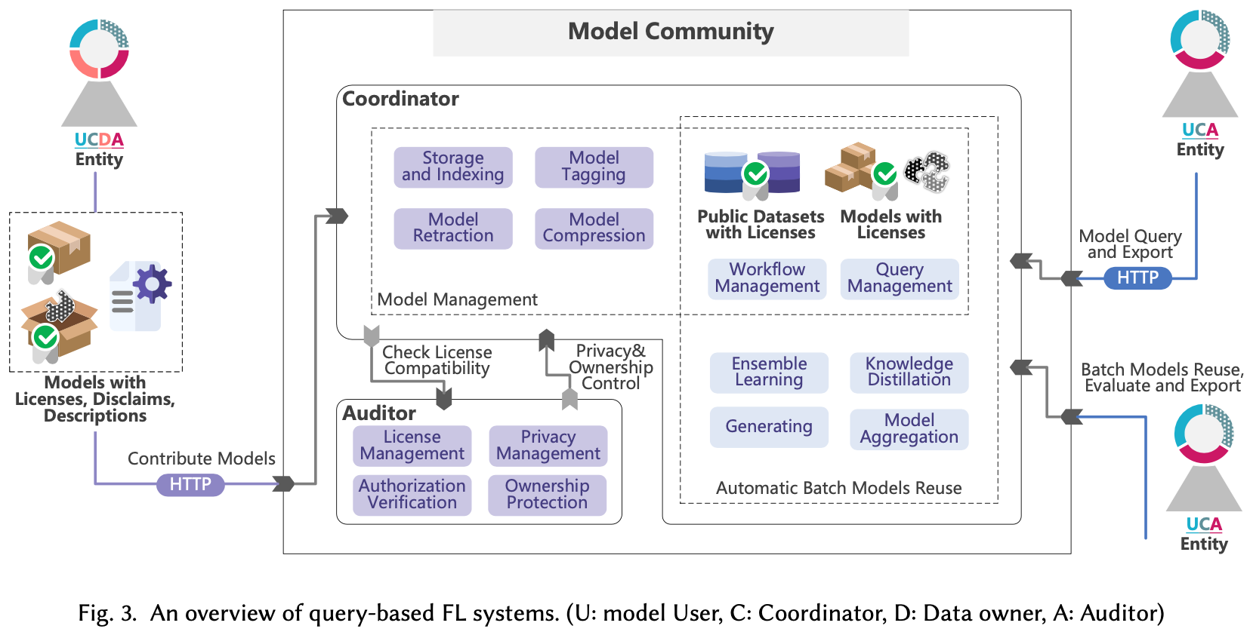
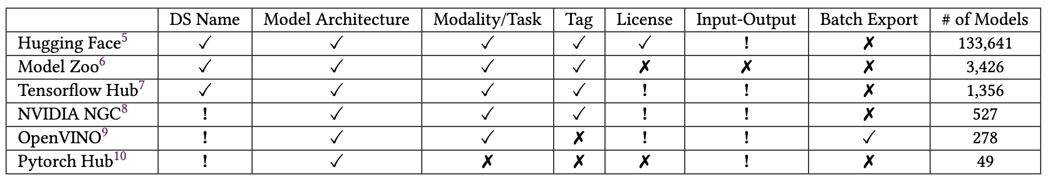

Slide 4
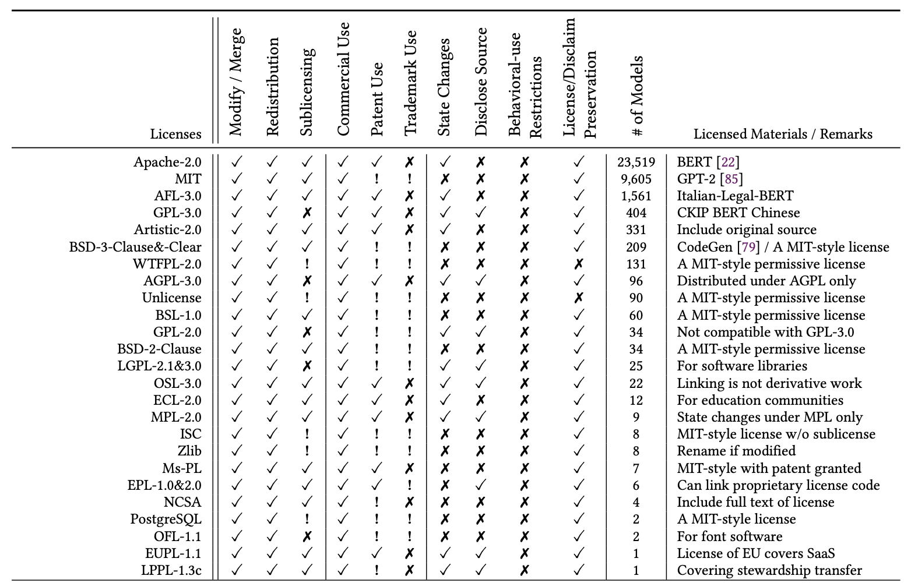

Slide 5
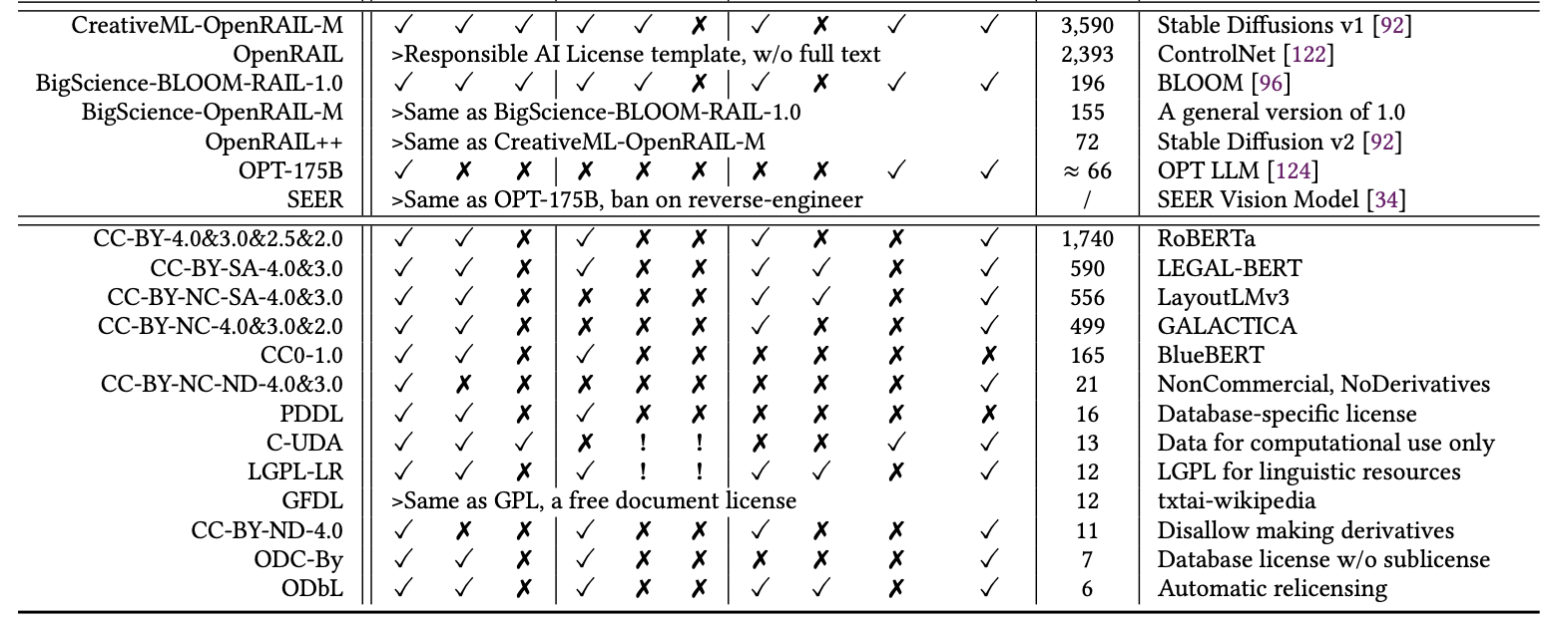
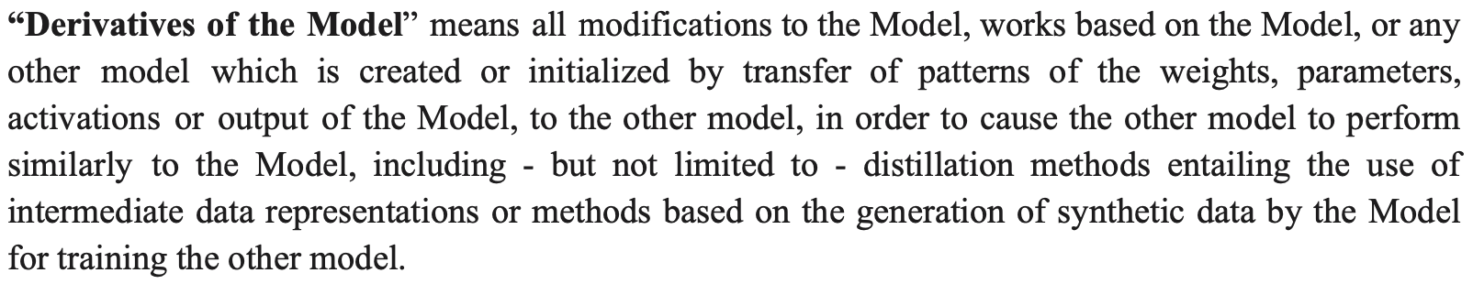

Slide 6
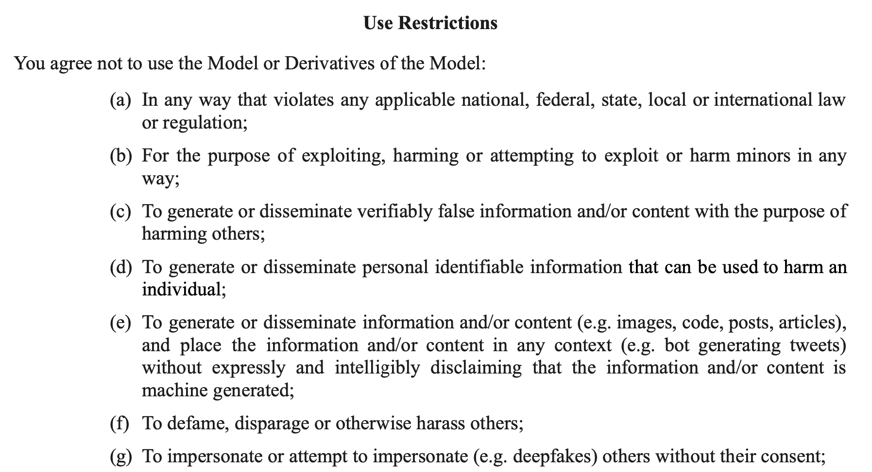
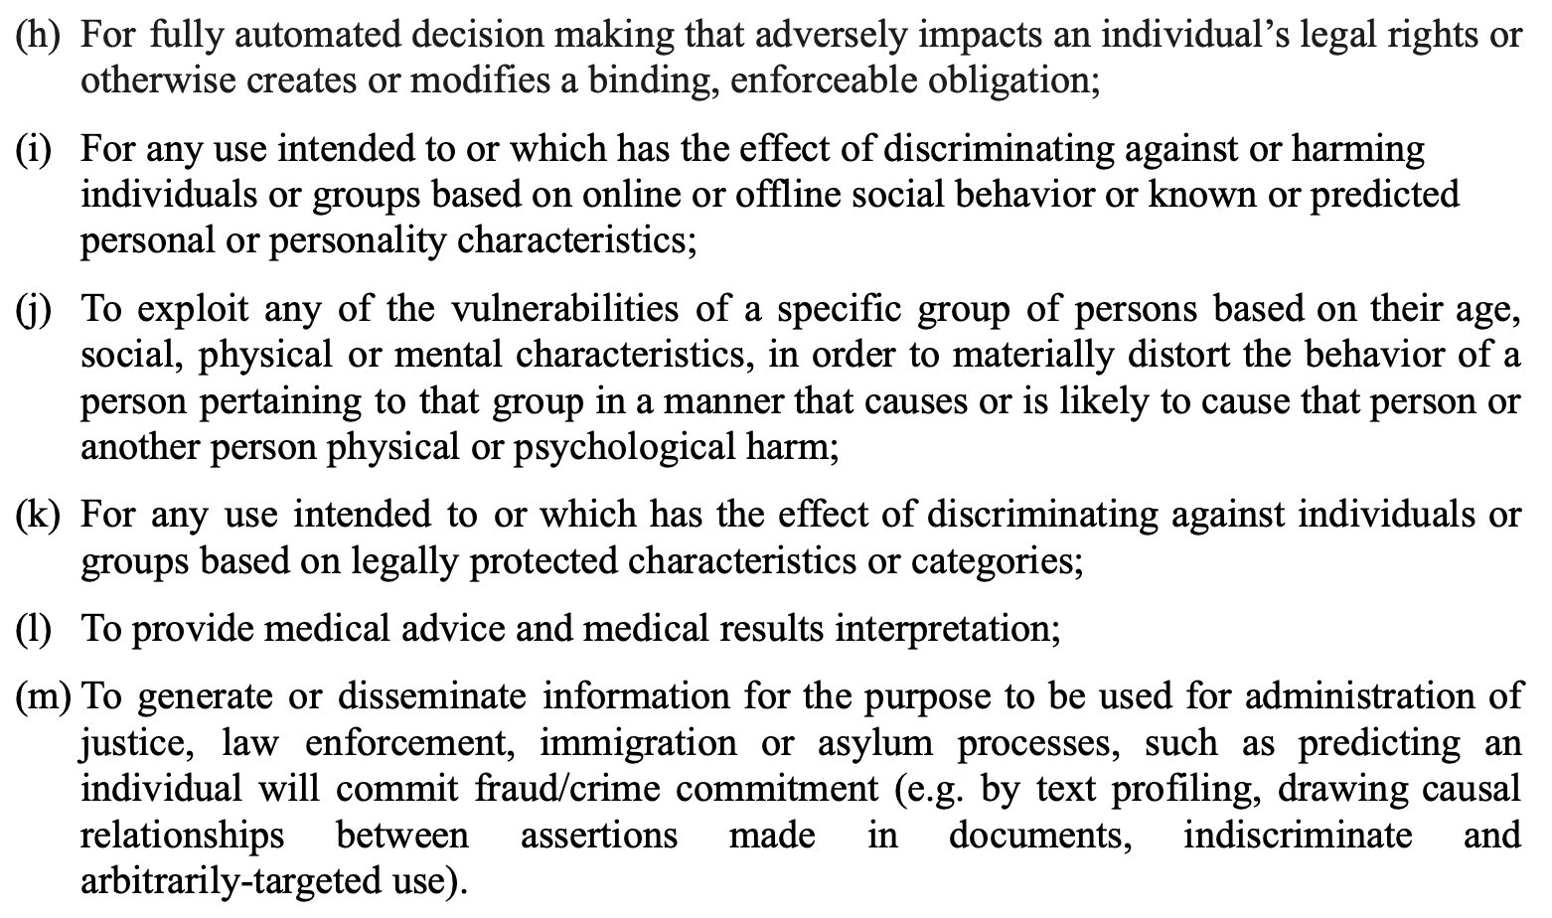

Slide 7
