Slide 1
Title: A Survey of Model-Centric FML Systems
Papers to review:
Model fusion (Bryan Low)
Model Fusion for Personalized Learning, Thanh Chi Lam, Nghia Hoang, Bryan Kian Hsiang Low, Patrick Jaillet Proceedings of the 38th International Conference on Machine Learning, PMLR 139:5948-5958, 2021.
White-box, Black-box
Focus: learning, influence attacks etc.
??? Assume: Model are fixed and given to the server; no supervised learning by server
Single shot FML (Qinbin, zhaomin, etc)
Parties: use local data -> models (very complex models; server supervised training) -> FML
Ensemble (Liu Ling@Gatech)
Model query/processing
Pretrained based FML
Model based contractive learning
Model based protection
…

Slide 2
Definition: model, ensemble, representation.
Taxonomy:
Horizontal, vertical, hybrid, etc.
Challenges and opportunities:
The current def: on-demand training on local data
Model market
V0: each party submits its models (without the knowledge of downstream tasks from the server)
V1: single shot training. each party submits its models (with the knowledge of downstream tasks from the server)
The server gives parties sensitive or non-sensitive info
V2: proactive, the server can iteratively request the model training from the local data from each party.=> FedAvg

Slide 3
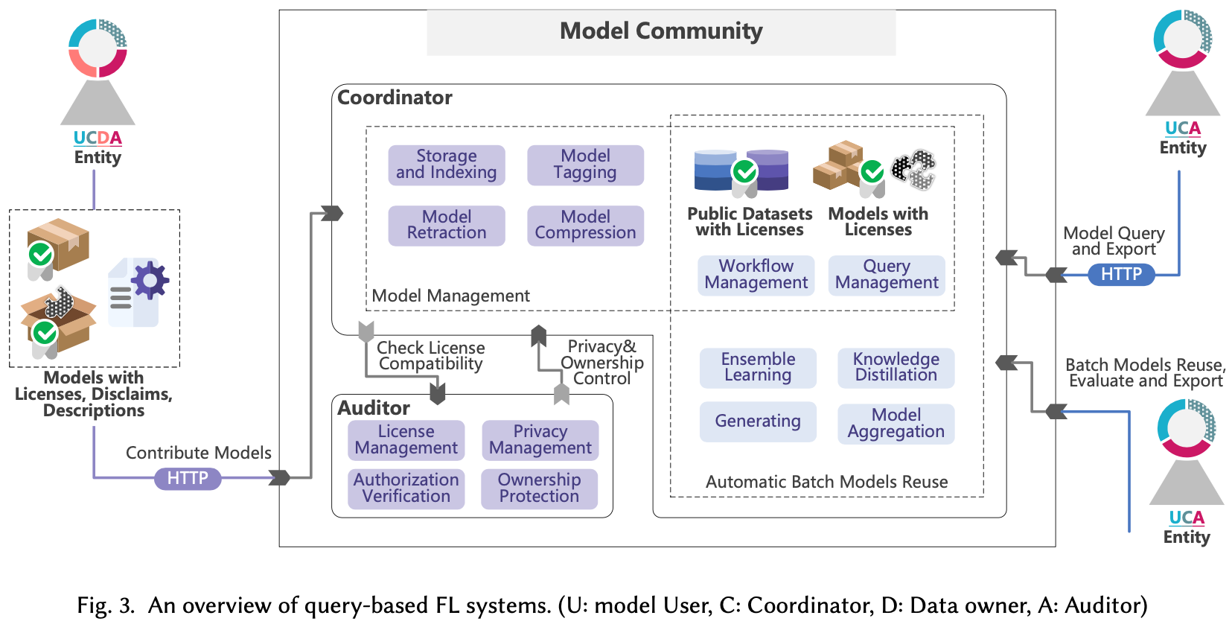
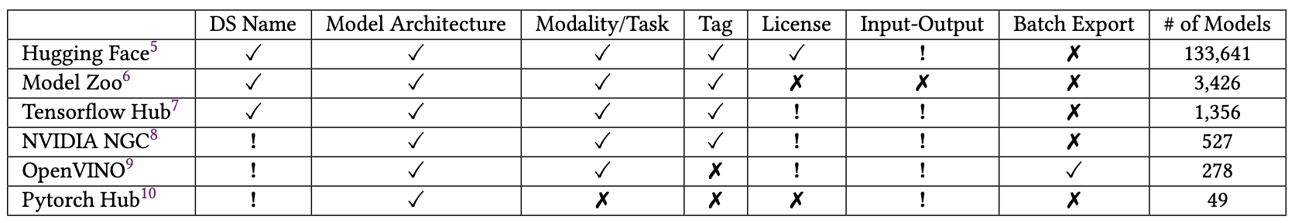

Slide 4
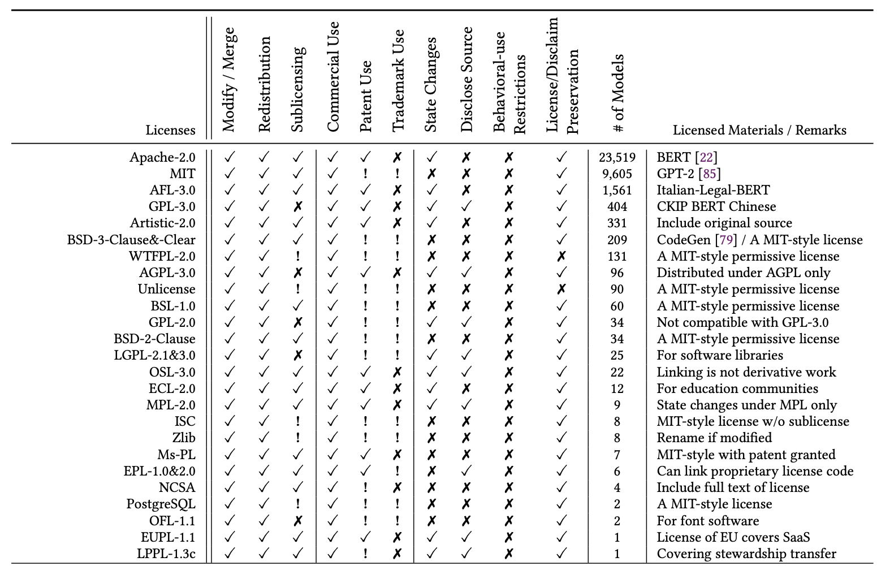

Slide 5
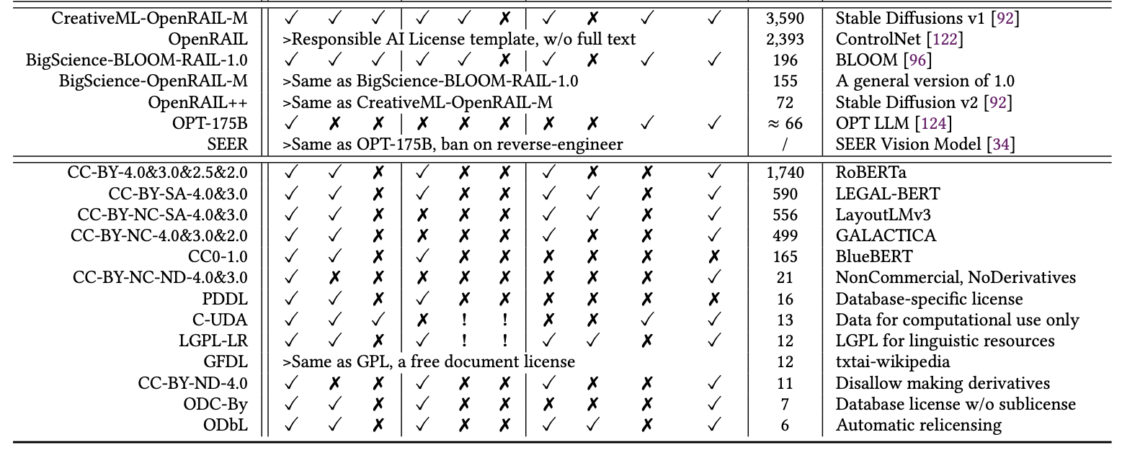
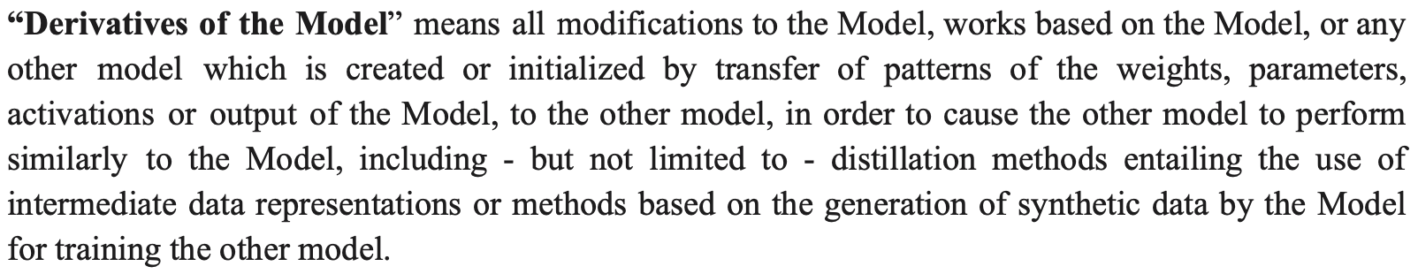

Slide 6
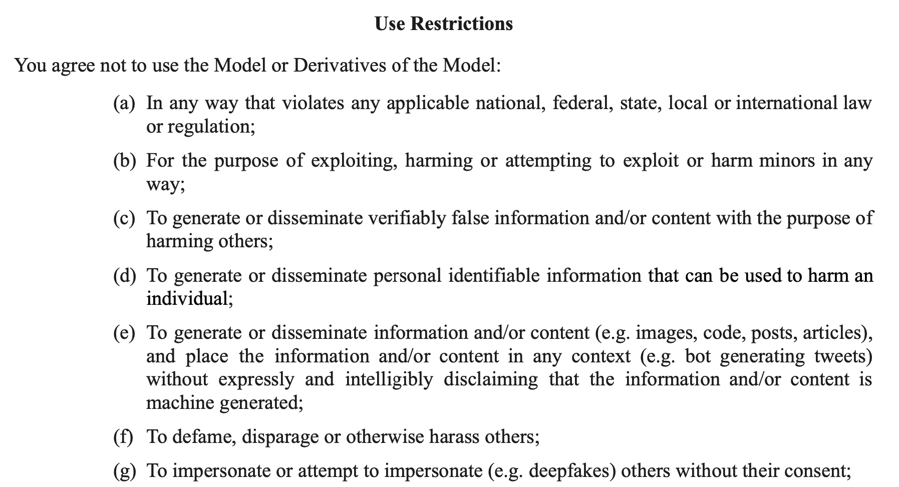
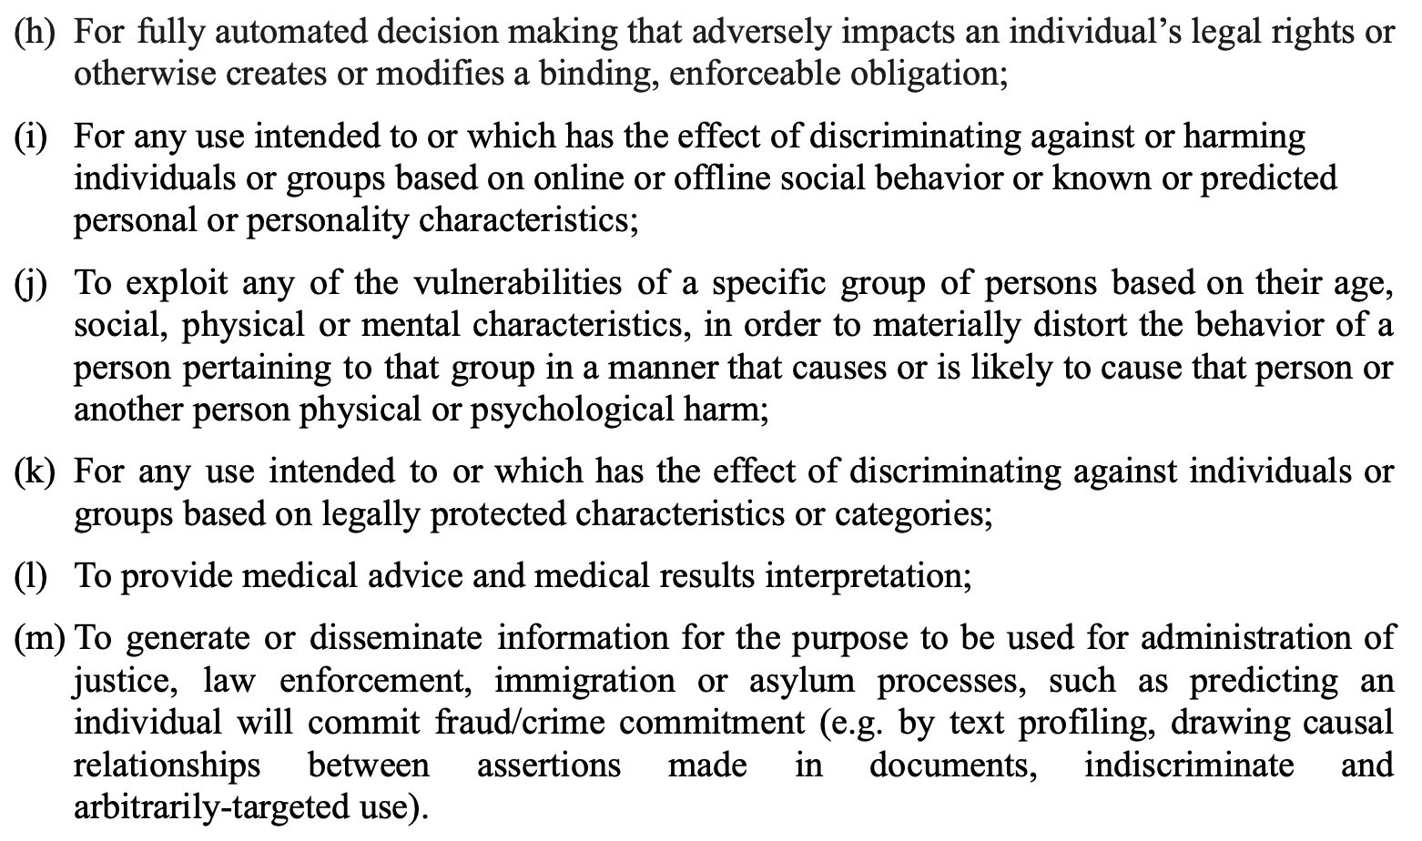

Slide 7
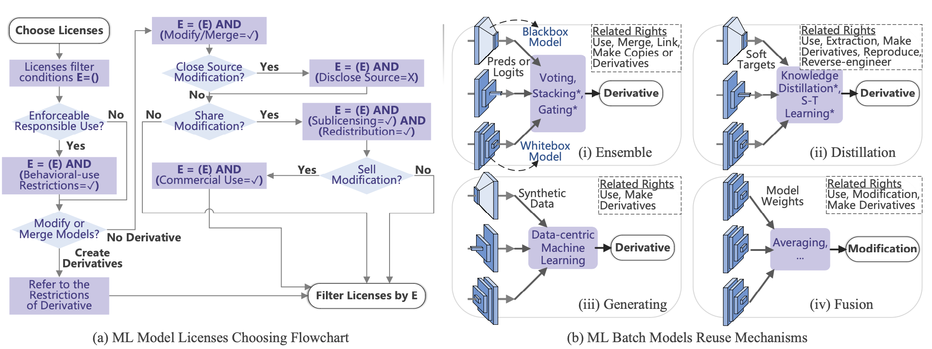

Slide 8
Preferences for Datasets or Databases: CC0-1.0, ODC-By > CC BY > C-UDA > LGPL-LR.
Preferences for Software: Apache-2.0, AFL-3.0, Artistic-2.0, ECL-2.0 > MIT, BSD-3-Clause&-Clear, BSL-1.0, BSD-2-Clause, NCSA ≈ Ms-PL > WTFPL-2.0, Unlicense, ISC, Zlib, PostgreSQL.
Preferences for Models: Apache-2.0, AFL-3.0, Artistic-2.0, ECL-2.0 > OpenRAIL and its derivatives
CreativeML OpenRAIL-M:
Therefore You cannot use the Model and the Derivatives of the Model for the specified restricted uses ... You shall require all of Your users who use the Model or a Derivative of the Model to comply with the terms of this paragraph.
You shall undertake reasonable efforts to use the latest version of the Model

Slide 9
Copyrightable 🤔
Level of creativity and originality.
Presence of at least minimal human creative effort at the time the work is produced.
Authorship -> Original intellectual conceptions.
Stable Diffusion License:
Licensor claims no rights in the Output You generate using the Model.
OpenAI Sharing&Publication Policy:
The published content is attributed to your name or company.

Slide 10
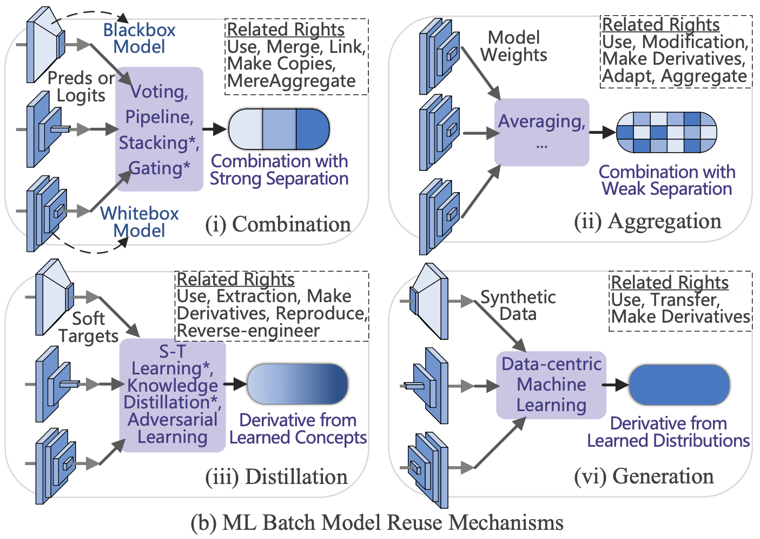
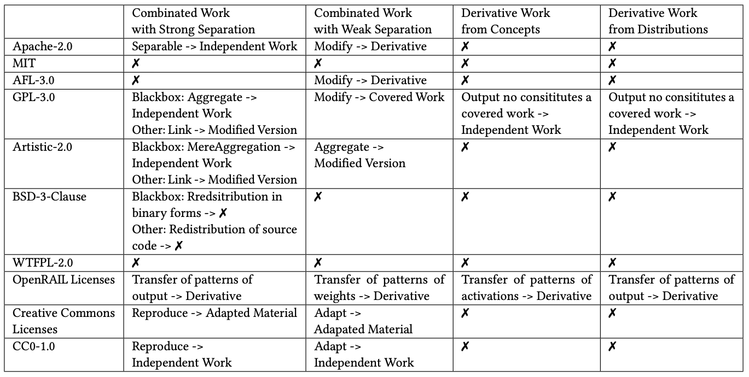

Slide 11
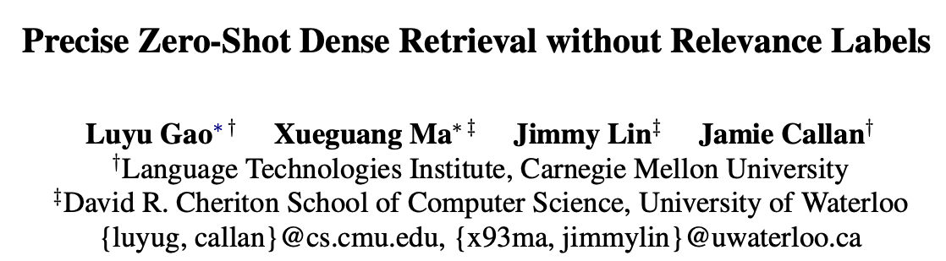
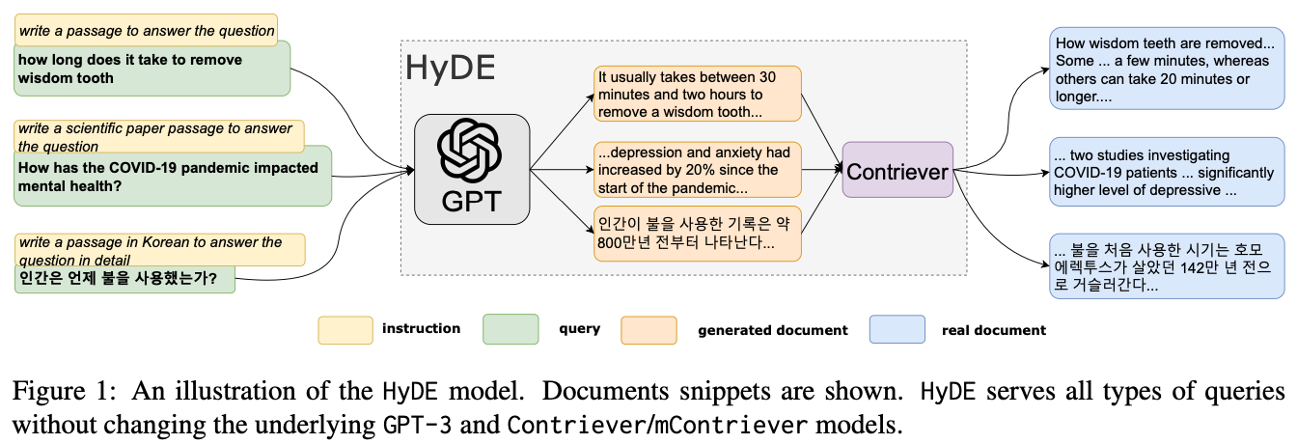

Slide 12
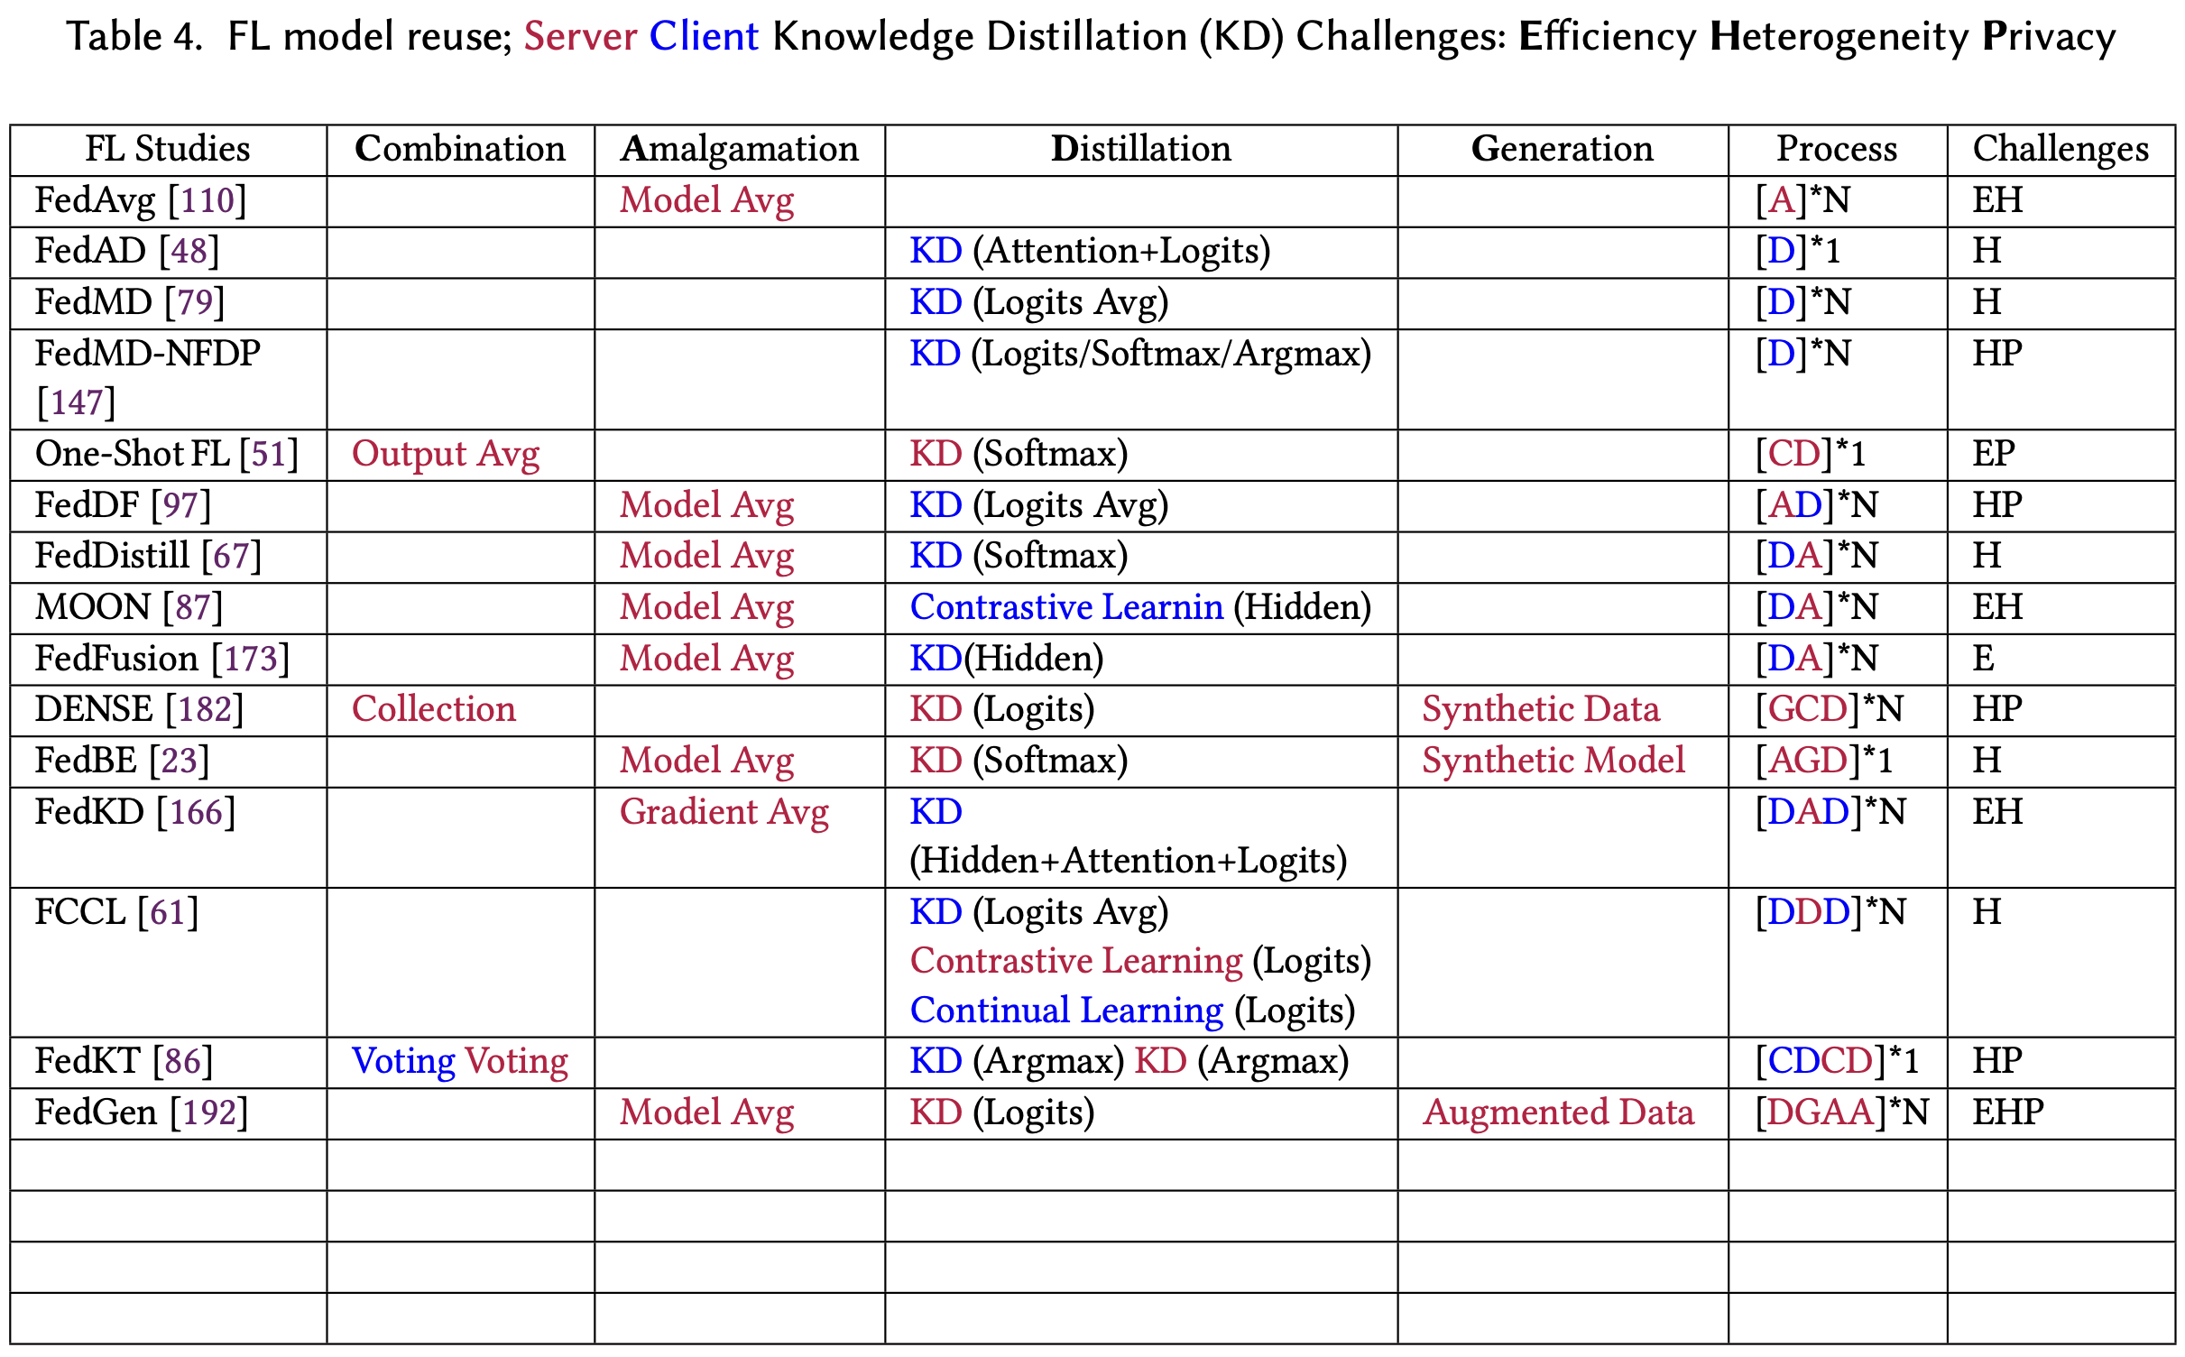

Slide 13
