Slide 1
SURETY
Agent Risk Underwriting for Amex Agentic Commerce
Continuous risk scoring · Dynamic exposure caps · Circuit breakers · Claims-grade evidence
Live prototype surety-policy-service.onrender.com
TEAM SURETY
CodeStreet 2026 · Governance Layer for Financial Agents
Notes:
Every team in this theme will show you a fence: permissions, dashboards, kill switches. We don't just build a fence. We underwrite the risk. SURETY is the actuarial layer that makes Amex's agentic commerce insurable. And it is not only a design: the policy engine is deployed and live at surety-policy-service dot onrender dot com, so anything on these slides can be tested during this call.

Slide 2
THE GOVERNANCE GAP
A Promise Without Underwriting
14 APR 2026
14 APR 2026
MISSING
ACE Developer Kit
Agent Purchase Protection
The actuarial layer
Amex opens agent-initiated purchasing to developers.
Industry-first cover for registered-agent purchase errors.
No exposure pricing. No live caps. No claims evidence.
WHY THE PROMISE NEEDS UNDERWRITING
ONE AGENT ERROR
An open-ended promise is an open-ended liability. Without live scoring, every registered agent carries the same unpriced exposure.
₹17,000
Disputes resolve after the money has moved, not before.
overspent against a stated ceiling
Nothing on file proves what the Card Member actually asked for.
Weeks of dispute.
No record of the original instruction.
324M global chargebacks forecast by 2028, up 24% on 2025, before agent errors are counted.
Sources: American Express Newsroom, ACE Developer Kit and Agent Purchase Protection, 14 Apr 2026 · Mastercard / Datos Insights, 2025 Global Chargebacks Outlook.
SURETY
02 / 11
Notes:
On 14 April 2026 Amex made the boldest promise in agentic commerce: the ACE Developer Kit opened agent-initiated purchasing, and Agent Purchase Protection committed to cover Card Members when a registered agent errs. That promise is strategically powerful and actuarially incomplete. The strategic gap is not payment execution, it is underwriting the risk of autonomous transactions and preserving evidence when agent behaviour deviates from authenticated intent. Without infrastructure to price risk, cap exposure and assemble evidence, every agent transaction is an open-ended liability. That is the gap we close. [Sources] - American Express Newsroom, ACE Developer Kit and Agent Purchase Protection announcement, 14 Apr 2026: https://www.americanexpress.com/en-us/newsroom/articles/innovation/american-express-debuts-agentic-commerce-experiences--ace--devel.html - Mastercard / Datos Insights, 2025 Global Chargebacks Outlook, global chargebacks forecast to reach 324M annually by 2028: https://www.mastercard.com/global/en/news-and-trends/Insights/2025/2025-global-chargebacks-outlook.html

Slide 3
THE SOLUTION
One Loop: Score, Cap, Stop, Prove
A FENCE ASKS
AN UNDERWRITER ASKS
"Is this single action allowed?"
"What is this agent's exposure, and who pays if it is wrong?"
01
02
03
04
SCORE
CAP
STOP
PROVE
Continuous risk scoring
Dynamic exposure caps
Circuit breakers
Claims-grade evidence
Every action re-scores the agent: intent deviation, baseline drift, category entropy, velocity.
The score sets the ceiling: per transaction, per merchant category, per window, recomputed live.
Revoke one agent, a class of agents, or the whole fleet. In-flight requests decline immediately.
Each breach assembles intent, cart, merchant and decision trail into a filable Claims Package.
XGBoost over a live Kafka feature stream
OPA policy + Redis token buckets
Three-level breaker, millisecond propagation
Hash-chained audit in PostgreSQL
Underwriting, not just enforcement.
SURETY
03 / 11
Notes:
SURETY treats every agent the way an underwriter treats a policyholder. Its behaviour earns it a risk score; the score sets its exposure limits and permissions in real time; and when it breaks its terms, SURETY doesn't just stop it, it files the evidence. Governance becomes an insurability engine.

Slide 4
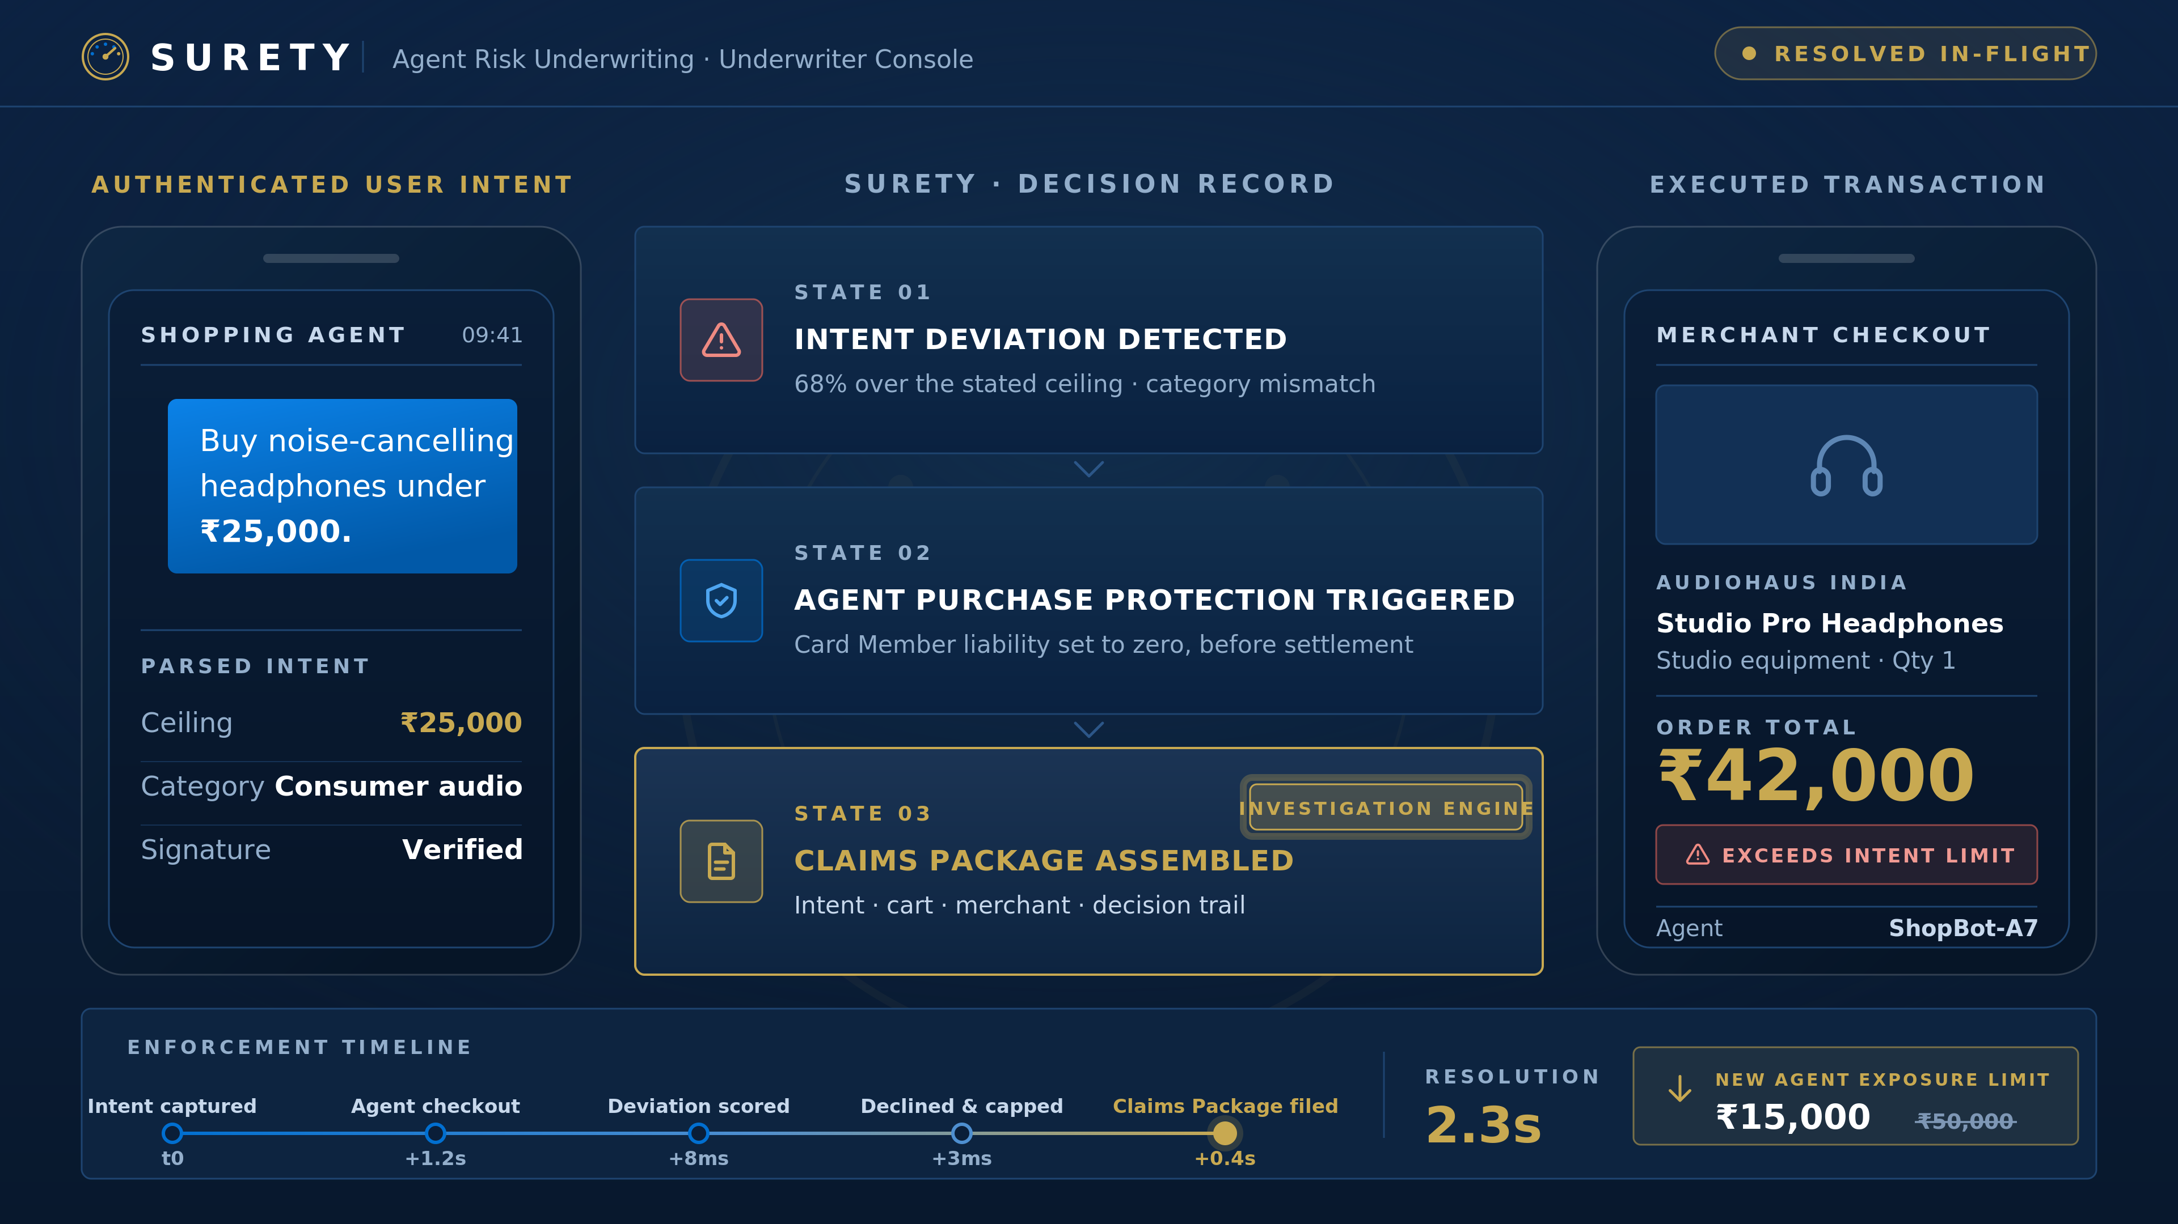
LIVE SCENARIO
An Agent Error, Resolved in Seconds
DETECTED
Caught in-flight
68% over the stated ceiling and outside the stated category, scored before the charge settles.
PROTECTED
Protection triggered
Agent Purchase Protection applied automatically. Card Member liability set to zero.
PROVEN
Claims Package filed
Investigation engine: intent, cart, merchant and decision trail in 2.3 seconds. Agent capped to ₹15,000.
Claims Package = the investigation engine that turns Amex's protection promise into closed-loop, evidence-backed resolution.
Manual: 7-14 evidence sources, several days
SURETY: 1 Claims Package, 2.3 seconds
Conceptual comparison - illustrative
Notes:
The Card Member asked for headphones under twenty-five thousand; the agent paid forty-two. This is the actual console view. SURETY catches the intent deviation mid-flight, declines the transaction, tightens that agent's limits, triggers Agent Purchase Protection and hands Amex a ready-to-file Claims Package. The Claims Package is the investigation engine: it turns the protection promise into closed-loop, evidence-backed resolution. Two point three seconds, instruction to filed claim. Conceptually, a manual investigation pulls seven to fourteen evidence sources over several days. SURETY produces one Claims Package in two point three seconds. This is not a dashboard. It is a resolved claim, before the Card Member notices.

Slide 5
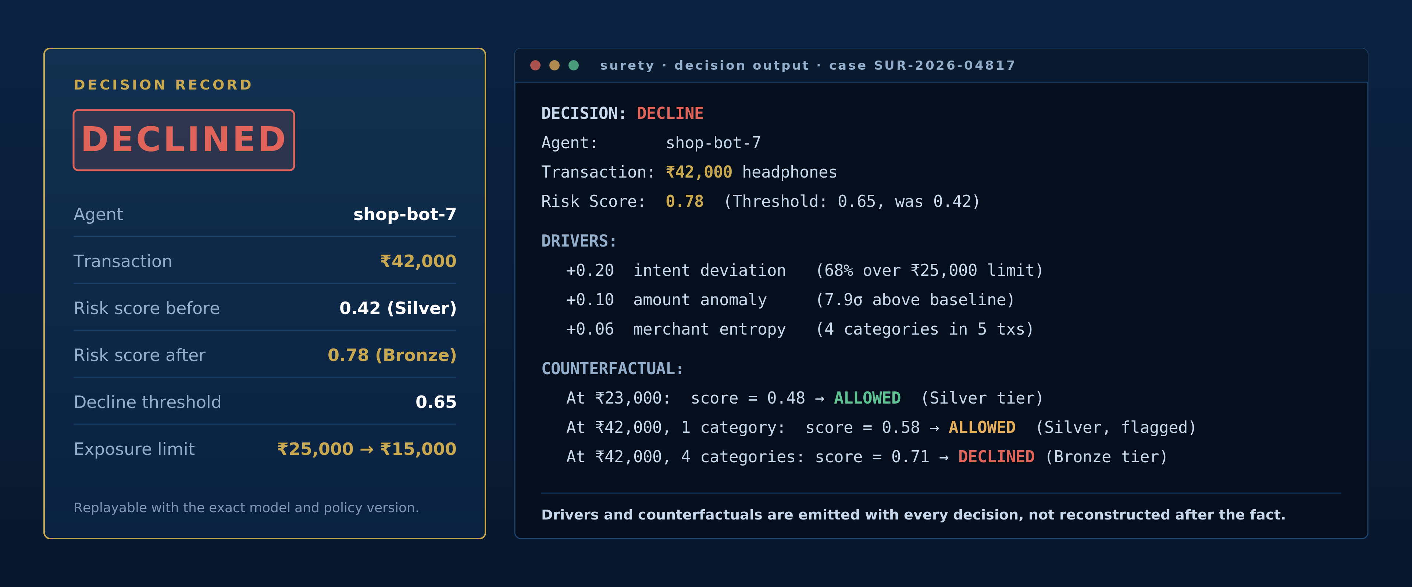
TRANSPARENCY
Underwriting You Can Interrogate
Every decision ships with its drivers and counterfactuals. Mathematically fair. No black box.
Notes:
Any system can say no. SURETY says no and shows exactly what would have changed the answer. We show the actual risk score and the exact drivers: the score moved from 0.42 to 0.78 against a decline threshold of 0.65, with intent deviation contributing 0.20, amount anomaly 0.10 and merchant entropy 0.06. The counterfactual proves it is not arbitrary: at twenty-three thousand rupees the same agent would be approved at Silver tier. That proves the model is not a black box. It builds trust with regulators, Card Members and merchants, and trust is the only currency that matters in underwriting.

Slide 6
RUBRIC COVERAGE
Complete Mapping to the Brief
REQUIREMENT
HOW SURETY DELIVERS IT
SHOWN IN THE DEMO
Granular permission model
Risk-tiered terms over action type, merchant category, velocity and amount ceiling. Operator-configurable.
Tier change applied live to a running agent
Dynamic spend caps, real time
Recomputed from the live risk score, enforced in-path by OPA with Redis token buckets.
Cap tightens the moment the score moves
Revocation and emergency stop
Three levels: single agent, agent class, whole fleet. In-flight requests decline at once.
Fleet breaker pulled on stage, declines visible
/breaker endpoint in prototype
Operator dashboard
Underwriter's console: live exposure, policy editor, decision replay, one-click breakers.
Console driven live, not screenshotted
Testing and optimisation
50-agent simulated fleet with planted rogues; precision, recall and p99 latency reported.
Measured results and a live tamper test
SURETY
06 / 11
Notes:
Every task the judges asked for is addressed explicitly: permissions, dynamic caps, revocation, dashboard, testing. The right-hand column is the commitment: each one is demonstrated live, not described. One of them is already built: revocation ships as a working POST /breaker endpoint in the Round 1 prototype, with agent, class and fleet scopes, and every trip written to the hash-chained audit ledger. If you want, we can pull the fleet breaker on this call.

Slide 7
TECHNICAL ARCHITECTURE
Designed for Sub-10ms Decisions
01
02
03
04
05
06
07
Agent action
Kafka
Feature extractor
XGBoost scorer
OPA + Redis
PostgreSQL
React console
Ingests ACE: intent intelligence, cart context
Event backbone
Deviation, drift, entropy, velocity
Continuous agent risk score
Allow, cap or decline in-path
Registry and hash-chained audit
FastAPI + WebSocket live view
Target: <10 ms p99 policy decisions @ 10K agents · designed for sub-10ms p99 enforcement
Stateless enforcement path
Tamper-evident by construction
Aligned to NIST AI RMF
The policy decision needs no session state, so it scales horizontally and is designed to hold the latency target under load.
Each audit record hashes the previous one. Editing a single row provably breaks the chain.
Mapped to the Govern and Manage functions, so the control story survives a real risk review.
Kafka · XGBoost · Open Policy Agent · FastAPI · Redis · PostgreSQL · React No exotic dependencies: every component is buildable inside the Round 2 window.
References: Open Policy Agent documentation · NIST AI Risk Management Framework (Govern, Manage).
SURETY
07 / 11
Notes:
The enforcement path is stateless and cached, and it is designed to target sub-ten-millisecond policy decisions at ten-thousand-agent scale. The agent action feed ingests ACE intent intelligence and cart context, so the model scores against what the Card Member actually asked for. The audit trail is hash-chained: tamper with one record and the chain breaks, provably. Every component is standard and realistic for the Round 2 prototype. [Sources] - Open Policy Agent documentation: https://www.openpolicyagent.org/docs - NIST AI Risk Management Framework: https://www.nist.gov/itl/ai-risk-management-framework

Slide 8
BUSINESS VALUE
Trust as a Product, Not a Cost Centre
Makes Agent Purchase Protection sustainable
Every registered agent carries a priced, capped maximum loss instead of open-ended exposure.
Loss ratio becomes forecastable
01
Cuts the cost of every agent dispute
Claims Packages arrive pre-assembled and aligned to Amex chargeback reason codes, so resolution starts with evidence in hand.
Lower handling cost per case
02
Underwriting-as-a-service
Developers who hold Gold-tier scores for 90 days earn a "SURETY Certified" badge: higher default limits, reduced checkout friction, and a recurring revenue stream for Amex.
Compliance becomes competitive advantage
03
Extends the Amex trust franchise
The brand that made card payments safe becomes the brand that makes autonomous payments safe.
Brand-consistent differentiation
04
Governance stops being a cost of doing agentic commerce. It becomes the product Amex sells.
Why only Amex? Closed-loop network → richer intent signals → better underwriting → faster claims → more trusted agents → more spend → more Amex revenue.
SURETY
08 / 11
Notes:
This ties directly to the agentic commerce strategy Amex has already announced. SURETY helps make Agent Purchase Protection sustainable by capping and explaining exposure, cuts claims cost with pre-assembled reason-code-aligned evidence, and creates a developer-facing trust tier. Developers who hold Gold-tier scores for ninety days earn a SURETY Certified badge, which unlocks higher default limits and reduced checkout friction for them, and a recurring revenue stream for Amex. Compliance becomes competitive advantage. The Card Member still sees only the app: granular spend controls and a protected purchase. And this is a network moat, not a feature. Amex runs a closed loop, so it sees both sides of the transaction: the closed-loop network gives richer intent signals, richer signals give better underwriting, better underwriting gives faster claims, faster claims give more trusted agents, more trusted agents give more spend, and more spend gives more Amex revenue. An issuer or a processor alone cannot close that loop. Governance stops being a cost centre and becomes trust, sold as a product. [Sources] - American Express Agentic Commerce: https://www.americanexpress.com/en-us/company/agentic-commerce/ - American Express Chargeback Code Guide: https://www.americanexpress.com/content/dam/amex/au/en/merchant/static/chargebackcodeguide.pdf

Slide 9
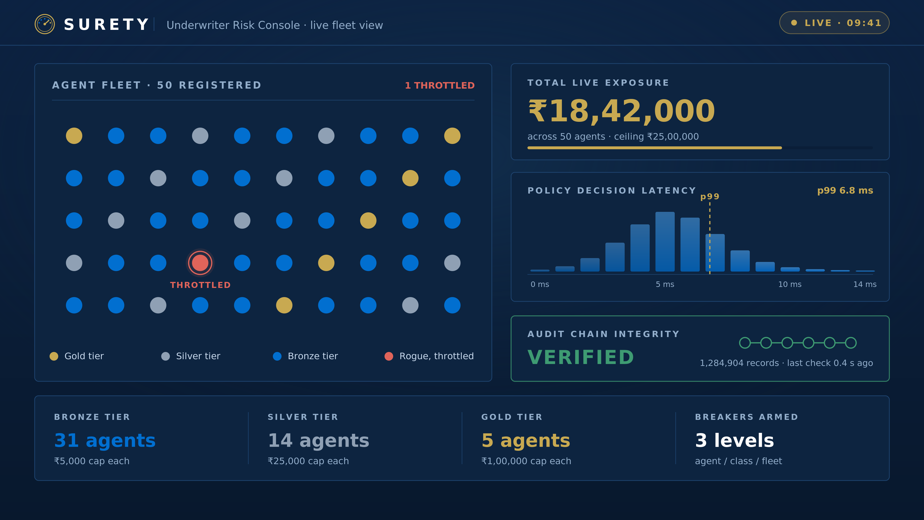
TESTING AND MEASUREMENT
Measured, Not Claimed
ROGUE DETECTION
Precision and recall
50-agent fleet with planted rogue behaviour.
POLICY LATENCY
Target: p99 under 10 ms
Load test against the enforcement path.
BREAKER PROPAGATION
In-flight declines, no leakage
Fleet-wide revoke during live traffic.
AUDIT INTEGRITY
Chain break on screen
A record edited on stage during the demo.
We will not claim performance. We will measure it in front of you.
Notes:
We will not claim performance, we will measure it in front of you. This is the operator console: live exposure by tier, the latency distribution with the p99 marker, and audit-chain state. The simulated fleet includes planted rogue agents, so we report real precision and recall rather than a demo happy path. In the finale we edit an audit record live and the chain breaks on screen. That is auditability you can see.

Slide 10
APPENDIX A
SURETY-ACE Integration Architecture
ACE DEVELOPER KIT
Intent Intelligence
SURETY
authenticated Card Member intent
Risk Scoring
Underwriting & Enforcement
Claims Package
Cart Context
continuous agent score from ACE features
tiers, dynamic caps, circuit breakers
hash-chained evidence on every breach
merchant, category, basket
Agent Registration
POLICY DECISIONS
registered agent identity
Operator Dashboard
Card Member Portal
underwriter risk console
spend controls, claim status
How SURETY plugs into Amex's ACE kit: Intent Intelligence and Cart Context are ingested as underwriting features; policy decisions are written back to Agent Registration - a closed governance loop.
SURETY
10 / 11

Slide 11
Every other governance proposal builds a fence.
SURETY builds the actuarial layer.
It decides how high each fence must be, prices the residual risk, and files the claim when it is breached.
The first network to underwrite autonomous transactions at scale owns the moat.
SURETY is the credit score for autonomous agents: a universal trust metric for the agentic economy.
Live prototype surety-policy-service.onrender.com
Team SURETY · Thank you
Notes:
Every other governance proposal builds a fence. SURETY builds the actuarial layer that decides how high each fence must be, prices the residual risk, and files the claim when it is breached. For Amex, the first network to underwrite autonomous transactions at scale does not just manage a risk, it owns a moat. We are building the credit score for AI agents. That is the moat. We would like to build it with you. Thank you.

