Slide 1
TORONTO INVESTMENT GUIDE

Slide 2
content
Introduction
Data
Methodology
results and discussion
Conclusion

Slide 3
introduction
I have found that a problem presented to many budding businessmen and investors is knowing what exactly to invest in. This is a difficultly faced everywhere in the world. For the scope of my model I am going to limit it to the Toronto area, and create a model in which can be used by investments to guide there choices in the area. By giving them an insight into all the prominent neighbourhoods in Toronto using Foursquare API to provide accurate location data. Hence the model will collate the pros and cons of investing in certain neighbourhoods in Toronto based on the types of venues already there and types of business and observing the type of reviews they have received. I feel this model will provide investments a chance to make a good financial decision.

Slide 4
Data
we will be using Foursquare location data and wikipedia First we will need to import the relevant libraries. The Wikipedia http link contained the data about the neighbourhoods in Canada and the foursquare location data contained the venue data. First we used the panda library in order to produce a dataframe. The Data needed to cleaned and prepared as it had some incomplete data called ‘not assigned’ and replace it with name of the neighbourhood. And then group the data of the borough and neighborhood and couple that with the geospartial data extracted from the data frame to get:

Slide 5
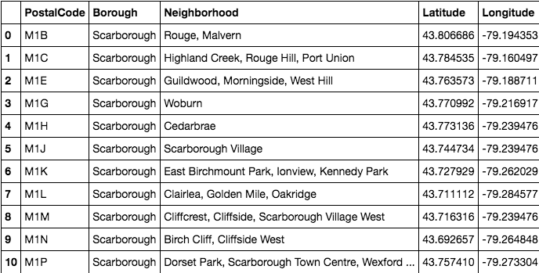

Slide 6
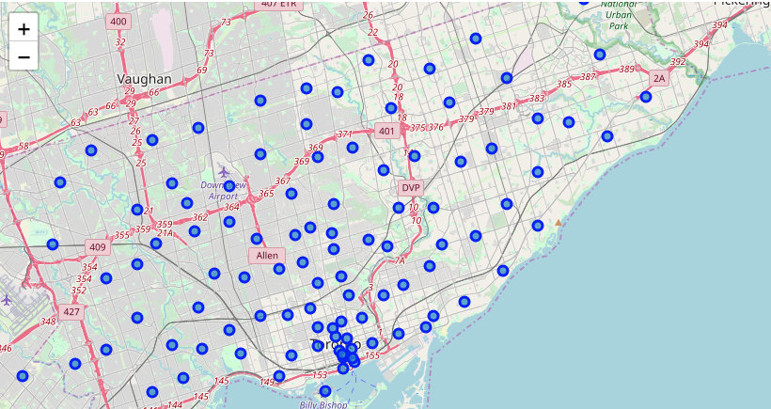
Creating a folium mop

Slide 7
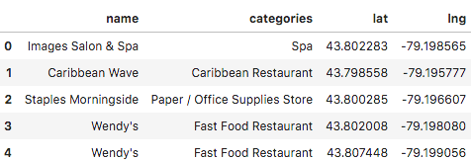
Using the foursquare developer api we sent requests to find the top 100 venues in studio district within a 1000meter radius.

Slide 8
Methodology
during the course of the project we determined what type of venues were most popular in parts of Canada honing in on the the Toronto boroughs.
Firstly we collected the data and we explained how we did that using juptyer and python in the section above, then we went on the analysis the data and explore the diferent types of venues in the area hence finding out the possible business investment opportunities in the area.
In the final step with the help of k cluster, a machine learning technique will created clusters of the best areas of venues and presented them on a map. The clusters present the basic requirements for investors to use as a starting point to see where they should invest in and one kind of category too. Then they can devote more resources to making a a further on site investigation of the area.

Slide 9
results and discussion
From our analysis majority visualised in the data frame above we can see that food relating vuenues close to the city center. Highest concenation of the them being coffee shops. By using clusters we caw that in the city center the most popular type of venu was ‘gardens’ but from a business prospective that may not be the best investment so we can look to see the 2nd and 3rd most common venue which was a womens store and dumpling restaurant this is valuable information for a investor, as they can see towards the inner city clothing and food is highly dense, so if they want to find a niche they know what is already common. From the data we can see that as you leave the center of the city center of Toronto we can see that the density of clothing shops decrease as you leave the city center. The purpose of the analysis was put together in order for investors to clearly see the right type of investment to make across Toronto for them to be successful to see where a type of business is already saturated in an area and make them find a niche or already see and trend in a type of business and come in and improve existing services in the area. What ever yields them the highest profits.

Slide 10
conclusion
In conclusion by using the foursquare location data we have created data frames to anaylise general boroughs in Toronto that meets certain requirements about the preexisting common venues already in the area. Given the finding presented to the potential business investors in Toronto they would also need to take into consideration other factors such as socioeconomic factors of the area , accessibility for example major roads, and local council regulations in which might cause a problem. So in conclusion I believe this study to be a ‘first step’ in the decision to invest in certain areas in Toronto.

