Slide 1
Biomedical Signal Processing
ECG signal decomposition using Fourier
analysis
Andrea Moretti

Slide 2
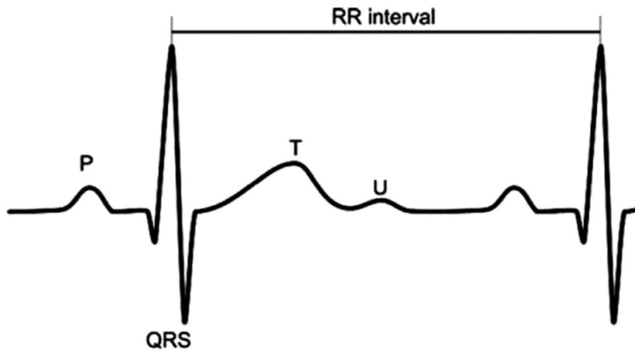
The main goal
ventricular repolarization
depolarization of the atria
The ECG is the main source of information for cardiac diagnoses
An important task is separating ventricular depolarization and repolarization
We want an efficient representation of the signals
ventricular depolarization

Slide 3
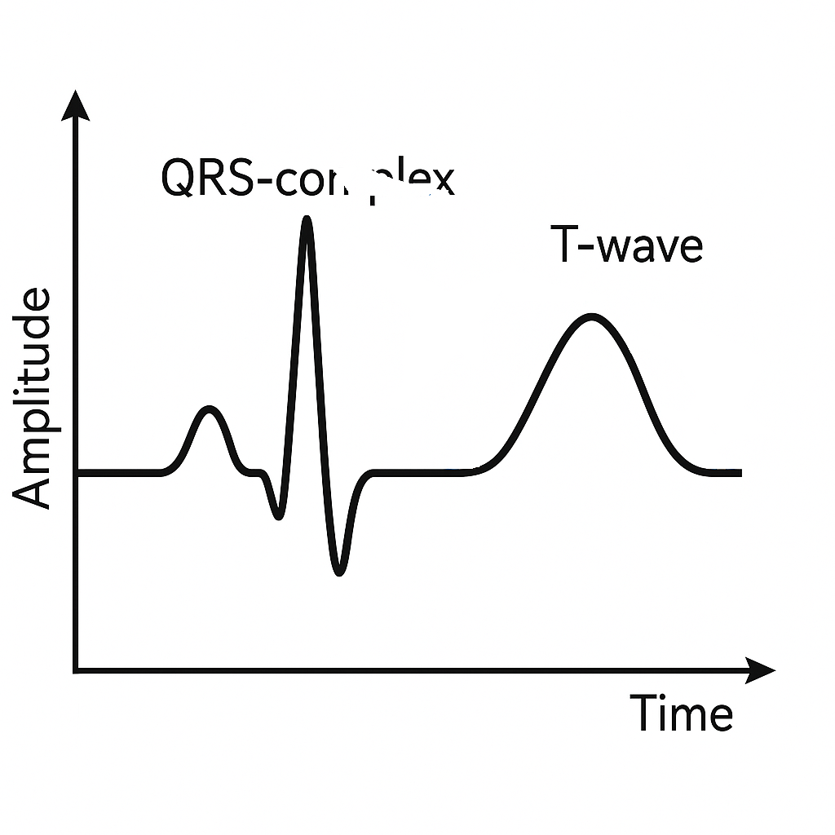
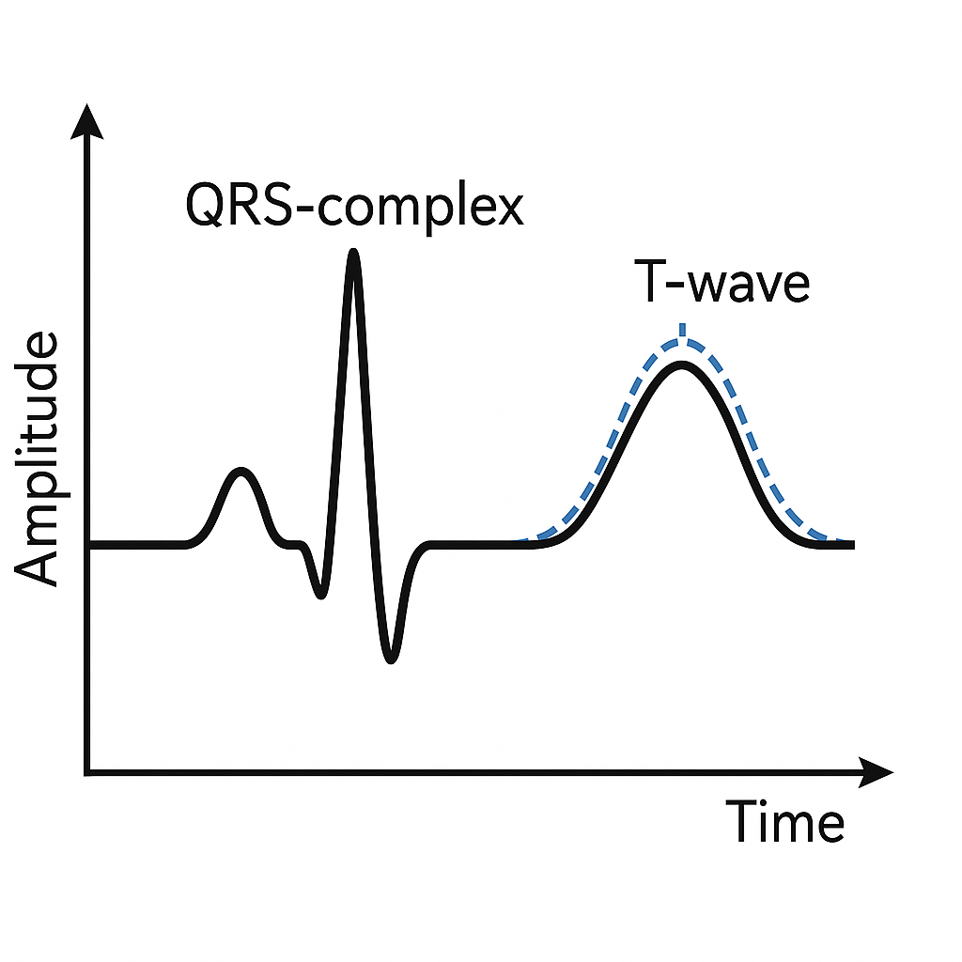
The problem
T-wave
For this reason a common task is to separate the T-wave from the QRS-complex
Hz
0
8
10
50
The problem is that these two waves overlap in the frequency domain
QRS-wave

Slide 4
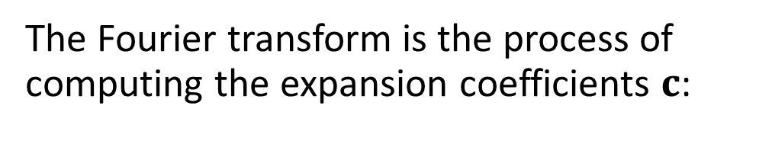
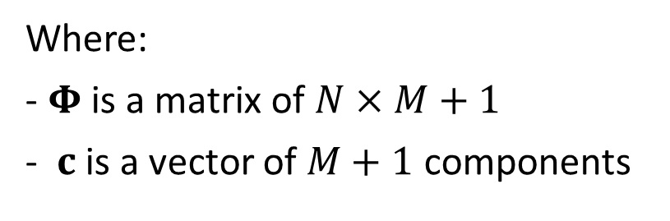


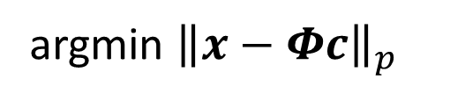
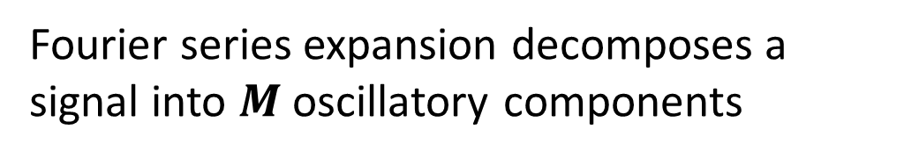
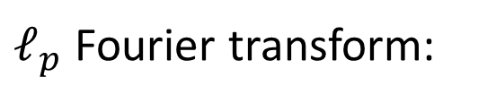
The discrete Fourier series
$(M≤N$)
coefficients
$$x_{apx}[n]= \sum_{k=−\left\lfloor \frac{M}{2}\right\rfloor }^{\left\lfloor \frac{M}{2}\right\rfloor }{c_{k}φ_{k}[n]}$$
Fourier series expansion decomposes a signal into $M$ oscillatory components
exponential basis
The Fourier transform is the process of computing the expansion coefficients $c$:
Vector notation:
$$x_{apx}=Φc$$
Where:
- $Φ$ is a matrix of $N×M+1$
- $c$ is a vector of $M+1$ components
$ℓ_{p}$ Fourier transform:
argmin ${\left\|x−Φc\right\|}_{p}$
c
Notes:
La sommatoria parte da –M/2 per includere anche componenti negative che servono per la rappresentazione e inoltre si sfrutta la proprietà di fourier della simmetria dove ci basta conoscere la prima metà positiva e negativa per avere l’intero segnale ricostruito

Slide 5




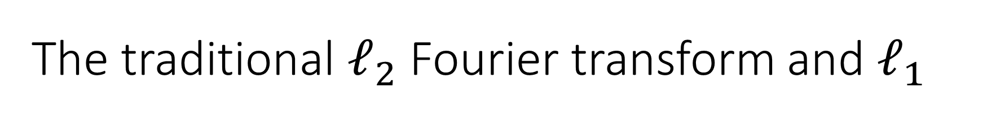














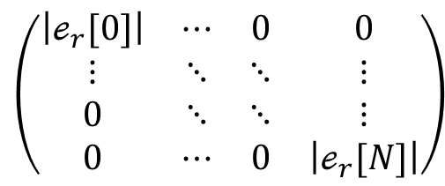




The traditional $ℓ_{2}$ Fourier transform and $ℓ_{1}$
$$ℓ_{2}−Fourier transform$$
$$ℓ_{1}−Fourier transform$$
The analytical formula for the coefficients:
Using majorization minimization approach:
$$c={\left(Φ^{H}Φ\right)}^{−1}Φ^{H}x$$
$$c^{(r+1)}={\left(Φ^{H}Λ_{r}^{−1}Φ\right)}^{−1}Φ^{H}Λ_{r}^{−1}x$$
$$={ Φ}^{H}x$$
$(Φ$ is orthogonal$)$
With:
$ℯ_{r}=x−x_{M}^{(r)}$
$⁡(\frac{𝒾2π}{N}1∙1)$
$⁡(\frac{𝒾2π}{N} ∙ )$
$$ℯ$$
$$⋯$$
$$1$$
$$M+1$$
$$ℯ$$
$$Φ_{N×M+1}=$$
$$\left(\begin{matrix}\left|ℯ_{r}[0]\right| & ⋯ & 0 & 0 \\ ⋮ & ⋱ & ⋱ & ⋮ \\ 0 & ⋱ & ⋱ & ⋮ \\ 0 & ⋯ & 0 & \left|ℯ_{r}[N]\right|\end{matrix}\right)$$
$$⋮$$
$$⋱$$
$$⋮$$
$Λ_{r}=$
$⁡(\frac{𝒾2π}{N} ∙1)$
$⁡(\frac{𝒾2π}{N} ∙ )$
$$N$$
$$⋯$$
$$N$$
$$M+1$$
$$ℯ$$
$$ℯ$$
Notes:
$Λ$ è lambda

Slide 6
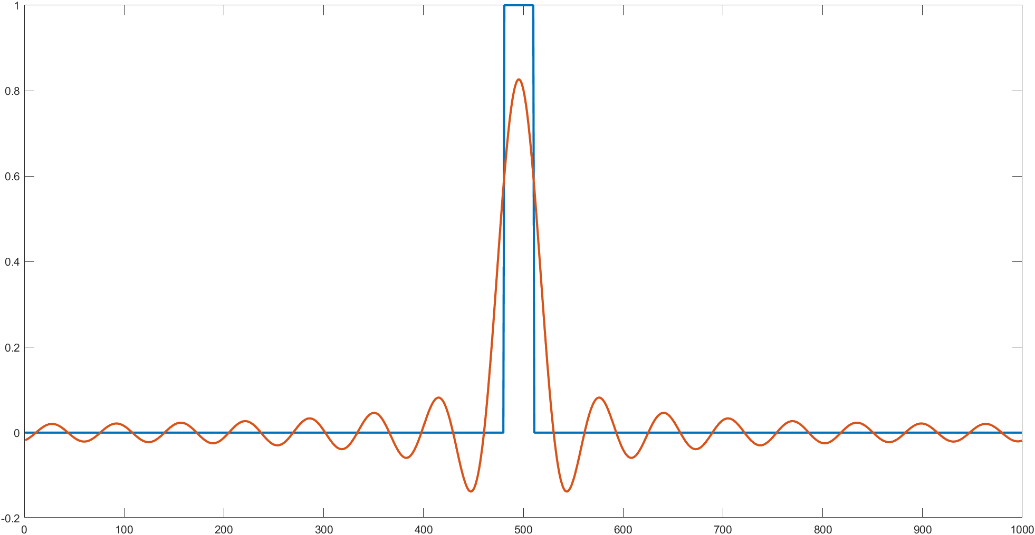


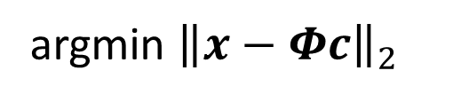
Some $ℓ_{2}$ problems
$$ℓ_{2}=$$
argmin ${\left\|x−Φc\right\|}_{2}$
each component of the error is squared
c
The error values are squared, making the sum more sensitive to large errors
As a result, some parts of the outliers are mixed with the slow components
Notes:
Siccome ogni componente della differenza (errore) è ^2, gli errori più grandi verranno ingranditi ancora di più

Slide 7
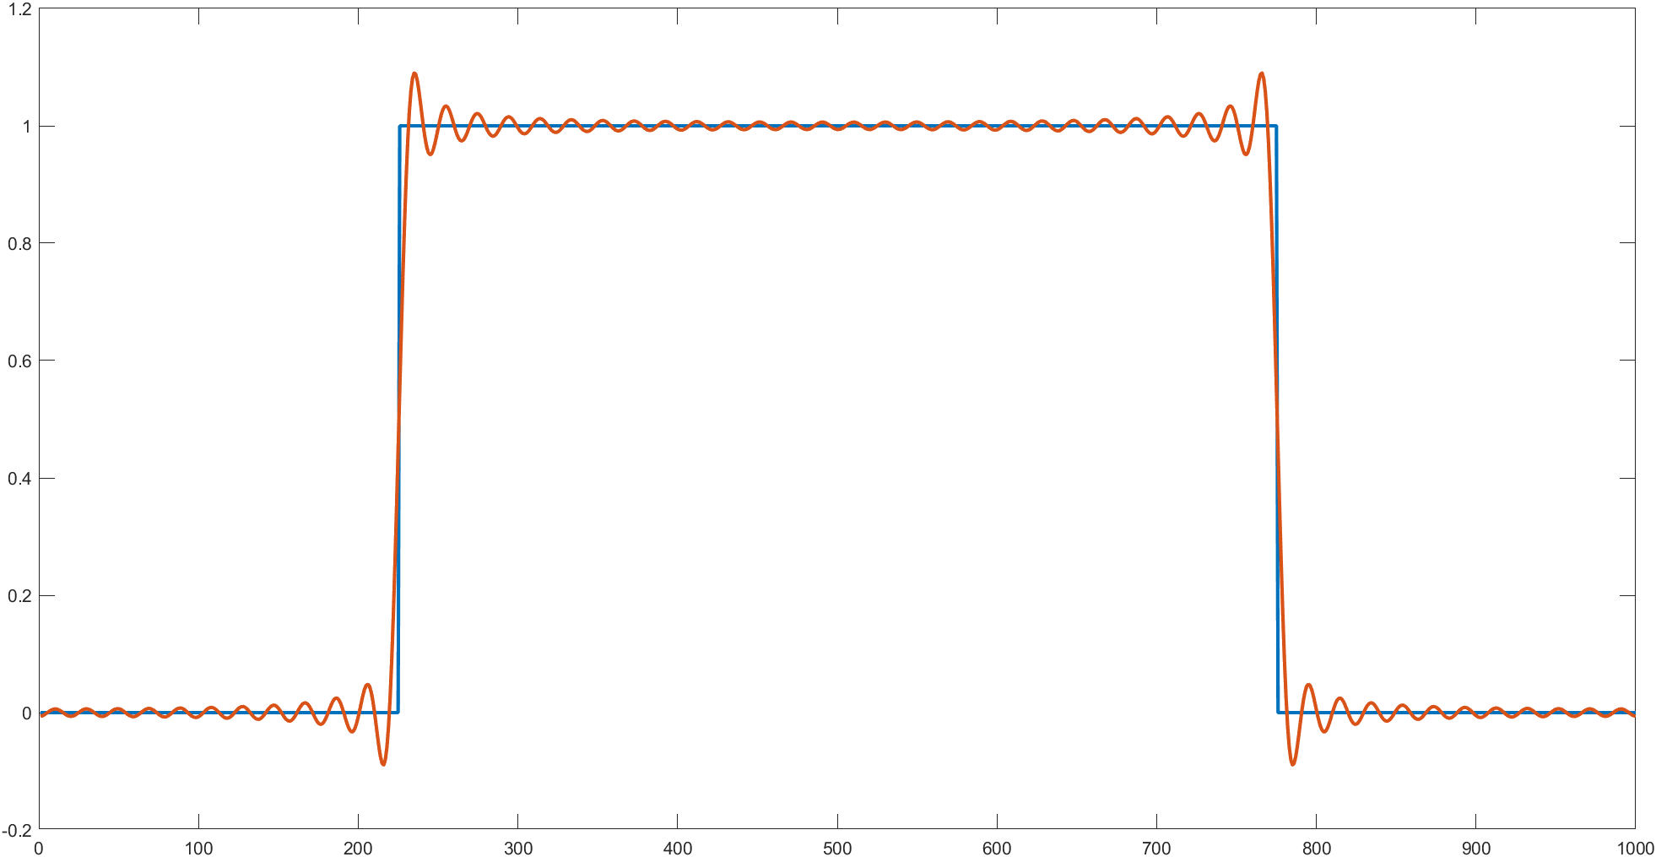
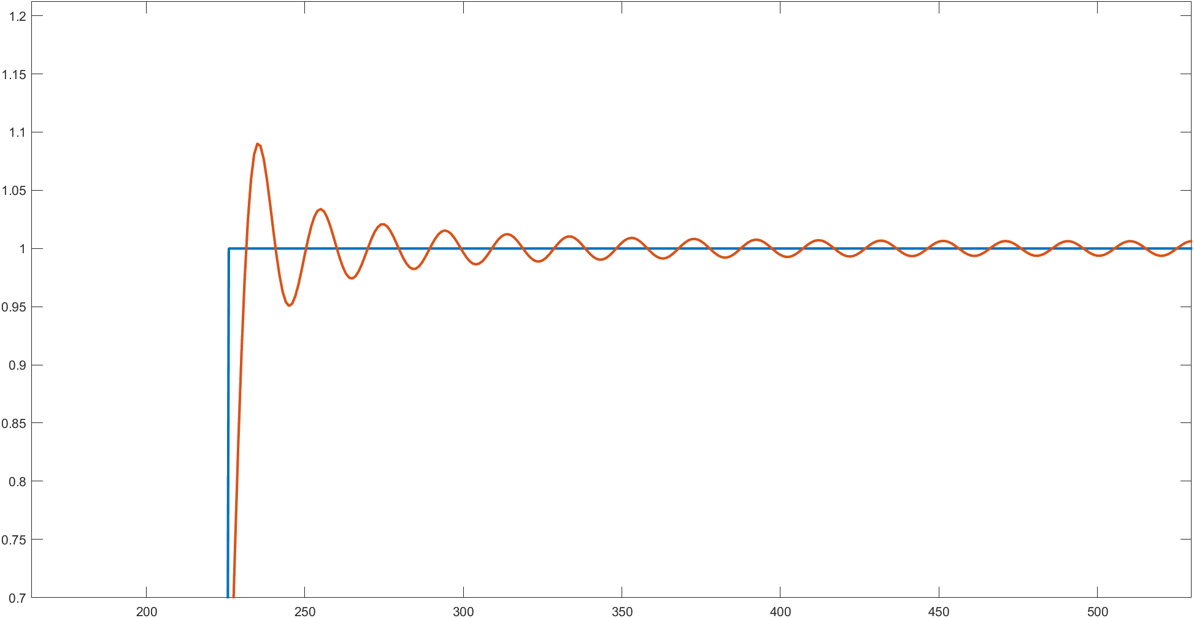
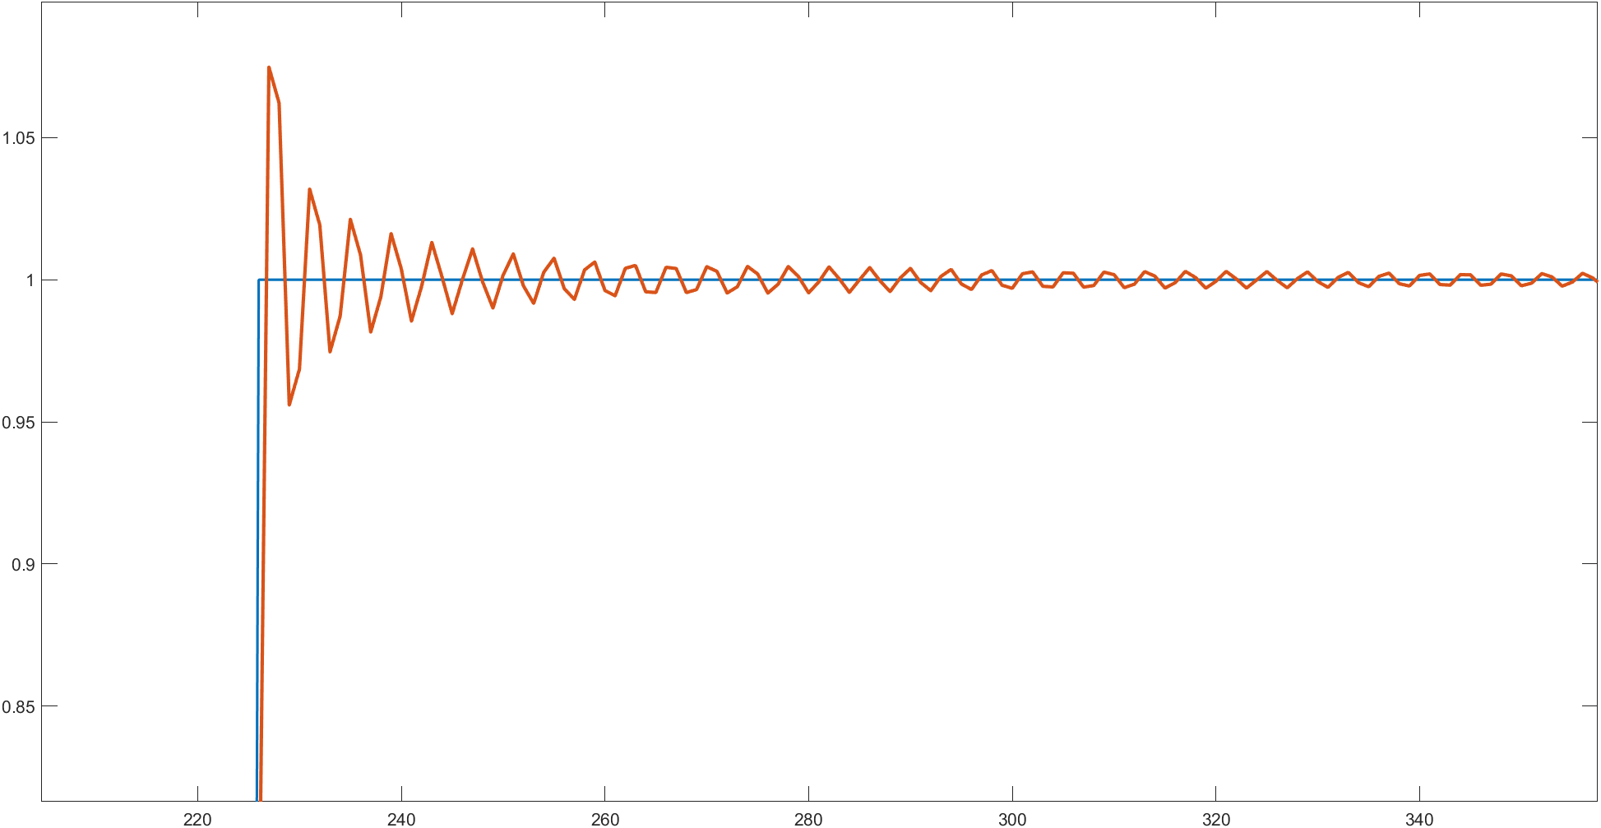
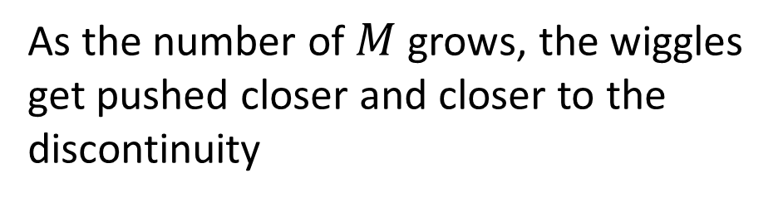
The Gibbs phenomenon
The Gibbs phenomenon is the oscillatory behavior of the Fourier series that produces large peaks around a jump discontinuity which overshoot and undershoot the function values
As the number of $M$ grows, the wiggles get pushed closer and closer to the discontinuity
Notes:
The wiggles have a 9% more size of the overshoot

Slide 8
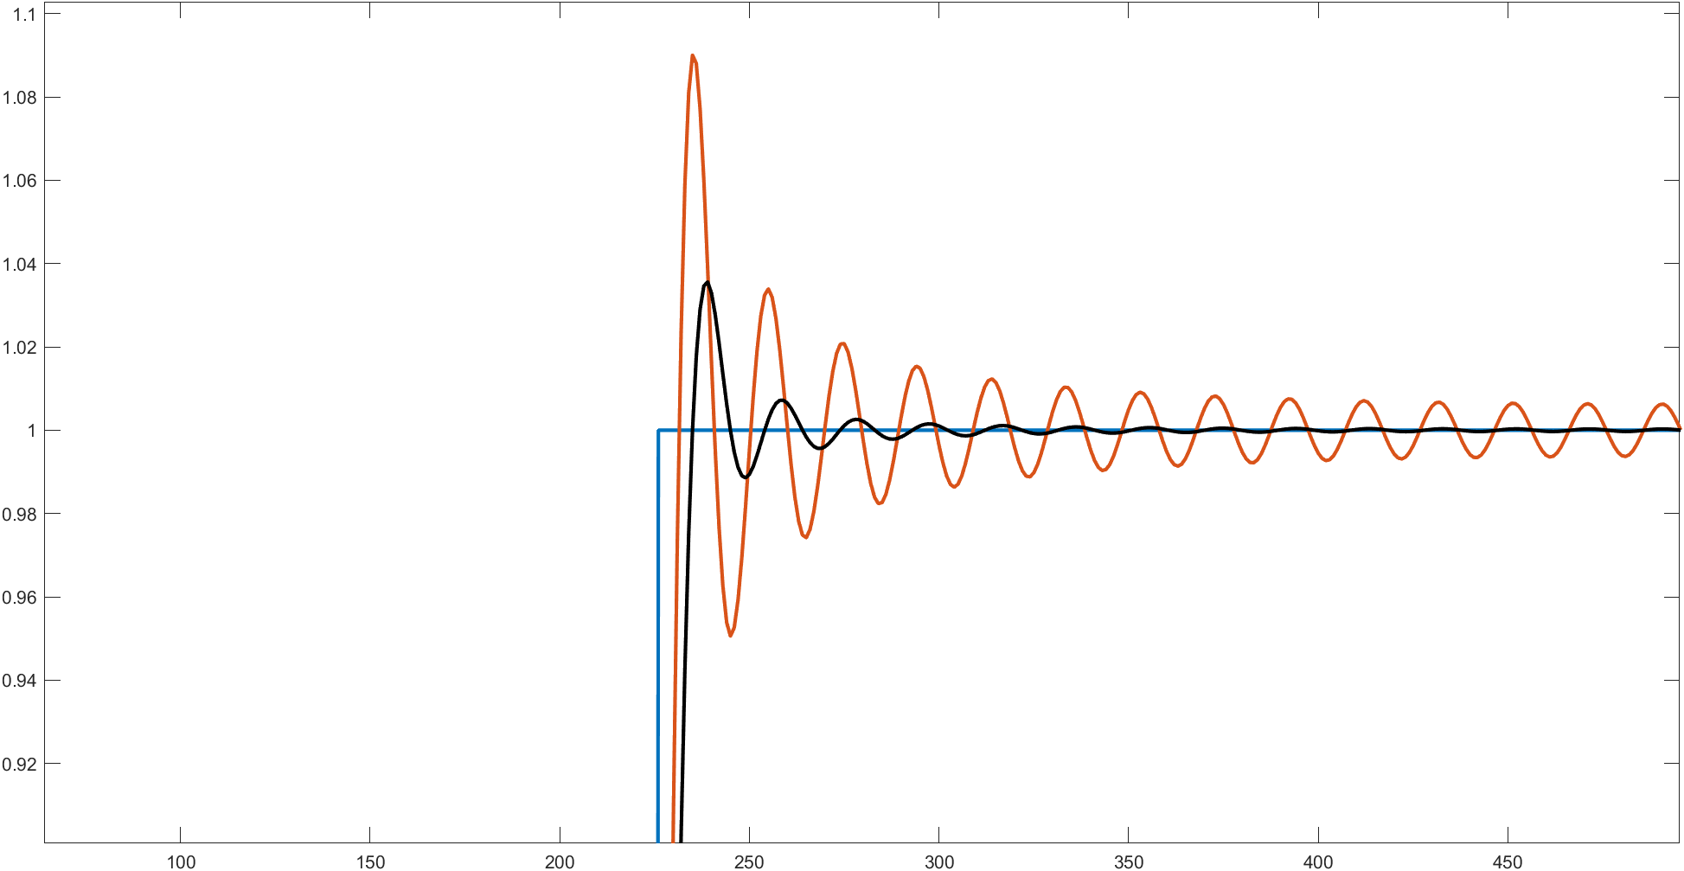
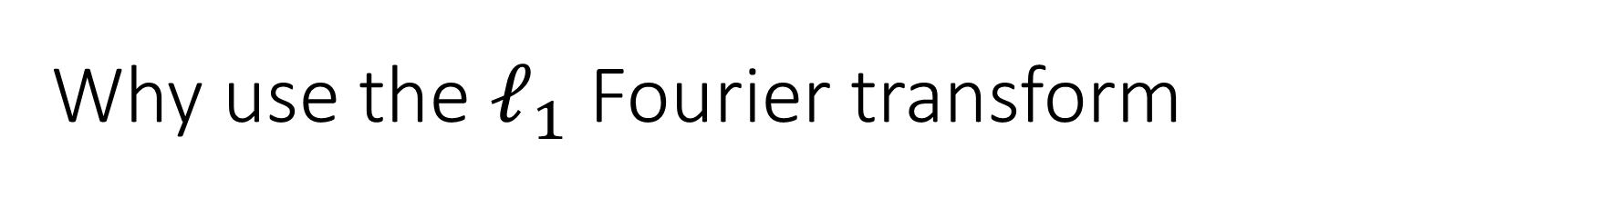
Why use the $ℓ_{1}$ Fourier transform
An evident reduction in the Gibbs phenomenon

Slide 9
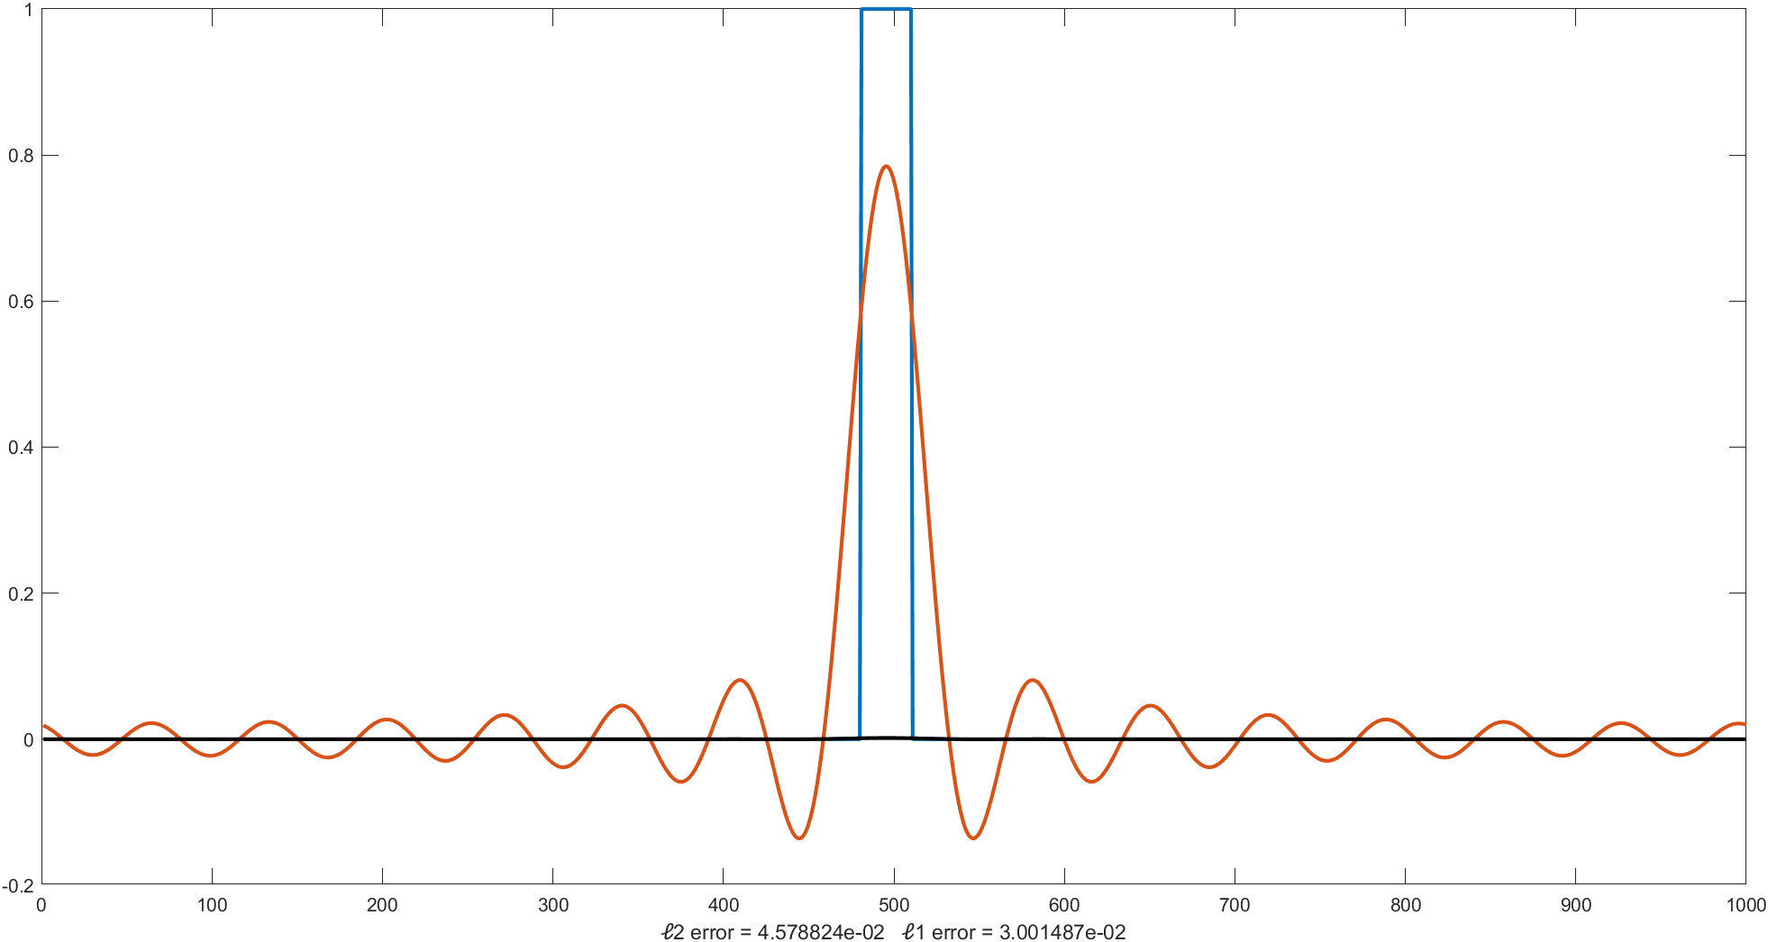
Why use the $ℓ_{1}$ Fourier transform
An improved signal stability and greater robustness to impulsive noise

Slide 10
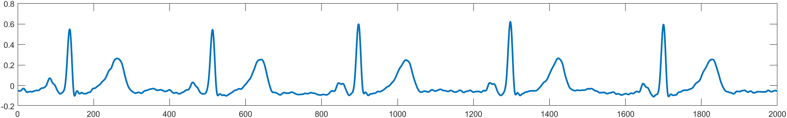
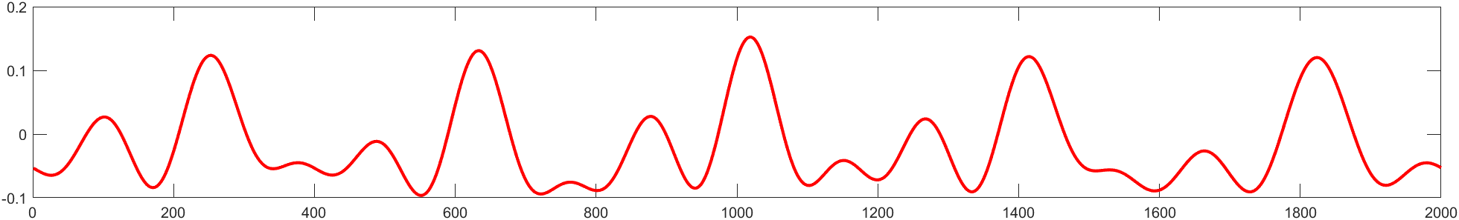
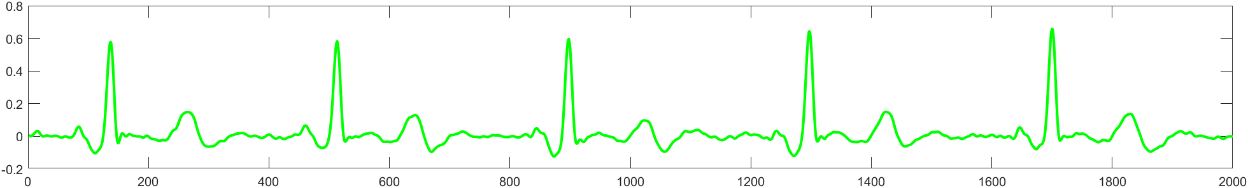
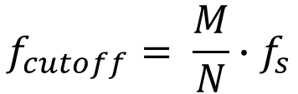



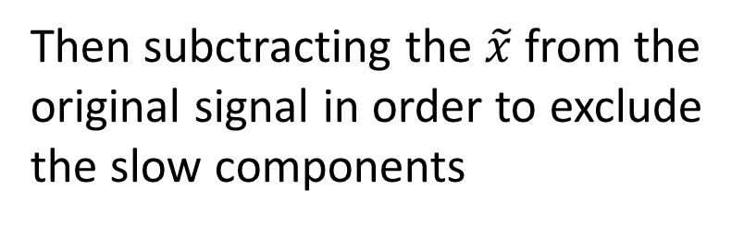
How to separate T-wave and QRS-complex?
The separation consists in reconstructing the original signal with a cutoff frequency at 8 Hz
$$x$$
-
The formula is:
$$\tilde{x}$$
$$f_{cutoff}= \frac{M}{N}∙f_{s}$$
=
Then subctracting the $\tilde{x}$ from the original signal in order to exclude the slow components
$$x−\tilde{x}$$

Slide 11
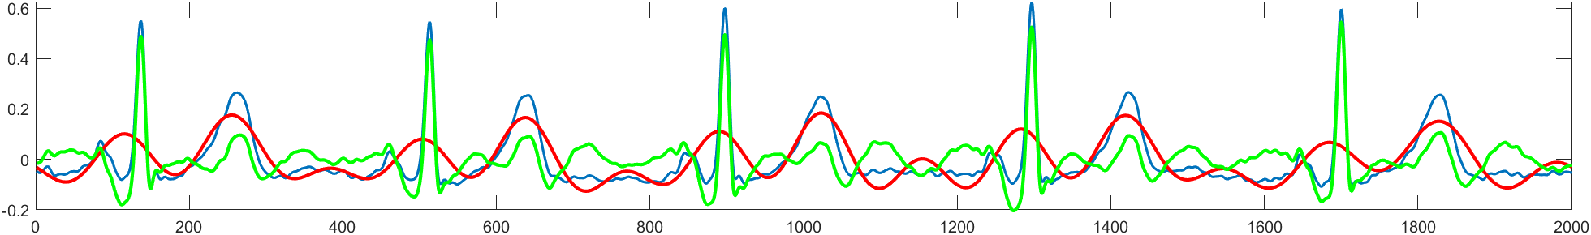
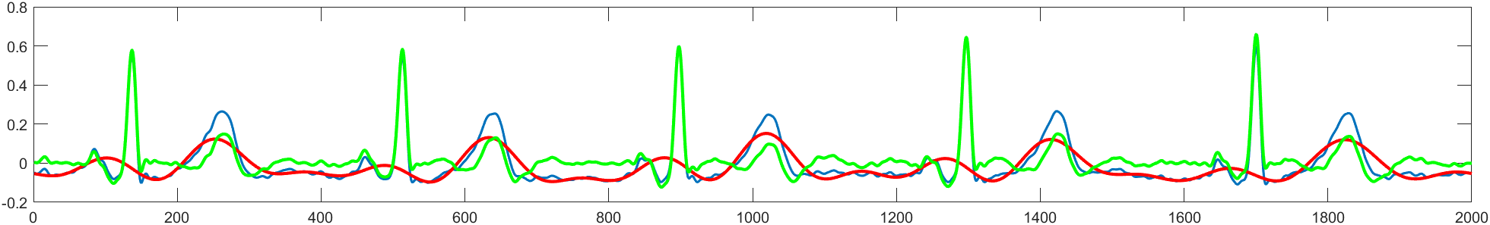
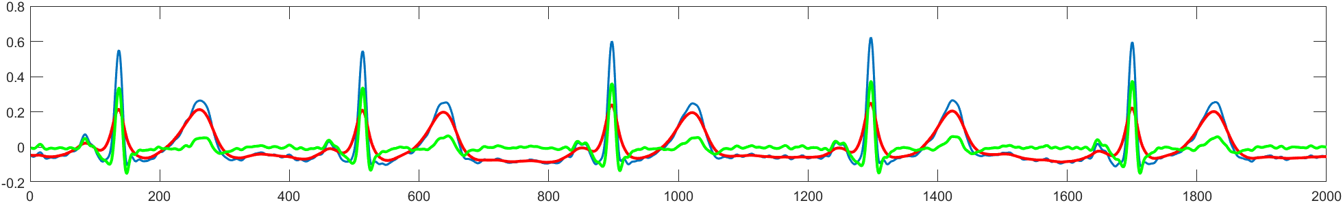



Some examples of T-wave detection
$ℓ_{2}$
0.0558
$ℓ_{1}$
0.0467
$butterworth$
0.0457

Slide 12
ECG of a patient without heart disease
$ℓ_{2}$
0.0558
$ℓ_{1}$
0.0467
$butterworth$
0.0457

Slide 13
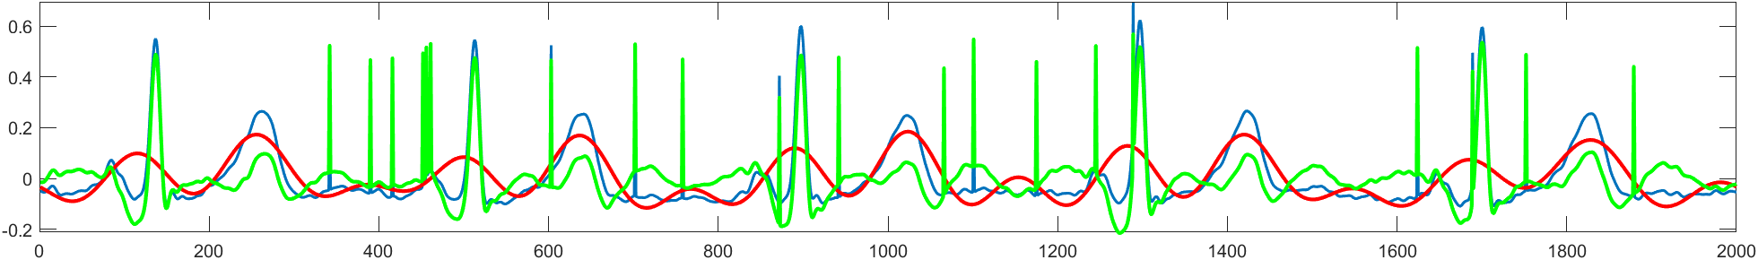
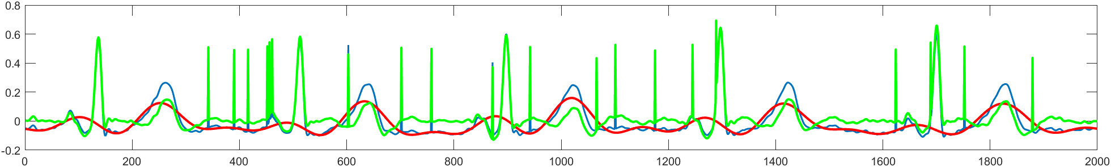
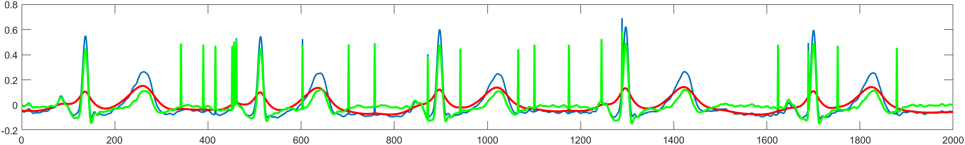



ECG of a patient with random spike noise
$ℓ_{2}$
$ℓ_{2}$
0.0608
$ℓ_{1}$
$ℓ_{1}$
0.0514
$butterworth$
$butterworth$
0.0529

Slide 14
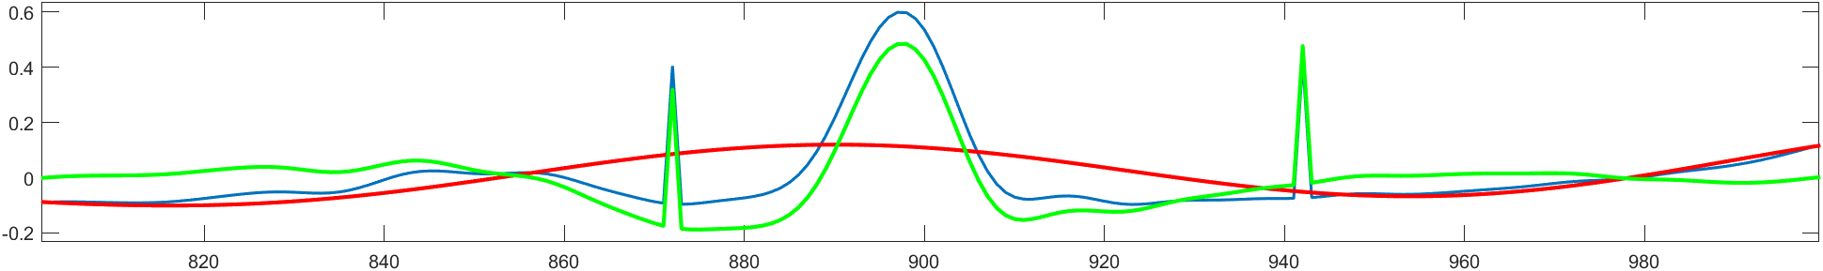
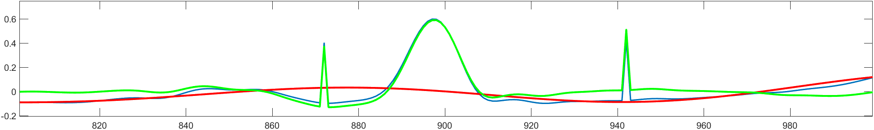
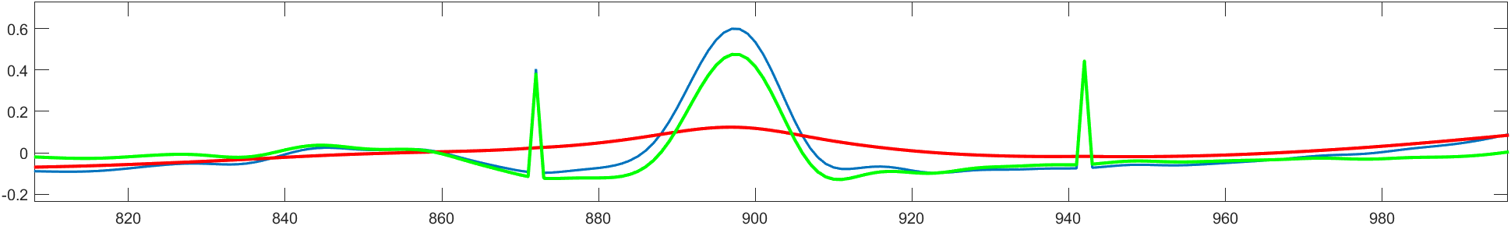



ECG of a patient with random spike noise
$ℓ_{2}$
$ℓ_{2}$
0.0608
$ℓ_{1}$
$ℓ_{1}$
0.0514
$butterworth$
$butterworth$
0.0529

Slide 15
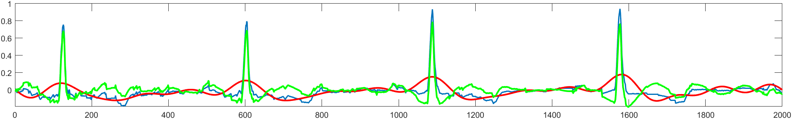
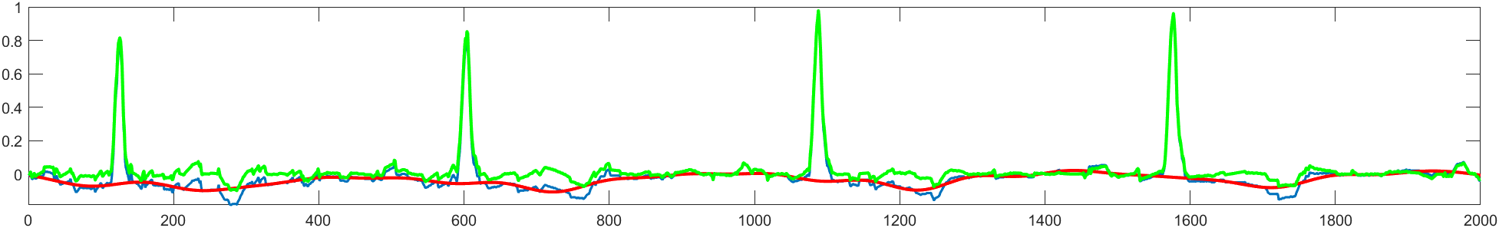
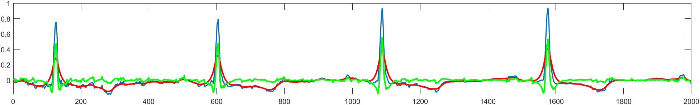
ECG of a patient with ventricular hypertrophy
$ℓ_{2}$
0.0542
$ℓ_{1}$
0.0381
$butterworth$
0.0246

Slide 16
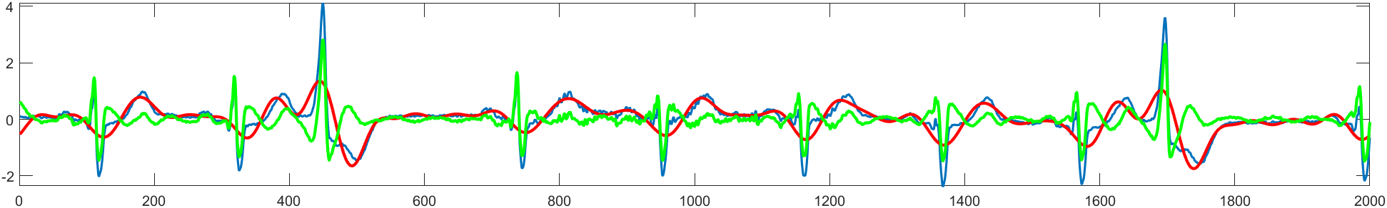
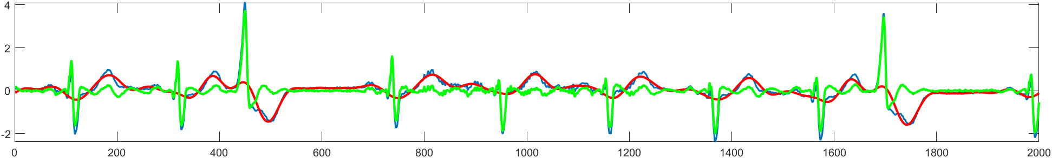
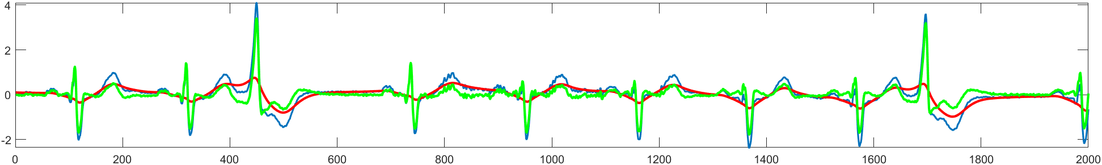
ECG of a patient with Atrial fibrillation
$ℓ_{2}$
0.2226
$ℓ_{1}$
0.1891
$butterworth$
0.1046

Slide 17
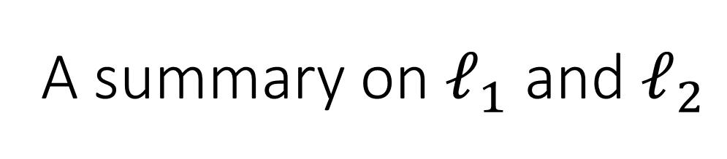
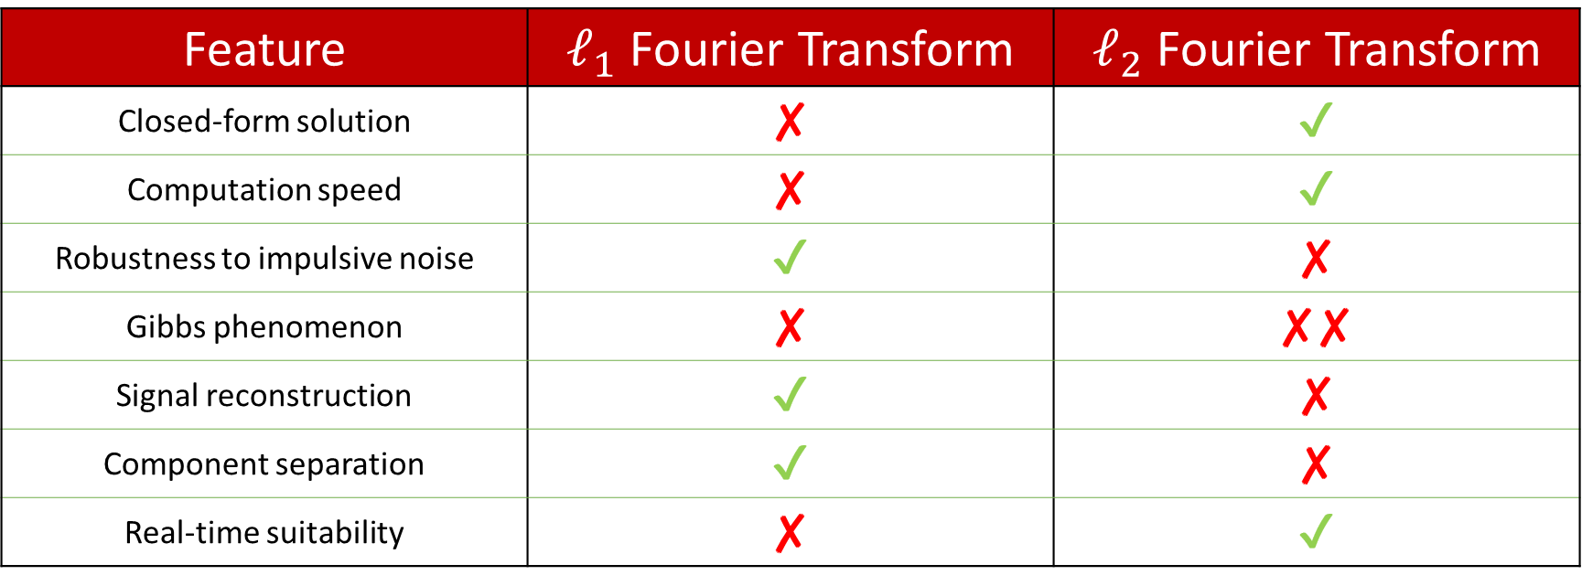
A summary on $ℓ_{1}$ and $ℓ_{2}$
Feature | $ℓ_{1}$ Fourier Transform | $ℓ_{2}$ Fourier Transform
Closed-form solution | ✘ | ✔
Computation speed | ✘ | ✔
Robustness to impulsive noise | ✔ | ✘
Gibbs phenomenon | ✘ | ✘✘
Signal reconstruction | ✔ | ✘
Component separation | ✔ | ✘
Real-time suitability | ✘ | ✔

