Slide 1
Decorator Pattern
Made by
Marcus Bech (au575154),
Marie Louise (au543213),
Thomas Bærentsen (au) and
Martin Krøjmand (au)

Slide 2
About the Decorator Pattern
Wrapper
Components
Decorators

Slide 3
Pizza example

Slide 4
SOLID
Single Responsibility Principle
Open-Closed Principle
Liskov Substitution Principle

Slide 5
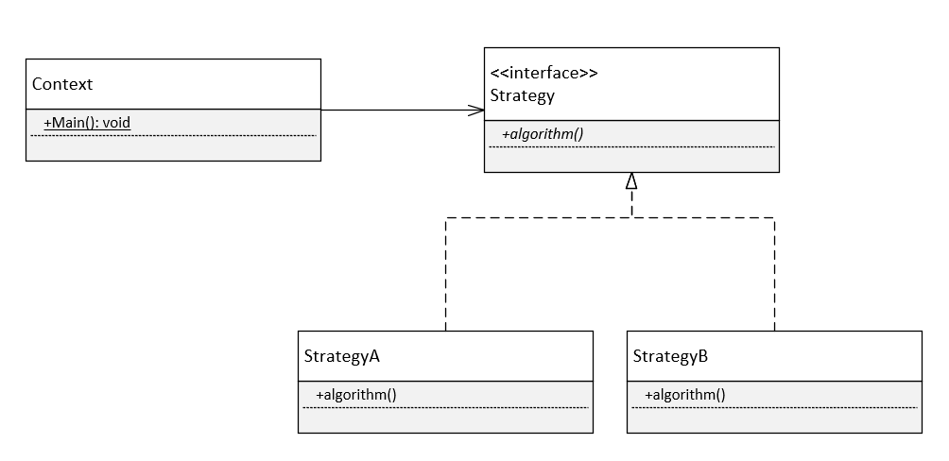
Comparison
Composite Pattern
Composite Pattern

Slide 6
Usage today
Frameworks
WPF

Slide 7
Conclusion

