Slide 1
Decorator Pattern
Made by Group 11
Marcus Bech (au575154),
Marie Louise (au543213),
Thomas Bærentsen (au554955) and
Martin Krøjmand (au593758)
Thomas Bærentsen (au554955) talks

Slide 2
About the Decorator Pattern
Components
Decorators
Wrapper
Thomas Bærentsen (au554955) talks

Slide 3
Pizza example
Marie Louise (au543213) talks

Slide 4
SOLID
Single Responsibility Principle
Open-Closed Principle
Liskov Substitution Principle
Martin Krøjmand (au593758) talks

Slide 5
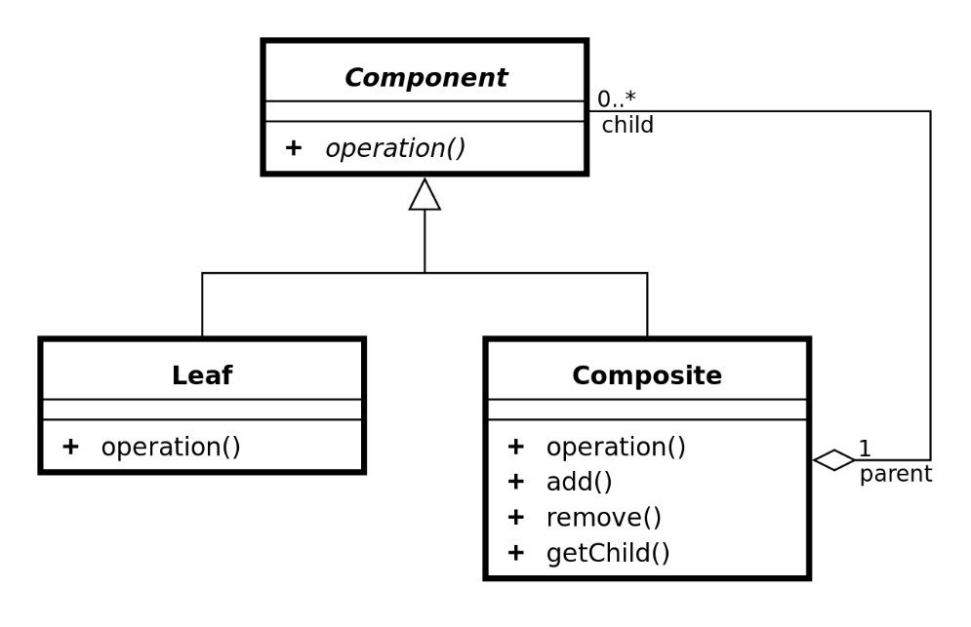
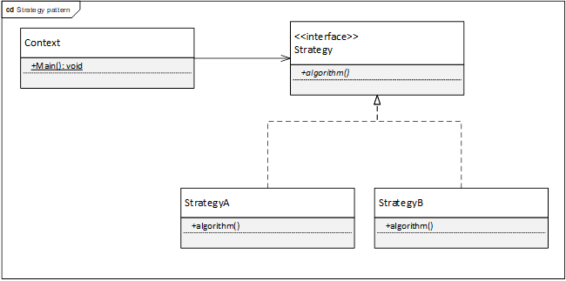
Comparison
Composite Pattern
Strategy Pattern

Slide 6
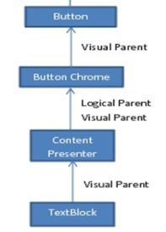
Usage today
Frameworks
WPF

Slide 7
Conclusion
Extends functionality
Structured like layers
Disadvantage: limitation
Apply SOL
Fat abstract class
Avoiding class explosion
Marcus Bech (au575154) talks

