Slide 1
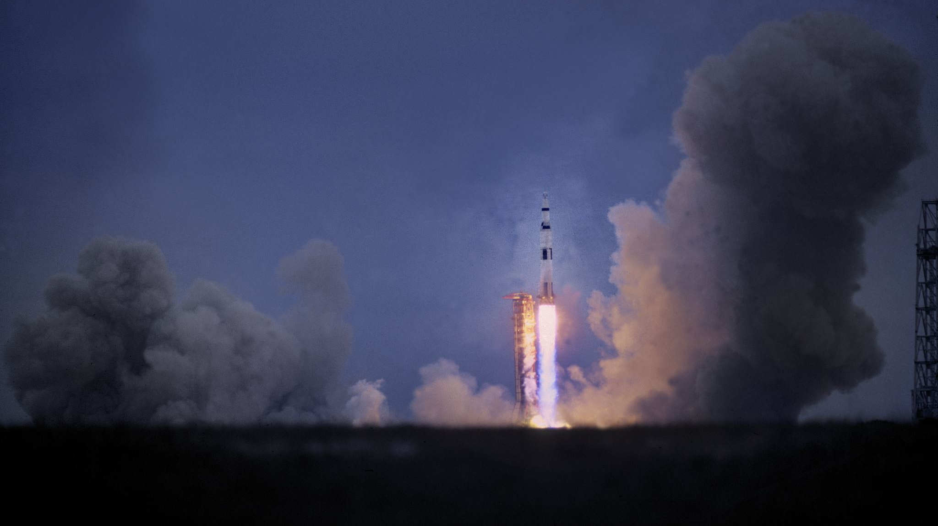
SpaceX Launch Analysis: Data Science Capstone Presentation

Slide 2

1. Executive Summary
Explored SpaceX launch performance using multiple data sources (API, Wikipedia, CSV).
Applied web scraping, SQL, Folium, and machine learning.
Developed interactive dashboard with Plotly Dash.
Achieved 83.33% accuracy across all classifiers.
Delivered key insights on launch site performance, success patterns, and booster versions.

Slide 3

2. Introduction & Objective
Objective: Analyze SpaceX launches to identify success drivers.
Tools: Python, Pandas, BeautifulSoup, Folium, SQL, Plotly, scikit-learn.
Scope: From data extraction to predictive modeling.

Slide 4
3. Data Collection
NASA/SpaceX API used to extract booster-related metadata.
Wikipedia scraped for launch records (launch site, date, outcome).
CSV files used for integration and formatting.

Slide 5
4. Data Wrangling
Cleaned column names, handled missing values.
01
Created binary success label (Class).
02
Extracted booster name, launch date, payload mass, and site info.
03

Slide 6

6. Predictive Modeling: Methods
Standardized features using StandardScaler.
Trained and validated 4 models: Logistic Regression, SVM, Decision Tree, KNN.
Used GridSearchCV with 10-fold cross-validation.

Slide 7
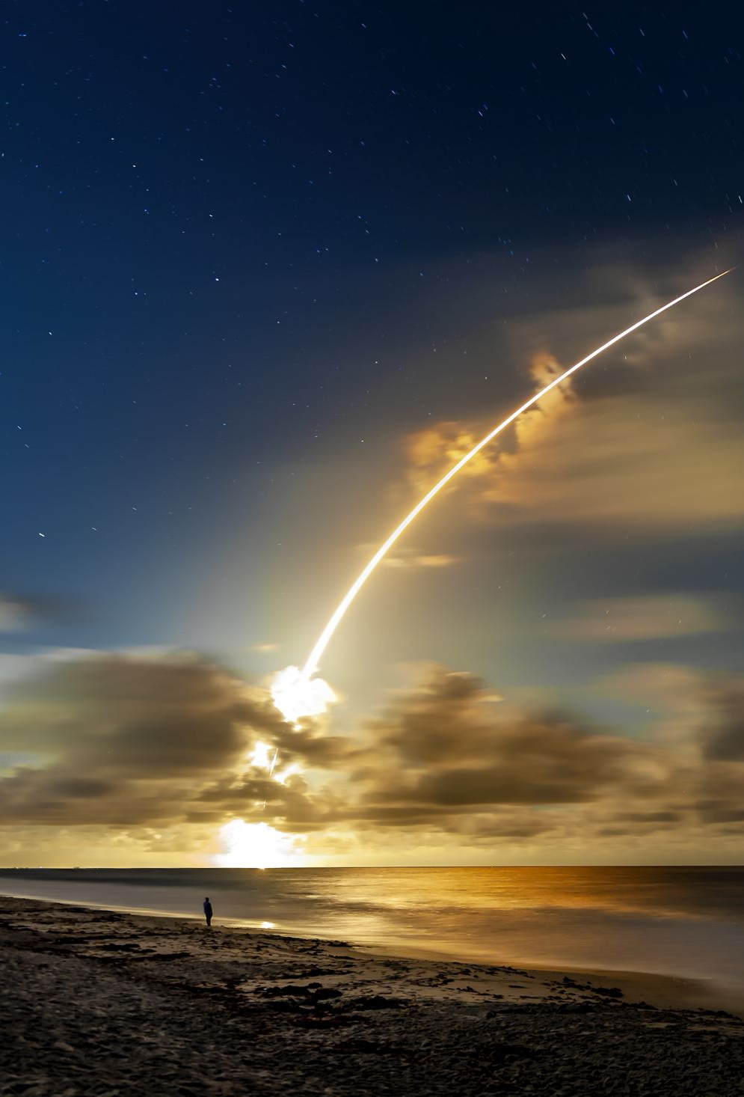
7. EDA: Visual Analysis
Launch success increased over time (FlightNumber).
GTO launches had lower success compared to LEO.
Payload Mass vs Launch Site scatter showed clustering by success.
Orbit type was a strong predictor of outcome.

Slide 8
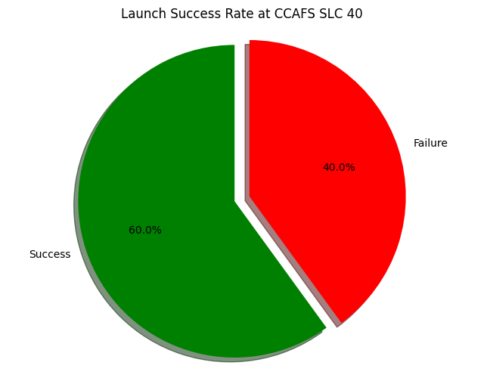
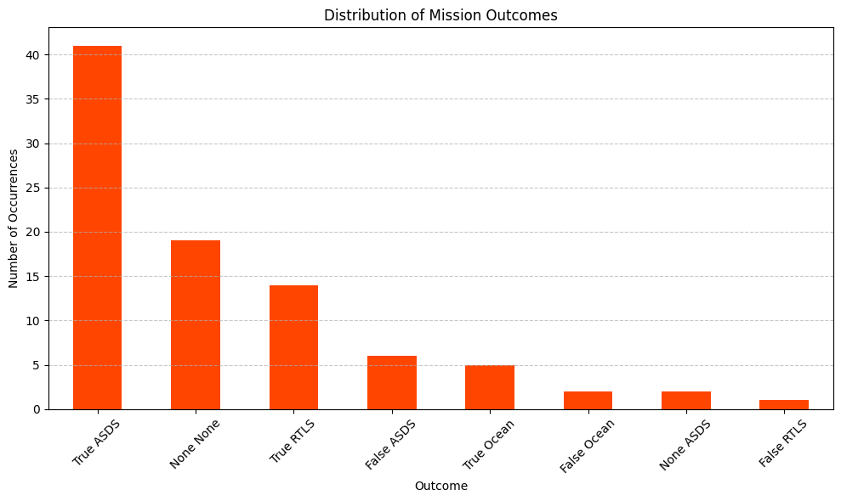
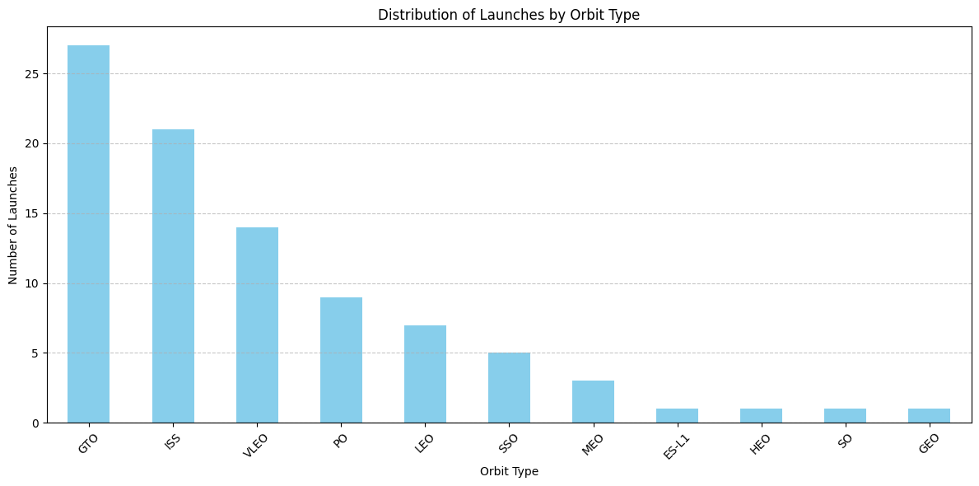
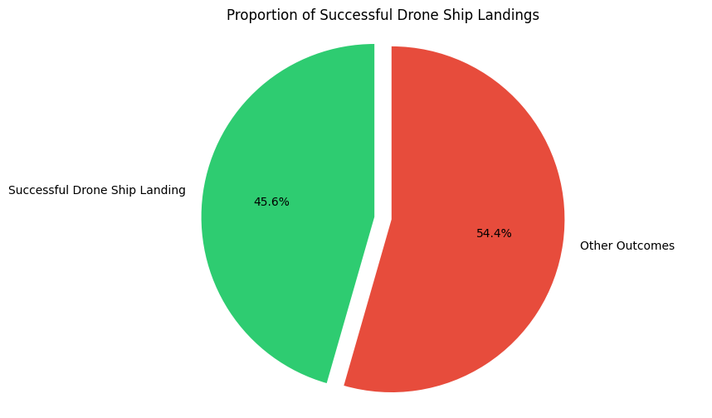
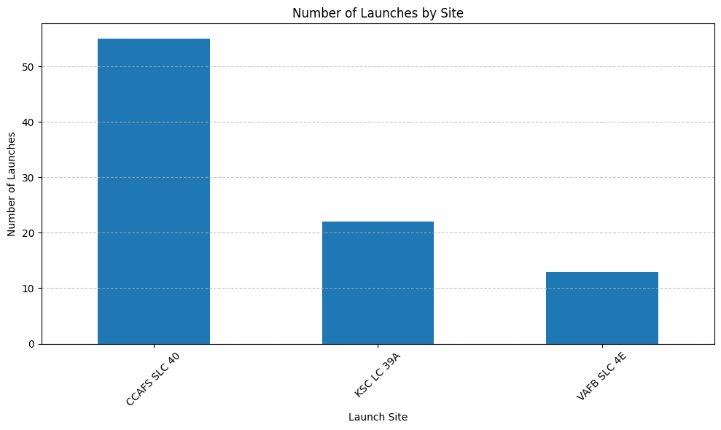

Slide 9
8. EDA: SQL Results
Queried unique launch sites and mission counts.
Filtered by payload range and outcome.
Aggregated success rates per site and booster.
Used SQLite via Python.

Slide 10

9. Interactive Map (Folium)
Mapped all launch sites with coordinates.
Colored markers by launch outcome (success/failure).
Tooltip popups showing site and status.
Great for spatial pattern recognition.

Slide 11
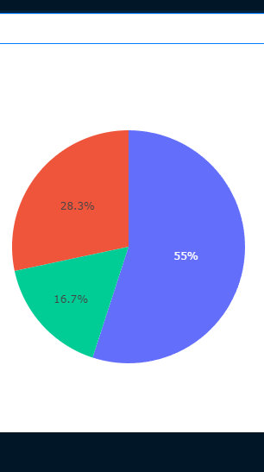
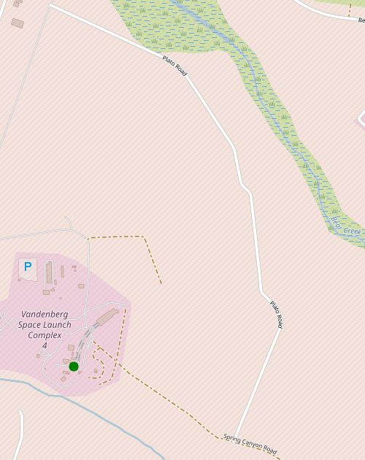
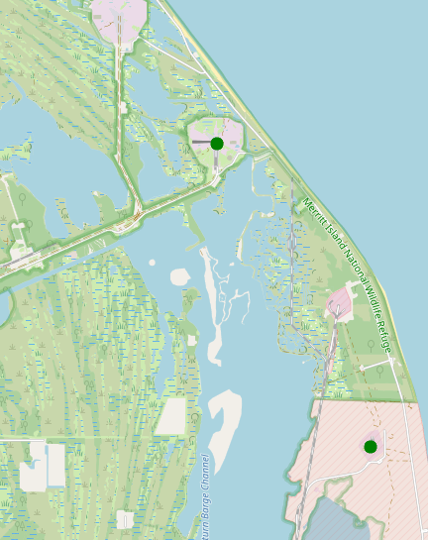

Slide 12

10. Dashboard (Plotly Dash)
Dropdown: Filter by launch site.
Range slider: Select payload range.
Pie chart: Launch success distribution.
Scatter plot: Payload vs outcome by booster version.
Fully interactive, built with Dash components.

Slide 13
11. Predictive Results
Test set had 18 samples (20% split).
All models achieved 83.33% test accuracy:
Logistic Regression
SVM (rbf kernel)
Decision Tree
KNN
Suggests high-quality, consistent data — or limited variability.

Slide 14
12. Conclusion
SpaceX launch data supports successful modeling.
Orbit and payload are key predictors of outcome.
Visual tools like Folium and Dash greatly enhance insights.
All models performed equally; future work could explore ensemble methods or time-based prediction.

Slide 15

13. Creativity & Innovation
Used real APIs + scraping + SQL + Dash.
Highlighted anomaly (equal model accuracy) as an insight.
Balanced technical rigor with clear storytelling.
https://github.com/moroianu13/IBM_Project

