Slide 1
Service Composition
Service Component Architecture
Samir Tata
Département INFormatique
TELECOM SudParis

Slide 2
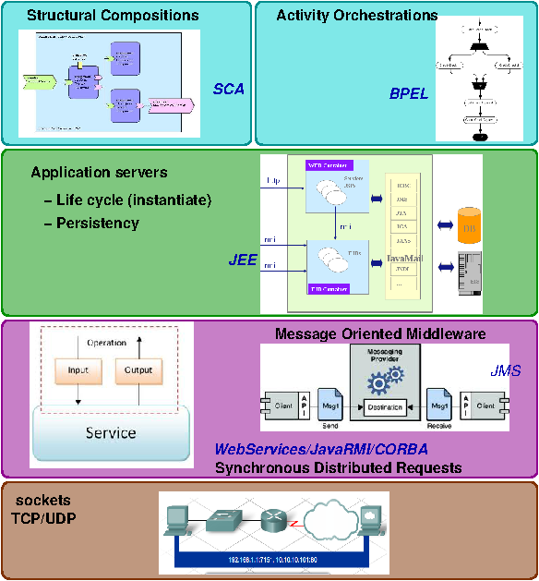

Slide 3
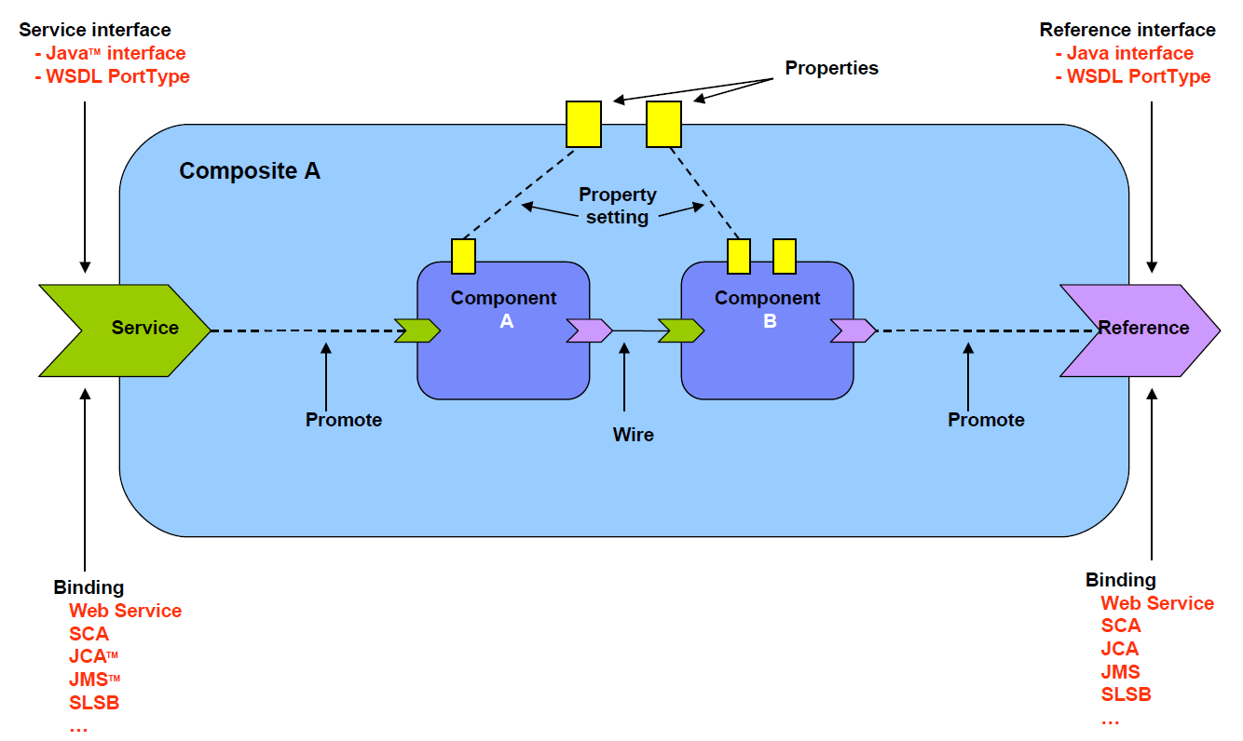
SCA Component
Implementation
C++
Java
BPEL
etc

Slide 4
SCA Component
Interface: description of business functions
  Eg: java interface, WSDL 1.1 portType, WSDL interface
Binding: access mechanisms used by services and reference
  Eg: WSDL binding, JMS binding, EJB Session bean binding
Service: externally accessible software functionality of an implementation
Reference: dependency on an external service
Property: allow for the configuration of an implementation with externally set data values
  Eg: an implementation that allows the value for ‘currency’ property to be set to any of the world currencies

Slide 5
SCA Composite
Implementation
C++
Java
BPEL
etc

Slide 6
<composite xmlns="http://www.osoa.org/xmlns/sca/1.0"
targetNamespace="http://example.org“ name=“..." >
<service name=“..." promote=“A"/>
<component name=“A">
<implementation ... />
<property name=“...">...</property>
<service name=“...">...</service>
<reference name="" target="B"/>
</component>
<component name=“B">
<implementation ... />
<property name=“...">...</property>
<property name=“...">...</property>
<service name=“...">...</service>
<reference name="“ .../>
</component>
<property name="...">...</property>
<property name="...">...</property>
<reference name="..."
promote=“B"/>
</composite>

Slide 7




Heterogeneous Assembly
PHP
BPEL
Java
Legacy
C++
  Components in the same composite share a common context for many aspects such as installation, deployment, security settings, logging behavior, etc.
Notes:
In top-down composition scenario, it is important to choose an implementation type best suited for the component functionality
In bottom-up composition scenario, reusing existing heterogeneous components is a practical need

Slide 8
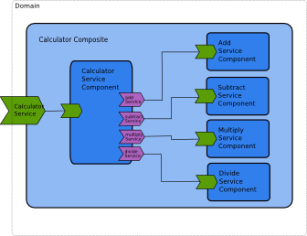
Example

Slide 9
<?xml version="1.0" encoding="UTF-8"?>
<composite>
<component name="CalculatorServiceComponent">
<implementation.java class="calculator.CalculatorServiceImpl"/>
<reference name="addService" target="AddServiceComponent" />
<reference name="subtractService" target="SubtractServiceComponent" />
<reference name="multiplyService" target="MultiplyServiceComponent" />
<reference name="divideService" target="DivideServiceComponent" />
</component>
<component name="AddServiceComponent">
<implementation.java class="calculator.AddServiceImpl"/>
</component>
<component name="SubtractServiceComponent">
<implementation.java class="calculator.SubtractServiceImpl"/>
</component>
….
</composite>

Slide 10
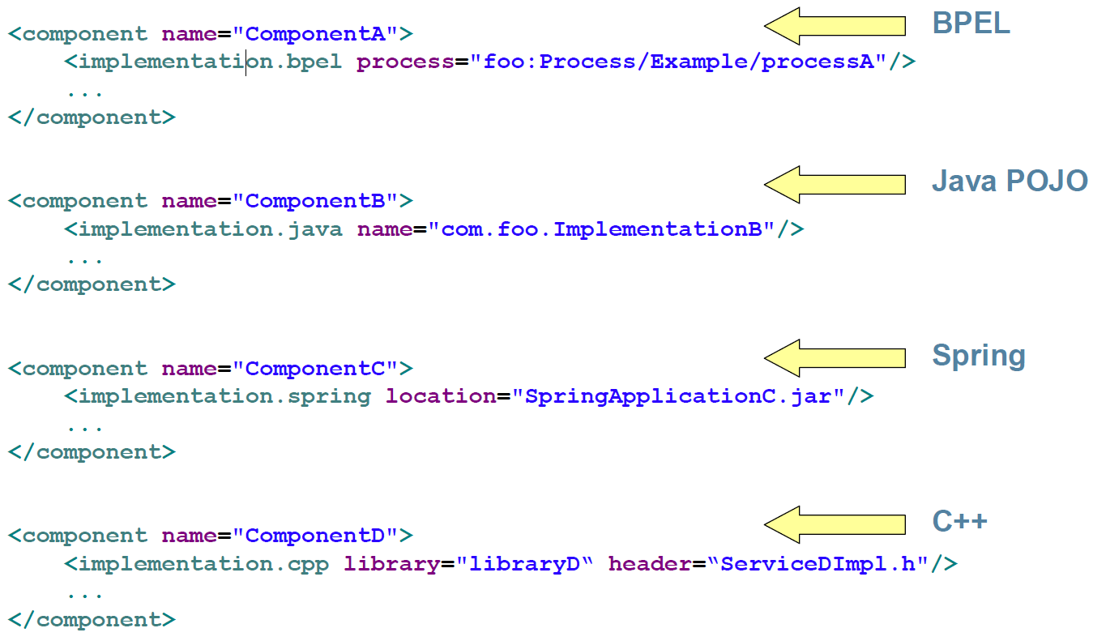
Implementation Types

Slide 11
Wiring java implementation with SCA description

Slide 12
Java Common Annotations
Java Annotations for generating corresponding componentType
Common across all Java-related specifications
Implementation annotations
  @Service, @Reference, @Property
Interface annotations
  @Callback, @Remotable, @Oneway

Slide 13
Java Annotation Example
package calculator;
import org.osoa.sca.annotations.Remotable;
@Remotable
public interface AddService {
double add(double n1, double n2);
}
package calculator;
public class AddServiceImpl implements AddService {
public double add(double n1, double n2) {
System.out.println("AddService - add " + n1 + " and " + n2);
return n1 + n2;
}
}

Slide 14
Java implementation
package calculator;
import org.osoa.sca.annotations.Reference;
public class CalculatorServiceImpl implements CalculatorService {
@Reference
private AddService addService;
…
public double add(double n1, double n2) {
return addService.add(n1, n2);
}
public double subtract(double n1, double n2) {
return subtractService.subtract(n1, n2);
}
}

Slide 15
SCA Bindings

Slide 16
SCA Bindings
Bindings
  Bindings specify how one component communicates with another.
  Specific to particular:
    Access Method / Protocol / Transport
    Serialization
    Framework
Types
  binding.ws
  binding.jsonrpc
  binding.jms
  binding.rss
  binding.ejb
  …

Slide 17
binding.ws
Service
<service name="AccountService" promote="AccountServiceComponent">
<interface.java interface="services.account.AccountService"/>
<binding.ws service="http://www.example.org/AccountService#
wsdl.endpoint(AccountService)"/>
</service>
Port
<service name="AccountService" promote="AccountServiceComponent">
<interface.java interface="services.account.AccountService"/>
<binding.ws port="http://www.example.org/AccountService#
wsdl.endpoint(AccountService/AccountServiceSOAP)"/>
</service>
URI
<service name="AccountService" promote="AccountServiceComponent">
<interface.java interface="services.account.AccountService"/>
<binding.ws uri="http://www.example.org/AccountService"/>
</service>

Slide 18
binding.ejb
<binding.ejb
homeInterface="NCName"?
ejb-link-name="NCName"?
session-type="stateful or stateless"?
ejb-version="EJB2 or EJB3"?
name="NCName"?
policySets=" sca:listOfQNames"?
requires="sca:listOfQNames"?
uri="anyURI"?
>
<!-- additional elements here -->
</binding.ejb>
<binding.ejb
uri="corbaname:rir:#ejb/JobBankServiceHome“ homeInterface="com.app.jobbank.JobBankServiceHome“
/>

Slide 19
SCA scenarios
Slides from www.oasis-open.org

Slide 20

Bottom-up Composition
Select a set of existing component implementations for building the new composite
Configure the component properties
Composite
Draw internal wires
properties
Wrap the components in a composite and configure external services/references
properties
Hand off the composite to Deployer
services
references

Slide 21
Top-down Composition
Properties
Composite
Ref
Start with gathering requirements for the top-level composite
Service
Define the services/references and properties for the composite
Ref
Break down the composite into individual components and wires between them
Recursively break down each component
Hand off the individual component contracts to developers for implementation

Slide 22
SCA
SCA tools

Slide 23
SCA Tools
Eclipse SOA Tools Project
  Outils Eclipse for SOA – SCA applications
  http://www.eclipse.org/stp/
SCA containers (application servers)
  Commercial
    IBM WebSphere,
    SAP,
    Oracle Fabric,
    BEA,
    TIBCO
  Open Source
    OW2-Frascati (ow2.org),
    Newton
    Apache Tuscany

Slide 24

Tuscany
Apache Tuscany
  Tuscany SCA Java
  Standalone runtime or deployed on WebSphere, Geronimo, Tomcat, JBoss platforms
Tuscany SCA C++
  Supports components implemented in C++, Ruby, Python or PHP
http://tuscany.apache.org
Notes:
Market view, open source competitors, Apache Tuscany

Slide 25
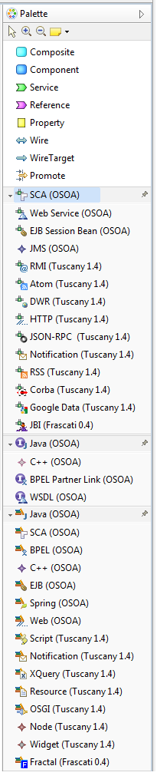
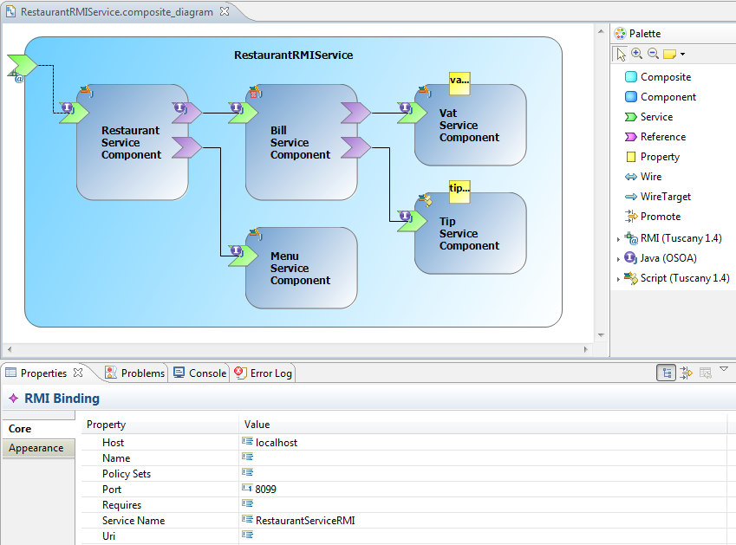
Eclipse STP SCA
Composite Designer
S²A – Les architectures orientées services

Slide 26
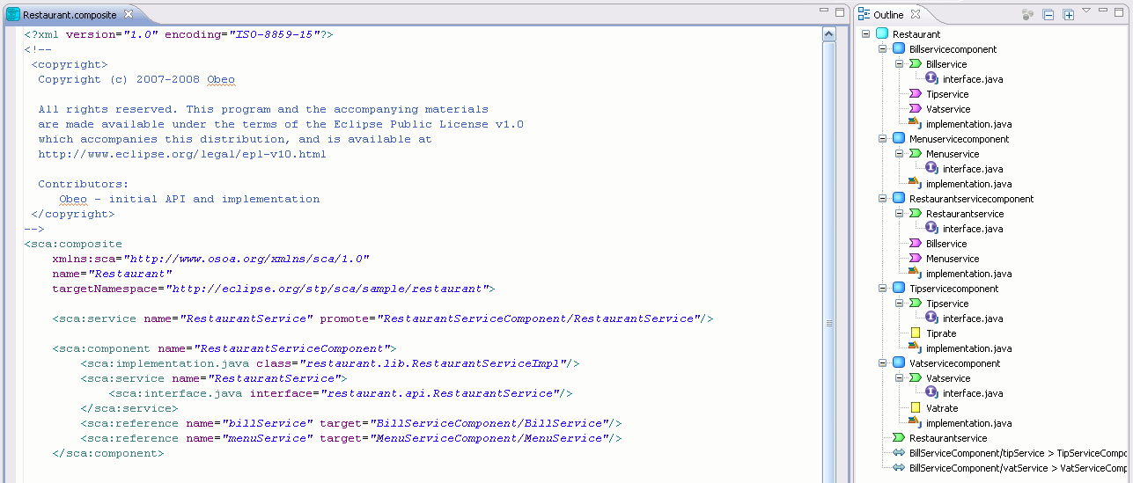
Eclipse STP SCA
XML Editor
S²A – Les architectures orientées services

Slide 27
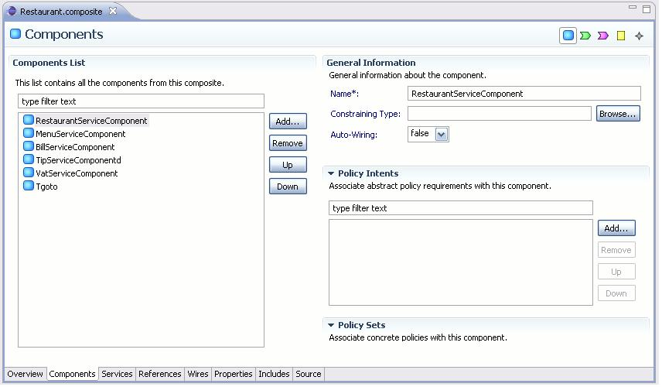
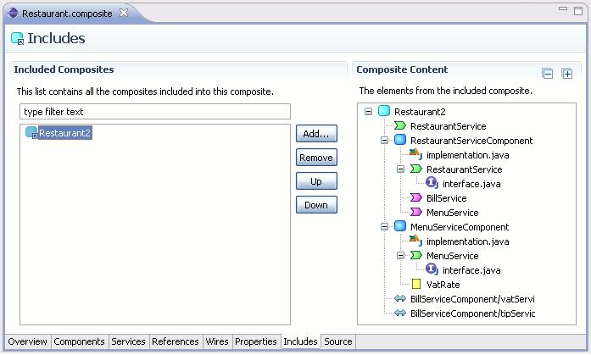
Eclipse STP SCA
Form Editor
S²A – Les architectures orientées services

