Slide 1
CSS430 Final Project Review

Slide 2
Recorded version
https://mix.office.com/watch/1wi2kogvp9zhn
THANKS to Prof. Panitz!
Instead of ~sdame, you can run from default ThreadOS/class files for Test5
Good idea to comment out the sleep() in Disk.java

Slide 3
Final Project Objective
Build a Unix-like file system on our ThreadOS

Slide 4
Collaboration, Design, Code
Form teams of two
If there is a team or two of three that is fine as well
Assign a focus for each member
One or more of the Java classes needed for the file system implementation
Do a basic system design first (document)
Design is part of deliverable
Design will be graded
After design code and test.

Slide 5
Statement of Work: SOW
Design and implement a file system in ThreadOS.
Run Test5.java.
This program will test the functionality of every class, check the data consistency and fault tolerance of your file system.
It will return a simple pass/fail test status for each of

Slide 6
What does success look like?
$ java Boot
threadOS ver 1.0:
Type ? for help
threadOS: a new thread (thread=Thread[Thread-3,2,main] tid=0 pid=-1)
-->l Test5
l Test5
threadOS: a new thread (thread=Thread[Thread-5,2,main] tid=1 pid=0)
1: format( 48 )...................Superblock synchronized
successfully completed
Correct behavior of format......................2
...
18: uwb0 read b/w Test5 & Test6...
threadOS: a new thread (thread=Thread[Thread-7,2,main] tid=2 pid=1)
Test6.java: fd = 3successfully completed
Correct behavior of parent/child reading the file...0.5
19: uwb1 written by Test6.java...Test6.java terminated
Correct behavior of two fds to the same file..0.5
Test completed

Slide 7
Files to Use
Use ThreadOS' original classes except Kernel.java and Scheduler.java
These: You need to modify

Slide 8
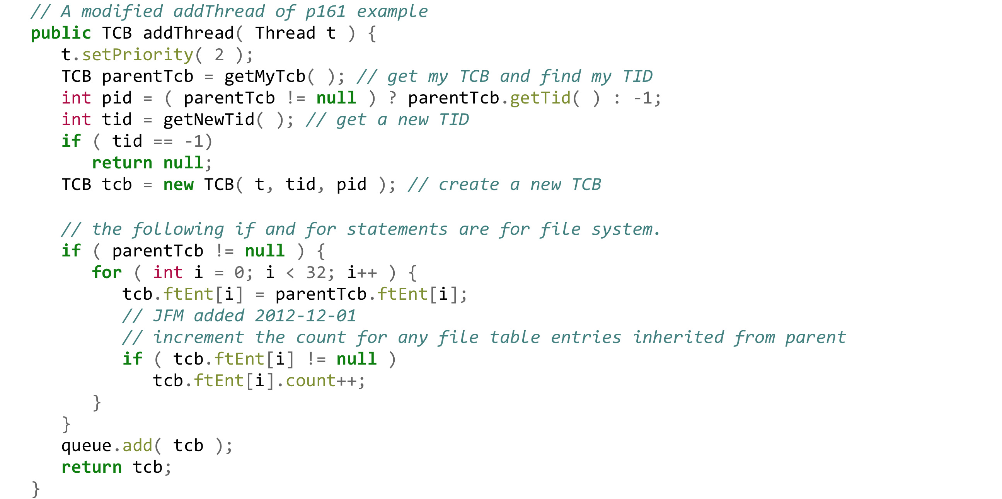
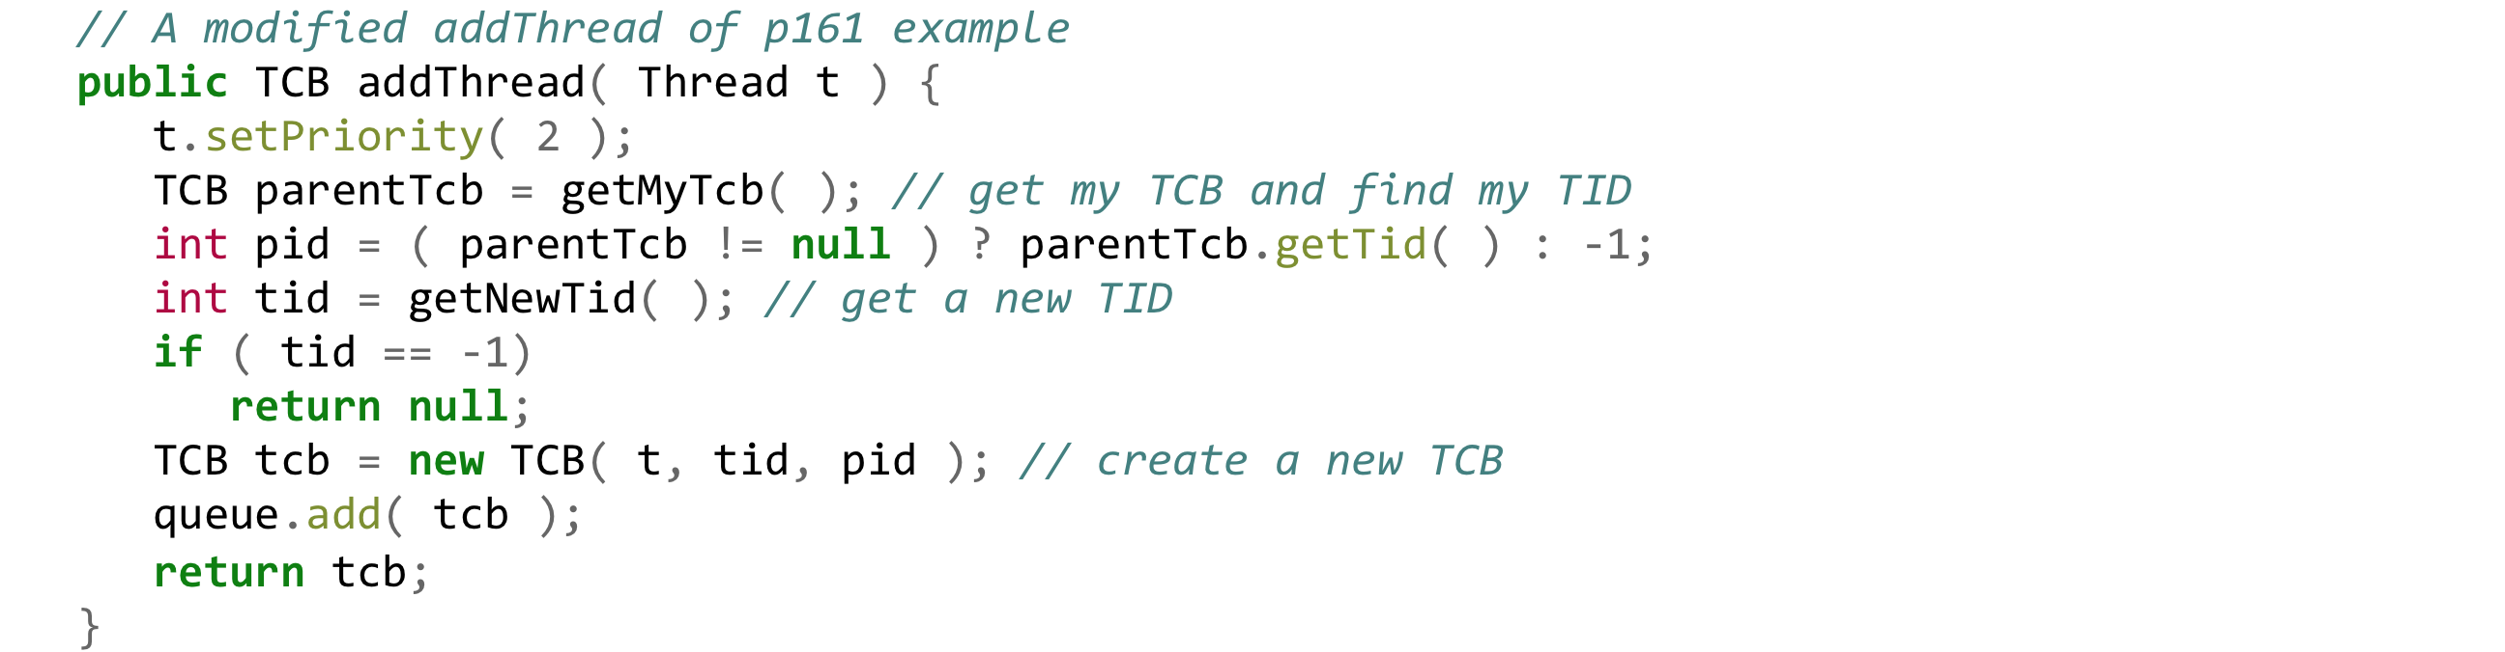
Scheduler.java
Modified

Slide 9
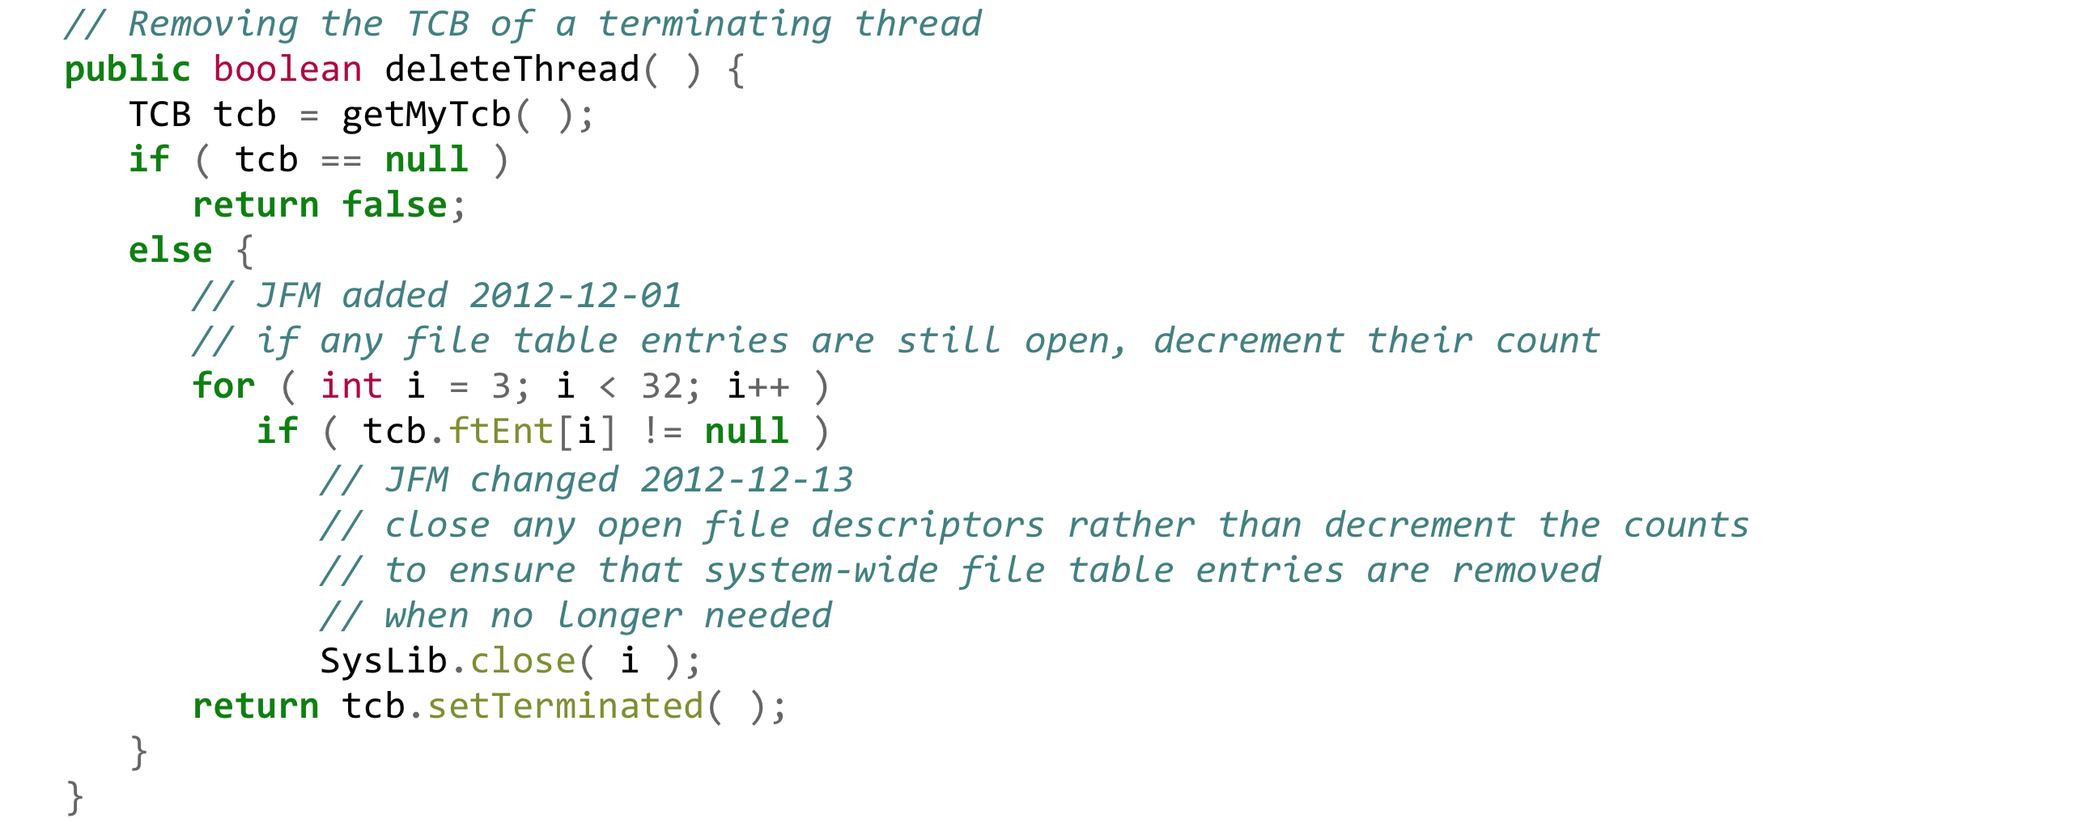
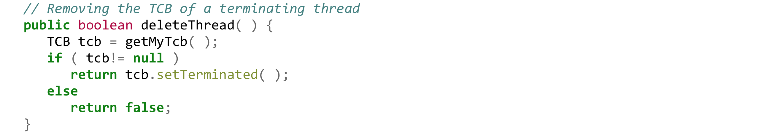
Scheduler.java (cont.)
Modified

Slide 10
Kernel.java: Changes required

Slide 11
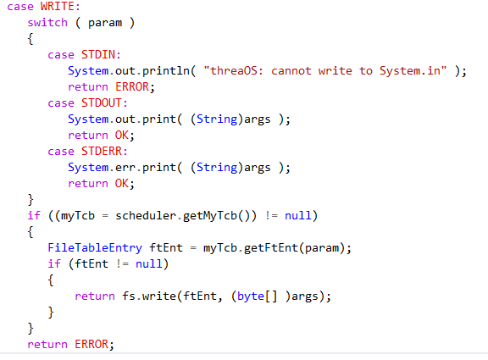
Kernel.java (changes required)
Note: READ also has to be written and a FileSystem object (fs) needs to be created

Slide 12
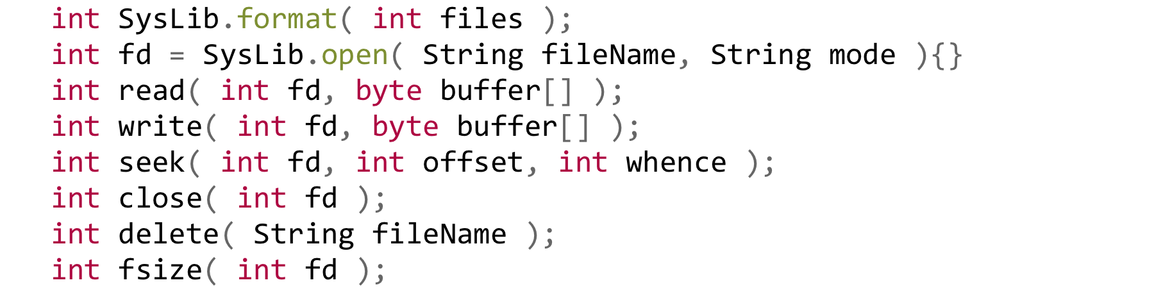
Interface (8 System Calls)

Slide 13
Basic Call Flow
SysLib
Kernel
FileSystem
Check Test5.java for details...

Slide 14
Implementation
Class | Description
class Superblock {} | OS managed structure used to describe (1) the number of disk blocks, (2) the number of inodes, and (3) the block number of the head block of the free list.
class Inode {} | Simplified version of the Unix inode
class Directory {} | The "/" root directory maintains each file in a different directory entry that contains its file name
class FileTableEntry {} class FileTable {} | The file system maintains the file (structure) table shared among all user threads.
class TCB {} | Each user thread maintains a user file descriptor table in its own TCB
class FileSystem {} | The main file system class that ties everything together and is how you declare a FileSystem (e.g. FileSystem fs).

Slide 15
CSS430 ThreadOS File System Superblock and Inodes
Superblock
int totalBlocks;
int totalInodes;
int freeList;
Block #0
Free
Block #x
Free
Block #y
Free
Block #z
Inode #0 32bytes
Inode #1
Block #1
Inode #15
/ root
directory
Block #2
Inode #inodeBlocks -1
Block #totalBlocks - 1

Slide 16
CSS430 ThreadOS File System “/” Root Directory
Directory()
Initialize “/” directory
bytes2directory( byte data[])
Initialize directory with byte[] which have been retrieved from disk
directory2bytes()
Converts directory information into byte[]
ialloc(String filename)
Allocate an iNumber
ifree(short iNumber)
Deallocate the iNumber
namei(String filename)
Return this file’s iNumber
Entry[] fname size fileName
(iNumber)
0
1
2
3
4
5
6
7
8
9
10
inodeBlock-1
1
4
4
4
4
5
5
6
6
9
6
6
5
/
init
fsck
clri
motd
mount
mknod
passwd
umount
checklist
fsdblb
config
getty

Slide 17
CSS430 ThreadOS File System
Process
int fd = SysLib.open(“fileA”, flags);
SysLib.read(fd, …);
TCB
0
1
2
3
stdin
stdout
Inode:
length
count 1
direct[12]
indirect[3]
stderr
struct file:
count 1
inode
Disk
User file descriptor table
File (Structure) table
Inode table
Thread Control Block

Slide 18
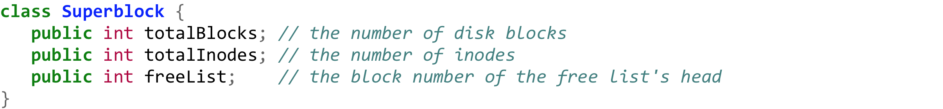
Superblock

Slide 19
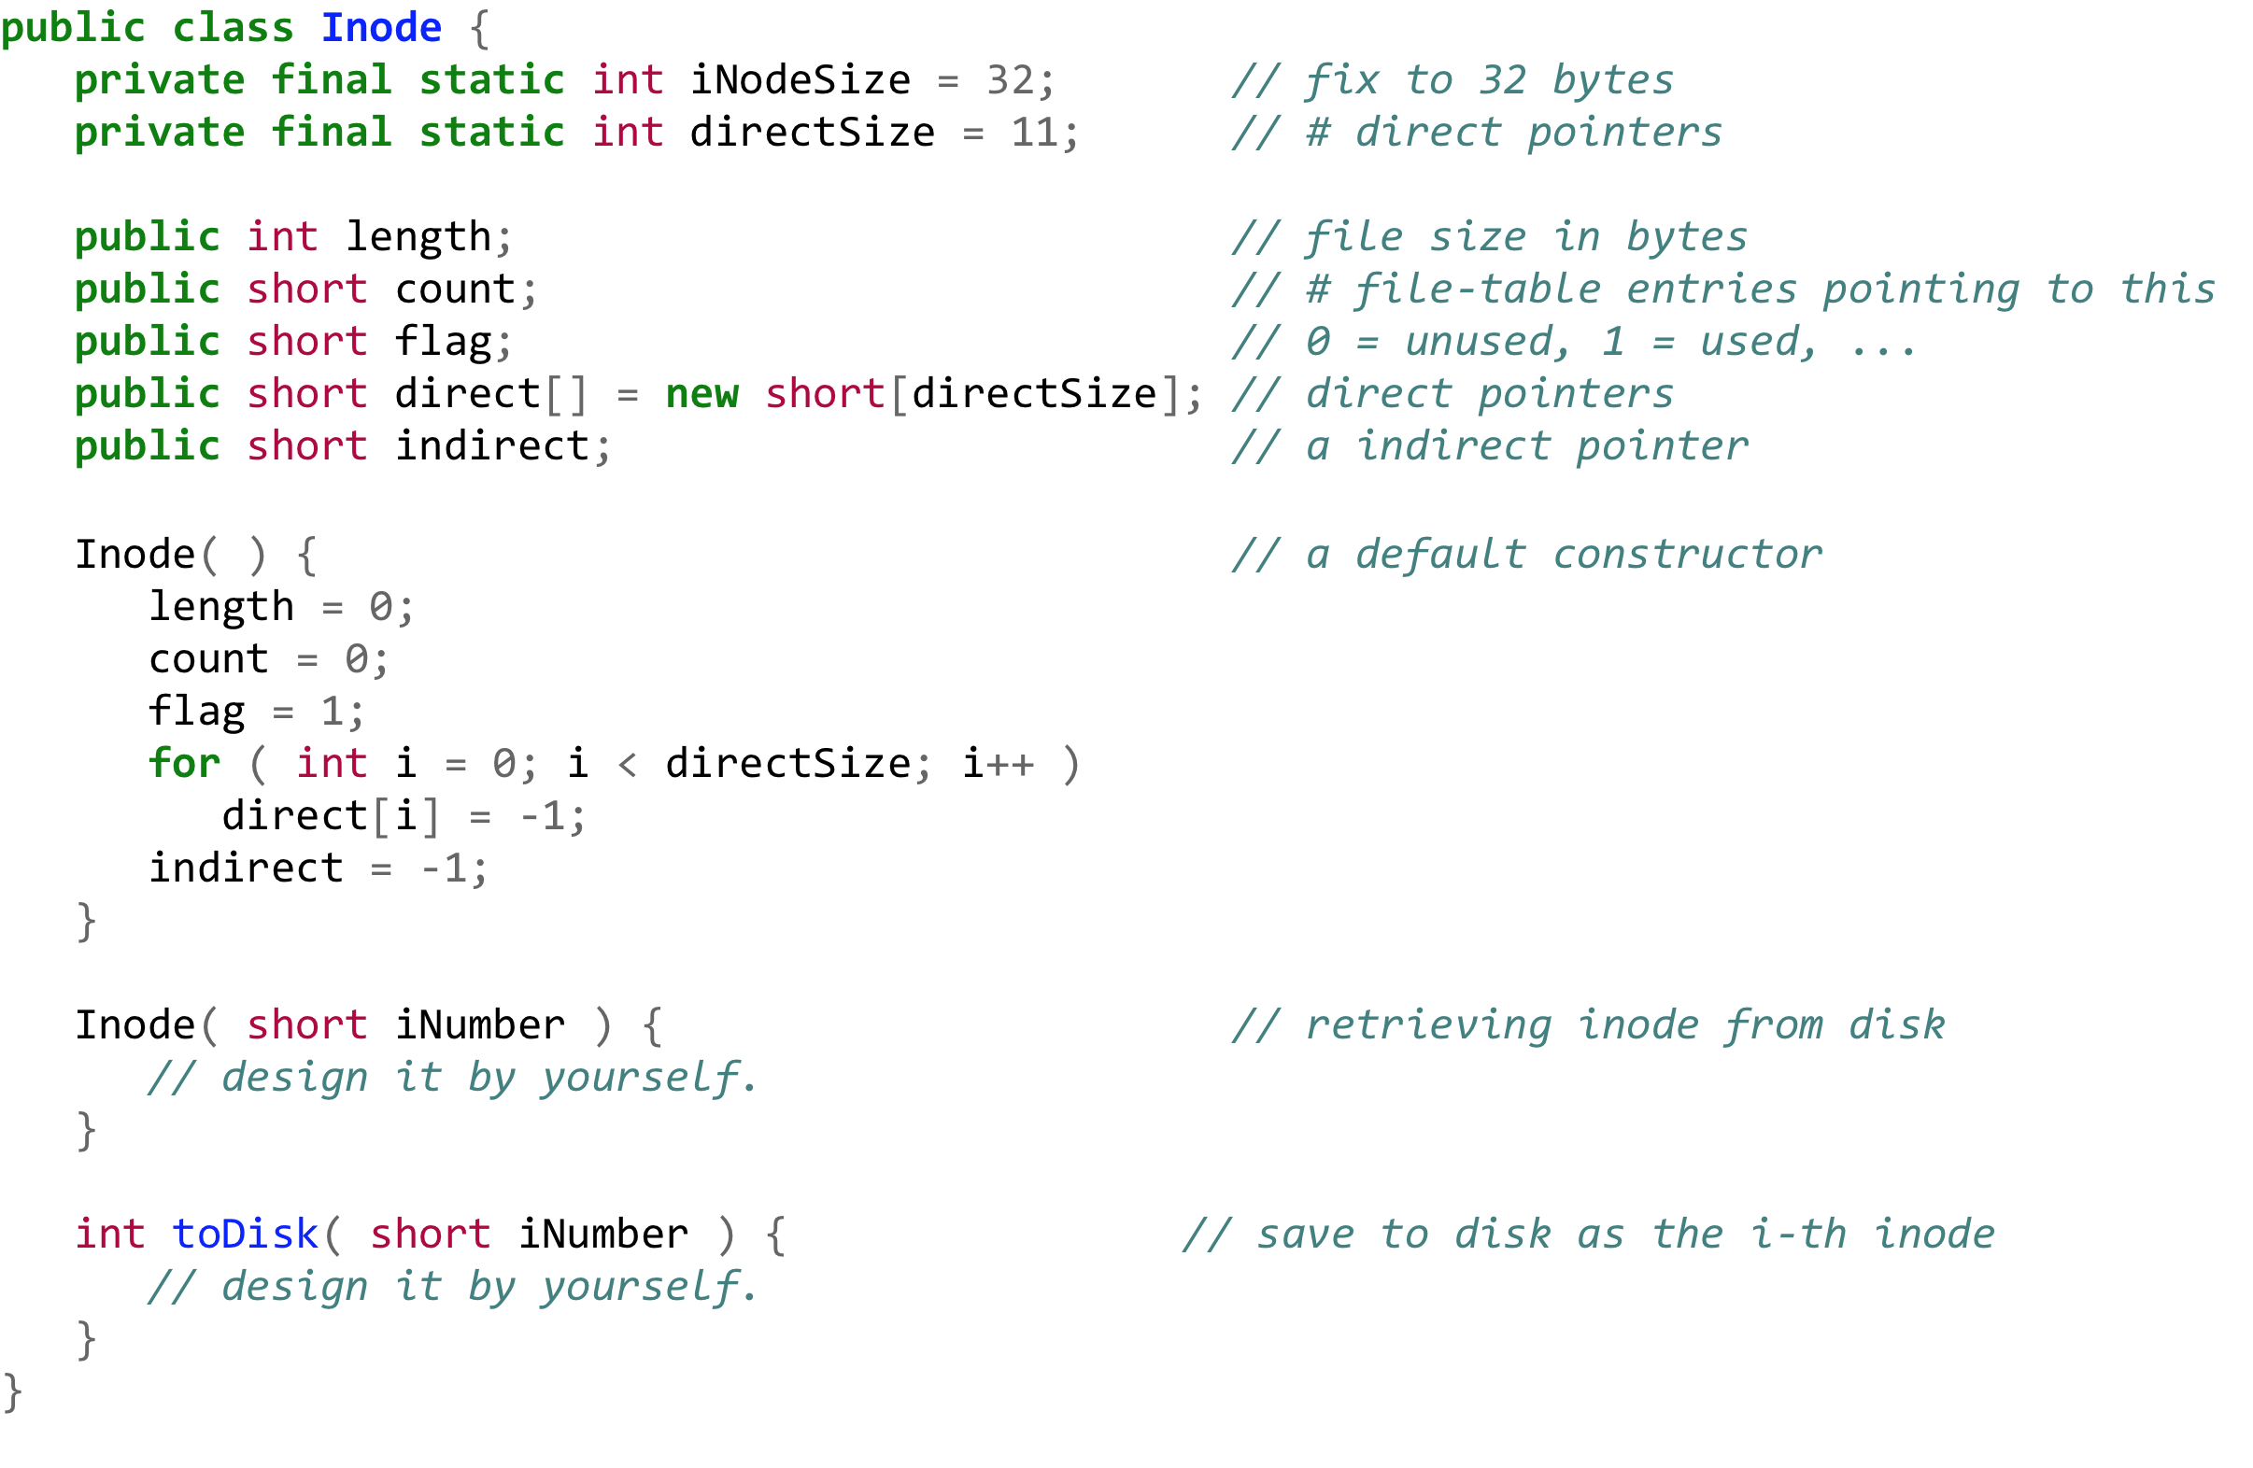
Inode.java

Slide 20
Directory.java

Slide 21
Directory (cont.)

Slide 22
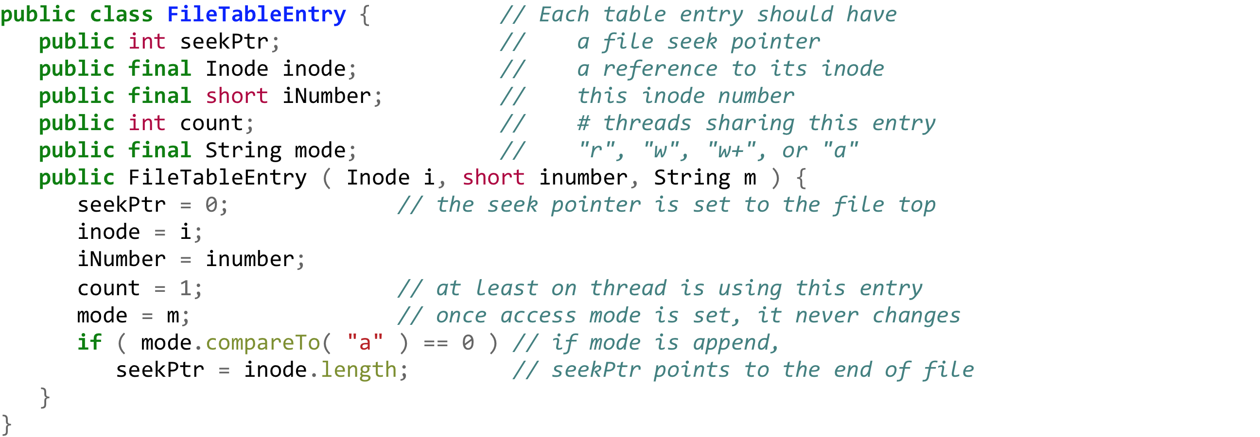
File (Structure) Table

Slide 23
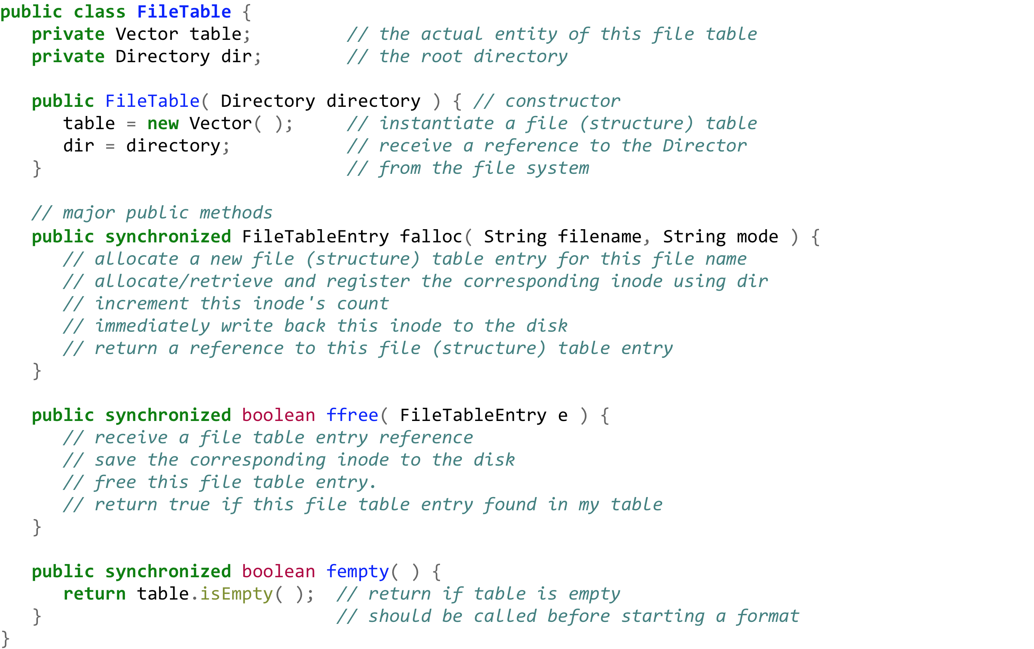
FileTable

Slide 24
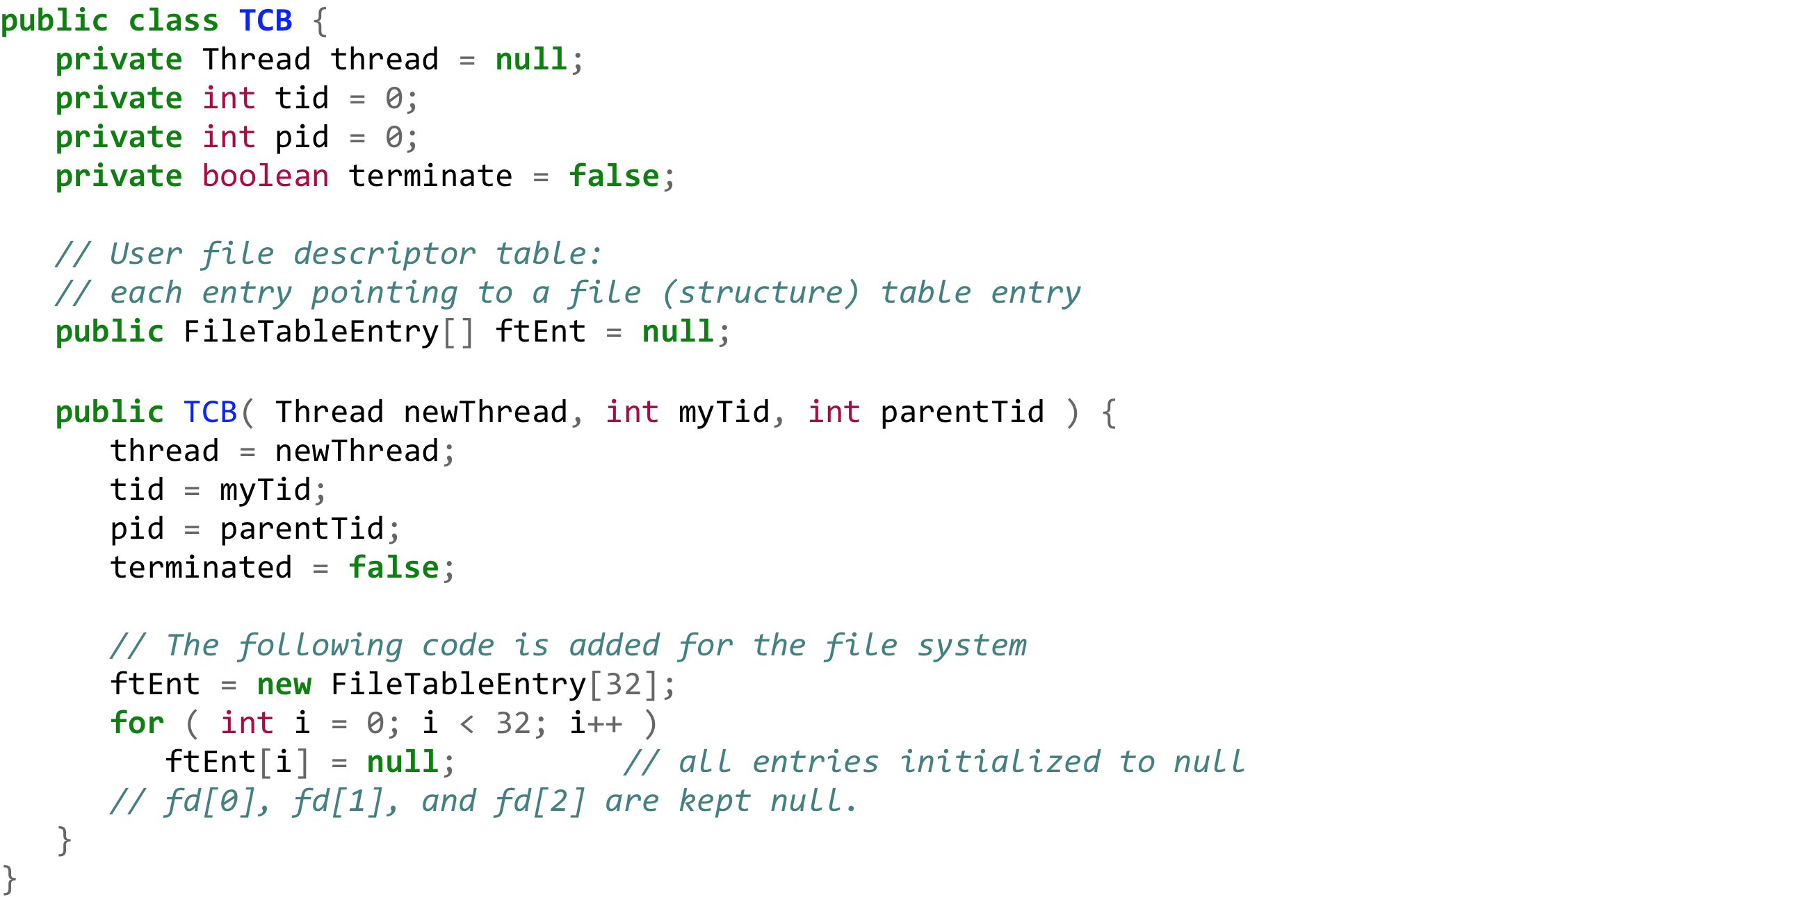
File Descriptor Table (TCB)

Slide 25
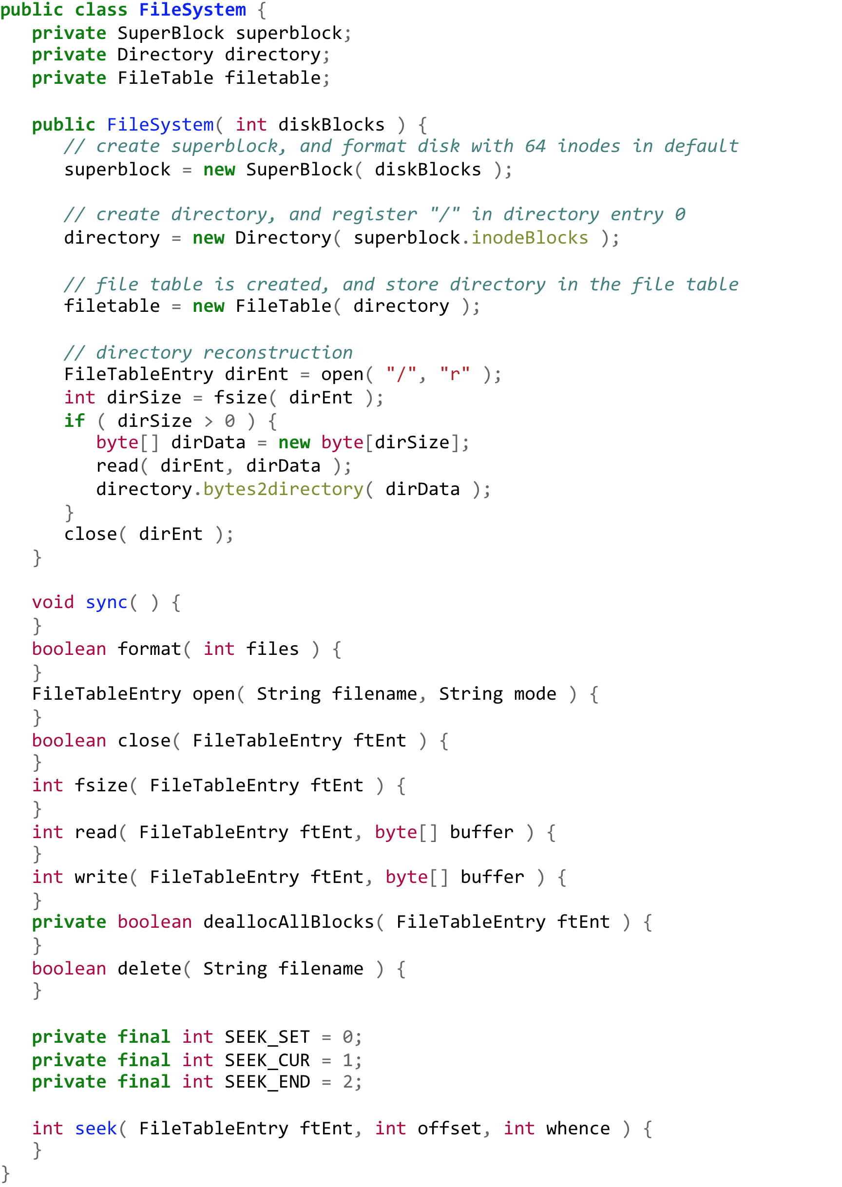
Implement FileSystem.java

Slide 26
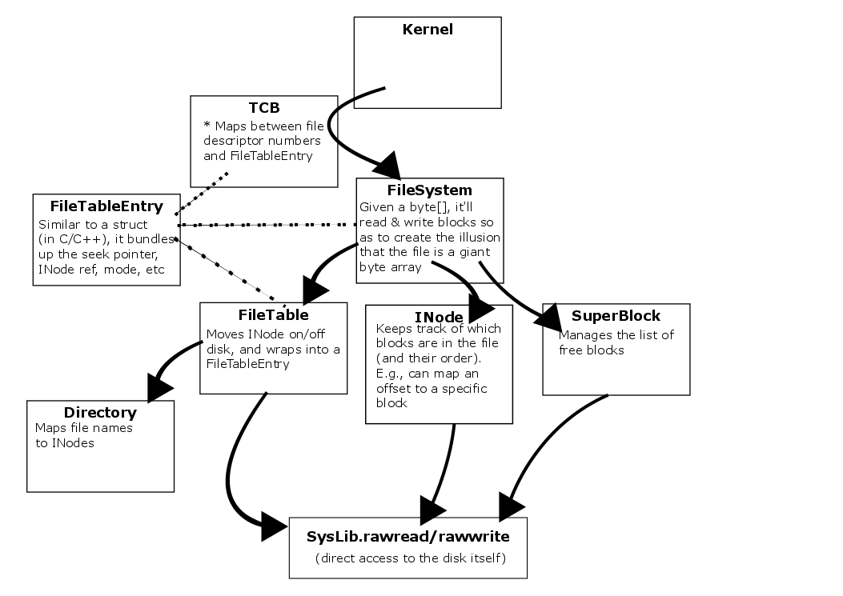
Notes:
We're not going to talk directly about / see pictures of the file system format, since that's specified elsewhere

Slide 27
Basic Call Flow
SysLib
Kernel
FileSystem
Check Test5.java for details...
And a few more clues in...
http://courses.washington.edu/css430/prog/dimpsey/finalproject.html

