Slide 1
ELEN4017 - Network Fundamentals
Socket Programming and Multithreading
Morongwa Thobejane - 1432370

Slide 2
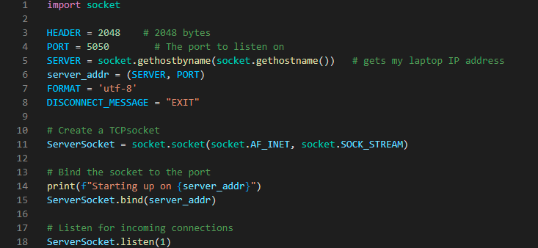
TCP Server Socket
Line 3 to 8 show the defining to variable that are going to be used in the implementation. Using variables makes the implementation easy to follow.
The follow lines create a socket, binds the socket to the port and the server listens for any connections from the client.

Slide 3
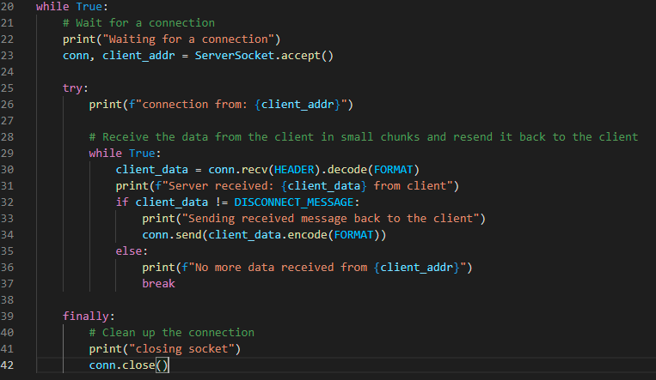
TCP Socket
Line 23 accepts the connection from the client socket, and it stores the client’s address.
Lines 29 to 37 receive messages from the client socket and echo back the messages to the client.
The implementation allows the server to receive a message from the client more than once, if there is still a connection between the server and client.
Lines 39 to 42 close the connection upon receiving a “EXIT” message from the client.

Slide 4
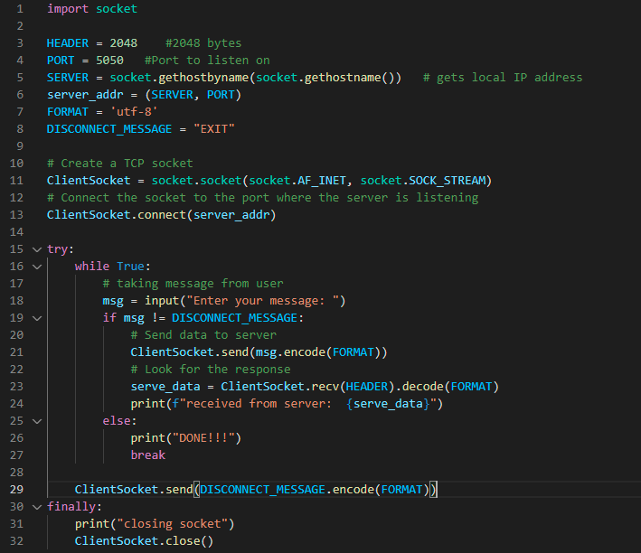
TCP Client Socket
The client socket has the same implementation as the server socket, excerpt for line 13. A clients connects to the server and the server listens for connections and accepts them.
The implementation allows a user to type in a message and to send the message to the server more than once, if there is still a connection between the server and client.
The client socket closes the connection when the user types in an “EXIT” message.

Slide 5
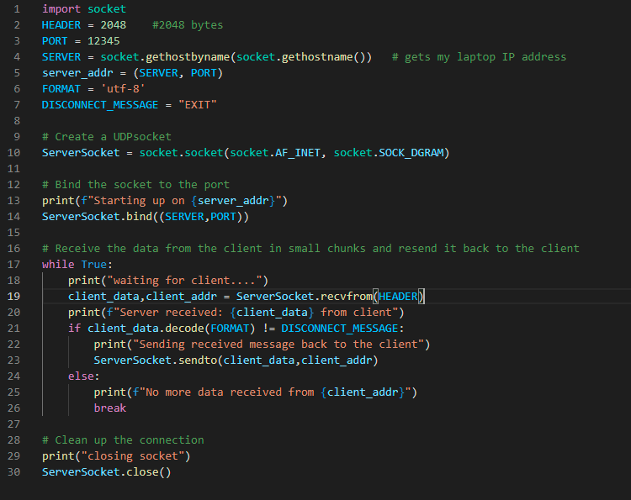
UDP Server Socket
The difference between a TCP server and UDP server is the UDP server is connectionless. Therefore, it does not listen and accept connections like a TCP server does.
The order difference is spotted in lines 19 to 23. The TCP socket uses revc() and send() functions, in order to receive and send and there is no need to specify the address the data is being sent to since the was a connection established already. A UDP socket uses recvfrom() and sendto() functions and the address to where the data is being sent to needs to be specified.

Slide 6
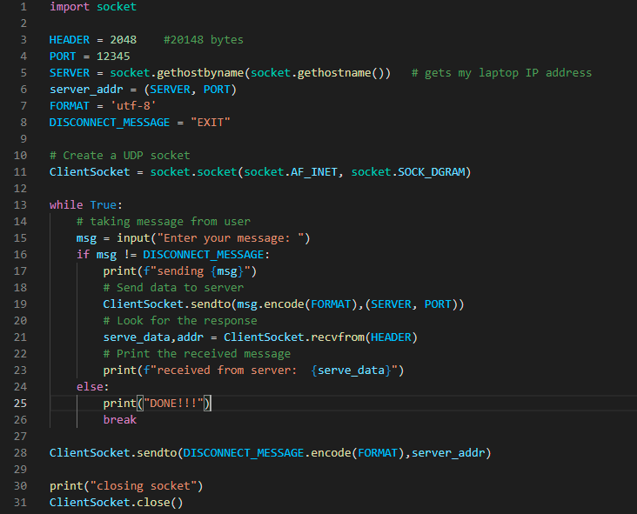
UDP Client Socket
The UDP client implementation is the same as the server socket implementation.

Slide 7
TASK 3:Multithreading
The execution time is 2.4 milli seconds.
The myThread(), self, threading.thread()

Slide 8
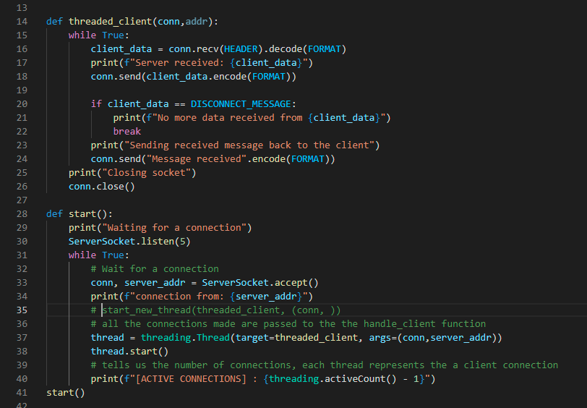
TCP Server Socket with Multithreading
The start() function creates a thread, and it assigns it to a client in line 37.
Line 38 starts the thread and line 40 keeps track of the number of clients that are connected to the server.
The threaded_client() function handles the communication between a client and a server.
The server allows more than one client to connect to the server.

Slide 9
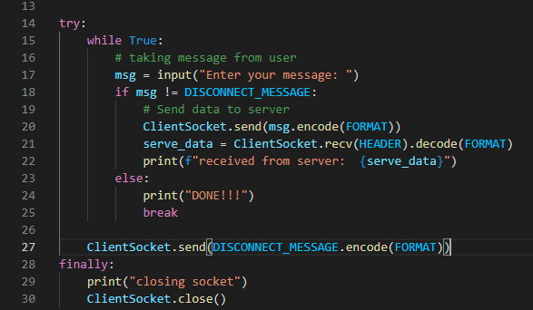
TCP Client Socket with Multithreading
Uses the same implementation as the one in the TCP client socket with no threading.

Slide 10
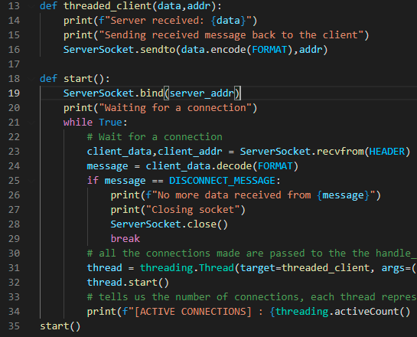
UDP Server Socket with Multithreading
This implementation is the same as the implementation in the TCP server socket, excerpt for lines 23 to 29. This is due to the fact that the UDP sockets are connectionless, therefore a thread is created as soon as a clients communicates to the server on a certain address.
The server creates another thread for a different client when the client sockets sends information from a different address.

